Slide 1
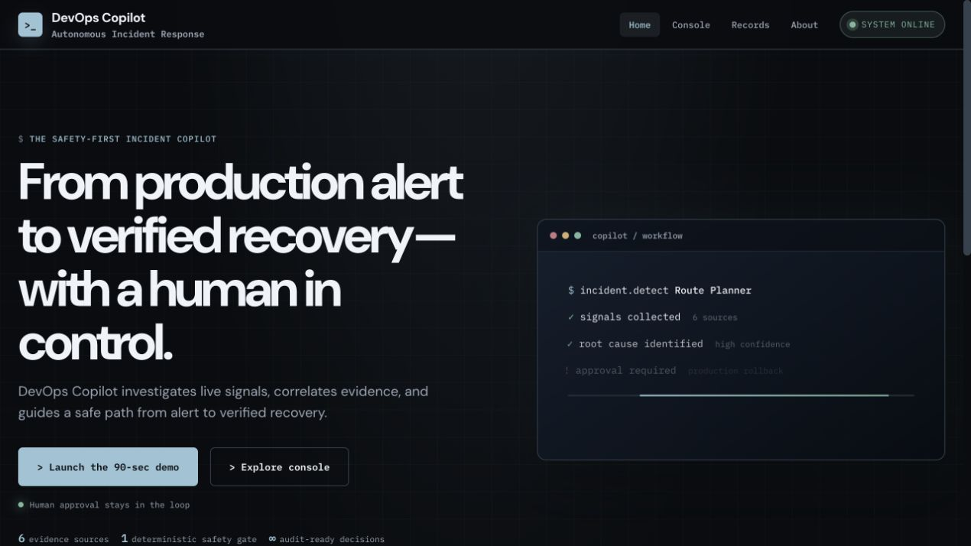
DEVOPS COPILOT
Evidence-led incident response
with a human approval gate
Investigate the signal, control the risk, verify the recovery.
Autonomous incident response | Hackathon 2026
LIVE PRODUCT INTERFACE
Notes:
Say: DevOps Copilot helps an operator move from a production alert to a verified recovery. The important point is control: AI investigates, but people still authorize production changes.
Visual: Actual product screenshot, captured from the project UI.
Layout: Minimal cover. Title on the left, live product on the right.

Slide 2
02
The incident-response problem
Production incidents demand decisions before teams have a coherent picture.
Health
Logs
Fragmented evidence
Risky decision window
Different tools tell partial stories.
Operators must correlate them under pressure.
A fast remediation can reduce impact.
An unsafe remediation can deepen it.
Deploys
Config
History
DEVOPS COPILOT | HACKATHON PRESENTATION
02
Notes:
Say: During an incident, the team has health data, logs, deployment history and configuration changes, but no shared evidence trail. The next decision can change production, so speed alone is not enough.
Visual: Signal sources converge into a fragmented-evidence problem and a risky-decision window.
Layout: Left-to-right flow. Keep the attention on the tension between urgency and safety.

Slide 3
03
Where existing approaches fall short
Alerting platforms, ticket workflows, and generic AI assistants each solve only part of the response loop.
Alerting & dashboards
Runbooks & tickets
Generic AI assistants
Detect symptoms
Surface metrics
Hand investigation to people
Standardize process
Preserve history
Rely on manual correlation
Summarize evidence
Suggest next steps
Lack an authorization boundary
Missing layer: one evidence trail that connects diagnosis, risk policy, human approval, remediation, and proof of recovery.
DEVOPS COPILOT | HACKATHON PRESENTATION
03
Notes:
Say: The issue is not a lack of tools. It is that the tools are disconnected. Alerting detects, runbooks guide, and AI can summarize, but the operating team still has to create the trusted chain of evidence and approval.
Visual: Three-column comparison with one missing-layer statement.
Layout: Use a calm comparison layout. The conclusion sits alone at the bottom.

Slide 4
04
A controlled response loop
DevOps Copilot combines evidence collection with a deterministic approval boundary.
01
02
03
AI investigates
Policy evaluates
People authorize
Read-only tools collect and correlate evidence.
Confidence and risk gates decide whether action is eligible.
Qualified operators approve, reject, or follow a manual runbook.
Verified recovery and an append-only audit record close the loop.
DEVOPS COPILOT | HACKATHON PRESENTATION
04
Notes:
Say: Our solution separates responsibilities. The AI investigates with read-only tools. Policy checks confidence and risk. A qualified operator chooses whether to approve, reject, or use the manual runbook. The system then verifies recovery and preserves the record.
Visual: Three editable responsibility blocks leading to the audit and verification outcome.
Layout: Strong center composition. Highlight the policy and human gates as the differentiator.

Slide 5
05
What the product delivers
The demo focuses on a complete response loop rather than a single AI summary.
01
Evidence correlation
02
Confidence gate
Health, logs, deployment, config, history, state
High-confidence evidence before production action
03
Approval controls
04
Runbook context
Qualified roles, reason, approval history
Why this action and manual recovery steps
05
Verified recovery
06
Durable ledger
Metrics check after remediation
Searchable incidents, notifications, audit events
DEVOPS COPILOT | HACKATHON PRESENTATION
05
Notes:
Say: These are the product moments we want the judges to see: a complete evidence trail, a clear confidence gate, human approval controls, runbook explanation, verification, and a durable incident ledger.
Visual: Six capability rows with short proof points.
Layout: Use two balanced columns with generous whitespace.

Slide 6
06
Major incident response process
A simple flow keeps the demo understandable in seconds.
1
2
3
4
5
6
Detect
Investigate
Explain
Gate
Authorize
Verify
Alert
Read-only evidence
Root cause + why
Confidence + risk
Approval / reject / manual
Recovery + audit
DEVOPS COPILOT | HACKATHON PRESENTATION
06
Notes:
Say: This is the full response path. The agent never crosses the authorization boundary during investigation. The flow becomes actionable only after the policy gate and a human decision. Verification makes recovery an observed result rather than an assumption.
Visual: Six-stage process diagram with numbered nodes.
Layout: Horizontal timeline. Use this as the central visual explanation.

Slide 7
07
Technology and architecture
A modular React and FastAPI system connects an agent workflow to controlled remediation.
Product interface
React + Vite
Incident console, guided demo, records
Safety boundary
Application API
FastAPI
Typed remediation request and policy endpoints
AI never executes
production change
Investigation engine
Gemini tool agent
Deterministic fallback when provider is unavailable
Control & evidence
Read-only tools, risk engine, verifier, SQLite incident ledger
DEVOPS COPILOT | HACKATHON PRESENTATION
07
Notes:
Say: The architecture stays modular. React presents the product. FastAPI exposes the workflow. The agent uses read-only tools, with a deterministic fallback for demo resilience. The risk engine, verifier and SQLite ledger provide the controlled system of record.
Visual: Four-layer editable architecture plus a visible safety boundary.
Layout: Vertical stack on the left and safety statement on the right.

Slide 8
08
The safety boundary is the USP
The project treats AI as an investigator within an explicit control system.
AI authority
System authority
Apply confidence policy
Classify risk
Require role-based approval
Verify recovery
Append audit event
Read evidence
Correlate signals
Explain root cause
Recommend action
POLICY
GATE
DEVOPS COPILOT | HACKATHON PRESENTATION
08
Notes:
Say: Our core innovation is governance around the model. AI can inspect and recommend, but the system owns the confidence threshold, risk classification, role check, idempotent execution and recovery verification. That makes the demo more credible than an AI chatbot that can simply call an action.
Visual: Two authority zones separated by a policy gate.
Layout: Symmetrical composition. Let the policy gate carry the message.

Slide 9
09
The live demo experience
The strongest visual moment is a guided incident that makes the safety story visible.
01
Launch the 90-sec demo
02
Review evidence and root cause
03
See confidence, risk, and runbook
04
Approve, reject, or remediate manually
05
Verify recovery and review the ledger
DEVOPS COPILOT | HACKATHON PRESENTATION
09
Notes:
Say: For the live demo, I will launch the database regression scenario. The audience immediately sees a guided path. We investigate, explain the evidence, show the confidence and risk gate, make a human choice, and end with verified recovery and an audit record.
Visual: Actual product screenshot plus five demo beats.
Layout: Screenshot occupies the left side. The exact talk track sits on the right.

Slide 10
10
Impact and scalability
The product targets teams that need faster understanding without surrendering production control.
On-call SRE
One evidence trail during a high-pressure incident
Scale path
Replace simulation adapters with
monitoring, deployment, and
notification integrations.
Persist incident records in
production-grade shared storage.
Incident Commander
A visible approval boundary and ownership record
Platform Team
A searchable ledger for review and learning
Expected operational value must be validated with a pilot. The prototype demonstrates the workflow and its safety controls, not performance claims.
DEVOPS COPILOT | HACKATHON PRESENTATION
10
Notes:
Say: The immediate users are the people running incidents. The product gives them a shared evidence trail, a concrete approval record and a durable ledger. For scale, the simulation adapters map directly to real monitoring, deployment and notification systems. Any measurable improvement needs a real pilot, so we do not claim numbers here.
Visual: Target user roles and a practical scale path. Include visible disclosure on unvalidated impact.
Layout: One narrative: who benefits, then how it scales.

Slide 11
11
Roadmap to production
The demo architecture points to clear next steps without overstating current integrations.
Next
Then
Later
Connect live observability and deployment systems
Add real Slack, Teams, PagerDuty, and email adapters
Deploy shared database storage
Add sign-in, RBAC, and organization-specific runbooks
Model service dependencies from live topology
Add post-incident learning and evaluation workflows
Current prototype: simulated infrastructure, simulated notification adapters, durable local ledger, and external-integration-ready interfaces.
DEVOPS COPILOT | HACKATHON PRESENTATION
11
Notes:
Say: The roadmap is deliberately realistic. First we connect the adapters to live signals and notification systems. Next we add identity, shared storage and organization-specific controls. Later we can learn from post-incident records and map dependencies from real topology data.
Visual: Three-horizon roadmap with one clear statement of current prototype scope.
Layout: Use simple vertical columns, no speculative metrics.

Slide 12
DEVOPS COPILOT
Fast investigation.
Controlled action.
Verified recovery.
READ
EVIDENCE
GATE
RISK
PROVE
RECOVERY
The takeaway: use AI to accelerate understanding while deterministic policy and human approval protect production change.
Thank you
Notes:
Say: DevOps Copilot turns an incident into a controlled, explainable response loop. It keeps people in control of production changes while giving them the speed and clarity of AI-assisted investigation. Thank you.
Visual: Closing statement with a three-word safety motif.
Layout: Minimal final slide. Pause after the takeaway before inviting questions.

