Slide 1
Guidelines
Kindly use the given template for submitting your prototype(Make a copy of the template)
One team is only required to submit one project.
Follow this template while preparing your presentation.
You are welcome to add as many POCs and design concepts to support your project.
The project should be feasible and the team members should be capable enough, to come up with the fully functioning prototype of the same idea, if required.
In case of queries, kindly reach out to us at solutionchallengesupport@hack2skill.com
Note: Prototype must include cloud deployment and use at least one Google AI model or service (e.g., Gemini) as part of the solution.

Slide 2


Team Details
Team name: double trouble 2x
Team members:
1) Aadi shah
2) nitya singh
Problem Statement: creators, journalists, marketplaces, and moderators need a fast way to detect duplicate media and verify ownership before content is reused, sold, or published.

Slide 3
Brief about SecureMedia AI
SecureMedia AI is a lightweight authenticity workflow for image uploads. The product combines perceptual hashing, optional AI similarity, and blockchain ownership status in one review step.
The MVP now runs as a live Google Cloud deployment with a React upload interface, a Flask upload API, duplicate detection, ownership verification fields, and a minimal smart contract path for EVM testnets.
For Google Solution Challenge alignment, the production path now uses Cloud Run hosting and is ready for Vertex AI multimodal similarity as the Google-native scoring layer.
Trust
Hash + AI + ownership
Live
Cloud Run deployment
Next Step
Vertex AI scoring
Managed secrets

Slide 4
Opportunities and Differentiation
Different from similar ideas
Combines duplicate detection and ownership tracking in one workflow.
Modular services keep the stack lightweight for pilots and hackathons.
Still degrades gracefully when AI or blockchain modules are unavailable.
How it solves the problem
Flags suspicious duplicate uploads before publication or resale.
Adds ownership context to moderation and review decisions.
Reduces ambiguity for creator-support, newsroom, and marketplace teams.
USP
One API response with similarity, duplicate state, owner, and verification.
Challenge-ready path to Google AI and Google Cloud.
Simple enough to ship, strong enough to extend.

Slide 5
List of Features Offered by the Solution
Image upload
Drag-and-drop or picker-based image submission
Live preview
Visual confirmation before analysis begins
Similarity score
Clear percentage output for fast review
Duplicate status
Original vs duplicate decision signal
Ownership status
Owner string and blockchain verification field
Modular backend
Hashing, AI, and blockchain modules work independently

Slide 6
Process Flow Diagram
1. Upload
User sends an image from the web client.
2. Hash
Perceptual hash is generated through the securemedia-core path.
3. Compare
Optional AI similarity compares against stored embeddings.
4. Verify
Ownership service checks and optionally registers the hash.
5. Return
Frontend receives similarity, duplicate, owner, verification.
Primary users: creators, moderators, marketplaces, journalists, and authenticity review teams.

Slide 7
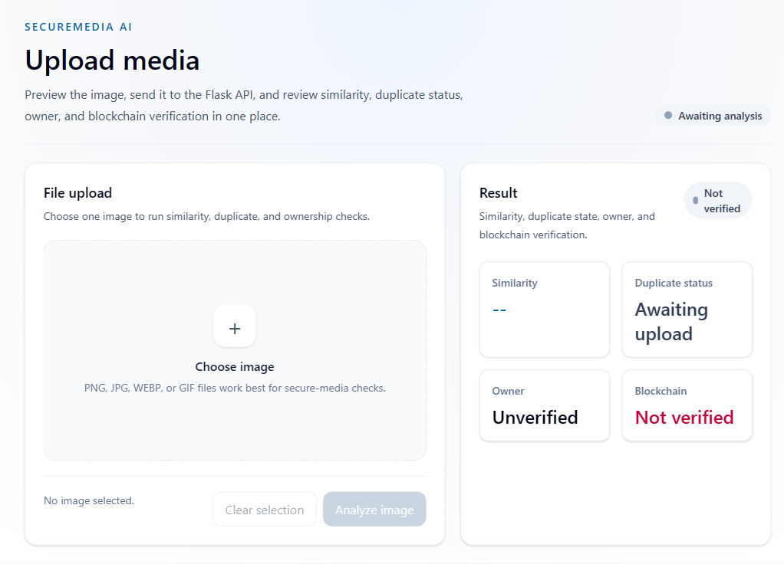
Wireframes / Mock Diagrams of the Proposed Solution
Upload panel
Single image input, preview area, and analyze trigger.
Decision cards
Similarity, duplicate status, owner, and blockchain verification stay visible together.
Review posture
Optimized for quick operator decisions, not consumer browsing.

Slide 8
Architecture Diagram of the Proposed Solution
Current MVP
Live Google Cloud Deployment
React Frontend
Upload UI + results
Flask API
POST /upload
Cloud Run
Frontend + backend deployed together
Cloud Storage
Planned evidence retention layer
Hash Service
Perceptual hash + duplicate logic
AI Similarity
Optional embedding comparison
Vertex AI Ready
Google-native similarity service path already wired
Secrets / State
Secret Manager and persistence are the next hardening step
Ownership Service
Web3 + local fallback
The current codebase already supports a modular split, which made the Google Cloud deployment a packaging step instead of a rewrite.

Slide 9
Technologies to be Used in the Solution
Current Prototype Stack
Challenge Deployment Stack
React 19 + Vite
Tailwind CSS
Cloud Run (live)
Cloud Storage
Flask API
Pillow + ImageHash
Secret Manager
Vertex AI multimodal embeddings
Optional Hugging Face CLIP
Solidity + Web3
Cloud Build / Artifact Registry
Monitoring + Logging
Sepolia / Polygon testnets

Slide 10
Estimated Implementation Cost
Estimated monthly cost for the live pilot on Google Cloud
Component
Assumption
Monthly cost
Cloud Run
Live frontend + Flask API service in us-central1
$10-$25
Cloud Storage
Uploaded image retention and evidence objects
$2-$5
Vertex AI
Similarity calls when Google scoring is switched on
$20-$40
Observability
Basic logs, traces, and monitoring
$0-$10
Testnet transactions
Registration on Sepolia / Amoy
Negligible
Estimated pilot total: about $32-$80 per month, with hackathon credits likely reducing early cost.

Slide 11
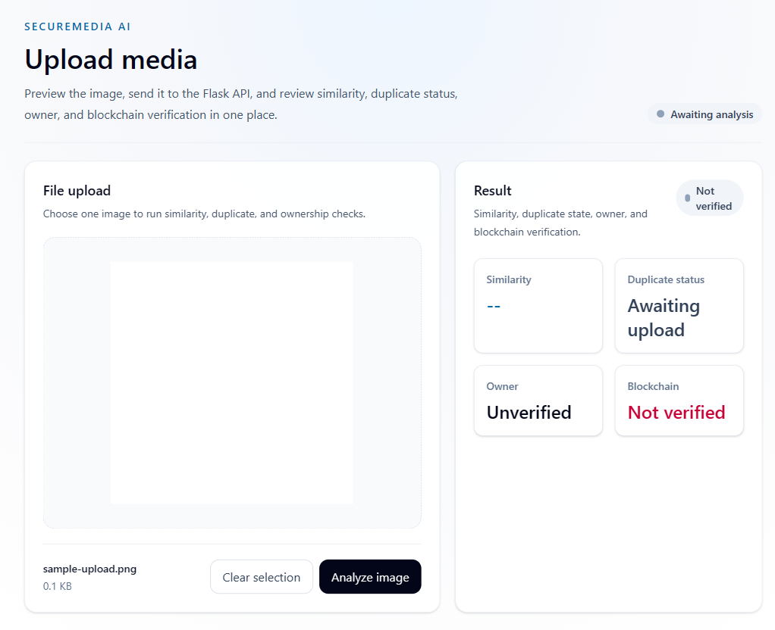
Snapshots of the MVP
Live Cloud Run deployment
Local operator flow with file selected
Production smoke-test response
{ "similarity": 0.0, "duplicate": false, "owner": "Unverified", "blockchain_verified": false }

Slide 12
Additional Details / Future Development
Immediate engineering follow-up
Turn on Vertex AI scoring in production with a managed embedding store.
Replace placeholder chain config with a real contract deployment and funded wallet.
Persist uploads, ownership history, and review trails beyond local JSON fallback.
Challenge-ready roadmap
Add creator accounts, evidence history, and case management.
Introduce Secret Manager and Cloud-native persistence for production operations.
Extend from image uploads to video frames, watermarking, and newsroom workflows.

Slide 13
Project Links
GitHub Public Repository
https://github.com/Aadishah17/secure-media
Demo Video Link (3 Minutes)
To be recorded before submission
Live MVP Link
https://securemedia-ai-97902534410.us-central1.run.app
Health Check
https://securemedia-ai-97902534410.us-central1.run.app/api/health

Slide 14
Impact and SDG Alignment
Why it matters
Protects original creators from silent reuse and counterfeit claims.
Gives moderators stronger evidence before approving or rejecting media.
Builds a path toward safer, more trustworthy visual publishing systems.
SDG 9
Industry, Innovation and Infrastructure
SDG 16
Peace, Justice and Strong Institutions

Slide 15

SecureMedia AI
Protect originality. Prove ownership.
GitHub: github.com/Aadishah17/secure-media
Live app: securemedia-ai-97902534410.us-central1.run.app

