Slide 1


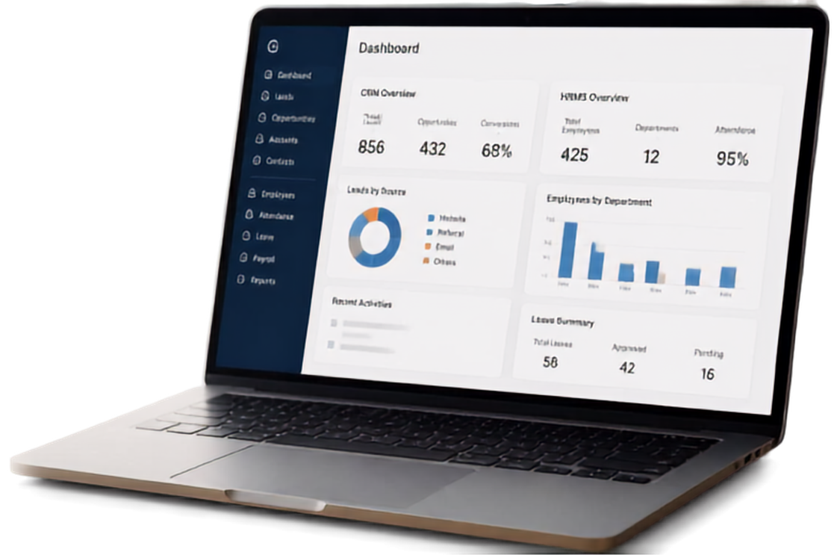




DESIGN, DEVELOPMENT AND DEPLOYMENT OF
CRM AND HRMS WEB PORTALS
Internship Project at
IMPOST INDIA PRIVATE LIMITED
Aadish Jain
B.Tech CSE, IILM University
Artificial Intelligence &
Information Technology Intern

Slide 2









ORGANIZATION
PROFILE
Barwani
IMPOST INDIA PRIVATE LIMITED
Indore
Khargone
WHAT WE DO
OUR FOOTPRINT
Tax Advisory
Barwani(M.P)
Corporate Legal Support
Khargone (M.P)
Tax And Audit Compliance
Indore (M.P)
Accounting

Slide 3














PROBLEM
STATEMENT
Operational gaps slowing marketing and human-resource management.
BEFORE
MARKETING UNIT
HR MANAGEMENT
Fragmented lead tracking across platforms
Manual attendance records across branches
Missed follow-ups and inconsistent communication
Leave tracking in spreadsheets and emails
No centralized sales dashboard or visibility
Grievance handling with no unified system
Fragmented records. Disconnected workflows. Limited visibility. Higher delays.

Slide 4



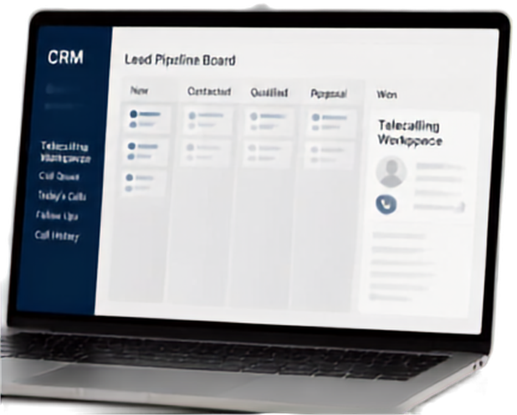


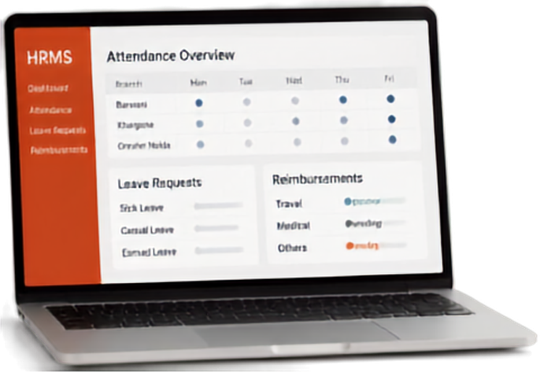





PROJECT
OBJECTIVES
Connecting business challenges to portal solutions
BUSINESS CHALLENGE
PORTAL SOLUTION
CRM
Build a unified Lead Pipeline Board and a dedicated Telecalling Workspace
Sales team needs a unified view of leads and calling activities
HRMS
Centralize branch-wise attendance and streamline leave and reimbursement requests
Back office needs centralized attendance and simpler leave and reimbursement workflows

Slide 5


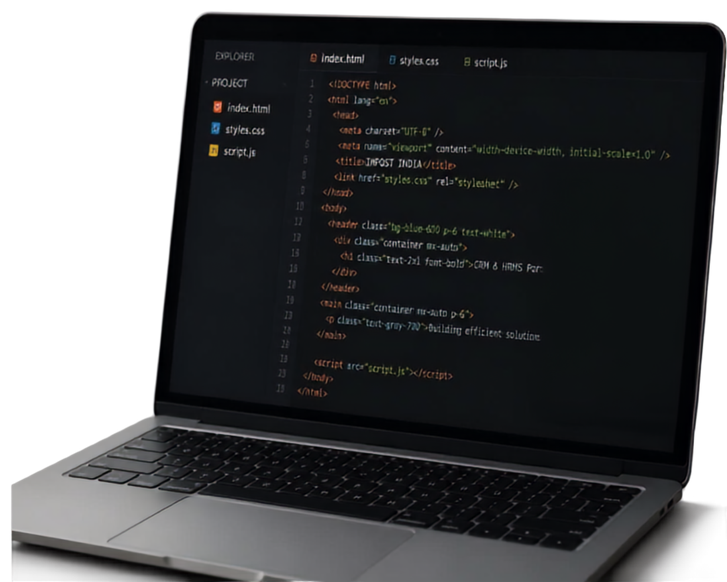





TECHNOLOGIES AND
TOOLS USED
AI ASSISTANT
FRONT-END STACK
AI
Claude
HTML5
CSS3
Tailwind CSS
Vanilla JavaScript
code suggestions
ChatGPT
coding help
Gemini
layout assistance
AI TOOLS USED
Claude
ChatGPT
Gemini
for coding and layout assistance

Slide 6
















SYSTEM
ARCHITECTURE
PRESENTATION LAYER
CRM PORTAL
HRMS PORTAL
client-facing web module
client-facing web module
APPLICATION LAYER
business logic for workflows, pipelines, and follow-ups
DATA LAYER
databases for leads, call logs, and employee records

Slide 7




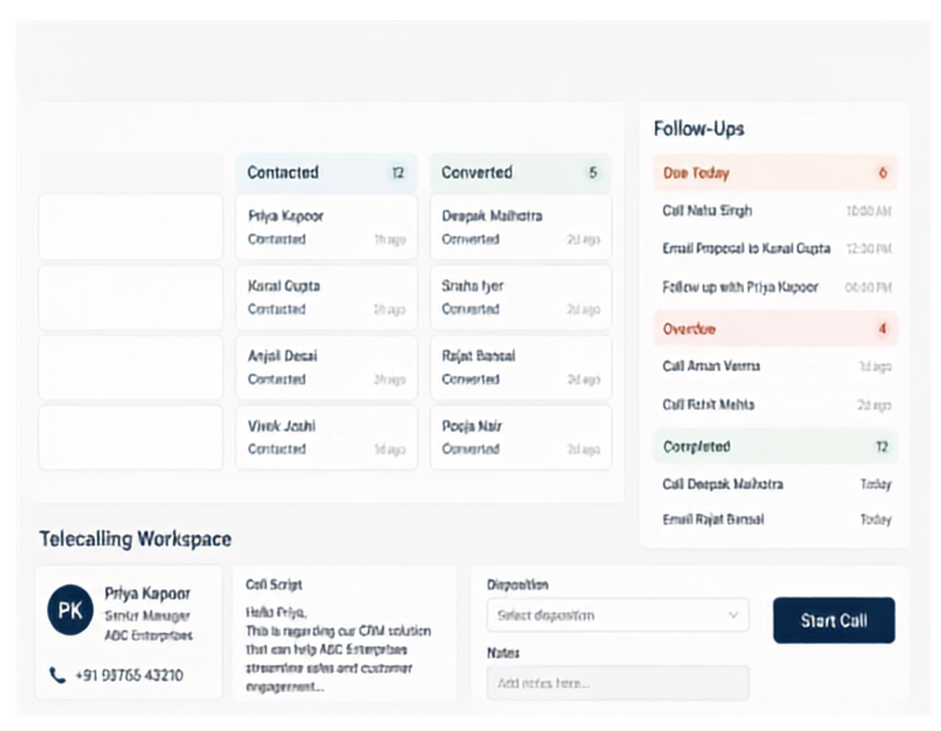












CRM PORTAL FEATURES
CRM Dashboard
Search leads, contacts...
AM
A unified workspace to manage leads, follow-ups, and conversations
LEAD PIPELINE
Track prospects across key stages from new to converted
FOLLOW-UP MANAGEMENT
Stay on top of tasks with clear queues and priorities
Priya Kapoor
Call Script
Disposition
Senior Manager
ABC Enterprises
Hello Priya,
This is regarding our CRM solution that can help ABC Enterprises streamline sales and customer engagement.
Select distribution
PK
V
Start Call
Notes
+91 98765 43210
Add notes here...
TELECALLING WORKSPACE
Access client context, call scripts and dispositions in one place

Slide 8




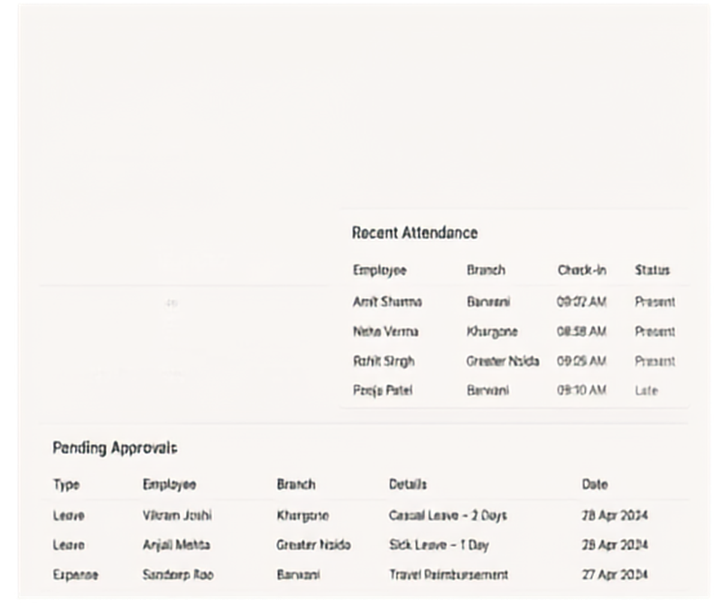





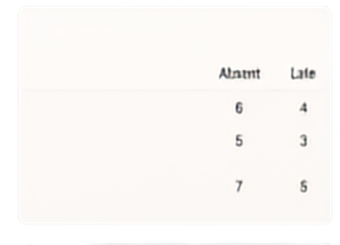

HRMS Portal
Features
HRMS Portal
Dashboard
Centralized workforce administration across all branches
Real-time overview of attendance and workforce metrics
Branch-wise attendance logs with check-ins and absences
Unified view to review and approve leave and expenses

Slide 9


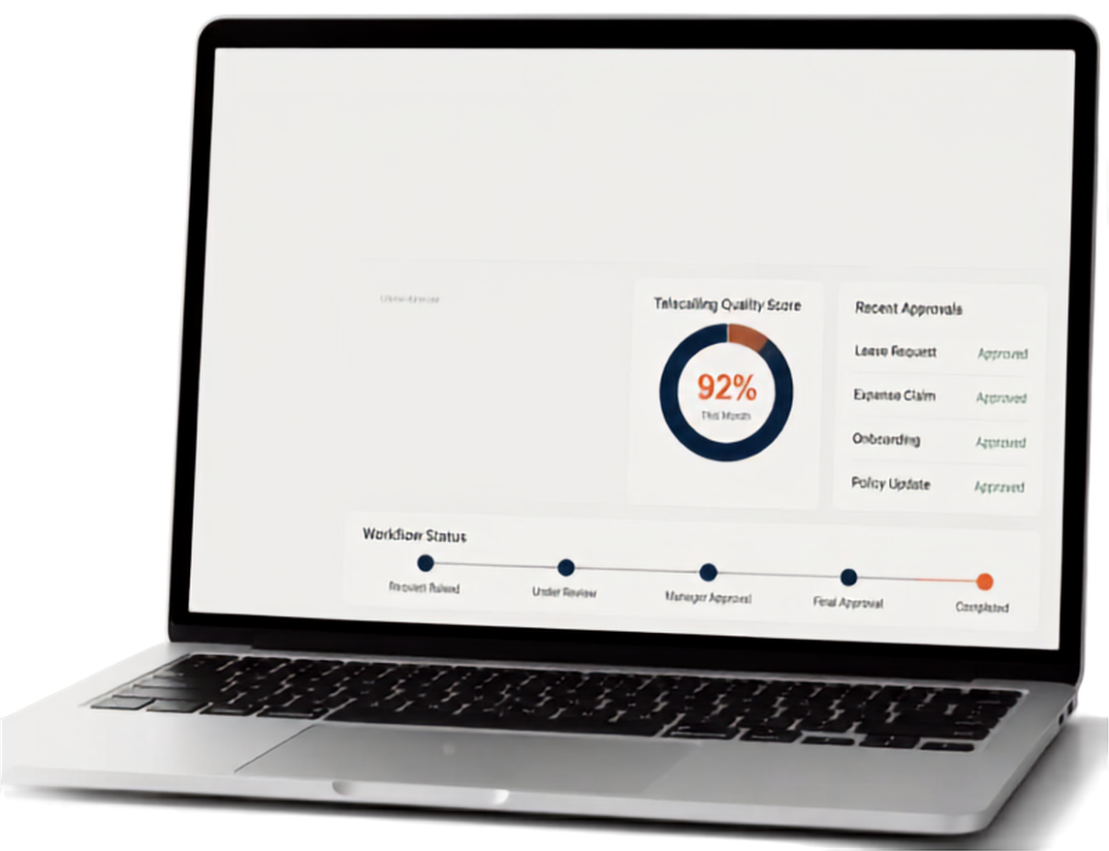








EXPECTED
Dashboard
OUTCOMES
Overview
Leads Generated
Calls Completed
Conversion Rate
HR Requests
Sales
1,240
8,675
18%
96%
Telecalling
Approved
HR
This Month
This Month
This Month
Better visibility for sales management and consistent telecalling quality
Approvals
Sales Overview
Telecalling Quality Score
Recent Approvals
Reports
Leave Request
Approved
92%
Expense Claim
Approved
Centralized HR tracking with clear, auditable approval workflows
This Month
Onboarding
Approved
Policy Update
Approved
Workflow Status
A scalable, reusable architecture built for smooth backend integration
Request Raised
Under Review
Manager-Approval
Final Approval
Completed
Streamlined operations and improved workflow efficiency across teams

Slide 10


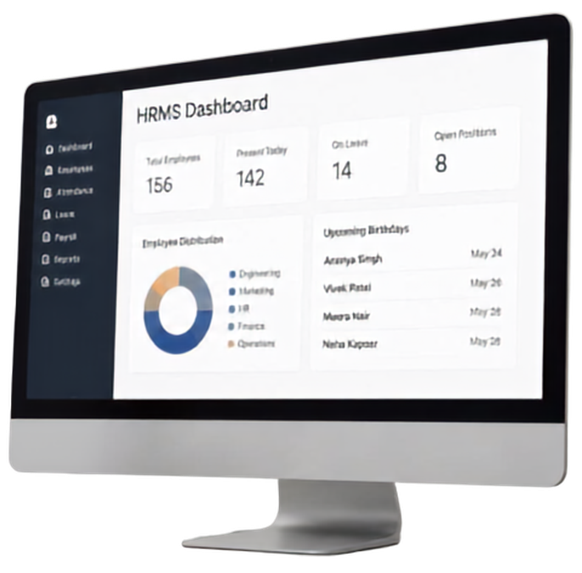
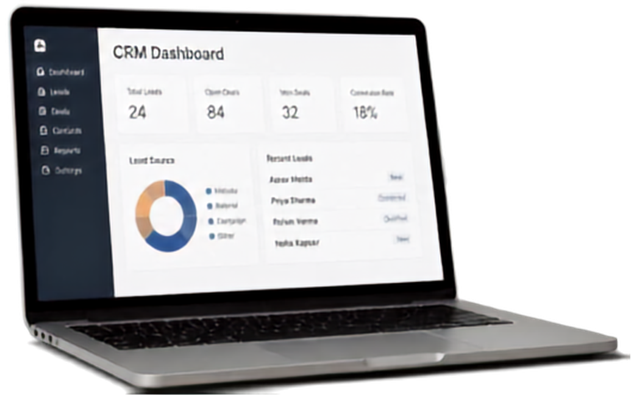

CONCLUSION
Delivered fully interactive
static prototypes for CRM and HRMS portals
Gained hands-on experience in AI Tools such as Gemini, Chatgpt and Claude for Web Development including effective Prompt Writing, AI- assisted coding, and website developmente
Strengthened understanding of user-centric design and portal workflows
THANK YOU
for the opportunity to learn, contribute, and grow.

