Slide 1
OCTA-based Assessment of morphological changes in active mCNV during anti-VEGF therapy
Paper Summary by Aadit Deshpande

Slide 2
Introduction
Purpose:
Profile quantitative changes of mCNV lesion using OCTA and explore biomarkers that could reflect outcome of VEGF inhibition.
mCNV:
Myopic choroidal neovascularization (type 2 CNV) threatens vision.
5-11% of individuals with Pathologic Myopia develop mCNV.
Treatment:
Anti-vascular endothelial growth factor (VEGF) intravitreal injection.
Diagnosis:
Standard Method: Fluorescein Angiography [dye-leakage risks]
Alternative: OCTA (optical coherence tomography angiography) [non-invasive, quantitative assessment.]

Slide 3
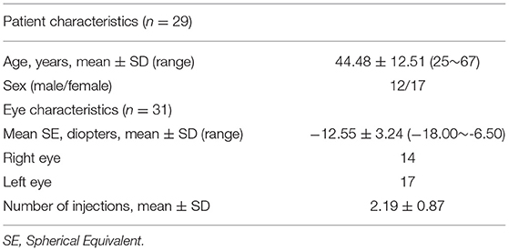
Patient Demographics, Data Acquisition
31 eyes (29 patients between Feb 2017 and Oct 2020 )
Subgroup Analysis:
Stable group (1 or 2 injections)
Unstable group (>2 injections)
OCTA Imaging using a commercial SD-OCT system.
Provided 4 en-face images (superficial and deep layers).

Slide 4
OCTA Image Assessment
Qualitative Estimation
Quantitative Estimation
Two mCNV phenotypes:
Organized Interlacing
Disorganized Vascular Loops
Morphology described by 5 criteria.
Organized Interlacing:
Medusa
Sea-Fan
Tree-In-Bud
MATLAB & ImageJ program to process OCTA images:
Manual Delineation
Denoising (Gaussian kernel)
Frangi vesselness Filter
Local Adaptive Thresholding
Skeletonization
Establish OCTA biomarkers.

Slide 5
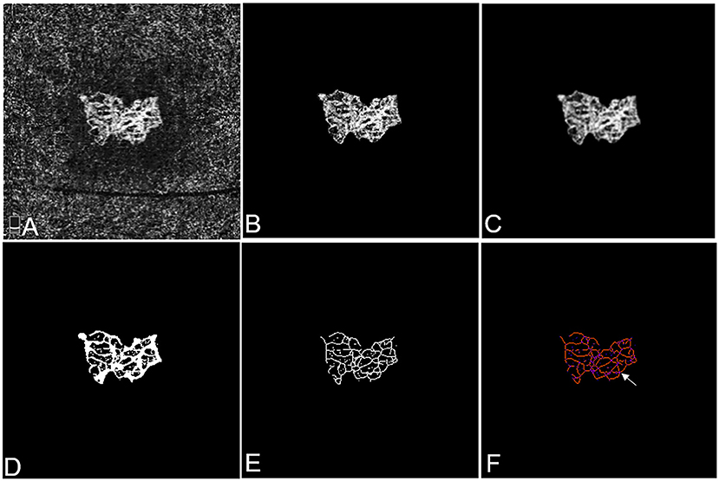
Quantitative Estimation
Figure | Stage | OCTA Biomarker
A | Input image
B | Manual Delineation | mCNV Area
C | Gaussian Blur
D | Local Thresholding | Vessel Area
E | Skeletonization | Fractal Dimension, Tortuosity
F | Skeleton Analysis | Junctions, Vessel Length

Slide 6
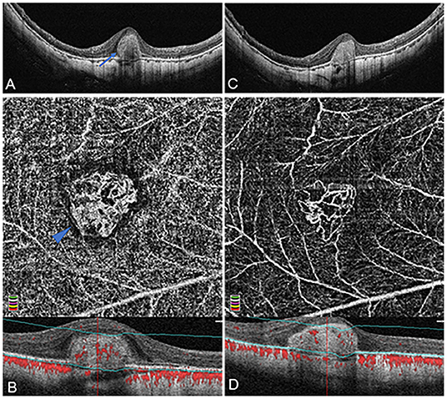
Results
Biomarkers After anti-VEGF treatment:
Moderate Correlation 4 between OCTA Biomarkers (mA, FD, VA, VL) and CRT
Decreased: mCNV Area Fractal Dimension Vessel Area Vessel Length Vessel Junction CRT (Central Retinal Thickness) | Increased: Vessel Density Vessel Diameter Tortuosity
Organized Interlacing mCNV: (A, B) Baseline (C, D) Post Therapy

Slide 7
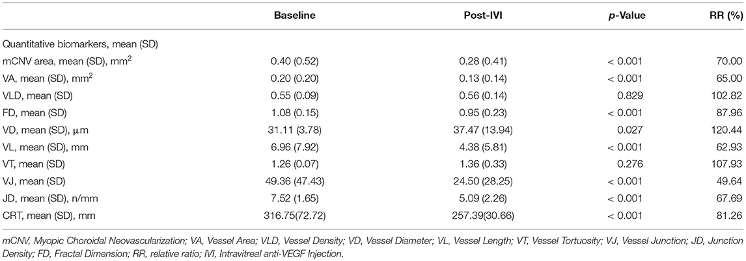
Statistical Analysis
Highlighted Biomarkers reported an increase post-treatment.

Slide 8
Conclusion
Distinguished Two subtypes of mCNV (Organized interlacing and Disorganized vascular loops)
MATLAB and ImageJ to analyze morphological, spatial vessel biomarkers.
Anti-VEGF safe and efficacious treatment:
Vessel junctions (-50.36%)
Vessel length (-37.07%)
Challenges: Segmentation errors artifacts for highly myopic patients.
Limitations:
1. Small sample size and short follow-up period.
2. Measurement accuracy compromised by automation.

Slide 9
Thank You

