Slide 1
DeskFlow
DF
DevOps End-Term Capstone · Aadit Dhariwal
A helpdesk ticketing app, shipped from laptop to a monitored Kubernetes cluster on AWS
React
FastAPI
PostgreSQL
Docker
GitHub Actions
Trivy
GHCR
Terraform
AWS EKS
Helm
Traefik
Prometheus
Grafana
Notes:
DeskFlow is a helpdesk ticketing system: customers raise tickets, support agents triage them by priority and category, assign owners and move them to resolved. The app is intentionally small. The project is the delivery pipeline around it: tests, containers, CI/CD, security scanning, a registry, infrastructure as code, Kubernetes with Helm, ingress, autoscaling and monitoring.

Slide 2
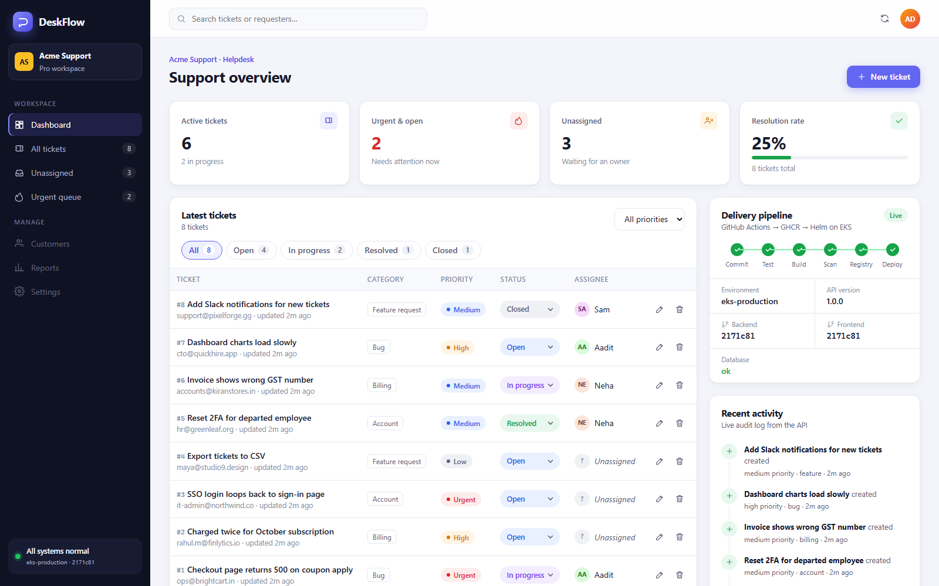
What I built
Tickets with priority, status, category and assignee
KPI dashboard, filters and a live activity feed
UI shows which commit is deployed
11
31
REST endpoints
pytest tests
0
2
Live on AWS EKS through the Ingress, deployed by CI at commit 2171c81
HIGH / CRITICAL CVEs
tables via Alembic
Notes:
React + Vite frontend served by unprivileged Nginx, FastAPI backend with SQLAlchemy and Alembic migrations, PostgreSQL database. Eleven REST endpoints including CRUD, stats, an activity log, health, readiness and Prometheus metrics. 31 pytest tests run against an isolated SQLite database. The pipeline card in the UI shows the commit SHA that's live, so you can trace production back to source.

Slide 3
Architecture overview
Developer
git push to main
GitHub Actions
tests → build → Trivy scan
GHCR
images tagged by SHA
Helm deploy
upgrade --install
AWS ap-southeast-2 · VPC + EKS cluster provisioned by Terraform
Frontend
React + Nginx ×2
2 public + 2 private subnets · NAT gateway
EKS 1.35 · 2 × m7i-flex.large nodes
/
Load balancer
AWS NLB
Traefik
Ingress
Backend
FastAPI ×2–6 (HPA)
PostgreSQL
StatefulSet + EBS volume
/api
Prometheus
scrapes /metrics
Grafana
dashboards + HPA view
Notes:
Top row is the delivery path: a push to main runs GitHub Actions: lint and pytest, frontend build, Docker builds for both images, a Trivy gate that fails on fixable HIGH or CRITICAL CVEs, then the images go to GHCR tagged with the commit SHA. Helm deploys that exact SHA to EKS. Terraform builds the AWS side: a VPC with public and private subnets and a NAT gateway, plus the EKS cluster and node group. Inside, Traefik routes / to the frontend and /api to the backend. The backend autoscales on CPU, PostgreSQL keeps its data on an EBS volume, and Prometheus scrapes /metrics for Grafana.

Slide 4
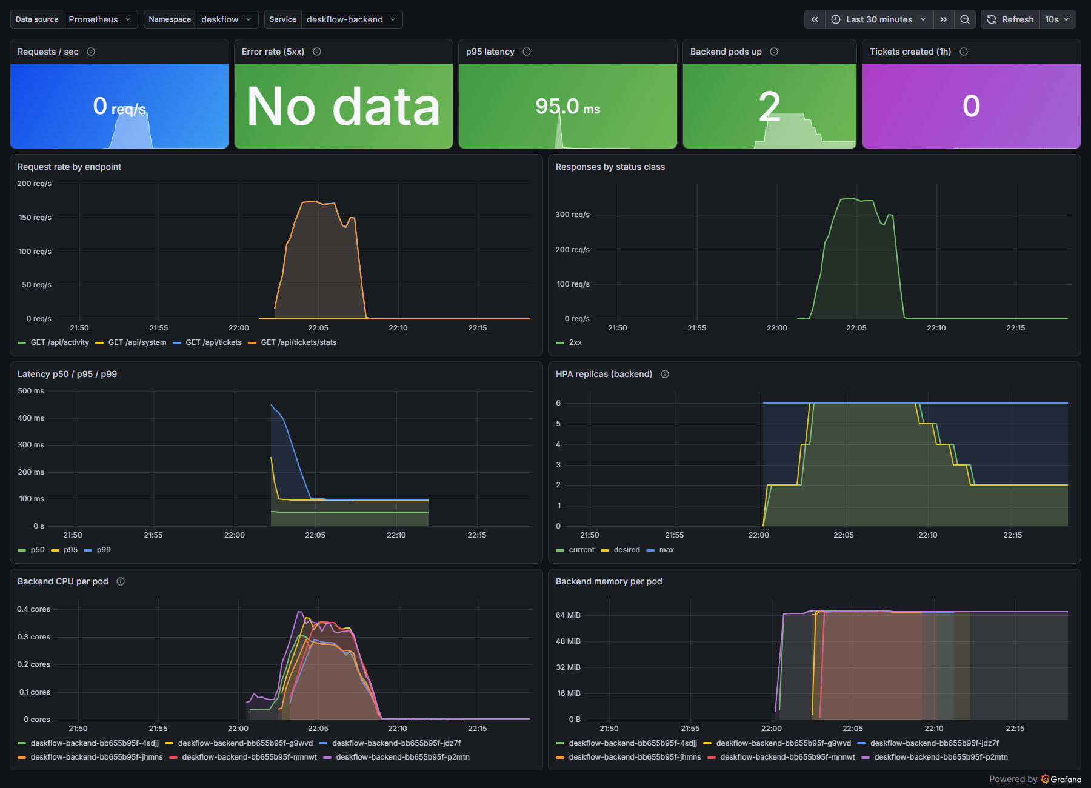
It runs, scales and is monitored
2 → 6
5 / 5
backend pods under load (HPA)
Prometheus targets UP
~2 min
59
CI: test, build, scan, push
AWS resources from Terraform
Every Pod runs an image tagged with its Git commit, and the live UI shows that SHA.
Grafana during the load test: traffic, latency, CPU and HPA replicas
Notes:
Under an in-cluster load test the HPA scaled the backend from 2 to 6 pods and back down once load stopped. Prometheus scraped all 5 backend pods. A full CI run takes about two minutes. Terraform created 59 AWS resources and terraform destroy removed every one of them afterwards, so nothing is left running.

Slide 5
Challenges solved
1
Trivy failed the backend image
HIGH CVEs sat inside pip itself. Removed pip from the runtime image and moved to Alpine: 0 HIGH/CRITICAL.
2
AWS Free plan blocked t3.medium
Nodes never launched. Switched to Free-Tier-eligible m7i-flex.large (8 GiB, 2 nodes).
3
Org policy blocked OIDC
No keyless deploy role allowed, so CI deploys with GitHub secrets and IRSA is off.
4
No runaway AWS bill
Teardown script removes the load balancer and volumes first; terraform destroy leaves 0 resources.
Takeaway: every change goes through tests and a security gate, becomes an immutable SHA-tagged image, is deployed declaratively onto infrastructure defined in code, and can be checked through metrics.
Notes:
Four real problems came up and were fixed along the way. Trivy caught HIGH CVEs that came from libraries bundled inside pip, so the runtime image no longer ships pip and uses Alpine. The AWS Free plan only allows certain instance types, so the node group moved to m7i-flex.large. The AWS organization blocks OIDC providers, so CI uses repository secrets. And a scripted teardown makes sure nothing keeps billing. The takeaway is the pipeline: tested, scanned, traceable, declarative, observable.

