Slide 1
Technical Documentation of the System. System Name: EstiloViento i.e. Style-Wind Developer Contributions - Team SAKA Github: https://github.com/adideo03/EstiloViento-Ontological-Framework-for-Fashion-Semantics (Will be made available upon request Please mail: adideo03@gmail.com)

Slide 2
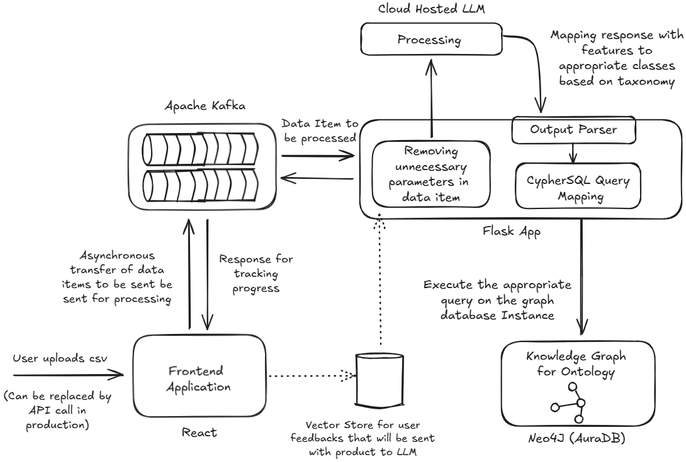
System Architecture Diagram (With Component Interaction flow)

Slide 3




System Scalability Considerations
Initial Knowledge Graph construction is a resource-intensive task, since we would need to deal with thousands/millions of data items.
The proposed system can handle that due to usage of Kafka which makes it asynchronous. Moreover, making backend service multithreaded (given that LLM API calls doesn’t exceed rate limiting concerns, which is not the case for custom LLM deployed in a container).
After initial construction of a knowledge graph, the frontend API call for uploading CSV in the POC needs to be replaced by a DB trigger (or you can continue with the given UI as well). This will make this call when the product catalogue is updated, & you can use the system directly.
System is built for horizontal scaling, suitable for deployment scenarios. Neo4j Professional Subscription might allow better scaling options and metric monitoring.

Slide 4
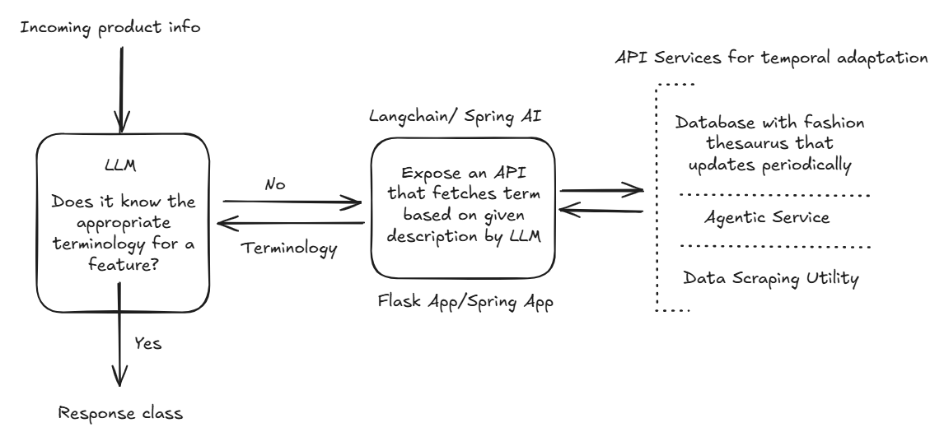
Proposal for Incorporating Temporal Dynamics Using Function Calling
From online thesaurus that update periodically
https://wwd.com/fashion-dictionary/

Slide 5
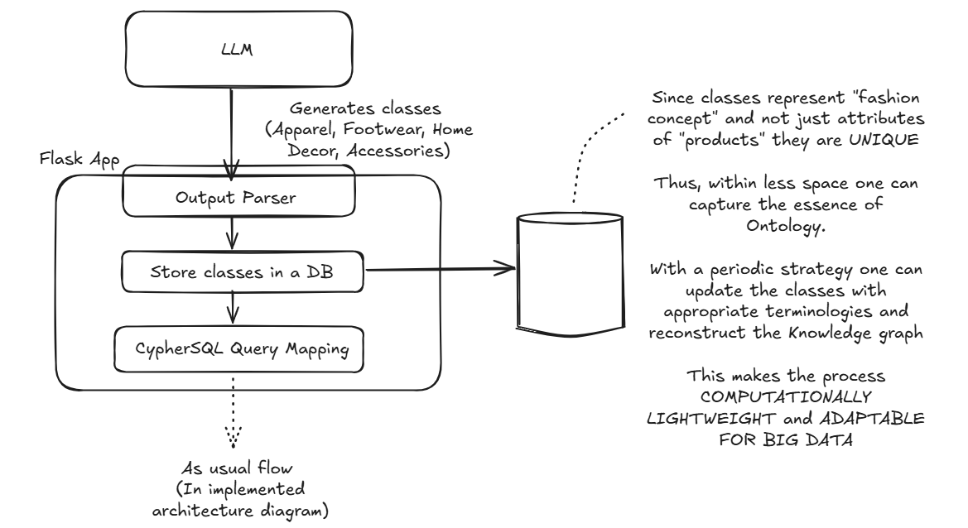
Proposal for Incorporating Backfilling Strategy with a Datastore

Slide 6
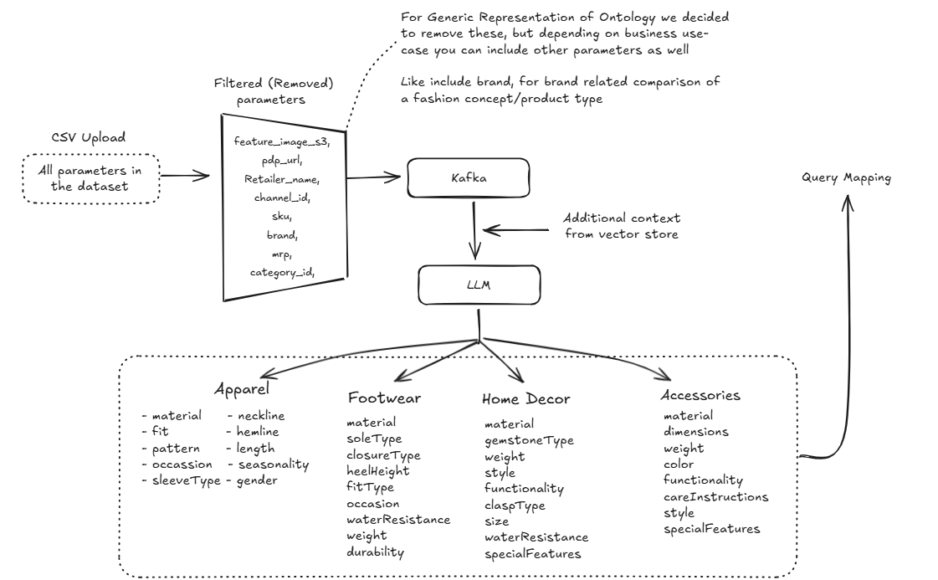
Data Processing Pipeline Visualization (data format in the flow)
Class members for ontology, can be changed depending upon requirement or comcerned taxonomy of the graph

Slide 7
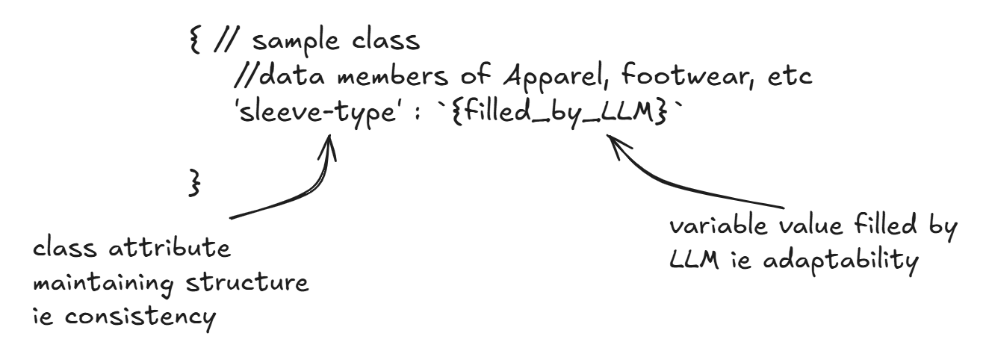
Inherent Extensibility Mechanism
The consistency of the ontology is maintained by the feature taxonomy/ extracted classes from the data inputs (mentioned in previous slide).
Herein the structure of classes provides this consistency, whereas the ‘values’ or ‘fields’ which are variables are filled by LLM, which undergoes and acquaints to temporal dynamics, finetuning, etc making a consistent yet transient representation.

Slide 8
Multimodal LLM for Feature Extraction
LLMs have a better ‘understanding’ of a fashion concept rather than just a feature; allowing them to relate it to trends and nuances. One can combine them with RAG tools as proposed earlier for more features, better integration, etc.
Cross-modal understanding can be better achieved with LLMs. We think one can consider using a CV model for describing the feature, rather than defining the feature, to stay adaptable to temporal dynamics
But for benchmark worthy descriptions, architecturally one leads to vision transformers, which defeats the purpose to segregate the LLM and Computer Vision model, more over it reduces cross modal understanding.
Thus, our technology decision was to use a single LLM, which would be easier to manage, and wallet friendly.

Slide 9
Multimodal LLM Specification and Steps
We used Llava-V1.5-7b (Large Language and Vision Assistant) as our base model.
To adapt to CUDA Memory constraints for 8-bit Quantization, we configured with 4-bit quantization for memory efficiency (You could get even better results by increasing quantization & other parameters depending upon your compute limits).
To incorporate the learnings in the research paper of UNIFASHION LLM (GitHub, Paper), we leveraged the LoRA (Low-Rank adaptation parameters) provided and finetuned the base model using PeftModel. Link to LoRA params and other model features – Unifashion_LORA_Params
Suggestion for production – For continuous feedback using a vector store always with expert comments results in unnecessary token exchanges, even if it works & is proposed in our architecture. Refer the strategy as proposed in CONTINUAL LLAVA.
Proposal – You could deploy the model given in unifashionLLM.ipynb in source code to OLLAMA, since without rate limiting concerns you can leverage tools like function calling, agentic RAG using langchain, that too multimodal.

Slide 10
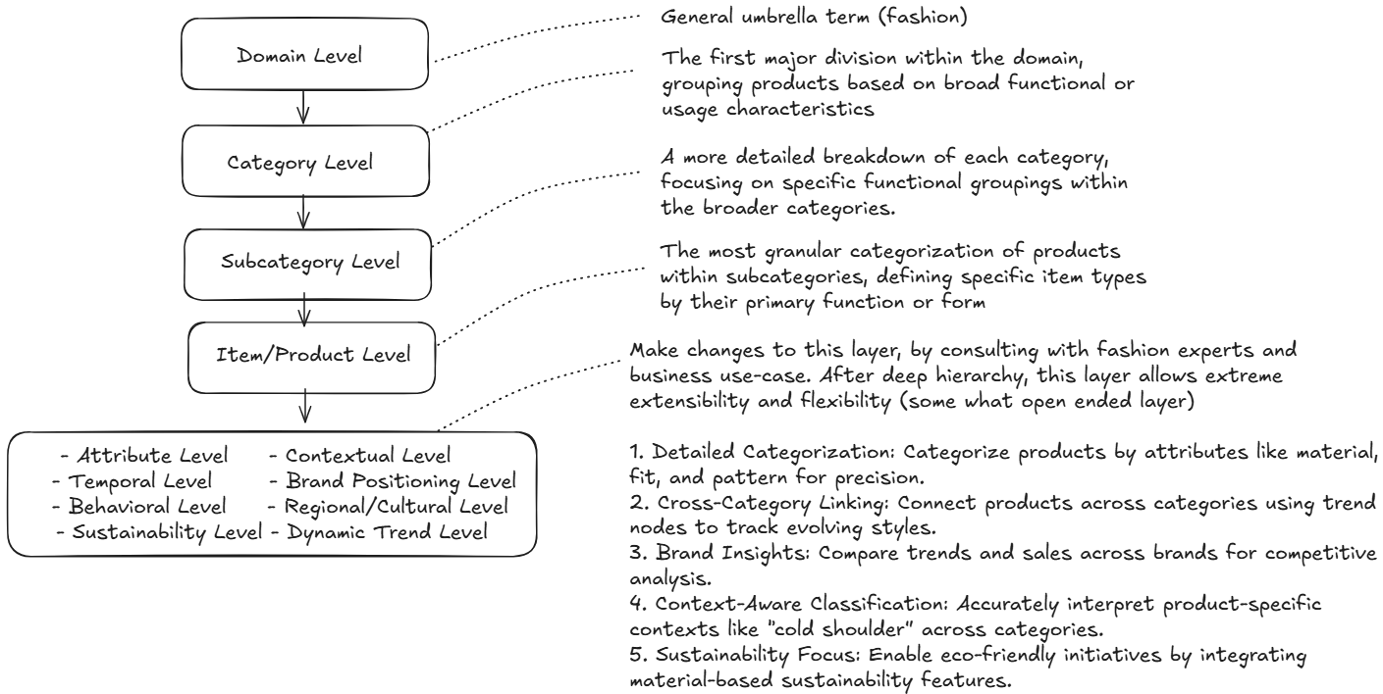
Ontology schema (Hierarchical Levels)

Slide 11
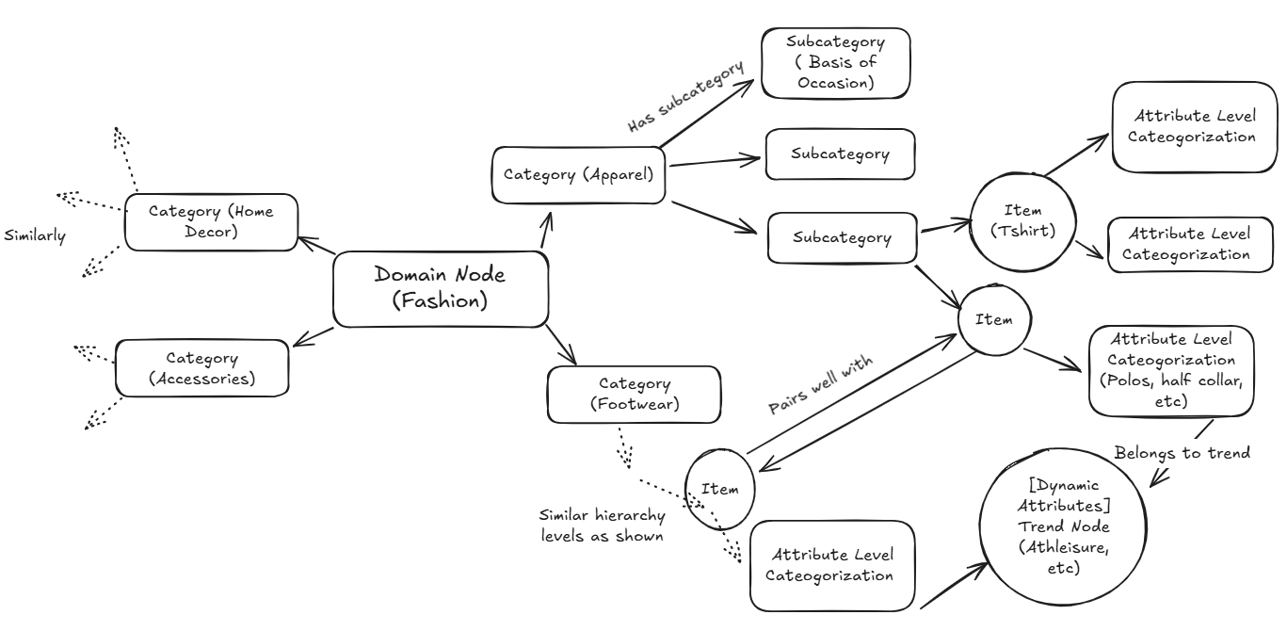
Ontology schema (Within Neo4j)
PAIRS_WELL_WITH Relationship

Slide 12
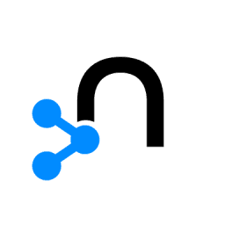

Ontology Management, Version Tracking, Updates
NEO4J vs OWL
Version Tracking and Update Methodology
Neo4j offers dynamic handling of complex relationships, user-friendly querying with Cypher, real-time traversal, and multi-format integration, making it ideal for trend analysis, recommendations, and fast-changing domains
The backfilling strategy proposed in initial slides, reconstructs the knowledge graph by updating the terms from web.
Versions can be represented by timestep at which a particular serverless scripts run and update the terminologies of class instances in the database that stores the classes generated by
LLM for fashion ontology.
Construct a new knowledge graph for each change by which you can compare the differences and gain insights.
You can update existing knowledge graph as well, by traversing the graph hierarchy from domain node, for each class instance present in the database, improving memory efficiency.
In contrast, OWL's schema-bound and rule-heavy approach limits flexibility, real-time capabilities, and handling of non-standard data sources.

Slide 13
New Trend Incorporation Mechanism & Extensibility Mechanisms
Adding New Attributes - Expand product attributes to include additional details like seasonality, occasion, etc. Schema is designed to allow adding new attributes without disrupting existing data.
Nodes and Relations
Trend Nodes – Link the attribute level classification to a trend or style allowing us to track social phenomenons.
Pairs well with relation – gives insights about which 2 products go together well, to capture changes that occur.
Add classes, to capture the fashion umbrella better by consulting the experts.

Slide 14
Snaps from Neo4j
Apparel Hierarchies: Demonstated the flow from the root node till specific product - "Kanchipuram Saree".
Link: https://drive.google.com/file/d/1BsWusY1_h-2hiFsXkCvVgsScffA0PQX9/view?usp=drive_link
Trend mapping: Uses the "Pairs_Well_With" Relationship. We have defined the pairings in the code which can be edited by human moderator, not solely relying on AI.
Link: PairsWellWith.png - Google Drive
Neo4j Ontology Video: (Since it was huge, we made a video to explain it!)
Link: https://drive.google.com/file/d/1mDw9BRcnMrkXeIfE52wekjBzbLKT8Haq/view?usp=drive_link
NOTE: We can provide Neo4j login credentials to someone from Stylumia upon request. However, to maintain security, these credentials are not included here as this solution is publicly visible on hackerearth . The entire concept and functionality have been demonstrated through the three links given above.

Slide 15
Integration of Individual Product Attributes in last layer of ontology for future usecases.
• Name: A unique identifier for the product, ensuring no overlap in naming conventions for easier indexing.
• Description: A concise explanation highlighting the product’s key features to enhance discoverability.
• Brand: Differentiates products based on brand identity, enabling brand-specific insights and recommendations.
• Retailer: Identifies the retailer, allowing for retail-level analysis and performance tracking.
• MRP (Maximum Retail Price): Critical for pricing analysis. For example, if multiple brands sell similar products and one retailer asks why their product isn’t selling, our ontology can identify higher MRP as a potential factor. Comparisons with competitor pricing provide actionable insights.
• URL: A direct link to the Product Detail Page (PDP) for quick access and analysis of online presence.
• Color: Helps in trend prediction and pairing suggestions, e.g., identifying popular color combinations like “Orange” with “Dark Blue.”
• Material: Enables differentiation by quality and durability, e.g., “Cotton” for casual wear or “Leather” for premium appeal.
• Style: Categorizes products as “Casual,” “Ethnic,” or “Formal,” aiding in customer preference matching and occasion-based recommendations.
• Trend Score: A computed metric to indicate a product’s relevance in current fashion trends, helping prioritize trend-aligned products.
• Recommended Pairing: Suggests complementary products, e.g., “Kanchipuram Sarees” paired with “Gold Necklaces,” driving cross-category engagement and improved shopping experiences.

Slide 16
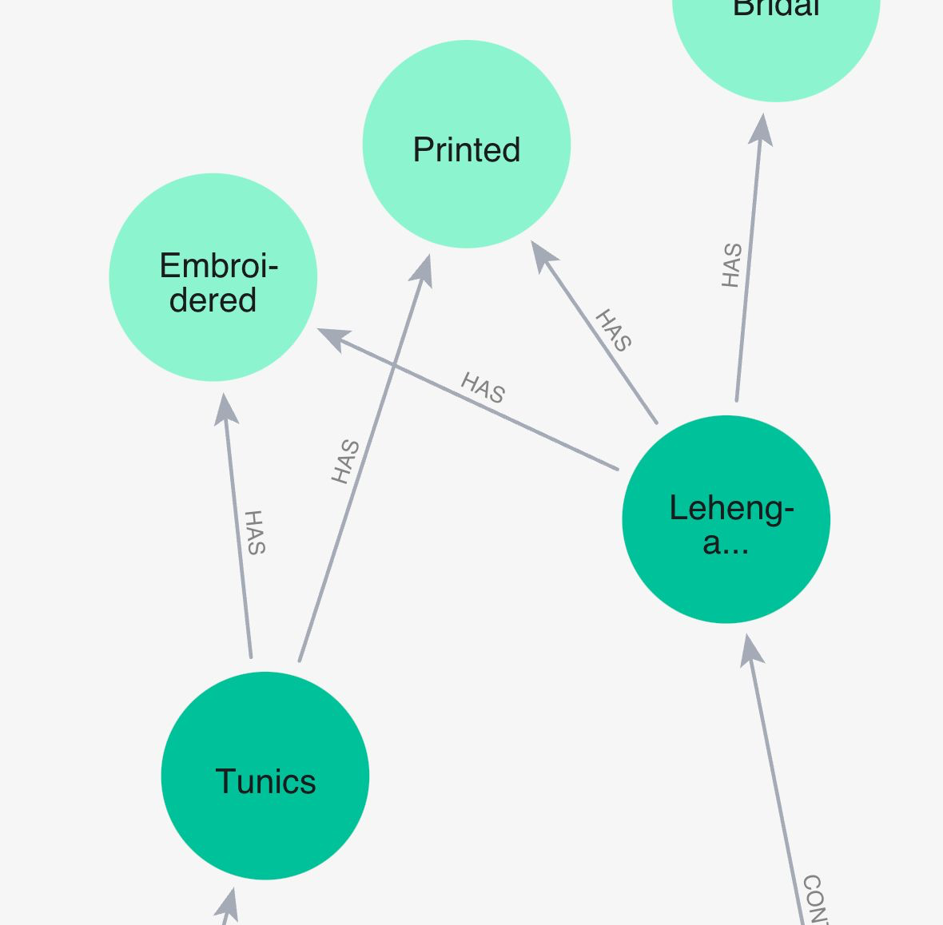
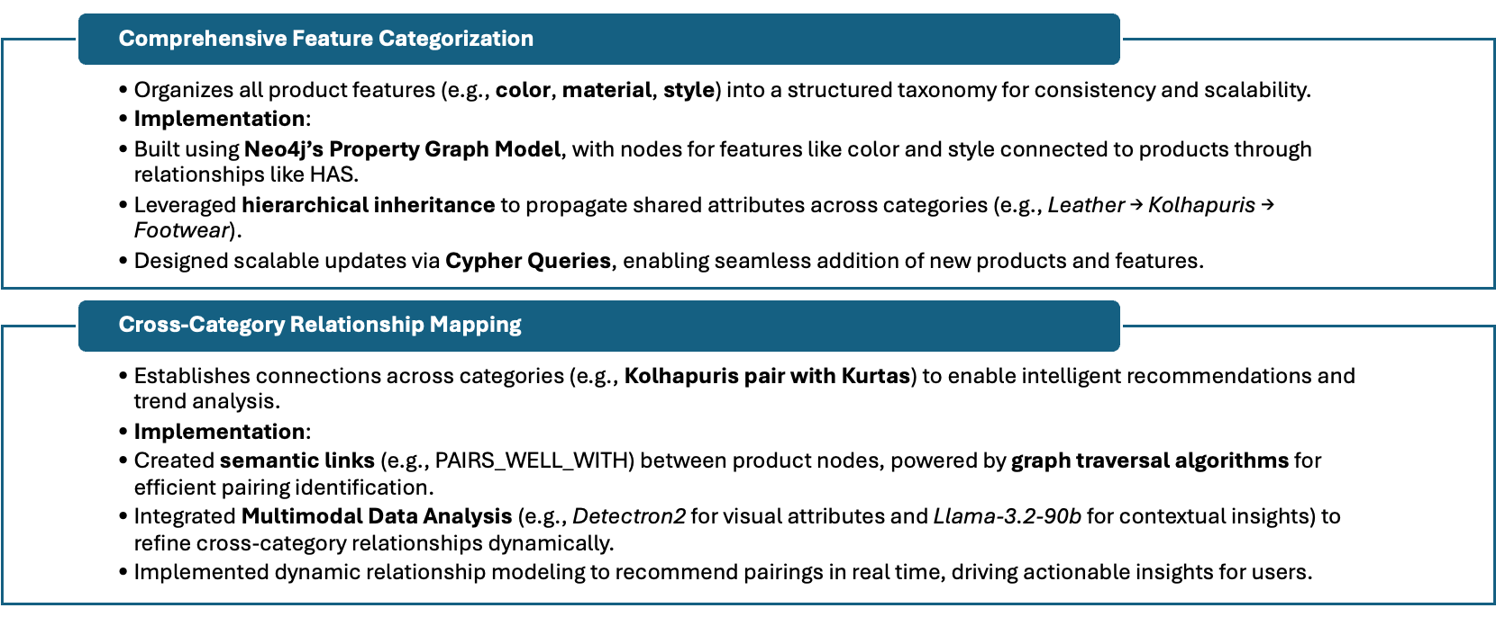
Feature Taxonomy Overview
Fig. Cross Category Relationships

Slide 17
Advanced Feature Design
Context-Aware Feature Definitions​
Features Adapt Dynamically:​
Utilized multimodal data analysis to extract and update attributes dynamically.​
Example: LLAMA3.2 identifies visual features like color and pattern directly from product images.​
Semantic attributes such as style (e.g., Formal, Casual) or occasion (e.g., Festive, Daily Wear) are contextually updated based on hierarchical relationships.​
Implementation:​
Features are linked to products via relational contexts (e.g., Sarees → Kanchipuram Sarees → Festive).​
Dynamic adjustments are performed using graph traversals and real-time data inputs from visual and textual models.​
Attribute Inheritance Patterns​
Hierarchical Inheritance:​
Parent-child relationships ensure shared properties are passed down the hierarchy.​
Example: “Leather Kolhapuris” automatically inherit material: leather and style: traditional from the parent node.​
Supports customized node-level overrides for specific cases (e.g., “Vegan Kolhapuris” override material).​
Implementation:​
Designed inheritance using Neo4j’s hierarchical queries to aggregate and retrieve features efficiently across parent-child nodes.​

Slide 18
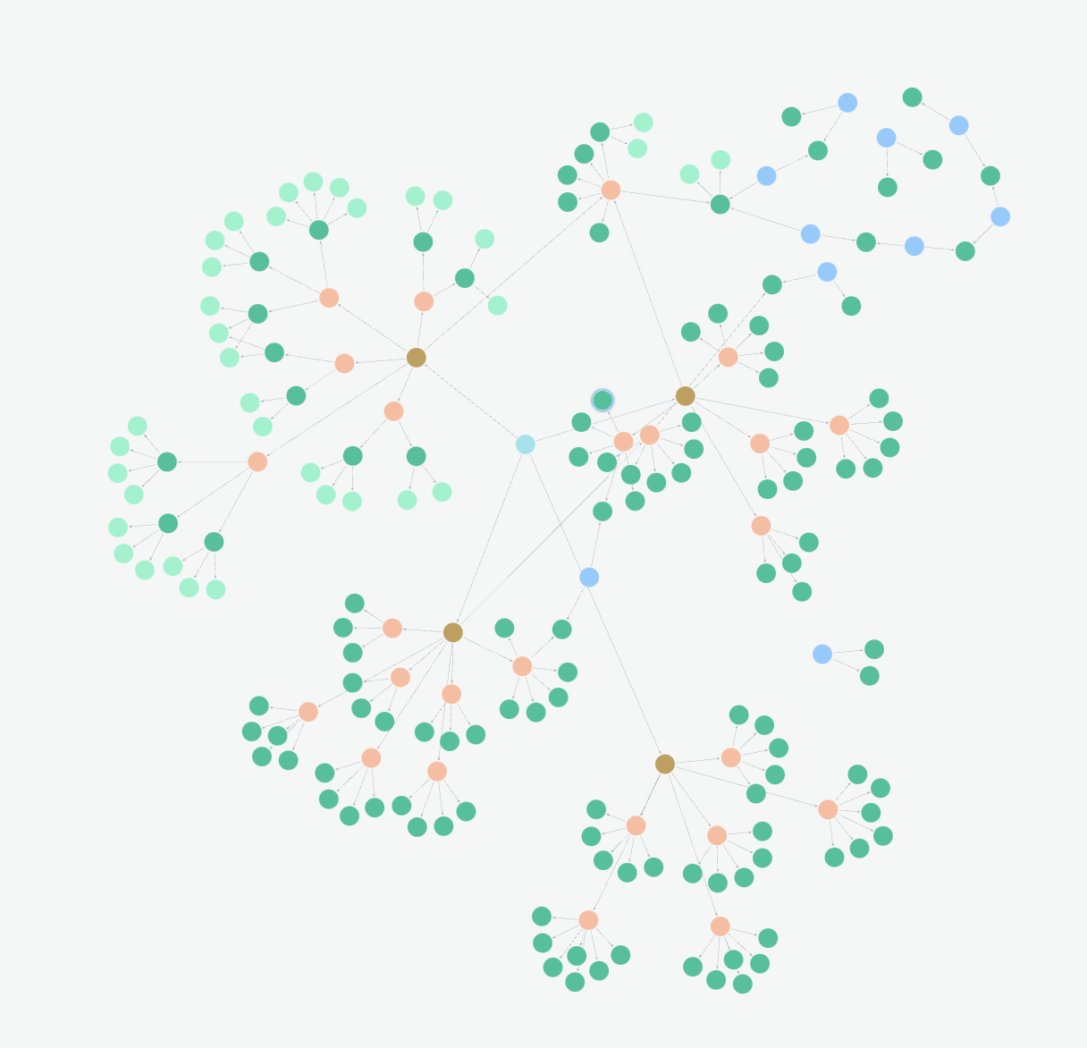
Representation of Input CSV
As discussed in "Currently Working on" slide, we plan to dynamically put them atop particular nodes where they suit well and create a product-to-product trend mapping, which will also be able to predict 'upcoming fashion trends'.
Fig. Current hierarchical ontology as displayed in Neo4j for the CSVs

Slide 19
Currently Working on:
Trend Analysis Success:
Expanding Product Integration:​
Adding specific products (e.g., 100 models of Kolhapuri Chappals) with unique attributes (see next slide) to nodes like “Kolhapuris.”​
Linking products dynamically, e.g., “Purple Mojadis” pairing with “Purple Kurtas.”​
Multimodal Analysis:
Vision:
Demonstrated insights like Kolhapuri chappals pair well with Dhoti-Kurta. (Shown in image no. 2)​
Leveraging Meta Vision Models like Llama-3.2-90b-vision for smarter product associations.​
Aiming for a state-of-the-art solution adaptable to every product in the market.​

Slide 20
Notes
Technology decisions
Unifashion LLM performs better than existing models like FashionCLIP, MarcoLLM, etc.
Encoder-based Models like RoBERTa, DistilBERT, and BERT family fall short of understanding the complexities that arrive continuously.
Due to open source tools as a requirement, we refrained from using azure, as proposed priorly. Better results could definitely be achieved using RAG Frameworks like langchain, langgraph which provides tool calling, agentic architectures. (Had this hackathon been in future, we would have been able to use those, lol).
Note – We couldn’t host the finetuned model that we have provided in code, due to monetary constraints. Thus for POC, we have used groq api – llama3.2 vision. Links and code for finetuned LLM have been provided

