Slide 1
VISUAL DEBUGGER FOR ERROR RESOLUTION IN C++
THE 15th INTERNATIONAL IEEE CONFERENCE ON COMPUTING, COMMUNICATION AND NETWORKING TECHNOLOGIES (ICCCNT)
Authors
Prof. Shailaja Uke
Abheerav Patankar
Aaditya Patil
Srujan Patwardhan
Swaraj Phand

Slide 2
AGENDA
Introduction
Problem Statement and Objectives
Proposed Solution
Results
Limitations
Future Scope

Slide 3
INTRODUCTION
The lack of C++ standardization results in fragmented debugging tools across different compilers and IDEs, leading to inconsistent developer experiences.
Enhanced debugging interfaces are crucial due to C++'s extensive use in critical systems, requiring intuitive tools like visualizers for complex data inspection.
Visual Studio stands out as a popular IDE for C++ development but lacks comprehensive visual debugging tools.
Developing a visualizer for Visual Studio could unify debugging experiences, providing graphical representations and enhancing productivity for C++ developers.

Slide 4
PROBLEM STATEMENT
The lack of built-in graphical visualization tools in C++ limits intuitive analysis and representation of complex data structures and language features during development.
Objectives
Develop or integrate third-party extensions for Visual Studio to provide interactive graphical visualization capabilities for C++ applications.
Enhance debugging visualizers within Visual C++ to offer more intuitive representations of data structures during runtime.
Improve developer productivity by enabling clear and comprehensive visualization of complex data relationships and structures in Visual C++ environments.

Slide 5
PROPOSED SOLUTION Target Process Identification
main thread
Process 1
Process 2
Capture thread snapshot of the main thread
Process 3
Process n
Suspend the thread for StackWalk
Iterate through alive processes find the target process by baseName

Slide 6

PROPOSED SOLUTION Construction of Stack Frames
Function Object
Stack Frame
Stack Trace
Process Memory
Construction of human-readable stack frames from PDB Files
Loading the binary symbol data for a particular function
Stack Frame
Constructs and stores the call stack
Stack Frame
PDB Files
Stack Frame
Frames consisting of symbols in functions

Slide 7
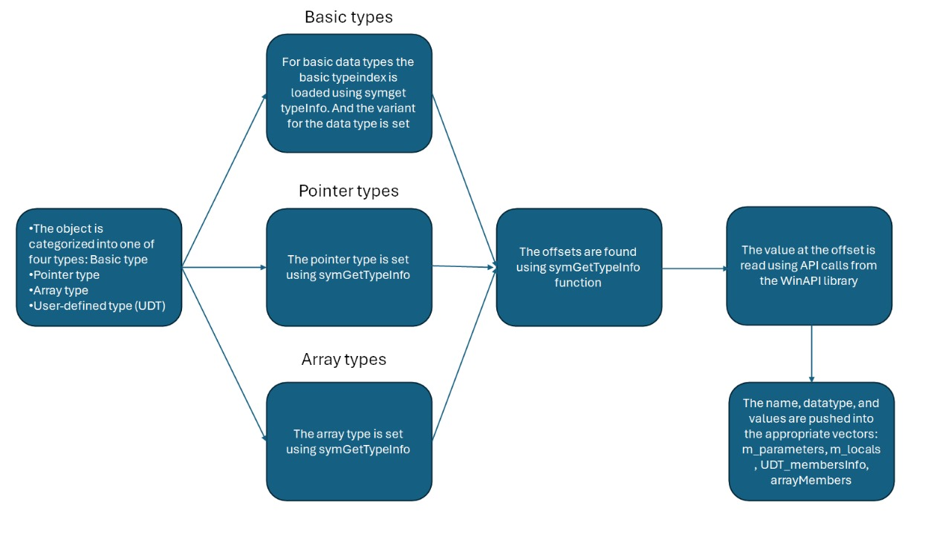
PROPOSED SOLUTION Symbol Enumeration

Slide 8
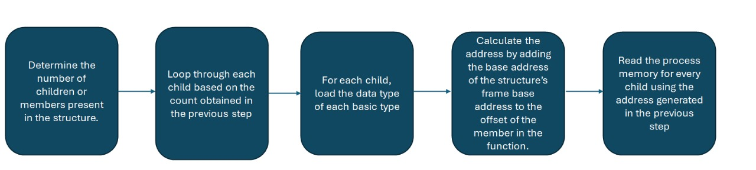
PROPOSED SOLUTION UDT Enumeration

Slide 9
PROPOSED SOLUTION Marshalling using P/Invoke from C++ DLL to WPF
RCW
Data stored in an appropriate data structure for ease of visualisation
Strings
String
Stream
Binary String Wrapper class
Marshalling data as BSTR (COM datatype)
Language Boundary
Runtime Callable Wrapper

Slide 10
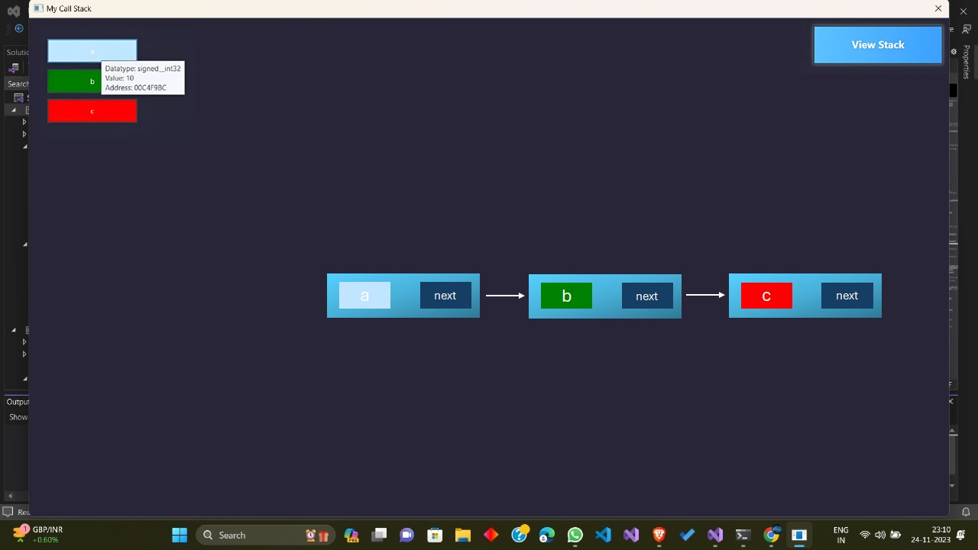
RESULTS

Slide 11
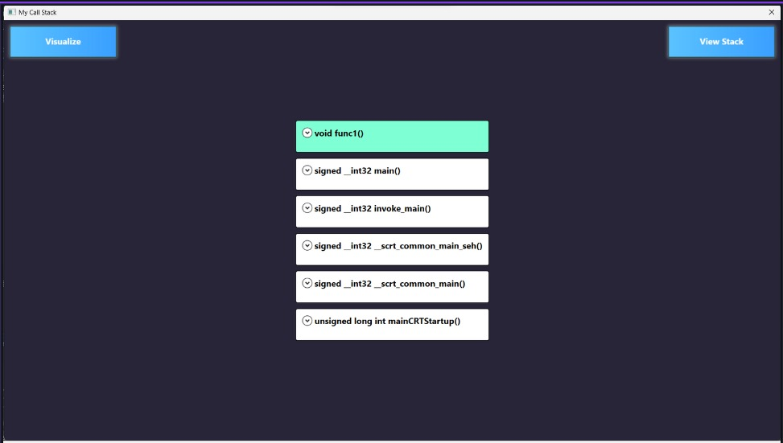
RESULTS

Slide 12
LIMITATIONS
Currently, the application displays the call stack of a single thread (only main thread) in the application.
Visualization of nested classes, nested data structures, and advanced C++ features such as templates, Standard Template Library, and other libraries requires exploration.
Adoption required for namespace isolations.
System is specific to Visual Studio IDE (Visual C++)

Slide 13
FUTURE SCOPE
Read and Marshal complex data structures using custom Marshaller and COM Objects.
Allow visualisation of multithreaded applications.
Visualisation of interlinked connections between and of data structures between different functions and even multiple threads.
Support visualization of new features from VC++ 11 onwards such as smart pointers, etc.

Slide 14
THANK YOU

