Slide 1




ET AI HACKATHON 2026 · SMART CITIES / ENVIRONMENTAL INTELLIGENCE
PRAANA
Predictive Real-time Attribution and Action for National Air quality
AI-Powered Urban Air Quality Intelligence for Smart City Intervention
Team Pheonix
Sense
Attribute & Forecast
Prioritise
Communicate
Detailed Solution Document & Pitch Deck

Slide 2



THE PROBLEM
India's Air Crisis Is a National Emergency — Not Just Delhi's
1.67M
218
60+
Premature deaths/year from air pollution in India
Delhi's average AQI in 2024–25 — 'Poor' or worse 200+ days
Days Mumbai recorded dangerous AQI levels in 2024
The Lancet Planetary Health
CPCB
CPCB
24/50
900+
31%
Of India's most polluted cities are Tier-1/Tier-2 metros
CAAQMS stations already deployed nationally
Of cities with monitoring data have any actionable response protocol
CPCB 2024
NCAP
CAG Audit 2024
PRAANA — ET AI Hackathon 2026
02 / 16

Slide 3



THE GAP
The Data Exists. The Intelligence Layer Does Not.
Dashboards answer one question. City administrators need answers to three.
Who
How bad
Where
is causing this pollution right now?
will it get over the next 72 hours?
should enforcement be sent today?
Nobody answers all three together. IITM-DSS and SAFAR come closest — but stop at diagnosis.
WHAT EXISTS TODAY
WHAT PRAANA ADDS ON TOP
IITM-DSS: City-level source apportionment (29 sources), Delhi NCR
1km ward-level granularity (not just city-level)
SAFAR: 3–10 day city-level AQI forecasts for 7 cities
Ranked enforcement actions — which site to inspect today
CPCB Dashboard: Shows the current AQI reading
Cross-city learning loop — tracks what interventions worked
IQAir / apps: City-level AQI number
Regional-language citizen advisories
PRAANA — ET AI Hackathon 2026
03 / 16

Slide 4

THE SOLUTION
Five Coordinated AI Agents, One Mission
Collect → Attribute to source → Forecast 24–72hrs → Rank enforcement → Compare across cities → Communicate to citizens.
A1
A2
A3
A4
A5
Source Attribution Engine
Hyperlocal Forecasting Agent
Enforcement Intelligence Agent
Multi-City Comparator
Citizen Health Advisory
Chemical fingerprinting + causal AI
GNN + atmospheric dispersion, 1km/72hr
Ranks actions by expected AQI impact
Cross-city trend & intervention learning
Regional-language alerts via app & IVR
PRAANA — ET AI Hackathon 2026
04 / 16

Slide 5
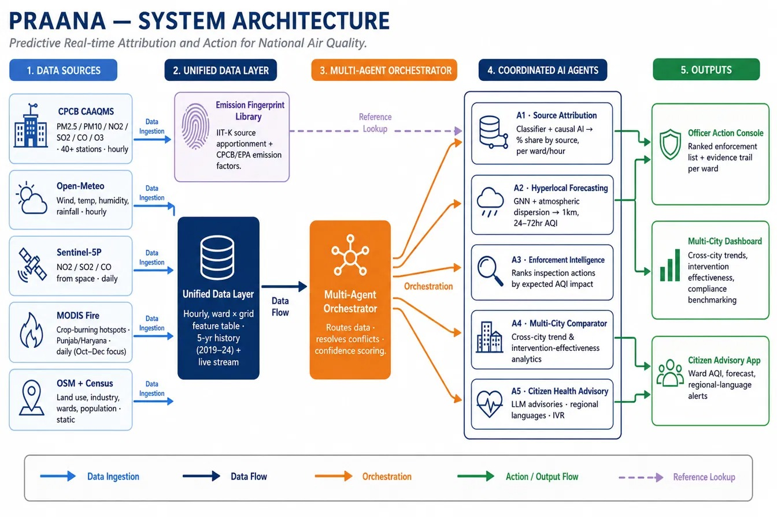
SYSTEM ARCHITECTURE
From Five Data Sources to Three Action Surfaces
PRAANA — ET AI Hackathon 2026
05 / 16

Slide 6



DATA PIPELINE
Six Data Families, Merged Into One Hourly Feed
OpenAQ v3 (CPCB-sourced)
Open-Meteo
Sentinel-5P
PM2.5, PM10, NO2, SO2, CO, O3 • all 5 cities • hourly • live today
Wind, temperature, humidity, rainfall • hourly
NO2 / SO2 / CO from orbit • daily, city-wide • roadmap
MODIS Fire
OpenStreetMap
Census + DataMeet
Crop-burning hotspots, Punjab & Haryana • roadmap
Industry, highways, construction, schools • live today
270 ward boundaries • population per ward
PRAANA — ET AI Hackathon 2026
06 / 16

Slide 7
AGENT 1 · WHO
Every Source Has a Chemical Fingerprint
Diesel vehicles: high NO2 + CO, moderate PM2.5
Live reading: ward attribution
Construction sites: very high PM10, low NO2
Crop burning: very high PM2.5 + CO, organic markers
Industrial stacks: high SO2 + NO2, heavy-metal traces
Causal AI, not just correlation
PM10 spikes downwind of a known construction site, confirmed against live wind direction — not misattributed to local traffic.
PM2.5=180 · PM10=220 · NO2=85 · SO2=12 · CO=45
PRAANA — ET AI Hackathon 2026
07 / 16

Slide 8

AGENT 2 · HOW BAD
1km-Resolution AQI Forecasts, 24–72 Hours Ahead
Prototype (running today): three independently trained models, one per forecast horizon, on 5 years of Delhi data.
Forecast example — Ward AQI, next 72 hours
Roadmap: Graph Neural Network treating stations as a connected network, blended with a physics-based dispersion model.
Output: a time slider — drag forward 24 / 48 / 72 hours to see predicted AQI for every ward.
PRAANA — ET AI Hackathon 2026
08 / 16

Slide 9
AGENT 3 · WHERE TO ACT
A Ranked, Evidence-Backed Action List
Every possible enforcement action across the city, scored by expected AQI impact.
1
Inspect construction site — Rohini Sector 15
Expected impact (%)
Expected 18% PM10 reduction, NW Delhi
2
Diesel-vehicle checkpoint — NH48 entry point
Expected 12% NO2 reduction, Dwarka
3
Notice to industrial cluster — Bawana
Expected 9% SO2 reduction, NW corridor
PRAANA — ET AI Hackathon 2026
09 / 16

Slide 10
AGENT 4 · MULTI-CITY COMPARATOR
One Pipeline, Five Cities
Live basic AQI comparison across all 5 cities today; deeper per-city validation (forecast models, wind-check) is the roadmap, not onboarding.
Delhi NCR
Mumbai
Kolkata
Bengaluru
Chennai
Live — deepest validation (forecast + wind-check)
Live — deepest validation (forecast + wind-check)
Live — basic comparison (deep validation is roadmap)
Live — basic comparison (deep validation is roadmap)
Live — basic comparison (deep validation is roadmap)
Cross-city learning loop
When a city deploys a recommended action, the dashboard tracks realised AQI change vs. predicted change — building a growing evidence base of what actually works, and surfacing successful interventions as candidates for wards with a similar source-attribution profile in other cities.
PRAANA — ET AI Hackathon 2026
10 / 16

Slide 11

AGENT 5 · CITIZEN HEALTH ADVISORY
Reaching Every Citizen, In Their Own Language
Ward-level AQI now + 72hr forecast, in plain language
Language coverage by city (Hindi live today; rest are roadmap)
Delhi NCR — Hindi (live)
Maps schools, hospitals & outdoor workers against forecast risk
Mumbai — Marathi (roadmap)
Roadmap: answering natural questions like 'Is it safe to walk my child to school tomorrow?'
Kolkata — Bengali (roadmap)
Bengaluru — Kannada (roadmap)
Sample advisory — Hindi
Chennai — Tamil (roadmap)
“Kal subah Rohini mein AQI 280 rahega. Bahar exercise na karein.”
PRAANA — ET AI Hackathon 2026
11 / 16

Slide 12



TECHNOLOGY STACK
Every Suggested Technology, Implemented
Geospatial & Remote Sensing
Multi-Agent AI
Real-Time IoT Integration
Atmospheric Dispersion
Sentinel-5P + MODIS + OSM Overpass API
Custom Python orchestrator (prototype)
LangGraph / CrewAI (roadmap)
OpenAQ v3 API • Open-Meteo • 40+ CAAQMS stations
Gaussian-plume model blended with GBR forecast
Predictive Analytics
Causal Inference
LLMs, Multi-Language
Frontend & Data
scikit-learn GradientBoostingRegressor (prototype)
PyTorch Geometric GNN (roadmap)
Cosine-similarity fingerprint + wind confounder adjustment
Template-based (prototype) · Anthropic Claude API (roadmap)
Streamlit + Plotly + pandas/Parquet (live, running)
PRAANA — ET AI Hackathon 2026
12 / 16

Slide 13
VALIDATION PLAN
How We Prove It Works — Including Real Numbers
1
Source attribution accuracy
Benchmarked vs. IIT-K / CPCB source-apportionment ground truth per source category
2
Forecast accuracy — ACTUAL RMSE
24h: 80.9 vs baseline 112.9 (28.3% better) • 48h: 82.6 vs 114.3 (27.8%) • 72h: 83.8 vs 114.2 (26.6%)
Model: scikit-learn GBR, trained 2019–2023, tested on held-out 2024 data (8,760 hourly rows)
3
Enforcement recommendation quality
Rated by domain experts against the evidence trail — 1–5 relevance & feasibility scale
4
Advisory relevance & language coverage
Severity-match rate + 5 languages validated by native speakers
5
Response-time reduction
Signal-to-intervention time vs. documented baseline in pilot wards
PRAANA — ET AI Hackathon 2026
13 / 16

Slide 14
JUDGING RUBRIC
Built Directly Against the Evaluation Weights
Innovation — 25%
Fingerprint + causal-AI attribution; IITM-DSS and SAFAR acknowledged — PRAANA's gap is ward-level enforcement prioritisation + cross-city learning.
Business Impact — 25%
Closes the CAG-identified 31% gap with a measurable, auditable action trail.
Technical Excellence — 20%
Three per-horizon GBR models, wired live into the app, + wind-confounder attribution check, both running today; actual RMSE 80.9/82.6/83.8h vs 112.9/114.3/114.2 baseline (~27% improvement).
Scalability — 15%
City-agnostic pipeline — new city needs a feed, not new code.
User Experience — 15%
Separate officer console + citizen app (live Streamlit dashboard).
PRAANA — ET AI Hackathon 2026
14 / 16

Slide 15

ROADMAP
From Two Cities to a National Platform
Wave 1 — Now
Wave 2 — Next
Wave 3 — Scale
All 5 cities live for basic comparison; Delhi NCR + Mumbai have deepest validation
Extend forecast models + wind-check validation to Kolkata, Bengaluru, Chennai
Any city with CAAQMS coverage
Expected deliverables
Working Prototype — Live Streamlit dashboard + GBR model with real RMSE numbers
Architecture Diagram — Full system diagram (this deck, slide 5)
Presentation Deck — This deck + accompanying solution document
Demo Video — Officer console + citizen app walkthrough
PRAANA — ET AI Hackathon 2026
15 / 16

Slide 16
THE PITCH, IN ONE LINE
We tell city governments not just that the air is bad — but exactly who is making it bad, how bad it will get tomorrow, and precisely where to send enforcement officers today to fix it.
PRAANA — Predictive Real-time Attribution and Action for National Air quality
Team Pheonix GitHub: https://github.com/Aaditee13/praana-air-quality-intelligence.git

