Slide 1
Design and Implement an AI-Powered System that leverages NLP to detect Adverse Drug Events(ADE)
AADITH P

Slide 2
Introduction
Vaccine pharmacovigilance relies on manual review of millions of free-text adverse event reports — a slow, error-prone process.
Natural Language Processing can automate extraction of Adverse Drug Events (ADEs) from clinical narratives at scale.
VAERS contains 200K+ reports annually a rich but largely unstructured data source requiring intelligent NLP-based processing.

Slide 3
Problem Statement
Free-text VAERS reports contain critical safety signals buried in unstructured narratives existing systems miss subtle ADE mentions.
Manual severity triage of adverse events is subjective, inconsistent, and does not scale to large report volumes.
No existing pipeline jointly performs ADE/Drug extraction via NER and hierarchical severity classification in an end-to-end manner.

Slide 4
Objective
To build an end-to-end NLP pipeline that automatically extracts Adverse Drug Event and Drug entities from VAERS reports using BioBERT-based NER with weak supervision, and classifies report severity into mild, moderate, or severe using a two-stage hierarchical classifier fine-tuned with QLoRA.

Slide 5
Dataset Description
Source: VAERS (Vaccine Adverse Event Reporting System) — publicly available from CDC/FDA.
Coverage: 2020–2025, three files per year — VAERSDATA, VAERSSYMPTOMS, VAERSVAX — merged on VAERS_ID.
Scale: 200K+ records after preprocessing — free-text SYMPTOM_TEXT field is the primary NLP input.
Annotation: Small gold dataset manually annotated in BIO-tag format (B-ADE, I-ADE, B-DRUG, I-DRUG, O); 250K records weakly labeled using the trained NER model.

Slide 6
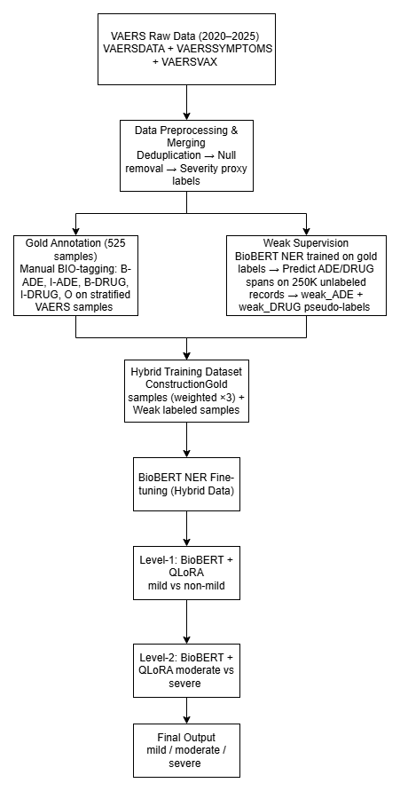
Methodology

Slide 7
Results(NER Performance Table)
Entity | Precision | Recall | F1-Score
ADE | 0.46 | 0.42 | 0.44
Drug | 0.69 | 0.91 | 0.79

Slide 8
Level-1: mild vs non-mild
Class | Precision | Recall | F1-Score
Mild | 0.84 | 0.85 | 0.84
Non-mild | 0.85 | 0.84 | 0.84

Slide 9
Level-2: moderate vs severe
Class | Precision | Recall | F1-Score
Moderate | 0.81 | 0.87 | 0.84
Severe | 0.79 | 0.70 | 0.74

Slide 10
Thank You

