Slide 1
ORAL CANCER DETECTION
SL.NO | NAME | ROLL NUMBER
1 | Ashika J | CB.EN.U4CSE21206
2 | Mathamgi Nair | CB.EN.U4CSE21238
3 | Aadithya ER Menon | CB.EN.U4CSE21301
Subject code : 19CSE437
Subject Name : Deep Learning for Computer vision
Review-3

Slide 2
Agenda
Overall Architecture Diagram
Existing Product features
Module Diagram
Explanation of Modules
Technology Stack
UI wireframe designs --- For each module
Working of the product

Slide 3
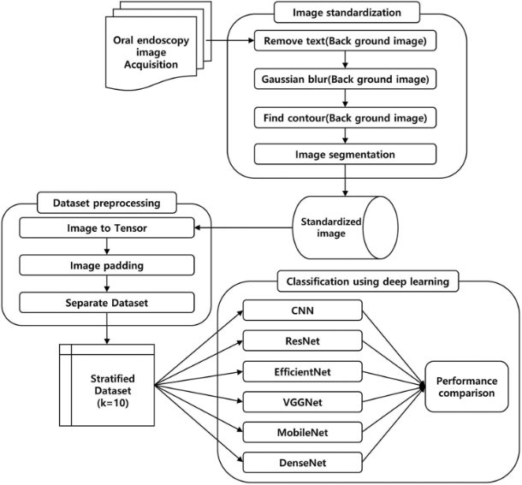
ARCHITECTURE DIAGRAM

Slide 4
Existing product features
Two interesting deep learning-based projects / webapps that focuses on detecting oral cancer are as follows:
Oral Cancer Detection Web-App using XceptionNet: This project, available on GitHub, is a web app built using Flask, TensorFlow, Keras, and OpenCV. It focuses on detecting oral cancer from histopathological images using a custom-trained XceptionNet model. The model claims an accuracy of 98% for classifying the presence of oral cancer​ .
Oral Cancer Detection using InceptionV3: GitHub repository utilizes the InceptionV3 model for detecting oral cancer from histopathological images. The model is implemented with Keras and TensorFlow, and the aim is to make diagnosis more efficient using image classification​

Slide 5
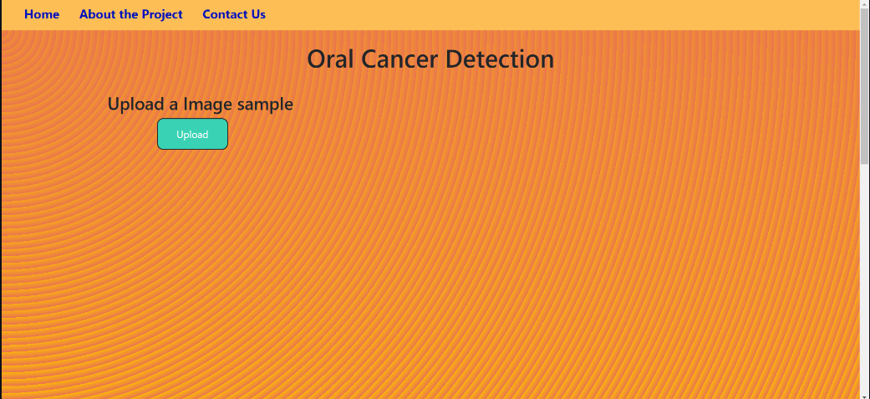
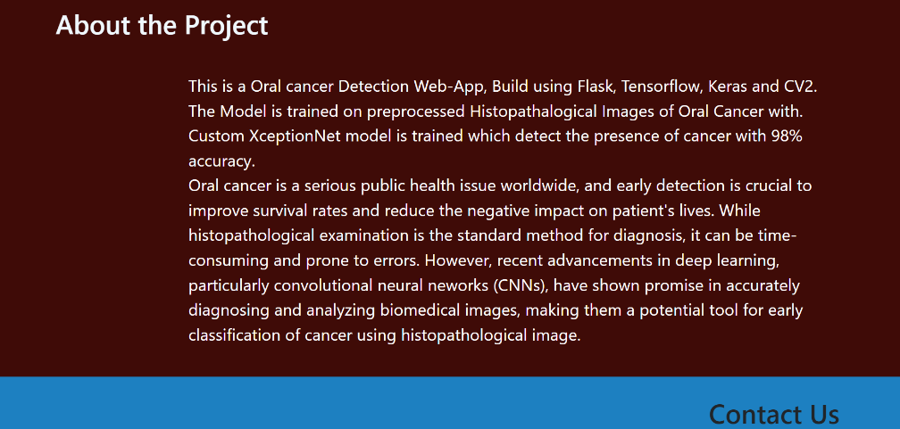
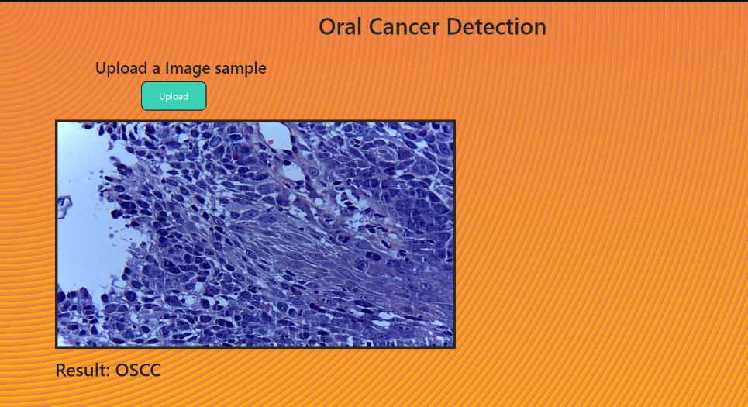
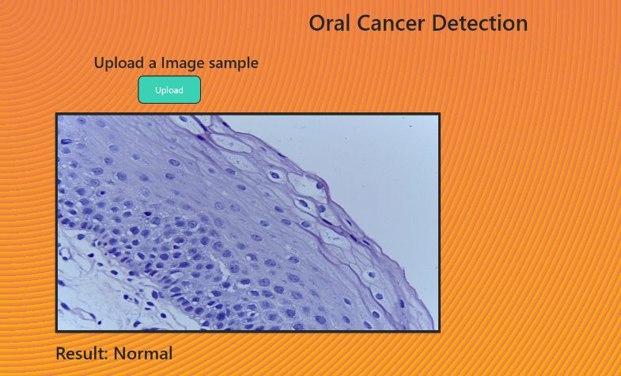
Existing product features
.

Slide 6
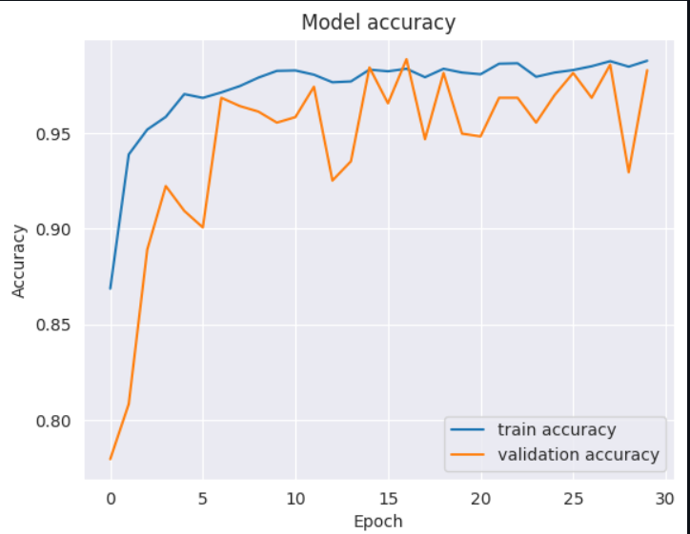
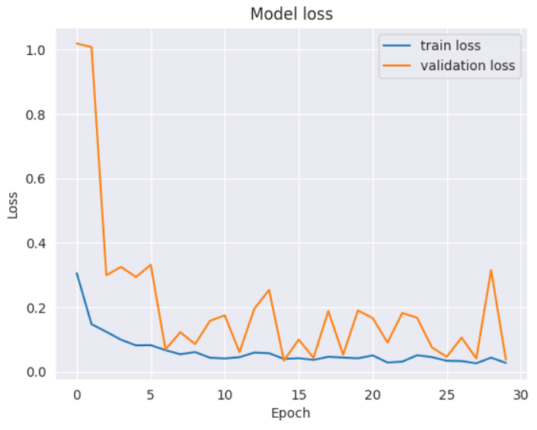
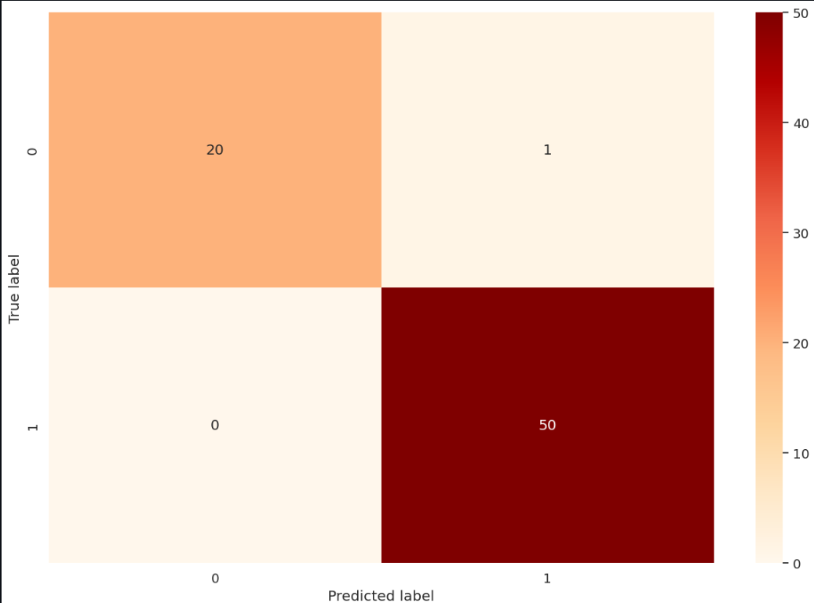
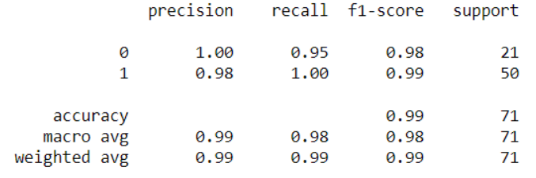
Existing product features
.

Slide 7
Workflow in existing product
Login: The user logs into the system using secure credentials.
Patient Information & Image Upload: Once logged in, the user enters patient details and uploads histopathological images of the oral cavity.
Image Preprocessing: The system allows basic preprocessing of the image to ensure it’s in the right format and size for the model.
Image Analysis: After uploading the image, the XceptionNet model processes it, detecting whether the tissue contains cancerous cells.
Results Display: The system displays the diagnosis (e.g., malignant or benign) and potentially highlights areas of concern in the image.
Report Generation: The user can generate and download a detailed report summarizing the diagnosis and patient details.
Patient Communication: The system allows users to send reports and messages directly to patients for follow-up or further consultation.

Slide 8
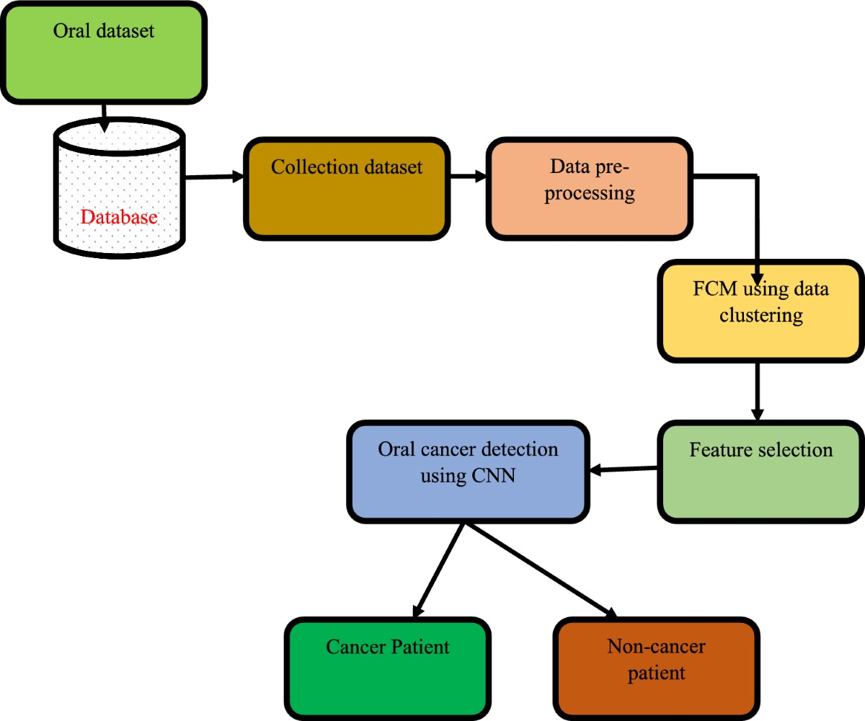
Module Diagram

Slide 9
Explanation of Modules
1. Oral Dataset Collection
Input: Dataset includes images, medical histories, etc.
Stored: In a database for easy access.
2. Collection Dataset
Data Extraction: Raw data is fetched for analysis.
3. Data Preprocessing
Objective: Cleans and normalizes data to remove noise.
Steps: Data cleaning, normalization, augmentation (for images), resizing/cropping.
Output: Refined dataset for clustering and feature selection.
4. Data Clustering (K-Means)
Method: K-Means partitions data into clusters based on similarity, simplifying pattern detection.

Slide 10
Explanation of Modules
5. Feature Selection
Objective: Selects relevant features to improve model accuracy.
Method: PCA, correlation analysis for dimensionality reduction.
6. Oral Cancer Detection (CNN)
CNN: Trained to distinguish between cancerous and non-cancerous cases.
Prediction: Identifies whether a patient is cancerous or non-cancerous.
7. Classification Output
Cancer Patient: Classified as cancerous.
Non-Cancer Patient: Classified as non-cancerous.

Slide 11
Technology Stack of the product
Frontend:
HTML/CSS/JavaScript: For structuring and styling the application.
Figma: For designing and planning the UI wireframe.
Backend:
Python (Flask): For creating a RESTful API to interact with the deep learning models.
Flask: Lightweight and easy to set up.
Deep Learning Libraries:
TensorFlow/Keras: For building, training, and loading CNN/GAN/LSTM models.
PyTorch: As an alternative for model training and deployment.
OpenCV: For image preprocessing before feeding it into the models.
Model Serving:
TensorFlow Serving: For deploying and serving the deep learning models.

Slide 12
Technology Stack of the product
Database:
MongoDB: For storing user data, image details, and analysis history.
Other Libraries:
Pandas: For handling data processing.
NumPy: For numerical operations related to image data.
Scikit-Learn: For preprocessing and evaluating the model.
Matplotlib/Seaborn: For visualizing model performance and results during the development phase.

Slide 13
UI wireframe designs
Module | Wireframe design Name | Student Associated(RollNo,Name)
Homepage of the website | EmotionUI | CB.EN.U4CSE21206, Ashika J
About Us of the website | AboutUsUI | CB.EN.U4CSE21238, Mathamgi Nair
Photo uploading part of the website | UploadUI | CB.EN.U4CSE21301,Aadithya E R Menon
Results of the uploaded picture | ResultsUI | CB.EN.U4CSE21206,CB.EN.U4CSE21238, Ashikha J, Mathamgi Nair
Blog, personal interacting and footer of the website | BlogUI | CB.EN.U4CSE21301, Aadithya E R Menon

Slide 14
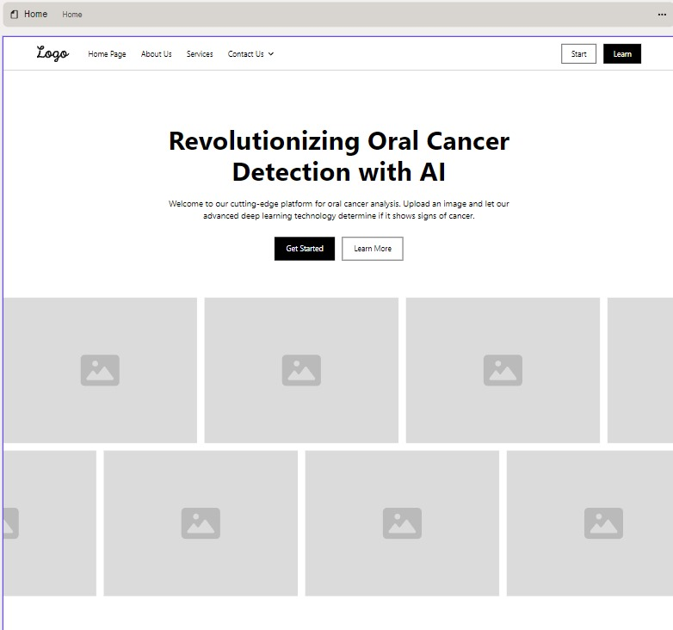
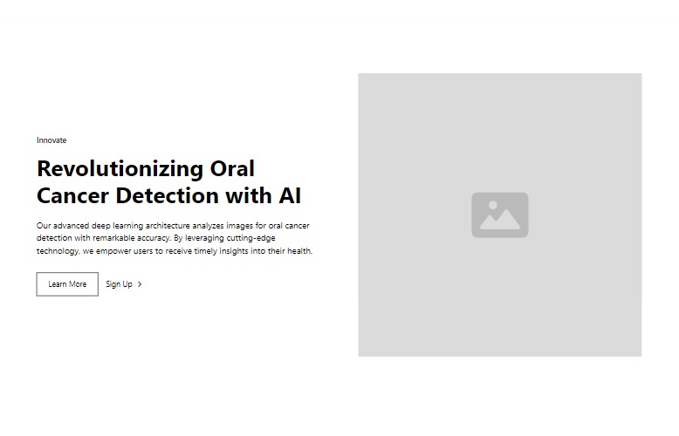
Wireframe designs

Slide 15
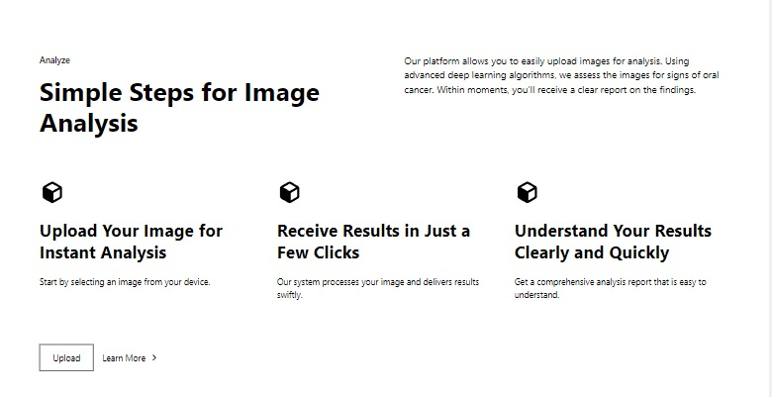
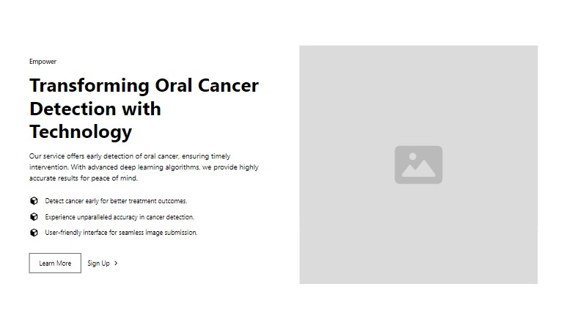
Wireframe designs

Slide 16
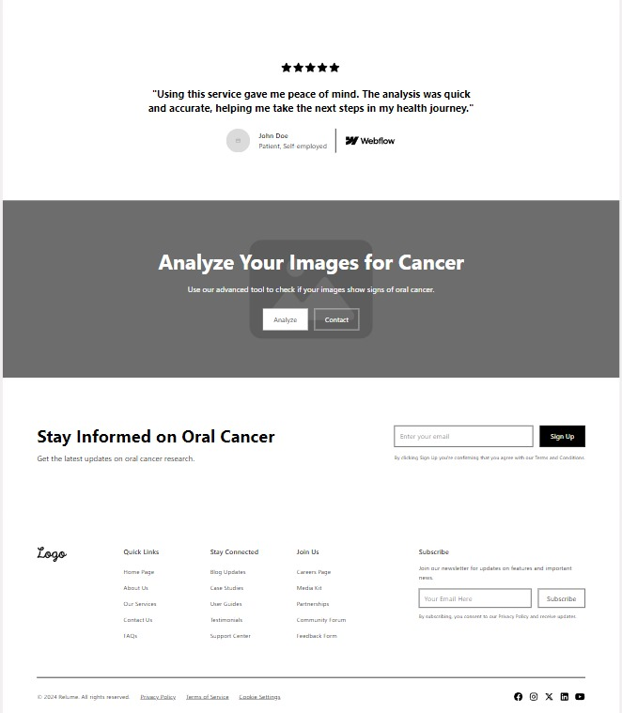

Slide 17
Working of the product
1. User Input
Action: User uploads an oral scan or image.
Process: Image is sent to backend for processing.
2. Preprocessing
Task: Image resizing, normalization, and augmentation (if needed).
3. Image Clustering (K-Means)
Task: K-Means clustering groups similar images to detect patterns.
4. Feature Extraction
Task: CNN extracts features like edges, textures, and color patterns.
5. Deep Learning Model (CNN)
Task: CNN predicts whether the image is cancerous or non-cancerous based on training.
6. Prediction Output
Result: Displays either "Cancerous" or "Non-Cancerous."
7. Display to User
Action: Results shown on web interface, possibly with confidence levels.
8. Post-Detection
User Options: Upload another image or explore additional resources.
system displays the diagnosis (e.g., malignant/benign) and provides highlighted regions in the image, and potential follow-up recommendations

