Slide 1
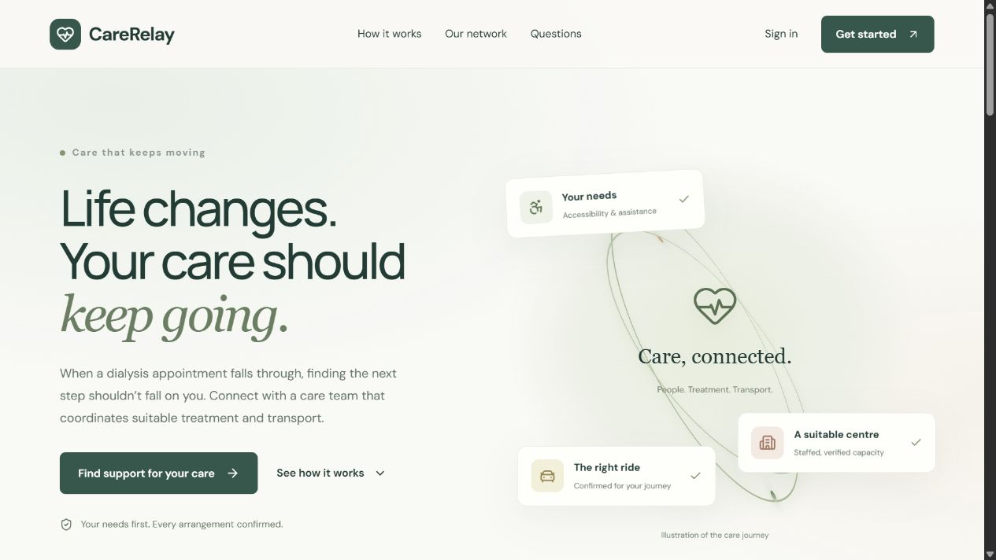
CARE, CONNECTED.
CareRelay
Dialysis Care and
Transport Coordination
One coordinated journey.
Patients, care teams, centres
and transport partners.
Aadithya Ram
Abhishek Bharathi
Notes:
CareRelay is a human-reviewed coordination prototype. Provider-reported availability requires confirmation. Test accounts shown.

Slide 2
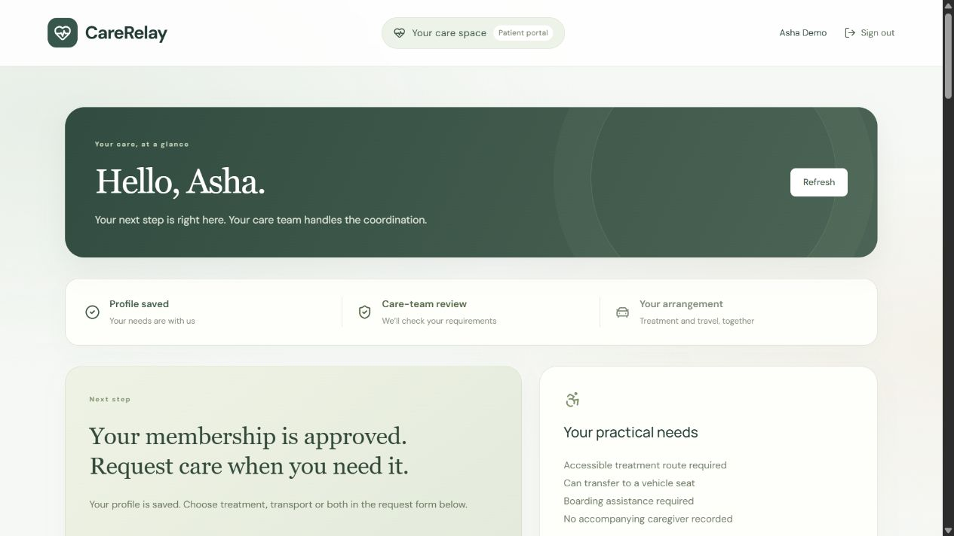
CARERELAY / THE PROBLEM
An appointment is only part of the journey.
A cancelled session can create several coordination tasks at once.
01 Find suitable treatment
A nearby listing does not reveal staffed machine capacity.
02 Arrange accessible travel
Boarding help, wheelchair space and a caregiver seat matter.
03 Align the whole schedule
Treatment, pickup, staffing and provider agreement must fit.
CareRelay · Project presentation · Test accounts shown
02
Notes:
Source: CareRelay v9 and docs/USER-GUIDE.md, docs/MATCHING-AUDIT.md, docs/ROLE-AUDIT.md, docs/VALIDATION.md. Screenshots: isolated test accounts, 11 October 2026. A cancelled session can create several coordination tasks at once.

Slide 3
CARERELAY / THE SOLUTION
Four roles. One shared care process.
Each participant confirms the part of the journey they can provide.
Patient / caregiver
Hospital / dialysis centre
Register once. Request treatment, transport or both.
Submit documents. Report readiness and staffed machine slots.
Care team / admin
Transport partner
Review membership, verify needs and approve suitable plans.
Report dated availability, vehicle suitability and fares; confirm trips.
The planner suggests. People review and confirm.
CareRelay · Project presentation · Test accounts shown
03
Notes:
Source: CareRelay v9 and docs/USER-GUIDE.md, docs/MATCHING-AUDIT.md, docs/ROLE-AUDIT.md, docs/VALIDATION.md. Screenshots: isolated test accounts, 11 October 2026. Each participant confirms the part of the journey they can provide.

Slide 4
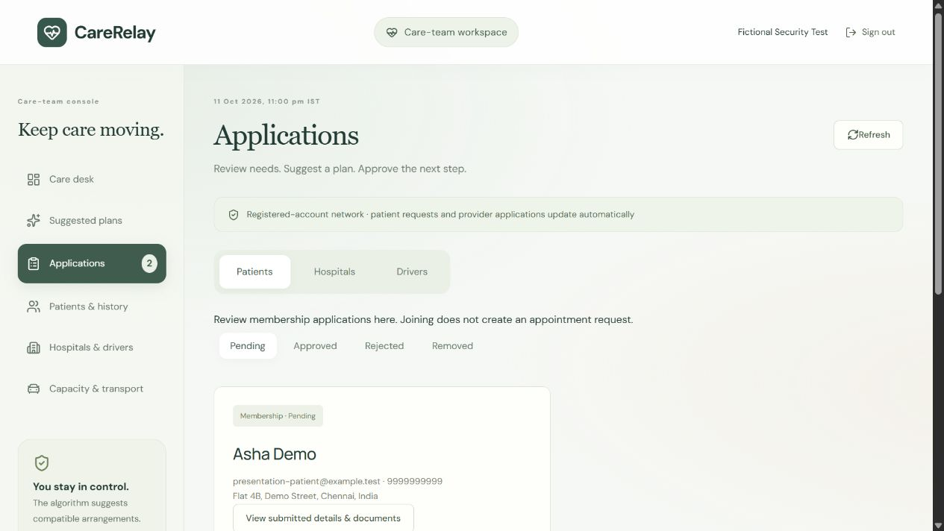
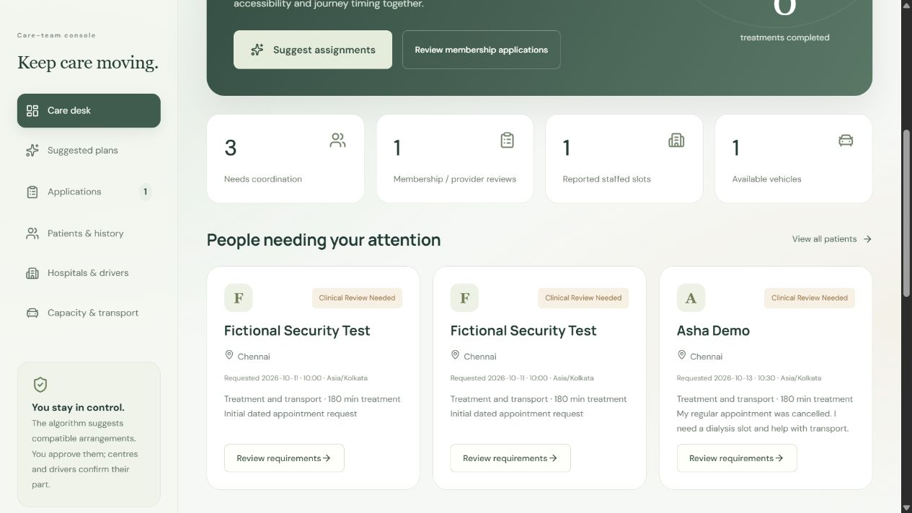
CARERELAY / THE CORRECT WORKFLOW
Membership first. Appointment requests separately.
1 Apply to join
2 Request care when needed
Registration enters patient applications.
Only active dated requests enter the care desk.
CareRelay · Project presentation · Test accounts shown
04
Notes:
Source: CareRelay v9 and docs/USER-GUIDE.md, docs/MATCHING-AUDIT.md, docs/ROLE-AUDIT.md, docs/VALIDATION.md. Screenshots: isolated test accounts, 11 October 2026.

Slide 5
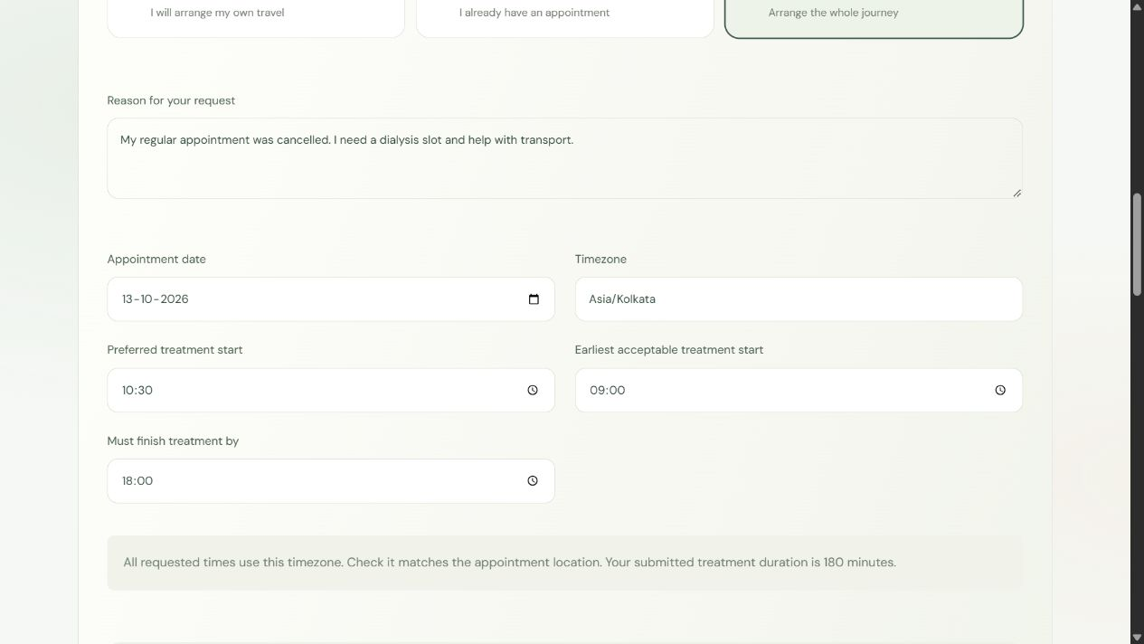
CARERELAY / PATIENT EXPERIENCE
Tell the team what you need, and when.
Choose services
Dialysis centre / machine, transport only, or both.
Give the context
Reason, date, timezone and preferred time.
Set a time window
Earliest start and finish / arrival deadline.
CareRelay · Project presentation · Test accounts shown
05
Notes:
Source: CareRelay v9 and docs/USER-GUIDE.md, docs/MATCHING-AUDIT.md, docs/ROLE-AUDIT.md, docs/VALIDATION.md. Screenshots: isolated test accounts, 11 October 2026.

Slide 6
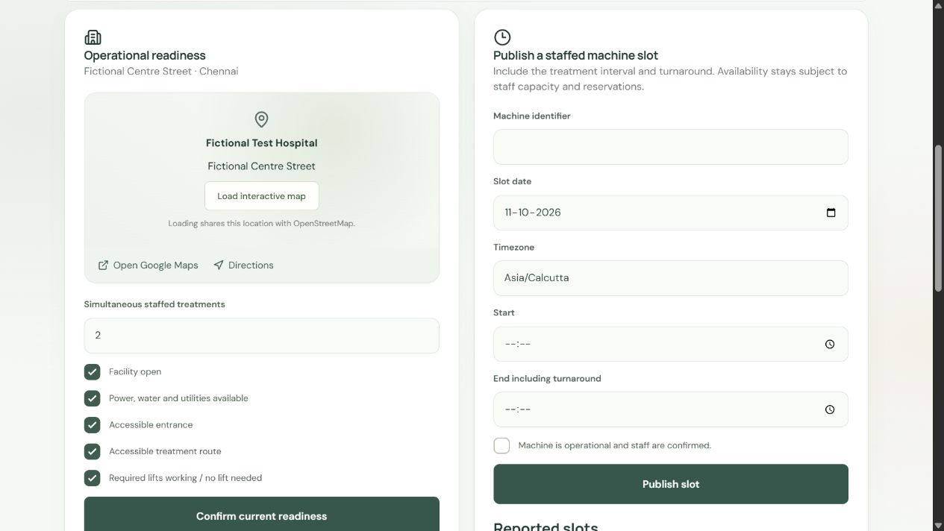
CARERELAY / PROVIDER AVAILABILITY
Availability comes from participating providers.
Hospitals report readiness, staff capacity and dated machine intervals.
Suitable treatment
Capability, accessible route, duration and turnaround.
Suitable transport
Date, hours, vehicle type, assistance, seats and payment.
CareRelay · Project presentation · Test accounts shown
06
Notes:
Source: CareRelay v9 and docs/USER-GUIDE.md, docs/MATCHING-AUDIT.md, docs/ROLE-AUDIT.md, docs/VALIDATION.md. Screenshots: isolated test accounts, 11 October 2026.

Slide 7
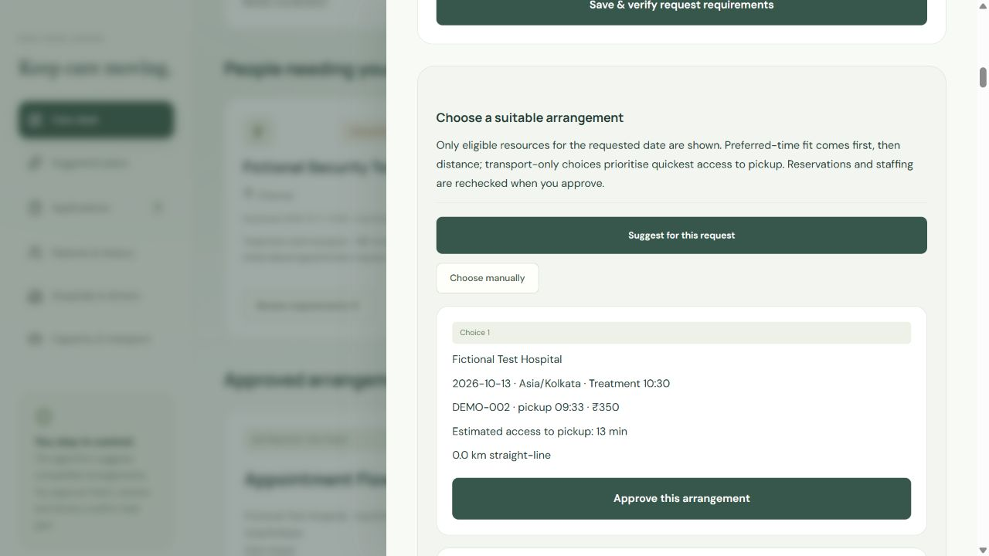
CARERELAY / MATCHING
Eligible first. Preferred time and proximity next.
1 Apply hard constraints
Approved membership, verified needs, consent, date and timezone.
2 Check compatible resources
Staffing, machines, accessibility, travel, budget and overlaps.
3 Rank feasible choices
Preferred-time fit, centre distance, vehicle access and fare.
Bulk planning uses a bounded search for coverage, priority and preference fit.
CareRelay · Project presentation · Test accounts shown
07
Notes:
Source: CareRelay v9 and docs/USER-GUIDE.md, docs/MATCHING-AUDIT.md, docs/ROLE-AUDIT.md, docs/VALIDATION.md. Screenshots: isolated test accounts, 11 October 2026. Manual centre choices rank time deviation before straight-line distance. Transport-only ranks vehicle access first. Bulk search maximizes feasible coverage, then urgency and fit. Search bounded at 40,000 nodes / 180 ms after preparation; not an unrestricted real-world optimum. Travel estimates are not live traffic.

Slide 8
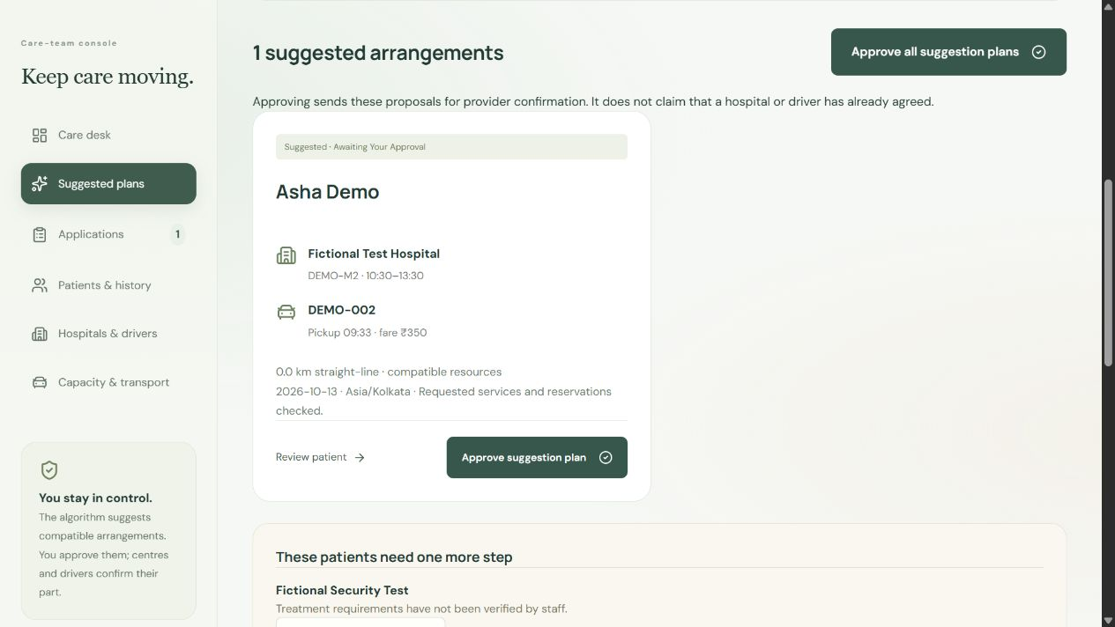
CARERELAY / ADMIN CONTROL
Review suggestions. Approve one or the whole plan.
Approval rechecks reservations, then asks providers to confirm.
Individual approval
Accept a suggestion for one patient.
Bulk approval
Approve compatible suggestions together.
Manual choice
Compare eligible options and choose an arrangement.
CareRelay · Project presentation · Test accounts shown
08
Notes:
Source: CareRelay v9 and docs/USER-GUIDE.md, docs/MATCHING-AUDIT.md, docs/ROLE-AUDIT.md, docs/VALIDATION.md. Screenshots: isolated test accounts, 11 October 2026. Approval rechecks reservations, then asks providers to confirm.

Slide 9
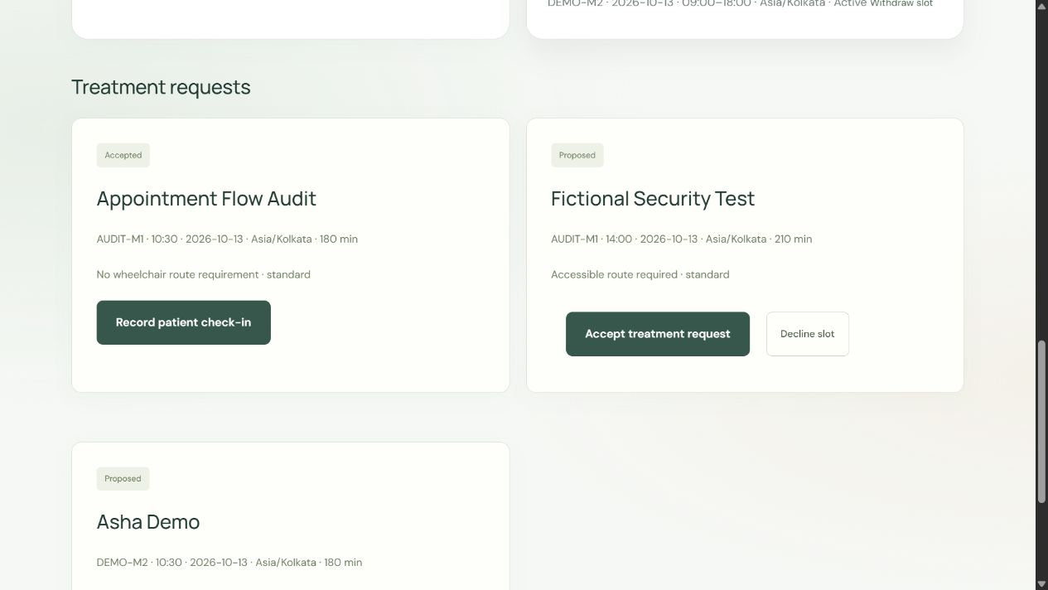
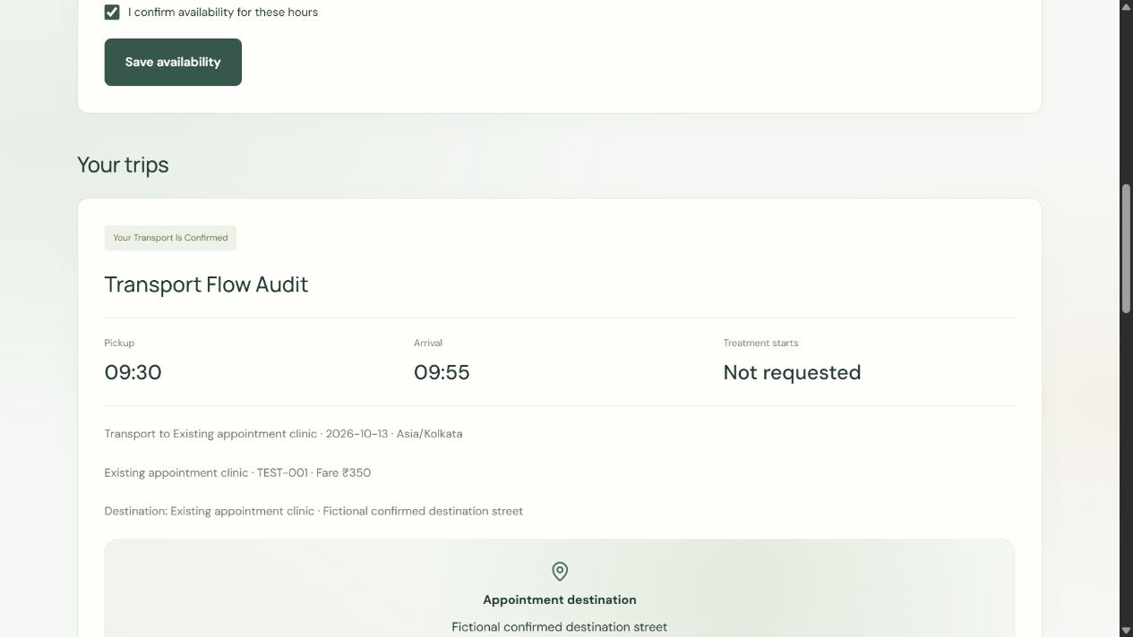
CARERELAY / PROVIDER CONFIRMATION
A proposed arrangement still needs agreement.
Hospital accepts the treatment slot.
Driver confirms the assigned trip.
Treatment-only follows the centre flow. Transport-only follows the driver flow.
CareRelay · Project presentation · Test accounts shown
09
Notes:
Source: CareRelay v9 and docs/USER-GUIDE.md, docs/MATCHING-AUDIT.md, docs/ROLE-AUDIT.md, docs/VALIDATION.md. Screenshots: isolated test accounts, 11 October 2026.

Slide 10
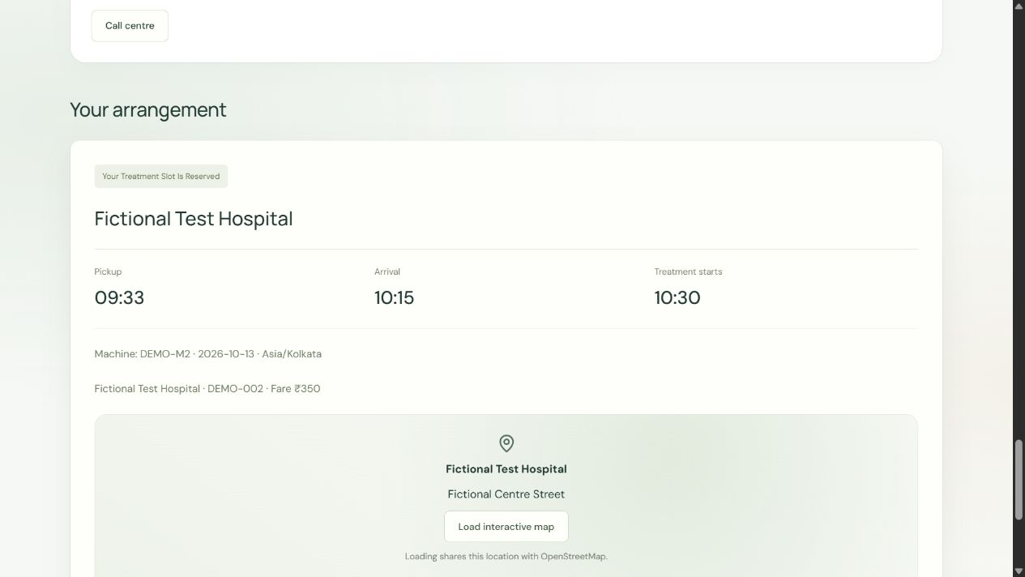
CARERELAY / PATIENT VISIBILITY
The next step stays visible to the patient.
Clear request receipt
The patient knows the submission reached the care team.
Appointment details
Centre, machine, date, timezone and journey timing.
Journey status
Track provider confirmation, arrival and treatment milestones.
CareRelay · Project presentation · Test accounts shown
10
Notes:
Source: CareRelay v9 and docs/USER-GUIDE.md, docs/MATCHING-AUDIT.md, docs/ROLE-AUDIT.md, docs/VALIDATION.md. Screenshots: isolated test accounts, 11 October 2026.

Slide 11
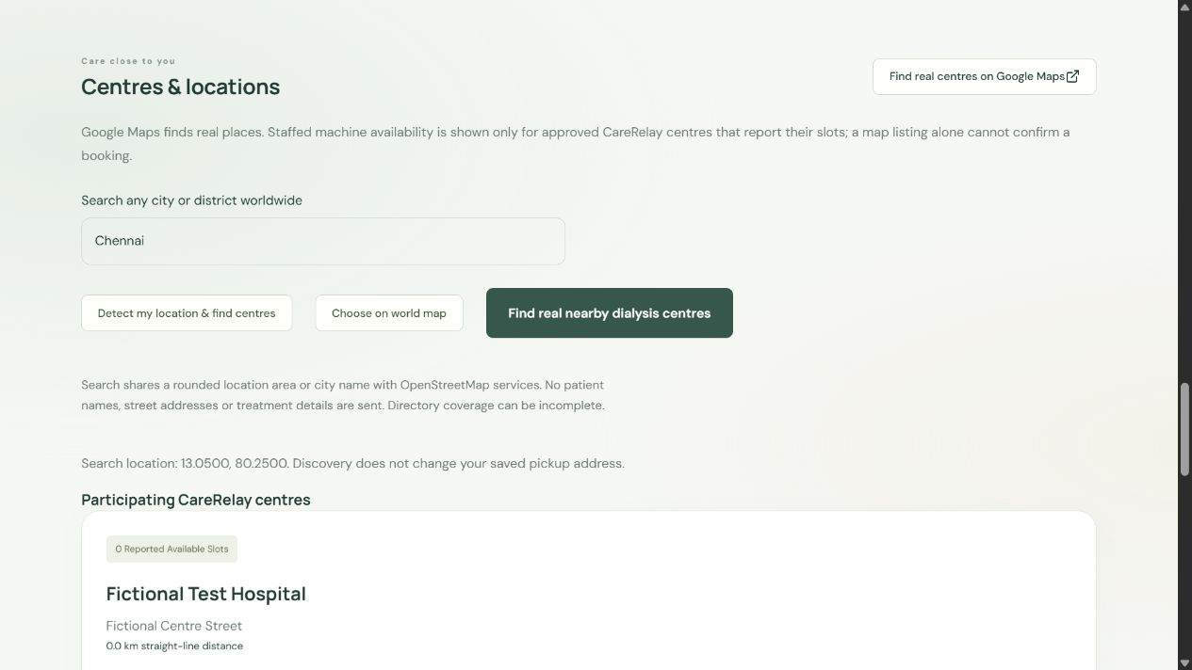
CARERELAY / WORLDWIDE DISCOVERY
Explore nearby dialysis centres worldwide.
Choose a location
Search a place, detect location or select a map pin.
Open a real listing
OpenStreetMap discovery and Google Maps links.
Confirm capacity
A directory listing does not guarantee a staffed slot or booking.
CareRelay · Project presentation · Test accounts shown
11
Notes:
Source: CareRelay v9 and docs/USER-GUIDE.md, docs/MATCHING-AUDIT.md, docs/ROLE-AUDIT.md, docs/VALIDATION.md. Screenshots: isolated test accounts, 11 October 2026.

Slide 12
CARERELAY / IMPLEMENTATION & VALIDATION
A working prototype with checks across the journey.
67
169
4 roles
Domain checks
API & security checks
Browser walkthroughs
Timing, compatibility, conflict
and scheduling rules.
Isolated account, document,
permission and request tests.
Patient, admin, hospital
and transport; desktop
and mobile layouts.
React / TypeScript · Cloudflare Workers + D1
Role-based access · Private documents
CareRelay · Project presentation · Test accounts shown
12
Notes:
Source: CareRelay v9 and docs/USER-GUIDE.md, docs/MATCHING-AUDIT.md, docs/ROLE-AUDIT.md, docs/VALIDATION.md. Screenshots: isolated test accounts, 11 October 2026. Counts from version 9 audit, not a production certification or universal absence-of-bugs claim. See docs/VALIDATION.md and docs/ROLE-AUDIT.md.

Slide 13
THE NEXT STEP
Keep care moving.
One request.
Human-reviewed matching.
Treatment and travel, coordinated.
Next: partner onboarding, supervised pilot feedback
and verified routing / provider integrations.
Live project
carerelay-dialysis-continuity.amplewand1.chatgpt.site
Notes:
Working prototype. Provider-reported availability; a listing or suggestion is not a confirmed booking. Human clinical review required. No live hospital integration, diagnosis or emergency dispatch. Proposed next steps are not implemented features. Live: https://carerelay-dialysis-continuity.amplewand1.chatgpt.site/

