Slide 1
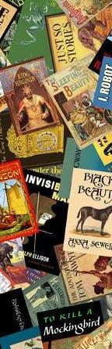
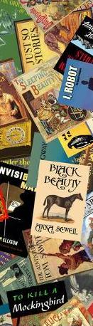
GOOD BOOKS RECOMMENDATIONS
Marketing Analytics
November 2019
Aadithya Anandaraj ● Sayesha Aravapalli ● Khyathi Balusu ● LaShay Fontenot ● Sadhana Koneni

Slide 2
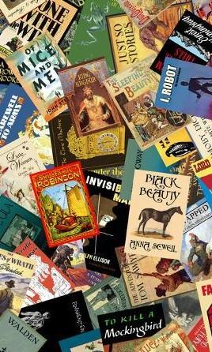
AGENDA
01
02
03
OBJECTIVE
DATA OVERVIEW
EXPLORATORY ANALYSIS
04
05
06
APPROACH
MODELS & RESULTS
RECOMMEND -ATIONS

Slide 3
OBJECTIVE
This analysis serves to create a recommendation system for books that allows for targeted marketing efforts
FOR READERS
What are the books you have not read that you are likely to rate highly?
What books should you market your book around (in store or online ads)?
FOR MARKETERS

Slide 4
DATA
The Good Books dataset, sourced from Kaggle, includes information and ratings on 10,000 books
BY THE NUMBERS
ATTRIBUTES
Descriptive information includes :
Book title
Author
Publication year
ISBN number
User tags
Language
10K
53K
Different
books
Unique
users
6M
1-5
Total
ratings
Ratings
scale
Notes:
international standard book number

Slide 5
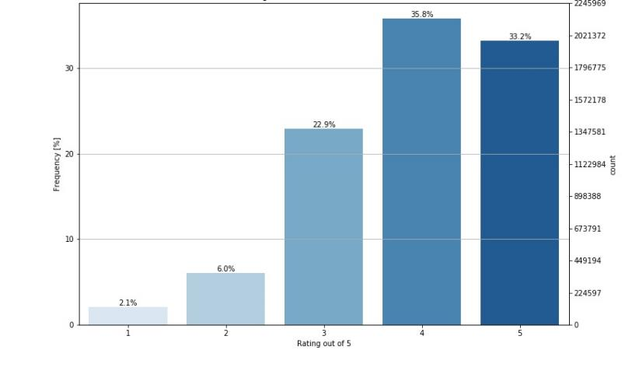
EDA
Diving deeper into the dataset we see that users have a tendency to provide good ratings
Distribution of Book Ratings
Takeaways
Nearly 70% of books were given a rating of 4 or 5
Only 220K, or 2% of ratings were a 1

Slide 6
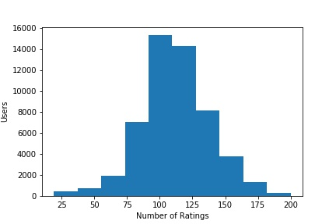
EDA
The average user has rated over 100 books
Distribution of Ratings per User
Takeaways
The most ratings received from a single user is 198
The average ratings per user is 110 ; seems very high - suspect bot activity
Notes:
12 books per year according to PEW research center

Slide 7
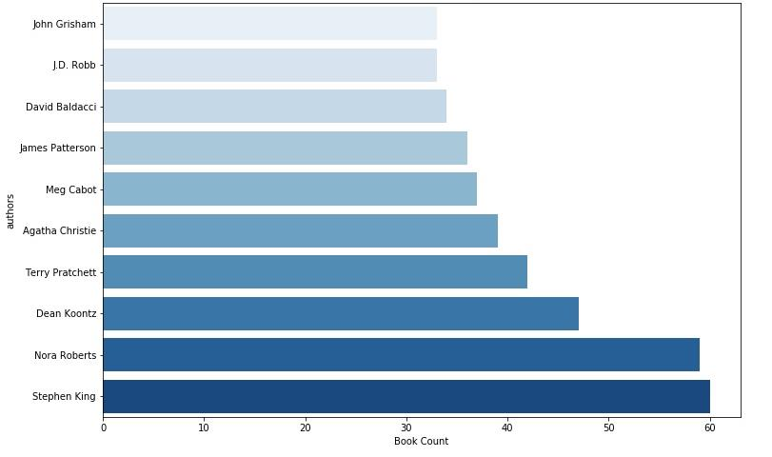
EDA
Stephen King and Nora Roberts are the most popular Authors in the dataset by book count (prior to sampling)
Top 10 Authors by Book Count

Slide 8
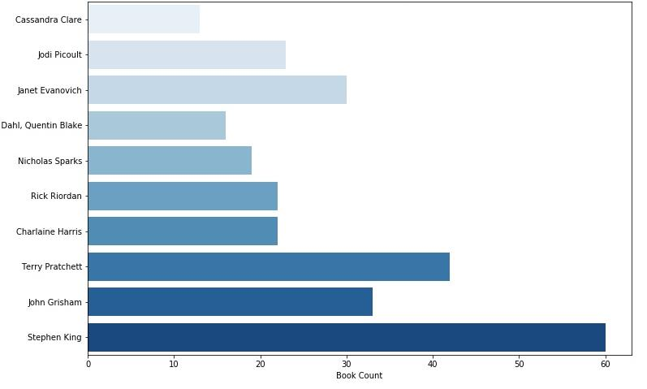
EDA
After sampling, the list of top 10 authors changes quite a bit
Top 10 Authors by Book Count
Notes:
Terry Pratchett

Slide 9



APPROACH
We used various similarity measures and methods of collaborative filtering to build our recommendation systems
CONTENT BASED
ITEM BASED
USER BASED
Finding similar books based on their titles and authors using cosine similarity on tf-idf matrix
Determining similar books based on ratings received from sample of users using cosine similarity
Finding similar users based on books read and ratings given using cosine similarity

Slide 10
POPULARITY BASED RECOMMENDATIONS
Popularity based systems recommend the books that are most rated
Process & Considerations
Book titles are sorted based on the total number of ratings received from users
Produce recommendation of the Top 5 most rated books in the set
This system recommends the most popular titles without considering any other information
This method is naive, and not personalized to the user in any way
Recommendations
1
2
3
4
5
The Hunger Games #1
Harry Potter and the Sorcerer’s Stone
Twilight
The Great Gatsby
The Hunger Games #2

Slide 11
CONTENT BASED RECOMMENDATIONS
This recommends books based on the content of book and does not need any rating information
TITLE BASED
AUTHOR BASED
TITLE + AUTHOR
USER INPUT
USER INPUT
USER INPUT
Harry Potter Boxed Set, Books 1-5
Harry Potter Book ID : 3275
India After Gandhi Book ID : 7844
RECOMMENDATIONS
RECOMMENDATIONS
RECOMMENDATIONS
The Harry Potter Collection 1-4 (score:0.445)
Harry Potter and the Deathly Hallows (score:1.0)
A History of the World in 6 Glasses by author Tom Standage (score:0.118)
Harry Potter Box set 1-7 (score:0.440)
Harry Potter Boxed Set, Books 1-5 (score:1.0)
The Ascent of Money: A Financial History of the World by author Niall Ferguson (score:0.093)
Harry Potter and the Goblet of Fire (score:0.438)
The Harry Potter Collection 1-4 (score:1.0)
A Little History of the World by author E.H. Gombrich, Caroline Mustill, Clifford Harper (score:0.086)
Notes:
Ideal to be done on the book descriptions
Solves cold-start problem
Similarity measure : Cosine Similarity
Based on user input of book details, recommends similar books

Slide 12
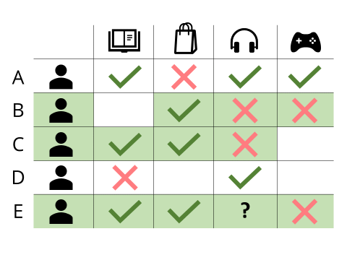
COLLABORATIVE FILTERING
Collaborative filtering models are based on the premise that the interests of a user can be predicted with the collection of preferences of other users
Companies that employ this model include Amazon, Facebook, Twitter, LinkedIn, Spotify, Google News and Last.fm
Disadvantages:
A successful implementation, however, often requires a sizable volume of data, creating the so-called “Cold Start Problem.”
Notes:
35 percent of what consumers purchase on Amazon and 75 percent of what they watch on Netflix come from product recommendations based on such algorithms. - https://www.mckinsey.com/industries/retail/our-insights/how-retailers-can-keep-up-with-consumers
https://techcrunch.com/2015/09/28/the-evolving-landscape-of-recommendation-systems/

Slide 13
Implementation Challenges
Implementation of Collaborative Filtering models can bring various challenges depending on the data being used
1
Challenge: Sparse matrix
Solution: Masking and creating the finite vectors for computing similarity
2
Challenge: Size of the data
Solution: Reduce data from 6M rows with ratings from 53k users, to 2k users
Remove the top and bottom 35th percentile of the users
Random sampling from the filtered users
Removing books with fewer than 10 users

Slide 14
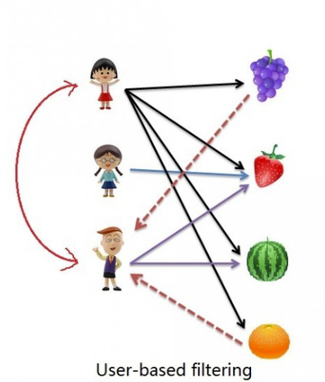
USER BASED COLLABORATIVE FILTERING
Identify similar users - Cosine Similarity or Correlation
Adjust the ratings by the mean rating
Calculate the weighted average of the ratings for the book
Recommend the book if the predicted rating is above the mean rating by the user of interest
Replace correlation with 0 when it is ‘nan’ for users who have given the same rating to all books
Results:
Similarity Metric | MAE
Cosine similarity | 0.69
Correlation | 0.70
Notes:
user - 9554

Slide 15
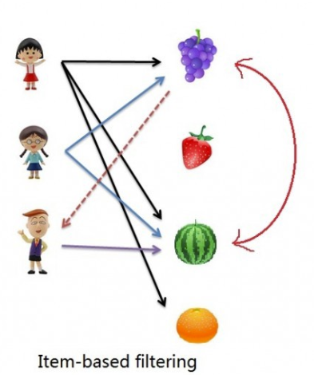
ITEM BASED COLLABORATIVE FILTERING
Calculate correlation/cosine similarity between books based on common users only
Find mean rating for the user
Predict rating the user would give by calculating weighted average rating
Recommend top books with highest rating
Replace correlation with 0 when it is ‘nan’ for users who have given the same rating to all books
Results:
Similarity Metric | MAE
Cosine similarity | 0.68
Correlation | 0.69

Slide 16
CREATING CLUSTERS
Clusters of similar books were created using K-means segmentation
Assumption :
Authors do not often cross genres
Approach :
TF-IDF matrix of title and author fields
K-means clustering algorithm to create 8 segments
Cross-validation of number of segments with elbow plot
Clusters named using top Authors’ collections of books
Results :
Top cluster (Cluster 7) includes 4398 books
Cluster 0 includes 741 books
Cluster 7
Sci-Fi / Thriller
Notable Authors
Terry Pratchett , Dean Koontz, Nora Roberts
Cluster 0
American Fiction
Meg Cabot, Michael Connelly, David Baldacci
Cluster 6
Novels
John Grisham, Nicholas Sparks, John Flanagan
Notes:
Stephen King rules cluster 5

Slide 17
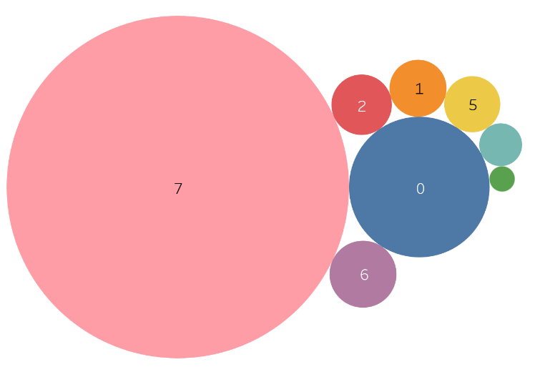

CREATING CLUSTERS – A CLOSER LOOK
The top segment by book count includes nearly half of all books in the set
Cluster
Books
 | 7 | 4,398
 | 0 | 741
 | 6 | 168
 | 2 | 137
 | 1 | 122
 | 5 | 118
 | 3 | 69
 | 4 | 24
Notes:
Stephen King rules cluster 5

Slide 18
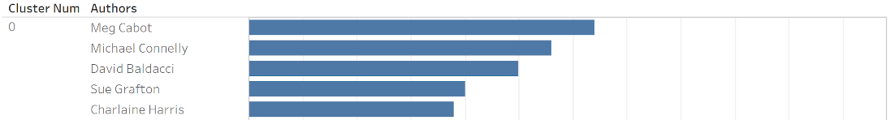
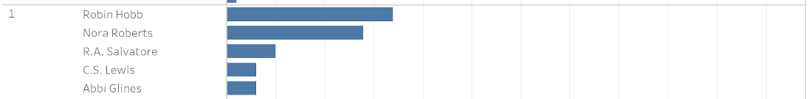
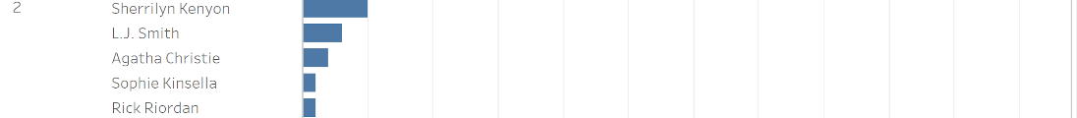
CREATING CLUSTERS – A CLOSER LOOK
Clusters were named based on the top authors in each cluster
Notes:
Stephen King rules cluster 5

Slide 19
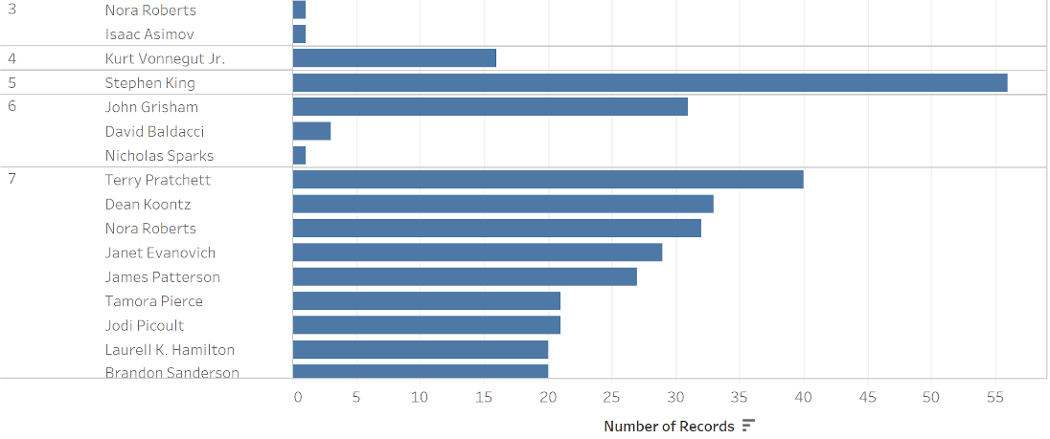
CREATING CLUSTERS – A CLOSER LOOK
Top authors in each cluster continued
Notes:
Stephen King rules cluster 5

Slide 20
SUMMARY OF RESULTS
Recommendation accuracy results with the test sets from Cluster 7 and Cluster 0 using different training sets
Type | Similarity metric | Test Set | MAE - Clustering | MAE - No clustering
User based | Cosine Similarity | Sci-Fi/Thriller | 0.68 | 0.69
User based | Correlation | Sci-Fi/Thriller | 0.68 | 0.68
User based | Cosine Similarity | American Fiction | 0.57 | 0.65
User based | Correlation | American Fiction | 0.52 | 0.67
Item based | Cosine Similarity | Sci-Fi/Thriller | 0.67 | 0.67
Item based | Correlation | Sci-Fi/Thriller | 0.69 | 0.69
Item based | Cosine Similarity | American Fiction | 0.56 | 0.63
Item based | Correlation | American Fiction | 0.59 | 0.61
Notes:
CLuster 7 - Sci-Fi/Thriller
Cluster 0 - American Fiction
better visibility for a lot of books

Slide 21
RECOMMENDATIONS

Slide 22


BOOK RECOMMENDATIONS
Filter out the book titles the user has not read
Predict ratings for the list of possible recommendations
Produce recommendation list of top 5 books

Slide 23
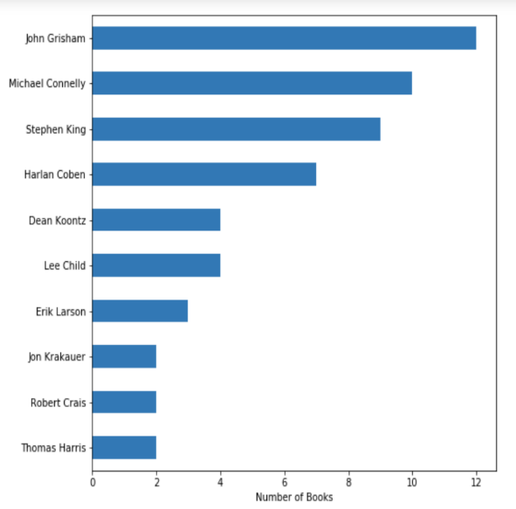
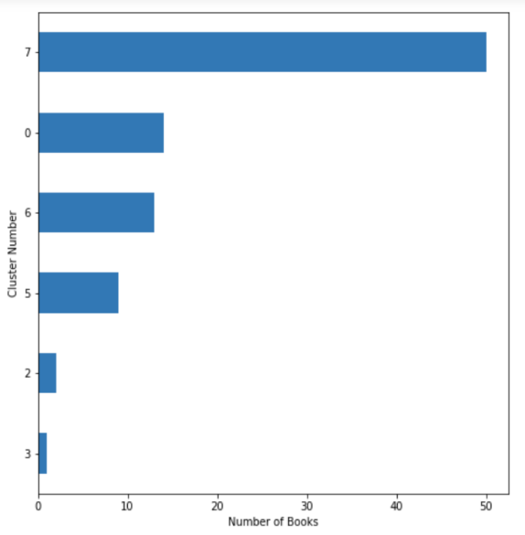
User 9554 Profile
User 9554 is being used as the demonstration case for user and item based recommendations
Authors of Books Read By User
Cluster Distribution of Books Read

Slide 24
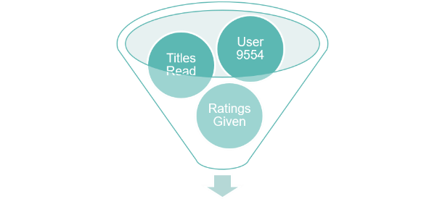
User Based: All Books
 | Title | Author | Cluster
1 | Thorn Queen (Dark Swan, #2) | Richelle Mead | 7 - Sci-Fi/Thriller
2 | Everlost (Skinjacker, #1) | Neal Shusterman | 7 - Sci-Fi/Thriller
3 | Demon from the Dark (Immortals After Dark #10) | Kresley Cole | 7 - Sci-Fi/Thriller
4 | Toll the Hounds (The Malazan Book of the Fallen #8) | Steven Erikson | 0 - American Fiction
5 | A River Runs Through It and Other Stories | Norman Maclean | 7 - Sci-Fi/Thriller

Slide 25
User Based: Sci-Fi/Thriller
 | Title | Author
1 | Thorn Queen (Dark Swan, #2) | Richelle Mead
2 | Demon from the Dark (Immortals After Dark #10) | Kresley Cole
3 | The Seeing Stone (The Spiderwick Chronicles, #2) | Holly Black, Tony DiTerlizzi
4 | Icefire (The Last Dragon Chronicles, #2) | Chris d'Lacey
5 | Fables, Vol. 9:Sons of Empire | Bill Willingham

Slide 26
User Based: American Fiction
 | Title | Author
1 | Flash Boys: A Wall Street Revolt | Michael Lewis
2 | Toll the Hounds (The Malazan Book of the Fallen #8) | Steven Erikson
3 | The Crown Tower (The Riyria Chronicles, #1) | Michael J. Sullivan
4 | Lunar Park | Bret Easton Ellis
5 | Revelations (Blue Bloods, #3) | Melissa de la Cruz

Slide 27
Item Based: All Books
 | Title | Author | Cluster
1 | Thirst No. 1: The Last Vampire, Black Blood, and Red Dice (Thirst, #1) | Christopher Pike | 7 - Sci-Fi/Thriller
2 | Things Not Seen (Things, #1) | Andrew Clements | 7 - Sci-Fi/Thriller
3 | The Valley of Fear | Arthur Conan Doyle, David Timson | 0 - American Fiction
4 | The Twilight Saga Complete Collection (Twilight, #1-4 ) | Stephenie Meyer | 7 - Sci-Fi/Thriller
5 | The Ship Who Sang (Brainship, #1) | Anne McCaffrey | 7 - Sci-Fi/Thriller
Notes:
CLuster 7 - Sci-Fi/Thriller
Cluster 0 - American Fiction

Slide 28
Item Based: Sci-Fi/Thriller
 | Title | Author
1 | Thirst No. 1: The Last Vampire, Black Blood, and Red Dice(Thirst, #1) | Christopher Pike
2 | Things Not Seen (Things, #1) | Andrew Clements
3 | These Broken Stars (Starbound, #1) | Amie Kaufman
4 | The World of Ice & Fire: The Untold History of Westeros and the Game of Thrones | George R.R. Martin
5 | The Twilight Saga Complete Collection (Twilight, #1-4 ) | Stephenie Meyer
Notes:
CLuster 7 - Sci-Fi/Thriller
Cluster 0 - American Fiction

Slide 29
Item Based: American Fiction
 | Title | Author
1 | X (Kinsey Millhone, #24) | Sue Grafton
2 | Witch & Wizard (Witch & Wizard, #1) | James Patterson, Gabrielle Charbonnet
3 | Undone (Will Trent, #3) | Karin Slaughter
4 | V is for Vengeance (Kinsey Millhone, #22) | Sue Grafton
5 | Unseen (Will Trent, #7) | Karin Slaughter

Slide 30
APPENDIX

Slide 31
ASSOCIATION RULES
Using a market basket approach, we assess what books readers are likely to rate highly, given a ‘basket’ of books typically rated highly
Process
Pull out highly rated books - rated a 5
Create ‘basket’ of books for each user
(# of books range from 1 – 198)
Adjust parameters of apriori model : support, confidence, length
Produce set of rules based on set parameters
Summary
This process produced anywhere from 0 to 1600 rules based on parameters given
Initially, a vast majority of rules created involved books from the Harry Potter series
This is most likely because of the popularity of the series. So we removed these books from the set and determined new sets of rules
After removing HP books, the new rules typically included The Hunger Games, Lord of the Rings, and Game of Thrones books
In summary, this analysis told us that if a user rates a book in a series a 5, they are very likely to rate another book in that series highly

Slide 32
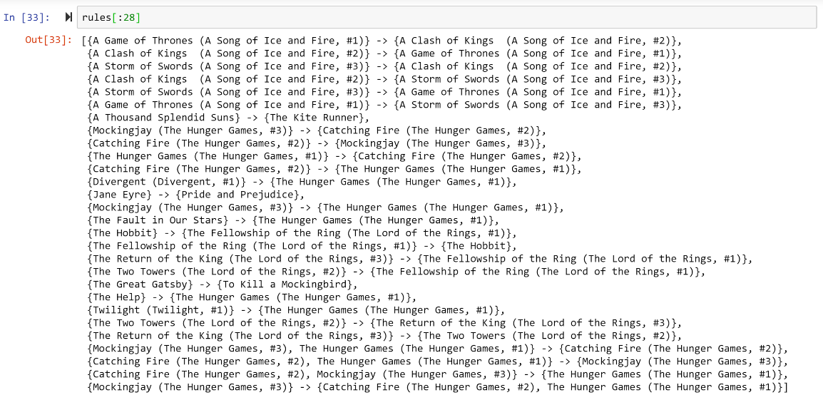
ASSOCIATION RULE EXAMPLE OUTPUT

Slide 33
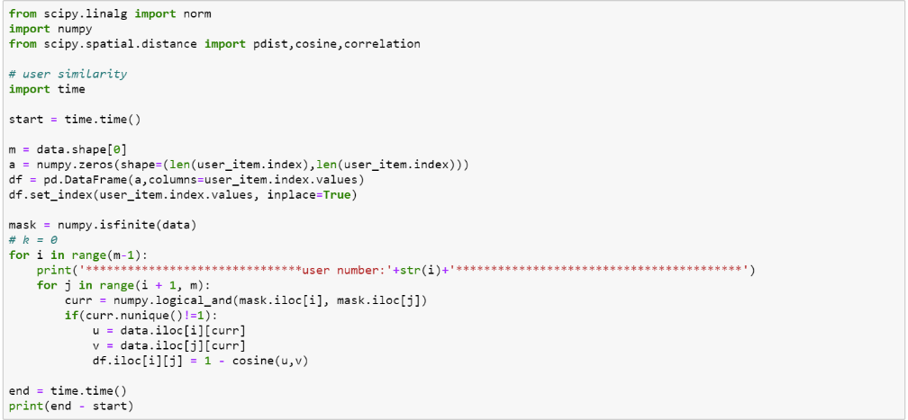
SPARSE MATRICES & SIMILARITY
Masking the vectors to get the finite vectors to calculate cosine similarity (for correlation replace cosine(u,v) with correlation(u,v))

Slide 34
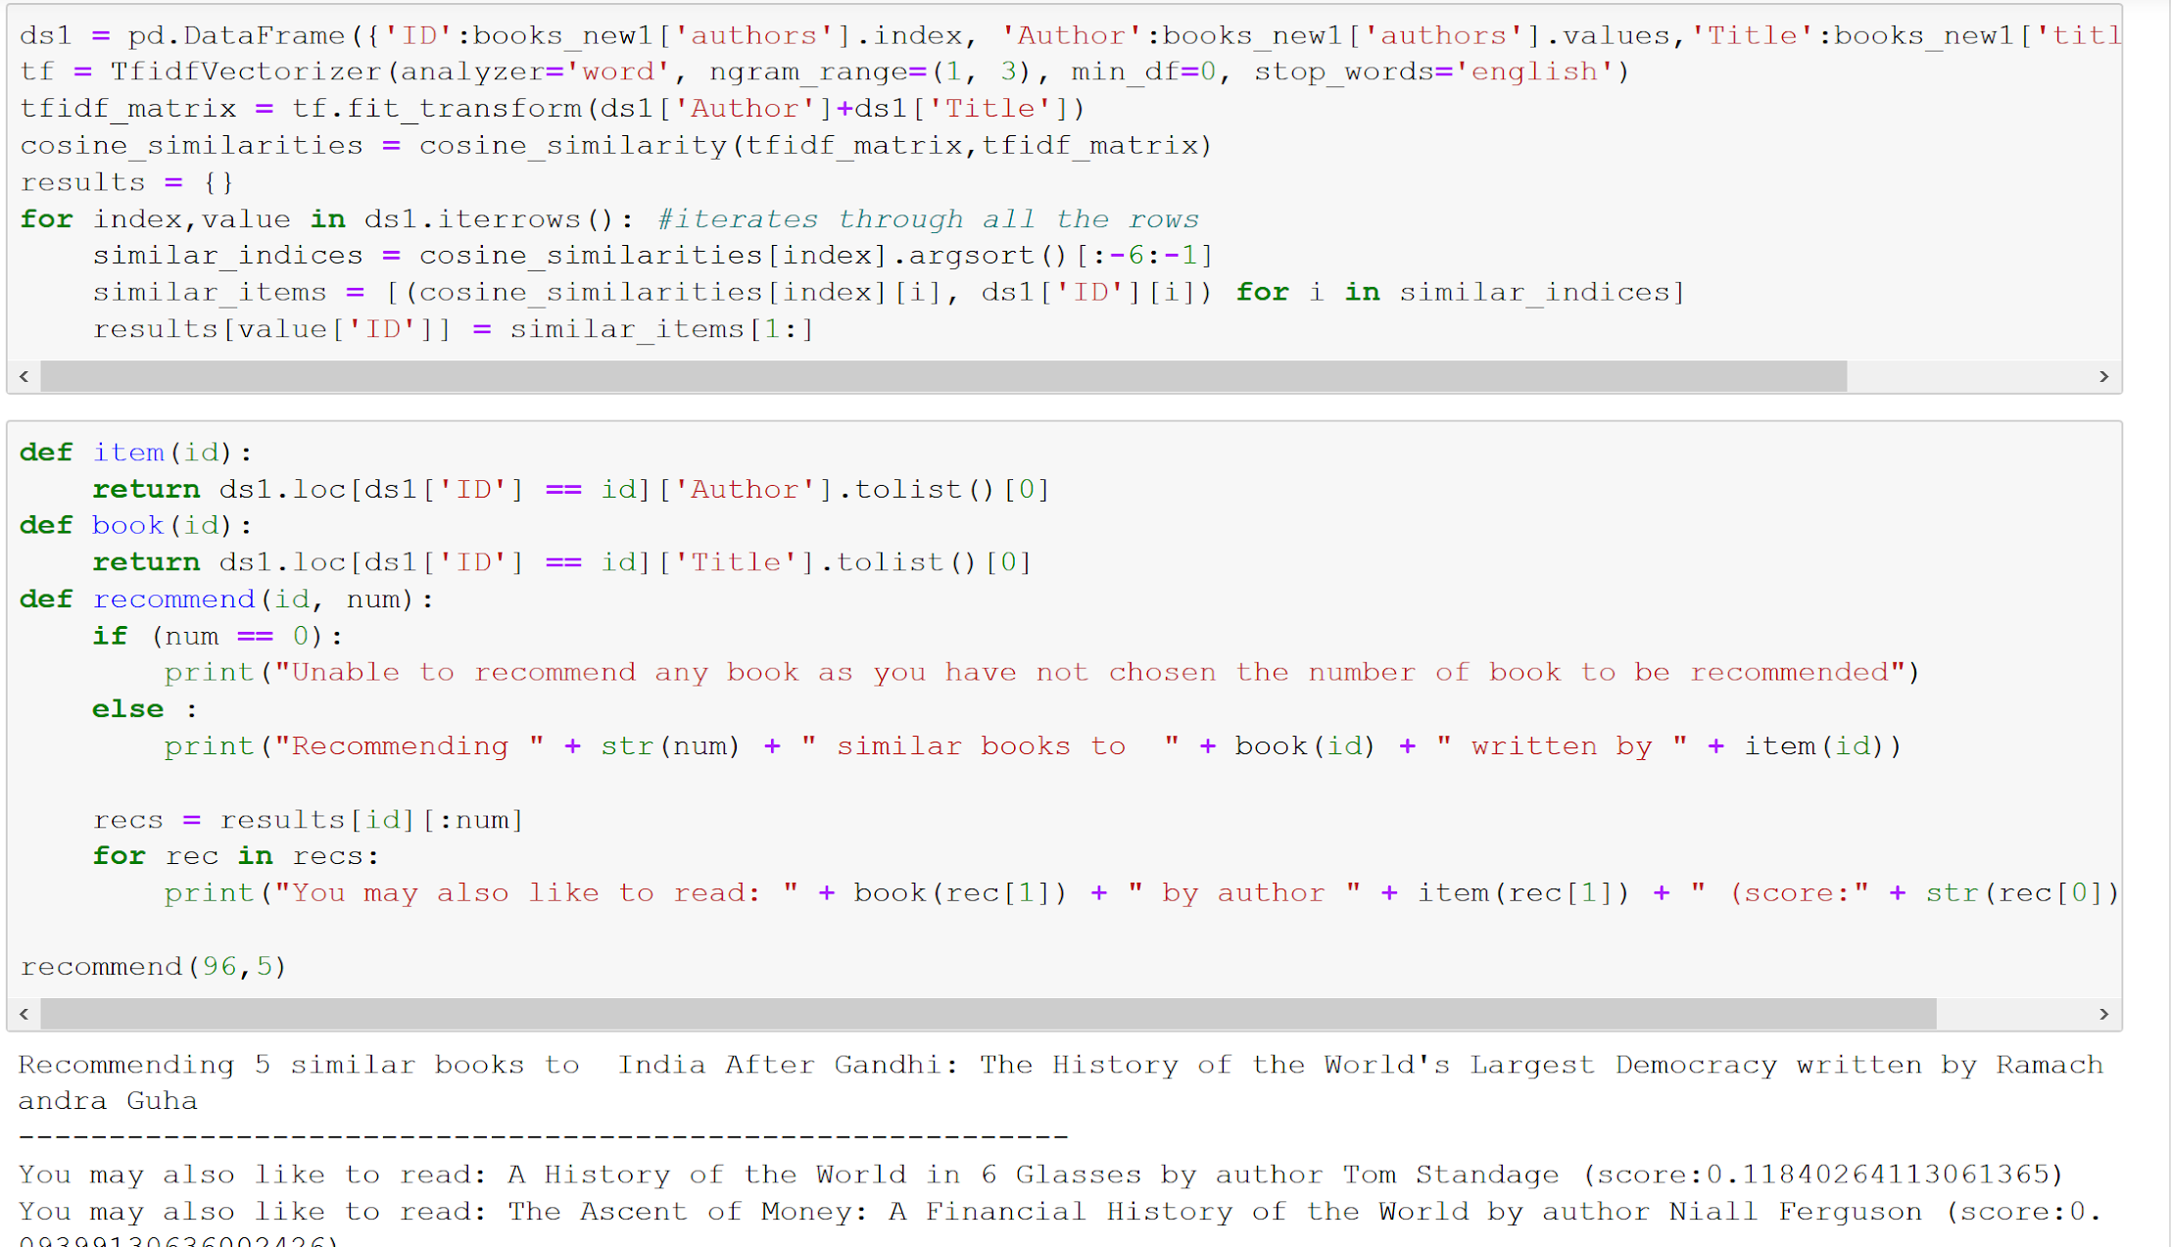
COSINE SIMILARITY ON TF-IDF MATRIX
Building the TF-IDF matrix to use cosine similarity and find similar books

Slide 35
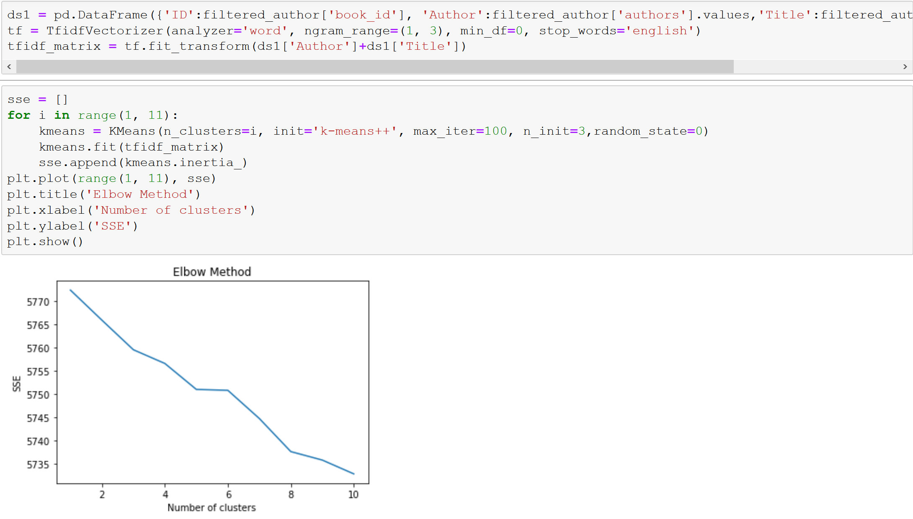
SEGMENTATION
Clustered books using K-means and mini-batch K-means on TF-IDF scores of titles and author.
Mini Batch K-means:
Uses random batches of data
Each iteration a new random sample is used to update the clusters till convergence
Faster than k-means
K-means:
Iterates over entire data in a step
Each iteration is longer as it updates centroids based on clusters
Used this after we reduced the data size
Observed better clusters compared to Mini batch k-means
We selected num_clusters = 8 as the reduction in SSE is very low and computational time increased significantly. So, as a trade-off between accuracy and computation, we stopped at 8 clusters.

