Slide 1
LOGISTICS OBJECT DETECTION & REASONING API
End-to-End Computer Vision System from RT-DETR Fine-Tuning to AWS Deployment
LOGISTICS OBJECT DETECTION & REASONING API
An End-to-End Computer Vision System from RT-DETR Fine-Tuning to AWS EC2 Cloud Deployment
Core System Components & Deliverables:
• RT-DETR-L Vision Transformer fine-tuned on 5 logistics domain classes.
• 4-Stage Post-Processing Pipeline (Class NMS, Containment IoS, Edge Filter, Cross-Class IoU).
• Deterministic Natural Language Reasoning API with 6 intents & strict refusal guardrails.
• Decoupled Microservice Architecture (FastAPI + Docker + Nginx Reverse Proxy).
• Infrastructure as Code (Terraform) live on AWS EC2 ap-south-1 Mumbai (http://13.233.255.22).
RAP Pre-Hackathon Submission | Slide 1 of 14
Notes:
WHAT TO SAY:
Welcome. Today I am presenting the Logistics Object Detection & Reasoning API—an end-to-end computer vision and deterministic reasoning system built for warehouse automation.
TECHNICAL SUMMARY:
This project fine-tunes an RT-DETR-L vision transformer across 5 logistics domain classes, implements a custom 4-stage post-processing guardrail, builds a deterministic natural-language reasoning API, containerizes the stack via Docker, and deploys it live on AWS EC2 with Terraform.
DEFENSE Q&A:
Q: Why build an end-to-end system instead of just training an object detection model?
A: In real-world ML engineering, a raw model checkpoint is insufficient. Production deployment requires domain post-processing (to eliminate sub-region duplicates), structured API contracts, confidence guardrails to prevent hallucination, containerization, and cloud infrastructure.

Slide 2
PROBLEM & OBJECTIVE
Real-World Logistics Vision & Bounded Natural Language Reasoning
Real-World Logistics Problem
• Dense, cluttered warehouse environments with overlapping objects.
• Domain requirement includes non-COCO class (wood pallet).
• Need exact bounding boxes + confidence scores for inventory tracking.
• Requirement for natural language Q&A without accepting LLM hallucinations.
• Must provide a reliable, self-contained, production-ready REST API.
System Objective Flow
1. Input Image: Upload warehouse scene (640x640 resolution).
2. Object Detection: RT-DETR-L extracts objects & bounding boxes.
3. Structured Output: 4-stage rule engine cleans raw predictions.
4. Natural Language Question: User queries image context.
5. Deterministic Reasoning: Intent router answers or cleanly refuses.
RAP Pre-Hackathon Submission | Slide 2 of 14
Notes:
WHAT TO SAY:
Warehouses are complex environments. Standard COCO object detectors fail on custom domain classes like wood pallets and struggle with dense box stacking. Furthermore, business users want to ask natural language questions without risk of AI hallucination.
TECHNICAL EXPLANATION:
Our objective was dual-fold: 1) Extract high-precision logistics bounding boxes, and 2) Build a bounded, deterministic reasoning layer that refuses to answer when visual evidence is insufficient.
DEFENSE Q&A:
Q: Why include wood pallet as a primary class?
A: Wood pallets are ubiquitous in supply chains but missing from COCO's 80 classes. Transfer learning on domain-specific logistics data was essential.

Slide 3
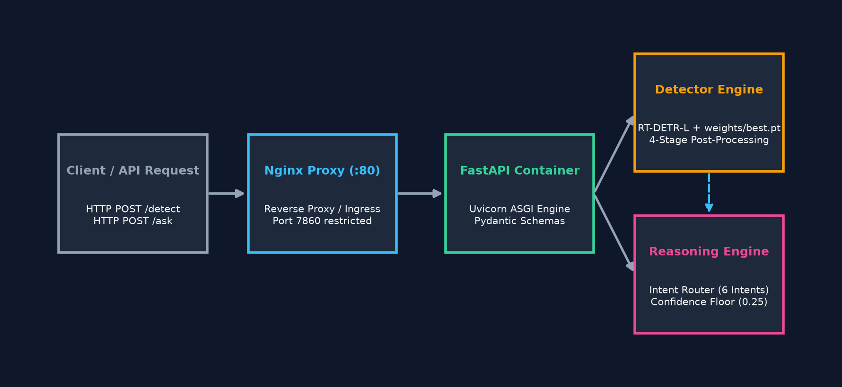
SOLUTION OVERVIEW
Dual-Endpoint Computer Vision & Reasoning Microservice Architecture
Key System Insights
• Decoupled Microservice: FastAPI framework with async Uvicorn engine.
• Dual Primary Endpoints: POST /detect for raw bounding boxes; POST /ask for Q&A.
• Operation Support: GET /health for container liveness; GET /classes for schema discovery.
• Nginx Reverse Proxy: Exposes Port 80 publicly while keeping Port 7860 bound locally.
RAP Pre-Hackathon Submission | Slide 3 of 14
Notes:
WHAT TO SAY:
Here is our end-to-end architecture. The solution exposes two primary endpoints: /detect for structured bounding boxes, and /ask for natural language query processing.
TECHNICAL EXPLANATION:
Traffic enters through Nginx on Port 80, proxied internally to FastAPI on Port 7860. Detections pass through a 4-stage post-processing pipeline before entering the intent-routed reasoning engine.
DEFENSE Q&A:
Q: Why decouple /detect and /ask instead of combining them into one endpoint?
A: Modular design allows frontend clients to retrieve raw bounding box overlays independently, cache detection results, or run downstream analytics without re-invoking the reasoning parser.

Slide 4
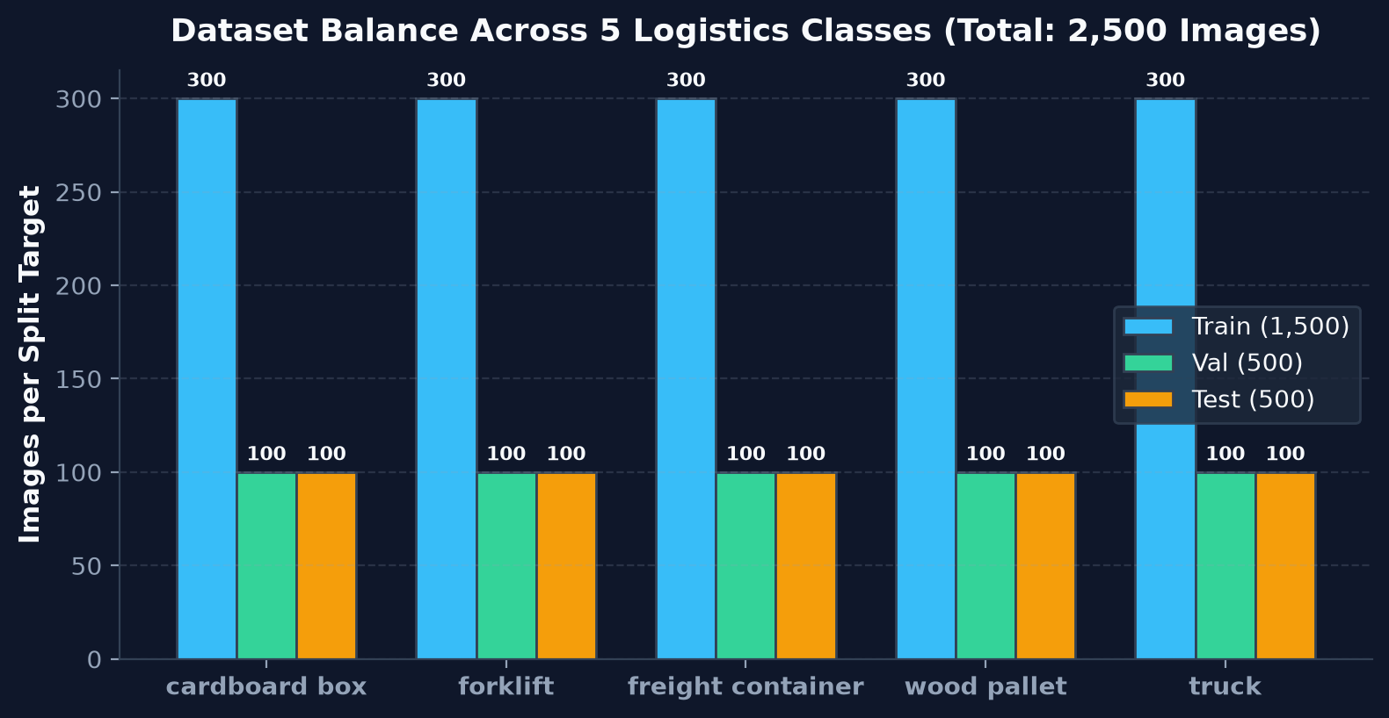
DATASET & CLASS DESIGN
2,500 Images across 5 Core Logistics Domain Classes
Key Breakdown
• 5 Logistics Classes: cardboard box, forklift, freight container, wood pallet, truck.
• 2,500 Total Images: Class-balanced splits across train, validation, and test.
• Train Set: 1,500 images (300 target images per class filter).
• Validation Set: 500 images (100 target images per class filter).
• Held-Out Test Set: 500 images (100 target images per class filter).
RAP Pre-Hackathon Submission | Slide 4 of 14
Notes:
WHAT TO SAY:
Our dataset comprises 2,500 total images evenly divided across 5 core logistics classes: cardboard box, forklift, freight container, wood pallet, and truck.
TECHNICAL EXPLANATION:
The data split strictly separates 1,500 training, 500 validation, and 500 held-out test images. Sampling ensured 300 training images and 100 evaluation images per class filter.
DEFENSE Q&A:
Q: Do these numbers imply strictly single-class images?
A: No, images are sampled based on primary class filters, meaning multi-object logistics scenes contain natural co-occurrences while ensuring balanced class representation across splits.

Slide 5
MODEL ARCHITECTURE: RT-DETR-L
Real-Time DEtection TRansformer for High-Efficiency Bounding Box Regression
Why RT-DETR-L?
• Transformer-Based Detector: End-to-end object query matching.
• HGNet-v2 Backbone: Multi-scale feature extraction (B0-B5 hierarchy).
• Hybrid Encoder: Intra-scale interaction & cross-scale feature fusion.
• NMS-Free Decoder: Eliminates traditional anchor hyperparameter tuning.
• Ultralytics Integration: COCO-pretrained weights (rtdetr-l.pt).
Architecture Benefits
1. Global Context Awareness: Self-attention handles large-scale objects.
2. High Efficiency: Designed specifically for real-time vision workloads.
3. Robust Transfer Learning: Pretrained COCO representations accelerate domain convergence.
4. Fine-Tuning Stability: Bipartite Hungarian matching stabilizes bounding box regression.
RAP Pre-Hackathon Submission | Slide 5 of 14
Notes:
WHAT TO SAY:
We selected RT-DETR-L, a Real-Time DEtection TRansformer developed by Baidu and implemented in Ultralytics. Unlike anchor-based CNNs, RT-DETR uses transformer decoders with learned object queries.
TECHNICAL EXPLANATION:
The HGNet-v2 backbone extracts hierarchical features, processed through a hybrid encoder. The transformer decoder matches object queries directly to ground truth bounding boxes.
DEFENSE Q&A:
Q: Why choose RT-DETR over YOLOv8?
A: RT-DETR combines transformer global context awareness with near-YOLO inference speeds, eliminating anchor box heuristics and providing superior bounding box localization for large logistics assets.

Slide 6
EXPERIMENT CONFIGURATION
Hyperparameters, Hardware, and Checkpoint Selection
Model
RT-DETR-L
Resolution
640 × 640
Batch Size
2
Configured Epochs
50
Completed Epochs
10
Deployed Checkpoint
epoch0.pt (Epoch 1)
Best Fitness
0.40391 (mAP50-95)
Initial LR
0.0001 (AdamW)
Weight Decay
0.0005
Augmentations
Mosaic 1.0, HSV, Scale
Hardware
NVIDIA RTX 3050 6GB
Training Time
3,235.52s (~53.9m)
RAP Pre-Hackathon Submission | Slide 6 of 14
Notes:
WHAT TO SAY:
Here is our experiment configuration dashboard. Training was executed locally on an NVIDIA RTX 3050 GPU for 3,235 seconds (~54 minutes).
TECHNICAL EXPLANATION:
While 50 epochs were configured, training was completed at epoch 10. The deployed best.pt checkpoint corresponds to epoch 1 (epoch0.pt), which achieved the highest Ultralytics validation fitness (0.40391).
DEFENSE Q&A:
Q: Why is best.pt from Epoch 1 instead of Epoch 10?
A: Ultralytics evaluates fitness as a weighted combination of mAP50 and mAP50-95. Epoch 1 achieved optimal validation generalization (fitness 0.40391) before subtle validation degradation occurred in later epochs.

Slide 7
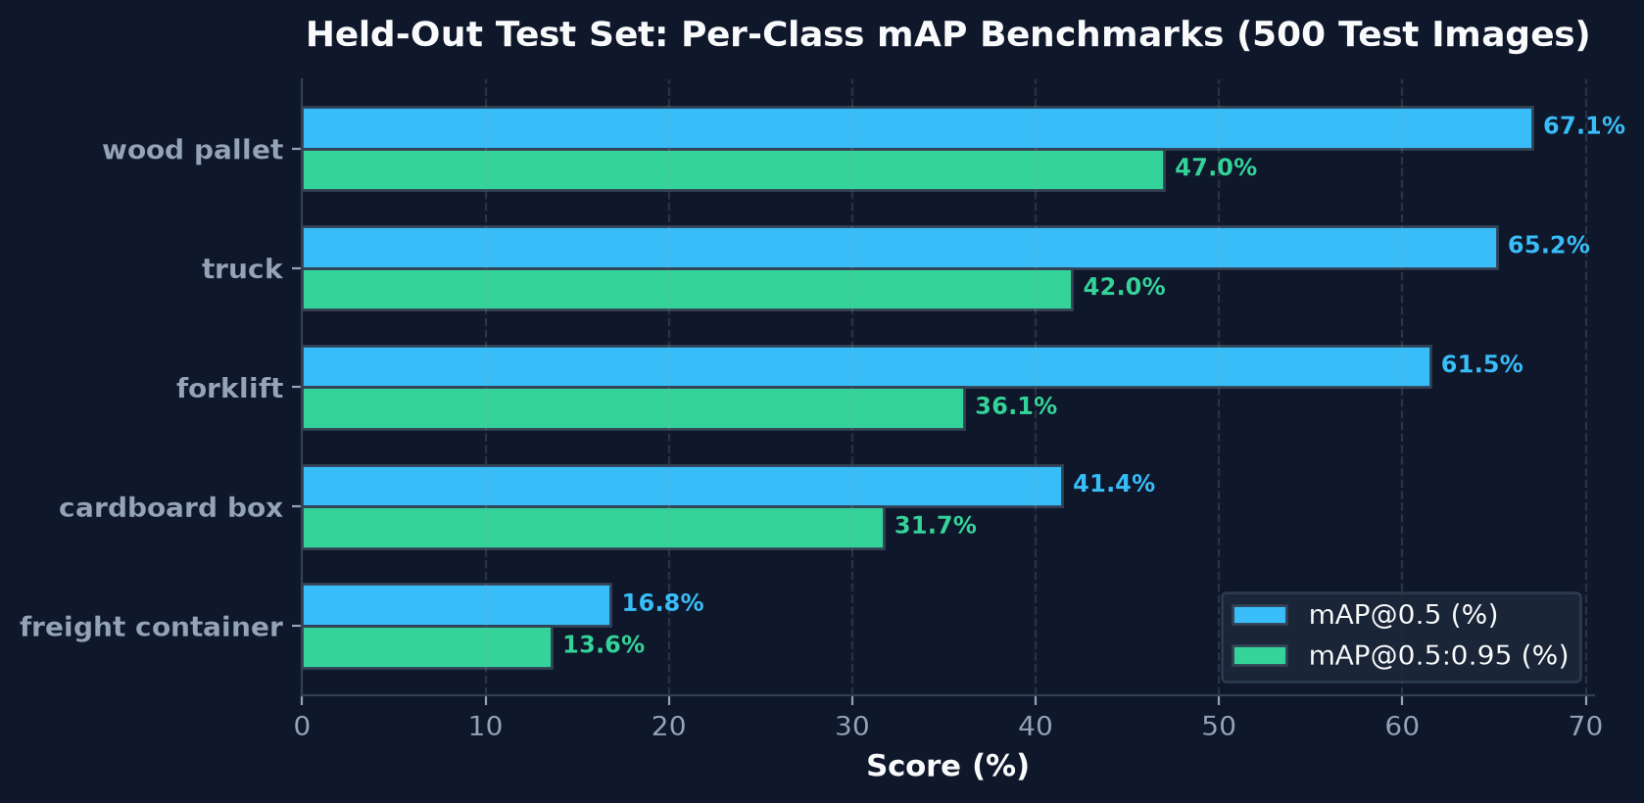
EVALUATION RESULTS
Rigorous Performance Benchmark on 500 Held-Out Test Images
0.5040
mAP@0.5 (Overall)
0.3408
mAP@0.5:0.95
0.5734
Precision
0.4873
Recall
RAP Pre-Hackathon Submission | Slide 7 of 14
Notes:
WHAT TO SAY:
Evaluating on 500 held-out test images, the system achieves an overall mAP@0.5 of 50.40% and mAP@0.5:0.95 of 34.08%.
TECHNICAL EXPLANATION:
Performance varies across domain classes: wood pallet achieves 67.08% mAP50, truck 65.15%, forklift 61.51%, cardboard box 41.44%, and freight container 16.83%. Precision is 57.34% and recall is 48.73%.
DEFENSE Q&A:
Q: Why is mAP@0.5:0.95 lower than mAP@0.5?
A: mAP@0.5:0.95 evaluates bounding box accuracy across 10 strict IoU thresholds up to 0.95, penalizing slightly loose boundary predictions.

Slide 8
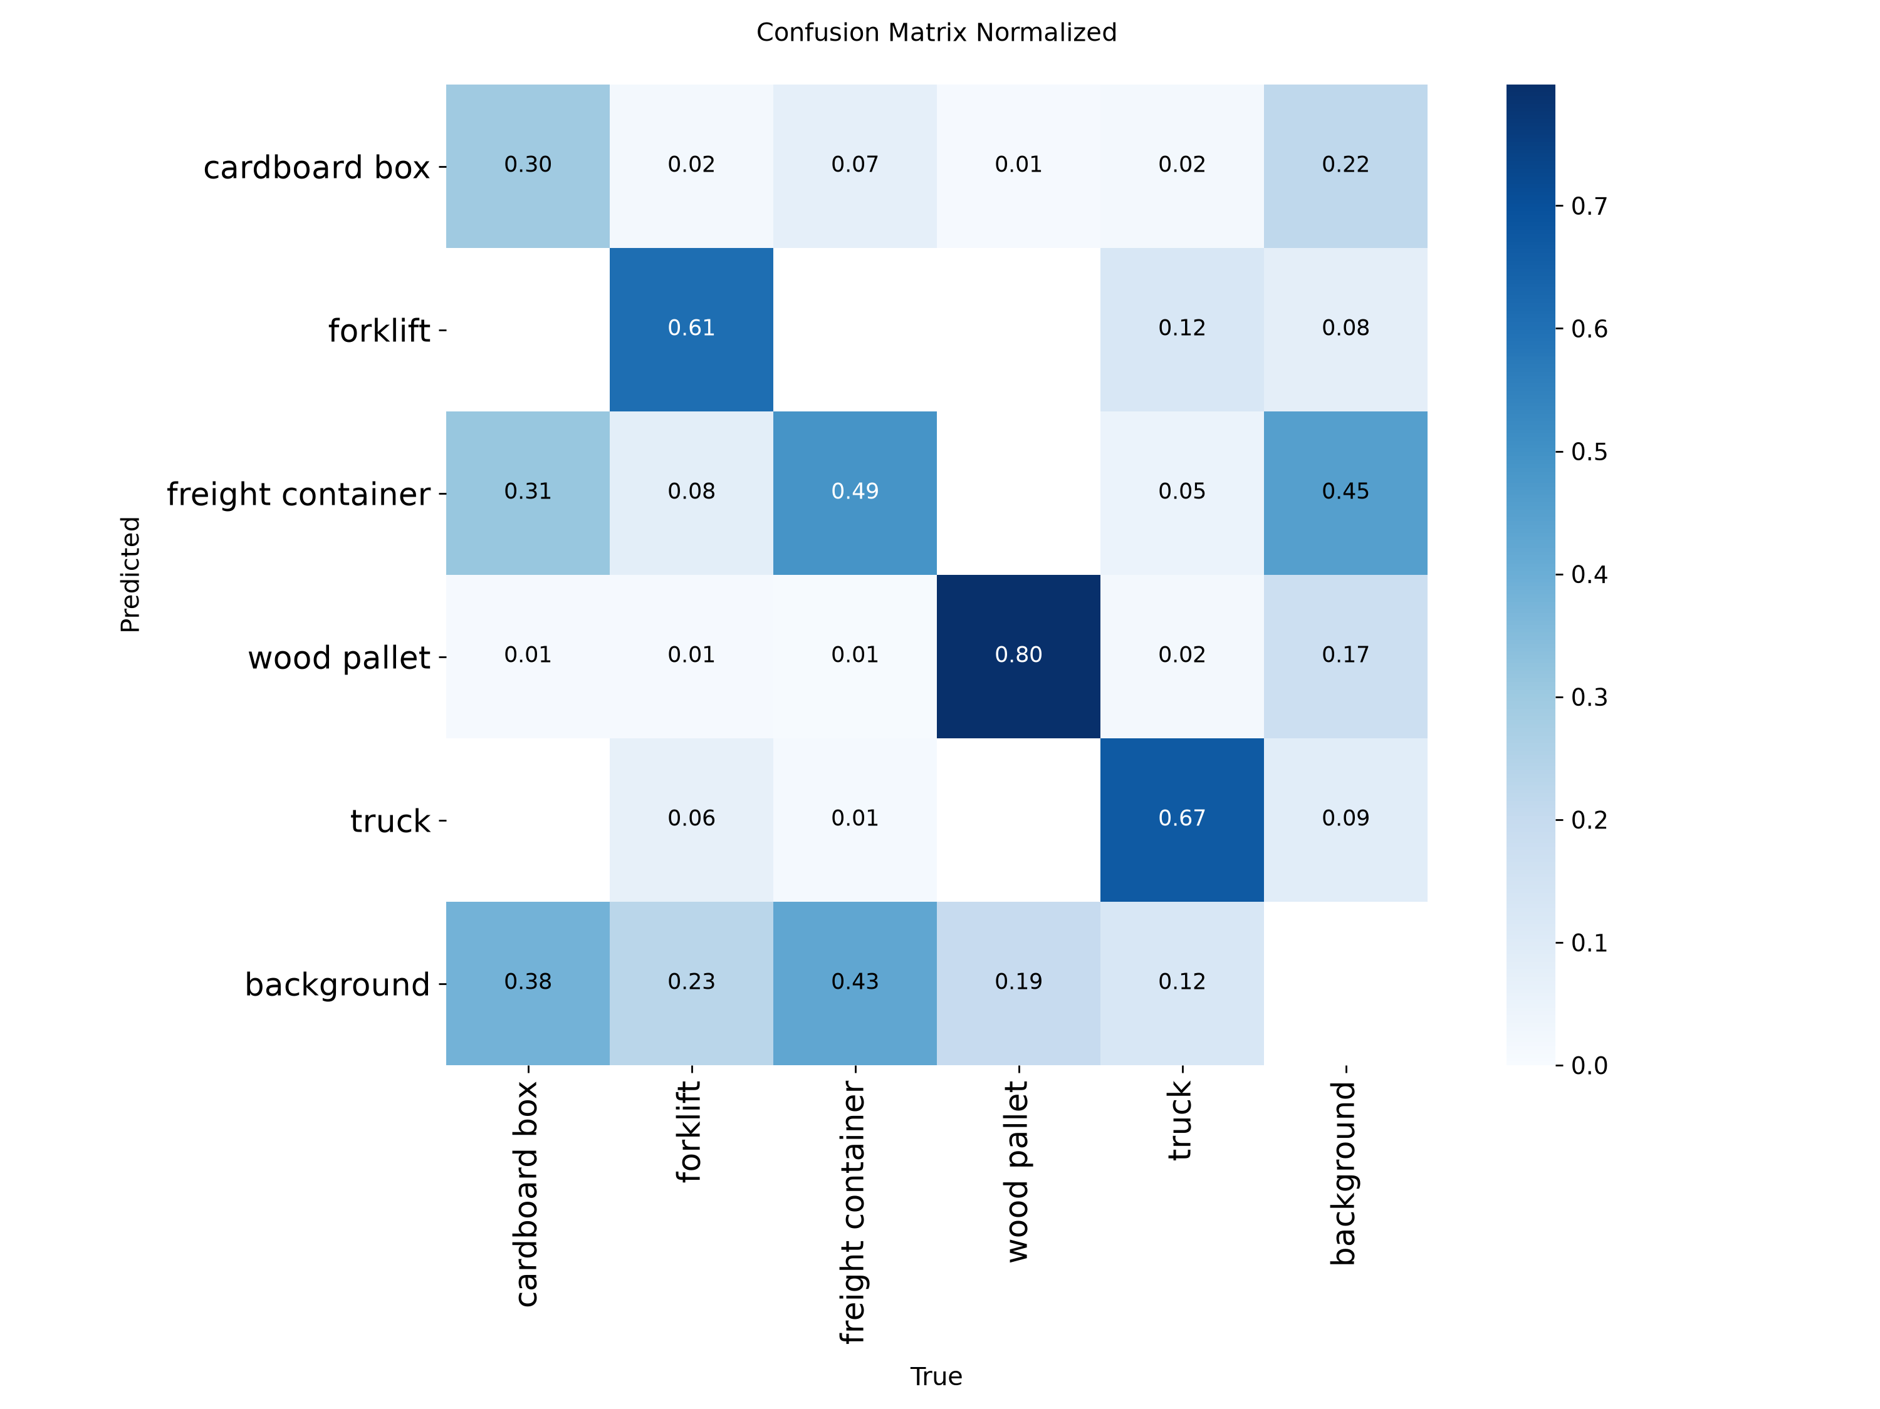
WHERE THE MODEL FAILS
Root-Cause Diagnostic of Real Detector Error Categories
5 Root-Cause Failure Categories
1. Same-Class Duplicate Boxes
↳ Nested predictions on large objects -> Addressed via Containment IoS
2. Cross-Class Duplicates
↳ Container vs truck overlap -> Addressed via Cross-Class IoU 0.80
3. Container Sub-Region Splits
↳ Large bodies split into parts -> Explains low Container mAP (16.83%)
4. Box vs Pallet Confusion
↳ Small packed boxes missed -> Explains low Cardboard Recall (28.30%)
5. Border Edge Artifacts
↳ Truncated edge detections -> Addressed via Inside Ratio < 0.50 Filter
RAP Pre-Hackathon Submission | Slide 8 of 14
Notes:
WHAT TO SAY:
Rather than masking model shortcomings, we systematically diagnosed where the raw detector fails. This empirical failure analysis directly motivated our custom post-processing rules.
TECHNICAL EXPLANATION:
We identified 5 primary failure modes: internal nested boxes, cross-class overlaps, container body fragmentation (causing 16.83% mAP), cardboard box recall loss (28.30%), and low-confidence border artifacts.
DEFENSE Q&A:
Q: Why did freight container perform poorly?
A: Freight containers exhibit massive aspect ratio variations, surface occlusions, and severe visual ambiguity with truck trailers, causing raw DETR queries to split containers into sub-boxes.

Slide 9
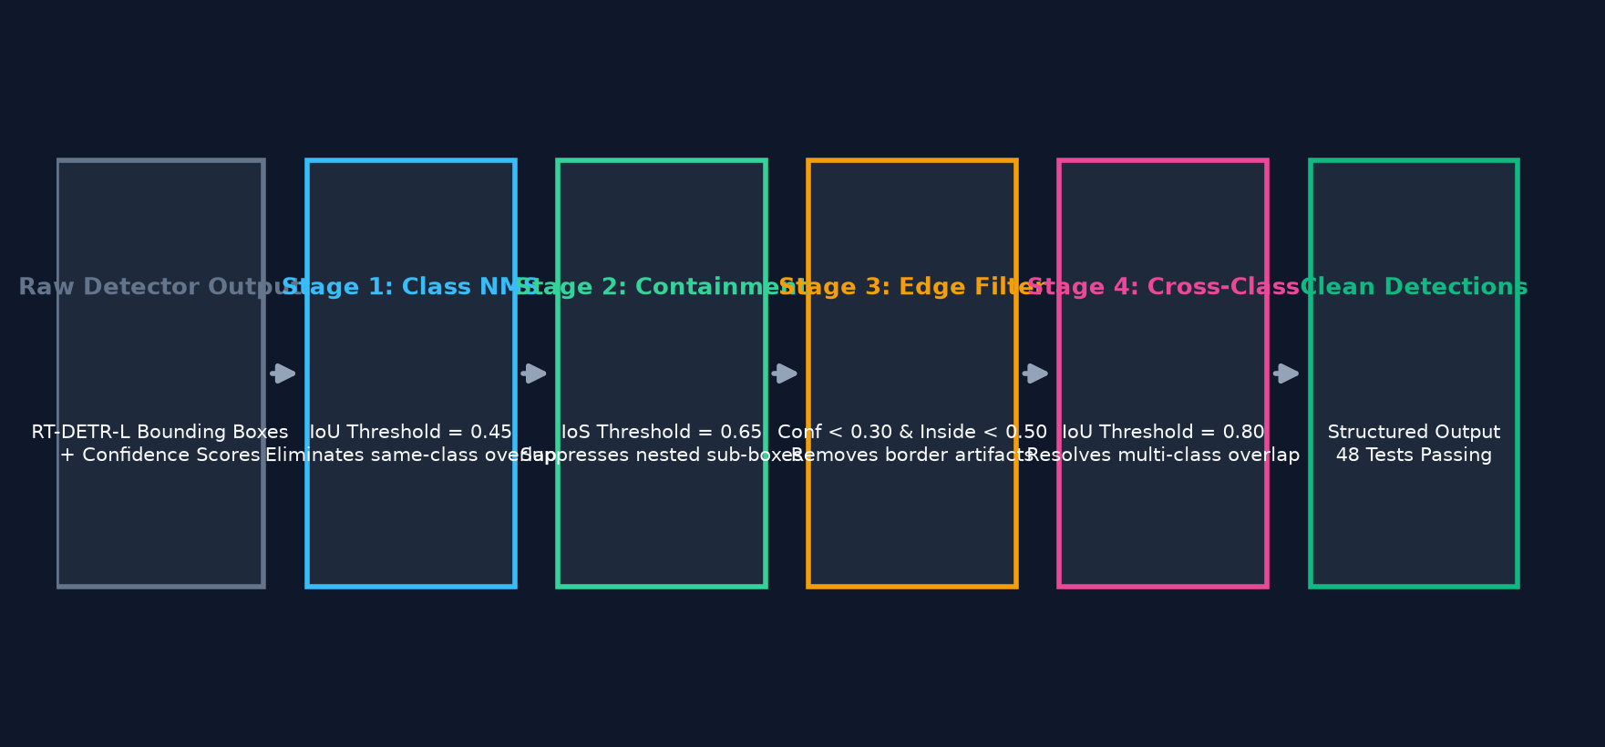
CUSTOM POST-PROCESSING PIPELINE
4-Stage Rule Engine for Error Mitigation & Output Cleanup
Key System Insights
• Stage 1: Class-Aware NMS (IoU = 0.45) — Eliminates standard same-class bounding box overlap.
• Stage 2: Containment Suppression (IoS = 0.65) — Removes internal sub-region duplicates nested inside large boxes.
• Stage 3: Boundary Artifact Filter — Drops edge boxes with conf < 0.30 AND inside_ratio < 0.50.
• Stage 4: Cross-Class Overlap Suppression (IoU = 0.80) — Resolves multi-class box collisions by keeping highest confidence box.
• Automated Verification: 48 PyTest unit tests passing with zero failures.
RAP Pre-Hackathon Submission | Slide 9 of 14
Notes:
WHAT TO SAY:
To fix the 5 failure modes discovered during evaluation, we engineered a deterministic 4-stage post-processing pipeline.
TECHNICAL EXPLANATION:
Raw detections are processed sequentially: Class NMS (IoU 0.45), Containment Suppression using Intersection over Smallest (IoS 0.65), Boundary Filtering, and Cross-Class IoU (0.80). The pipeline is fully verified by 48 passing unit tests.
DEFENSE Q&A:
Q: Why use IoS (Intersection over Smallest) instead of standard IoU?
A: When a small sub-box is completely inside a large box, standard IoU is low because the large box area dominates the denominator. IoS measures containment directly, suppressing internal sub-box clutter.

Slide 10
DETERMINISTIC REASONING ENGINE
Structured Natural Language Q&A with Strict Refusal Guardrails
6 Deterministic Intents
• COUNT: 'How many objects / forklifts are there?'
• PRESENCE: 'Is there a truck in the warehouse?'
• LIST: 'What objects are visible in the scene?'
• MOST_COMMON: 'What is the dominant object class?'
• SPATIAL: 'Where is the cardboard box located?'
• UNKNOWN: Out-of-scope questions -> Triggers Refusal Guardrail.
Guardrails & Zero Hallucination
1. Framework Constraint: Zero agentic frameworks (No LangChain, No CrewAI).
2. Global Confidence Floor: 0.25 detector confidence threshold.
3. High-Confidence Threshold: 0.50 threshold for affirmative assertions.
4. Refusal Policy: Explicitly returns 'insufficient information' if detections are absent or uncertain.
RAP Pre-Hackathon Submission | Slide 10 of 14
Notes:
WHAT TO SAY:
Our reasoning engine routes natural language questions into 6 deterministic intents. It relies on strict pattern matching without external LLM dependencies, ensuring sub-millisecond latency and zero hallucination.
TECHNICAL EXPLANATION:
Questions are parsed into COUNT, PRESENCE, LIST, MOST_COMMON, SPATIAL, or UNKNOWN intents. Detections below 0.25 confidence are dropped, and low-confidence visual evidence triggers an explicit refusal message.
DEFENSE Q&A:
Q: Why avoid LLMs or agent frameworks like LangChain?
A: Assignment rules prohibited non-deterministic APIs. Our deterministic engine guarantees zero hallucination, sub-millisecond execution, and 100% reproducible JSON responses.

Slide 11
END-TO-END SYSTEM ARCHITECTURE
Decoupled Production Microservice Architecture on AWS EC2
Key System Insights
• Ingress Layer: Nginx reverse proxy listening on public Port 80.
• Security Controls: Port 7860 bound exclusively to local container network.
• Application Core: FastAPI + Uvicorn engine running detector & reasoning modules.
• Containerization: Docker & Docker Compose setup with volume mounts.
• Infrastructure as Code: Terraform scripts managing Security Groups, EC2, and EBS storage.
RAP Pre-Hackathon Submission | Slide 11 of 14
Notes:
WHAT TO SAY:
Here is our production deployment architecture on AWS EC2. Nginx acts as the public ingress on Port 80, proxying clean traffic to the containerized FastAPI server on Port 7860.
TECHNICAL EXPLANATION:
Application Port 7860 is kept private inside the Docker network. Infrastructure is provisioned via Terraform, configuring Security Group ingress rules (22 admin, 80 public, 443 reserved).
DEFENSE Q&A:
Q: Why keep Port 7860 closed publicly?
A: Exposing application ports directly to the Internet bypasses Nginx rate limiting, buffer management, and security header controls. Port 7860 remains strictly internal.

Slide 12
API DEMONSTRATION & SCHEMAS
Production JSON Contracts for Bounding Box Extraction and Q&A
POST /detect Response Payload
{
"objects": [
{
"class": "wood pallet",
"confidence": 0.2783,
"bbox": {"x1": 85.9, "y1": 38.9, "x2": 616.5, "y2": 635.7}
}
],
"num_detections": 1,
"image_size": [640, 640]
}
POST /ask Response Payload
{
"answer": "Detected: 1 wood pallet. Total: 1 object(s).",
"used_detector": true,
"intent": "COUNT",
"confidence": "medium",
"detections_count": 1
}
RAP Pre-Hackathon Submission | Slide 12 of 14
Notes:
WHAT TO SAY:
Here are the actual JSON contracts returned by our production API endpoints. Both /detect and /ask provide structured, deterministic outputs.
TECHNICAL EXPLANATION:
/detect outputs normalized bounding box coordinates, confidence scores, and object counts. /ask returns the natural language answer alongside intent metadata, confidence rating, and underlying detection counts.
DEFENSE Q&A:
Q: How are invalid requests or bad image uploads handled?
A: FastAPI and Pydantic v2 validate incoming multipart form fields. Unparseable image buffers return HTTP 400 Bad Request, while invalid schemas return HTTP 422 Unprocessable Entity.

Slide 13
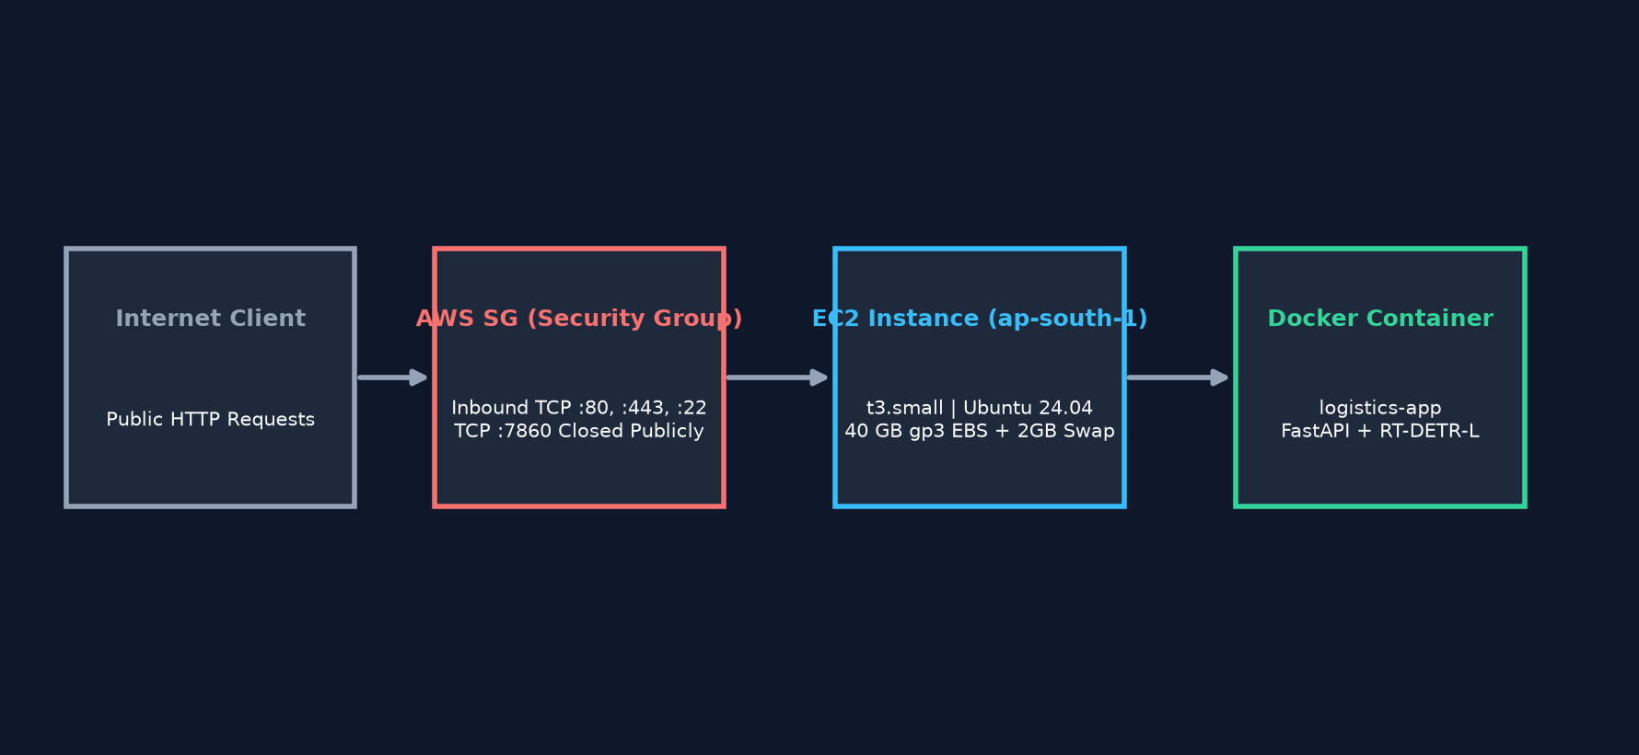
AWS INFRASTRUCTURE & DEPLOYMENT
Cloud Hosting, Infrastructure as Code, and Operational Incident Resolution
Key Breakdown
• Host Specifications: AWS ap-south-1 (Mumbai) | t3.small (2 vCPU, 2GB RAM + 2GB Swap).
• Storage Expansion: 40 GiB gp3 EBS volume provisioned via Terraform.
• Deployment Incident: Initial 20 GiB EBS disk exhausted space during PyTorch layer extraction.
• Operational Fix: Expanded EBS to 40 GiB, executed online growpart & resize2fs without downtime.
• Live Base API URL: http://13.233.255.22 (Swagger Docs: http://13.233.255.22/docs).
RAP Pre-Hackathon Submission | Slide 13 of 14
Notes:
WHAT TO SAY:
The application is live on AWS EC2 in ap-south-1 Mumbai at http://13.233.255.22. During initial deployment, we resolved a real-world infrastructure incident.
TECHNICAL EXPLANATION:
Extracting heavy PyTorch CUDA container layers exhausted our initial 20 GiB root disk. We expanded the EBS volume to 40 GiB and executed growpart /dev/nvme0n1 1 and resize2fs live on Ubuntu 24.04, allowing container startup to finish cleanly.
DEFENSE Q&A:
Q: How did you fix the Docker disk space issue?
A: We resized the EBS volume to 40 GiB via AWS, then performed online partition expansion using growpart and filesystem resizing using resize2fs without destroying the running EC2 instance.

Slide 14
RESULTS, LIMITATIONS & FUTURE WORK
Project Victories, Known Constraints, and Next-Generation Roadmap
WHAT WORKS (VICTORIES)
• Fine-tuned RT-DETR-L on 5 logistics classes.
• 50.40% mAP@0.5 on held-out test set.
• Custom 4-stage post-processing pipeline.
• Deterministic Q&A reasoning engine.
• 48 PyTest unit tests passing.
• Dockerized AWS EC2 deployment via Terraform.
LIMITATIONS (CONSTRAINTS)
• Freight container mAP is low (16.83%).
• Cardboard box recall is low (28.30%).
• Configured 50 epochs; stopped at 10.
• CPU AWS instance limits throughput (~2s/img).
• HTTP deployment (no SSL domain active).
FUTURE WORK (ROADMAP)
• Train full 50 epochs with cosine LR decay.
• Add hard negative freight container data.
• Implement class-weighted focal loss.
• Migrate to GPU EC2 instance (g4dn.xlarge).
• Configure domain name & HTTPS certificates.
RAP Pre-Hackathon Submission | Slide 14 of 14
Notes:
WHAT TO SAY:
In conclusion, we have built, benchmarked, safeguarded, containerized, and deployed an end-to-end computer vision reasoning pipeline.
TECHNICAL SUMMARY:
While freight container localization and CPU inference latency represent clear limitations, our deterministic post-processing rules, unit test coverage, and cloud infrastructure provide a solid, deployable baseline.
DEFENSE Q&A:
Q: What is your primary takeaway from this project?
A: Computer vision engineering requires a holistic workflow—from rigorous held-out dataset evaluation and failure mode diagnosis to deterministic guardrails and automated cloud deployment.

