Slide 1

Phishing Awarness Training

Slide 2
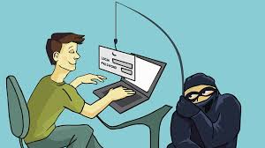
INTRODUCTION
Phishing is a type of cybersecurity attack that attempts to obtain data that are sensitive like Username, Password, and more. It attacks the user through mail, text, or direct messages. Now the attachment sends by the attacker is opened by the user because the user thinks that the email, text, messages came from a trusted source. It is a type of Social Engineering Attack.

Slide 3
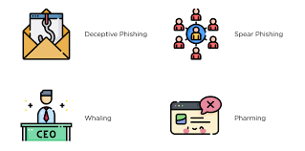
TYPES OF PHISHING ATTACKS
There are 5 types of Phishing Attacks are as follows:
SMS phishing – These attacks are used to make the user revealing account information. This attack is also similar to the phishing attack used by cybercriminals to steal credit card details or sensitive information, by making it look like it came from a trusted organization.
Voice Phishing – Some attacks require to direct the user through fake websites, but some attacks do not require a fake website.
Catphishing – It is a type of social engineering attack that plays with the emotions of a person and exploits them to gain money and information
Clone Phishing – This attack is actually based on copying the email messages that were sent from a trusted source.
Spear Phishing – This attack is used to target any specific organization or an individual for unauthorized access. These types of attacks are not initiated by any random hacker, but these attacks are initiated by someone who seeks information related to financial gain or some important information.

Slide 4
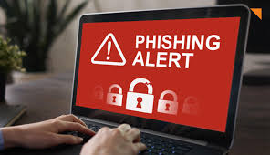
Symptoms of the phishing :
It may request the user to share personal details like the login credentials related to the bank and more.
It redirects to a website if the user clicks on the link that was sent in the email.
If they are redirected to a website it may want some information related to the credit card or banking details of the user.

Slide 5
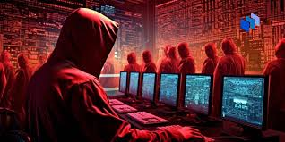
PREVENTION FROM PHISHING ATTACKS
Do not Save Passwords in PCs and if you save then try to keep it in crypted form.
Try to Avoid use of banking work in public place.
Do not try to open any suspicious email attachments.
Do not try to open any link which may seem suspicious.
Do not try to provide any sensitive information like personal information or banking information via email, text, or messages.
Always the user should have an antivirus to make sure the system is affected by the system or not.

Slide 6
CASE STUDY
In 2015, Ubiquiti Networks, a computer networking company based in the US, was the victim of a BEC attack that cost the company $46.7 million (of which they expected to recover at least $15 million). The attacker impersonated the company’s CEO and lawyer and instructed the company’s Chief Accounting Officer to make a series of transfers to close a secret acquisition. Over the course of 17 days, the company made 14 wire transfers to accounts in Russia, Hungary, China, and Poland.
The incident only came to Ubiquiti’s attention when it was notified by the FBI that the company’s Hong Kong bank account may have been the victim of fraud. This enabled the company to stop any future transfers and attempt to recover as much of the $46.7 million stolen as possible (which represented roughly 10% of the company’s cash position).

Slide 7
CONCLUSION
As per increasing the cyber crimes in world cause the financial damages to the people . Phishing Attack is also a kind of Cyber crimes which cause loss of personal data , etc. So the increasing amount of attacks we should be aware from such incidents and also make other people aware . The Cyber police should create a cyber attacks aware program to aware peoples.

Slide 8


