Slide 1

SMART INDIA HACKATHON 2026
TITLE PAGE
Problem Statement ID –
Problem Statement Title- Automated Detection, Credibility Tiering, and Velocity Tracking of Multilingual Misinformation
Theme- Miscellaneous
PS Category- Software
Team ID-
Team Name- Rag_Raiders

Slide 2
TRUTH INTELLIGENCE – Automated Multi-Modal Fact-Checking Engine
1. Solution Overview
Core Function: An automated AI engine that combats misinformation across text and visual media in real time .
Architecture: Full-stack pipeline featuring a FastAPI backend, Streamlit user interface, and RAG-based live verification.
2. Process Flow
3. Innovation & Uniqueness (Novelty Factors)
Real-Time Cross-Verification: Uses dynamic Retrieval-Augmented Generation (RAG) rather than static, outdated training data.
Multimodal Capability: Ingests both plain text and social media screenshots/images seamlessly.
Built-in Benchmark Suite: Features an automated evaluation framework (run_benchmark.py) to systematically measure accuracy.
One-Click Local Deployment: Packaged with automated execution scripts (Truth_Intelligence.bat) and Docker containerization.
@SIH Idea submission- Template

Slide 3
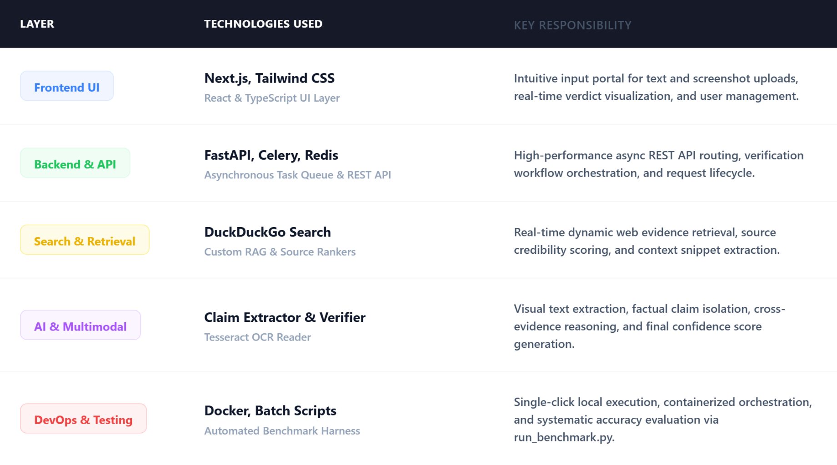
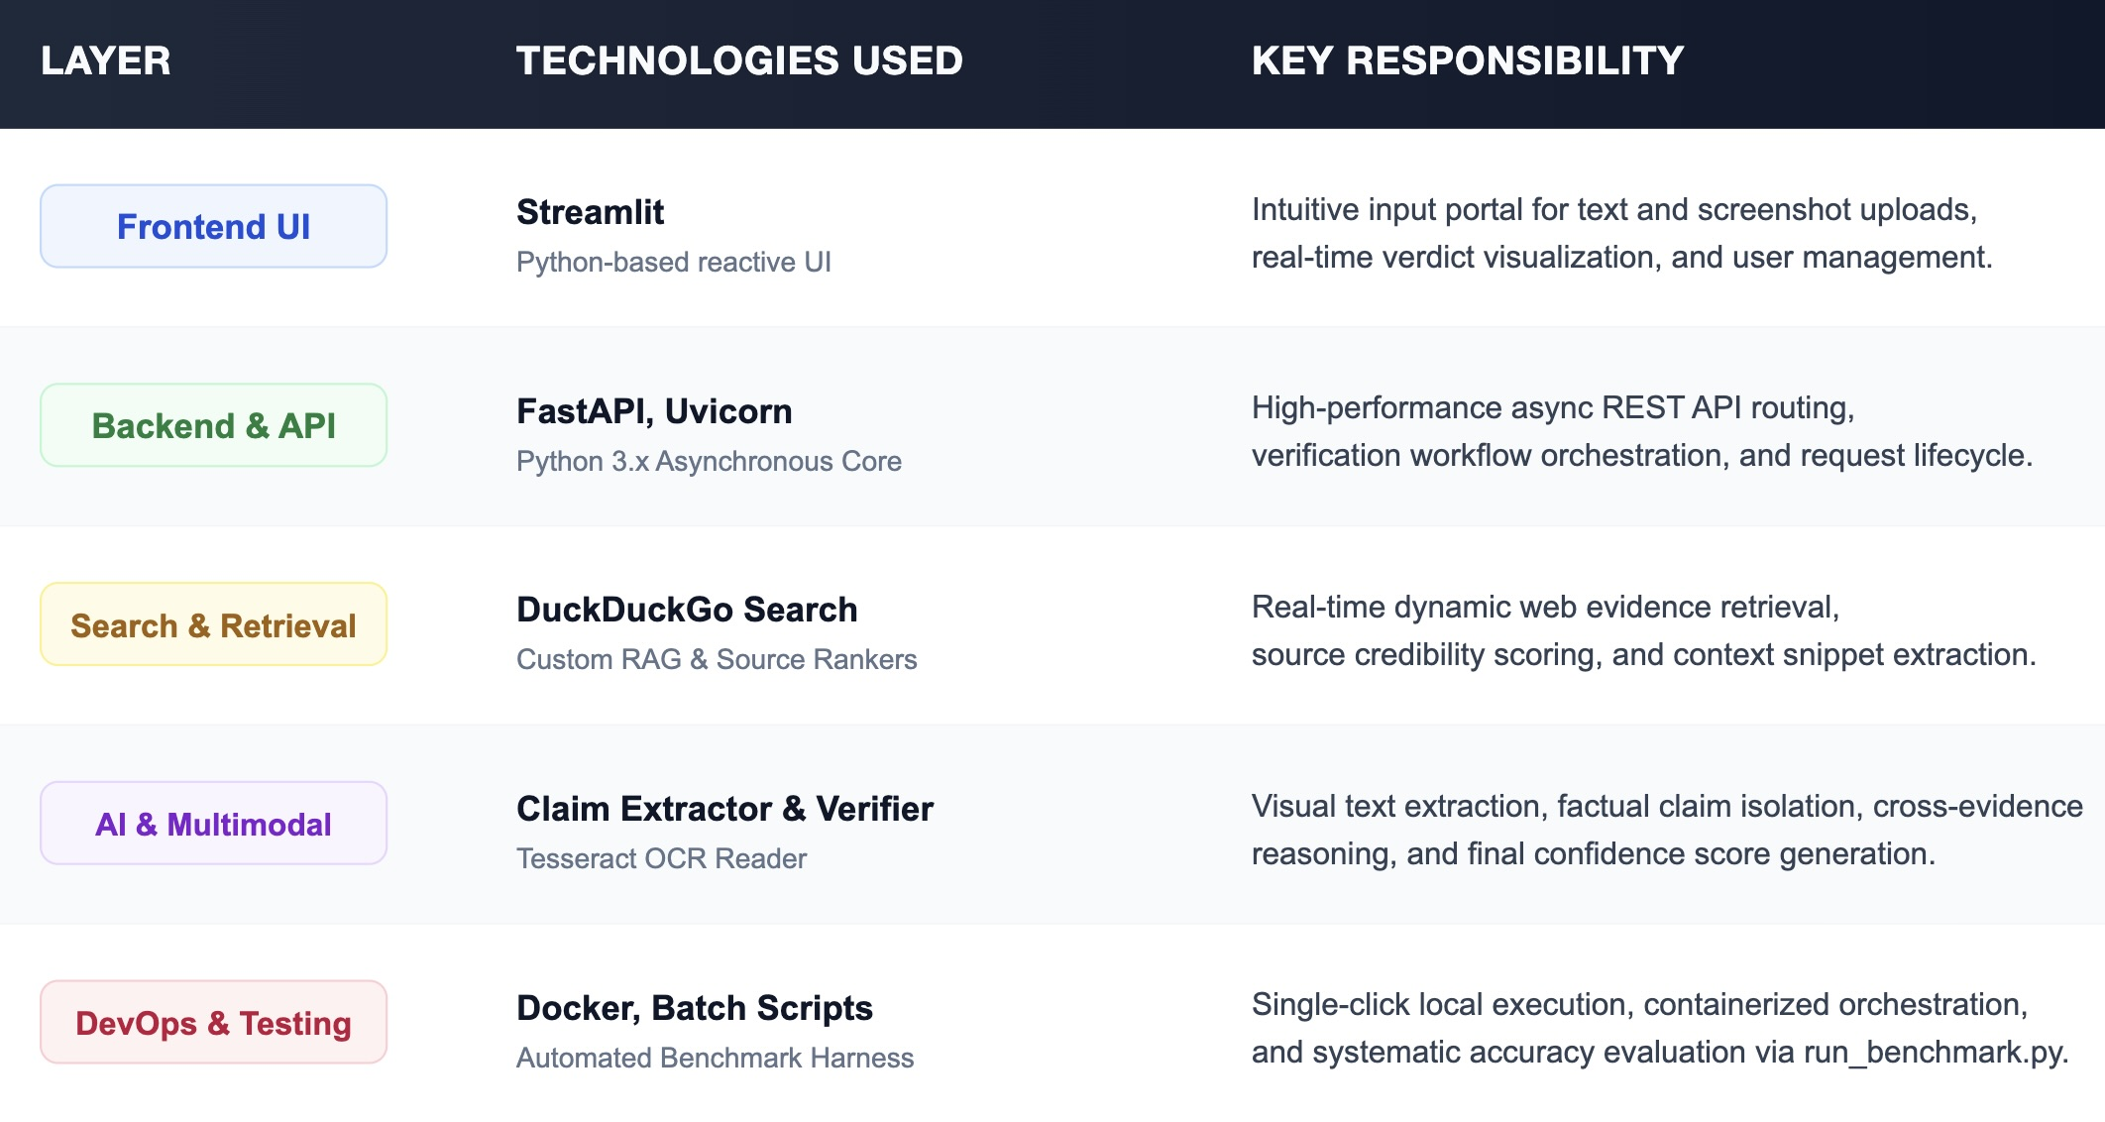
TECHNICAL APPROACH
Core Tech Stack Breakdown
2. End-to-End Execution Pipeline
Step 1: Multi-Modal Ingestion (frontend/app.py)
Ingests raw news text, social media statements, or screenshot images.
Step 2: OCR & Claim Parsing (ai/claim_extractor.py, multimodal/ocr_reader.py )
Extracts embedded text via OCR and isolates unambiguous, verifiable factual claims.
Step 3: Real-Time Web RAG (retrieval/rag_ranker.py, search_engine.py )
Queries live web sources, filters domain credibility, and ranks top-k authoritative context snippets.
Step 4: AI Cross-Verification (ai/verifier.py)
Evaluates claims against retrieved evidence snippets using an LLM reasoning engine.
Step 5: Verdict & Explanation Dashboard
Generates a final classification (True / Fake / Misleading), confidence score, and clear step-by-step reasoning.
@SIH Idea submission- Template

Slide 4
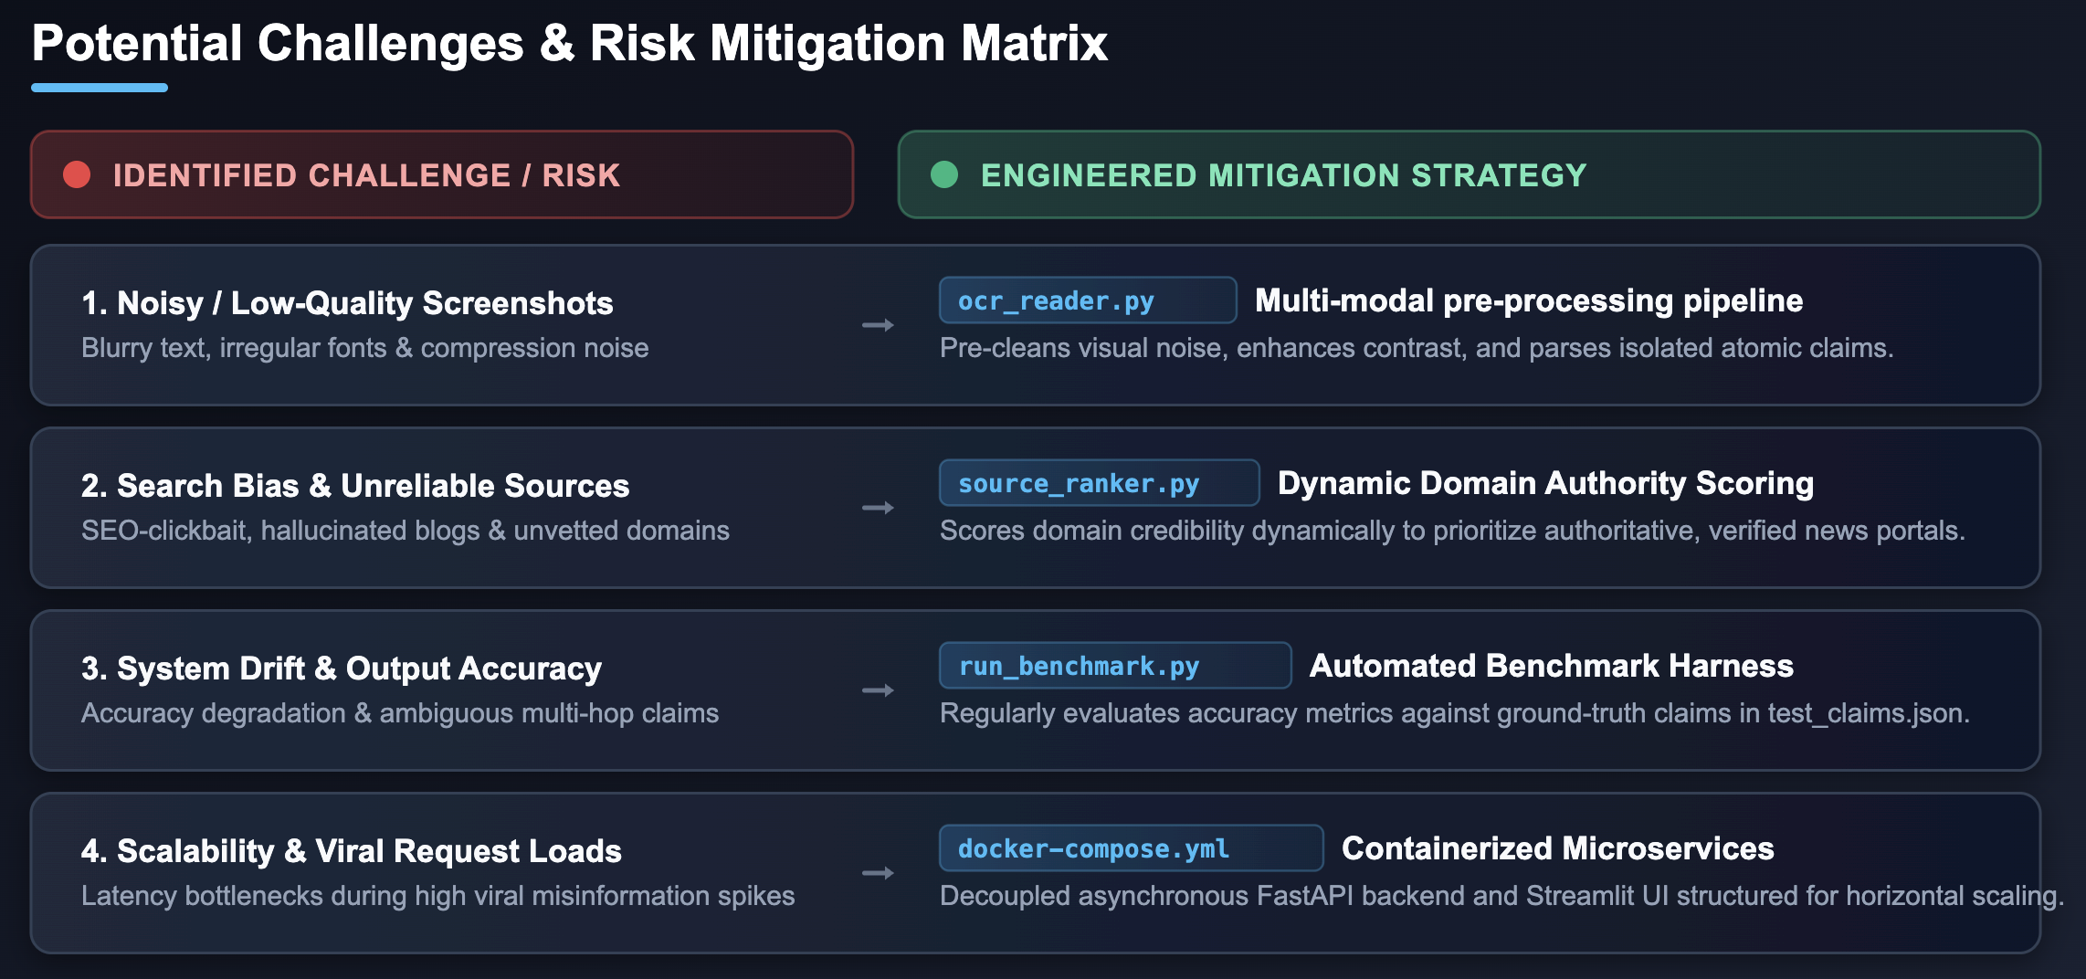
FEASIBILITY AND VIABILITY
1. Feasibility Analysis (Technical & Operational)
Lightweight & Modular Tech Stack: Built with FastAPI (asynchronous backend) and Next.js + Tailwind (interactive frontend) for low resource overhead and swift execution.
Real-Time Dynamic RAG: Leverages live web retrieval (search_engine.py) and context-aware ranking (rag_ranker.py) instead of relying on expensive, static model fine-tuning.
Zero-Setup Local Deployment: Packaged with a single-click launch script (Truth_Intelligence.bat) and Docker orchestration (docker-compose.yml) for seamless cross-platform deployment.
2. Potential Challenges & Risk Mitigation
3. Viability & Long-Term Sustainability
Cost-Effective Infrastructure: Uses open search connectors and local inference pipelines, eliminating recurring proprietary database overhead.
Continuous Quality Assurance: Built-in benchmarking harness ensures performance and latency can be tracked and scaled systematically.
@SIH Idea submission- Template

Slide 5
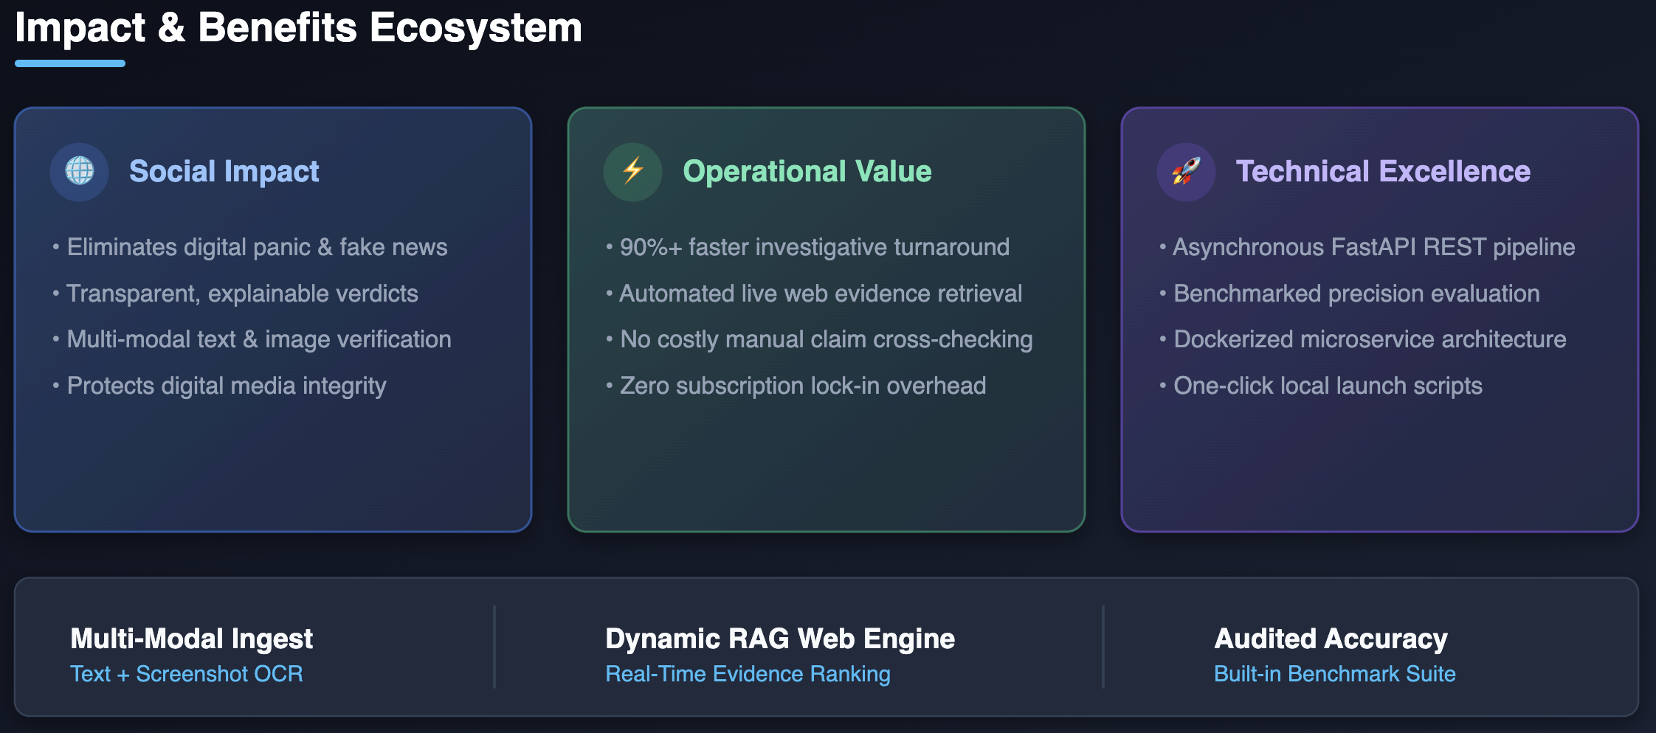
IMPACT AND BENEFITS
1. Potential Impact on Target Audience
General Public & Social Media Consumers: Enables instant debunking of viral text claims and screenshot-based rumors directly through an interactive interface (frontend/app.py).
Journalists, Fact-Checkers & Media Rooms: Accelerates investigation workflows by automating evidence gathering via live search (retrieval/search_engine.py) and providing step-by-step AI reasoning.
Digital Platforms & Community Moderators: Provides a containerized, API-driven backend (backend/main.py, Dockerfile.backend) for automated content moderation at scale.
2. Core Benefits of the Solution
Social Benefit (Combating Digital Misinformation): Curbs the viral spread of fake news, panic-inducing rumors, and deep-text fabrications with explainable AI verdicts and confidence scoring.
Economic & Operational Benefit (Zero-Cost Verification): Replaces expensive manual research and costly proprietary subscriptions with open, automated RAG pipelines and custom ranking algorithms (retrieval/rag_ranker.py, retrieval/source_ranker.py).
Technical & Scalability Benefit (Measurable Reliability): Ensures benchmarked precision and systematic quality tracking via an automated evaluation harness (evaluation/run_benchmark.py).
Deployment Benefit (Rapid Adoption): Delivers zero-barrier onboarding through one-click local launch scripts (Truth_Intelligence.bat) and Docker orchestration.
@SIH Idea submission- Template

Slide 6
RESEARCH AND REFERENCES
1. Core Research Foundations & Technical Pillars
Retrieval-Augmented Generation (RAG) & Evidence Ranking: Grounded in research on real-time evidence retrieval and dynamic semantic re-ranking (retrieval/rag_ranker.py, retrieval/source_ranker.py) to eliminate AI hallucinations.
Multi-Modal Claim Parsing & OCR: Implements computational linguistic extraction and computer-vision OCR pipelines (multimodal/ocr_reader.py, ai/claim_extractor.py) for multi-format claim isolation.
Automated Fact-Checking Benchmarking: Adopts standardized empirical evaluation methodology (evaluation/run_benchmark.py) to score precision, recall, and confidence reliability against curated claim sets (tests/test_claims.json).
2. Key Code References & Open Frameworks
Source Code Repository: [github.com/Aaditya-coding/SIH-Phase-1](https://github.com/Aaditya-coding/SIH-Phase-1) (Truth Intelligence Core Engine).
Backend & API Architecture: Event-Driven, Asynchronous Worker Model, FastApi, Redis, Celery, Qdrant and Next.js (backend/main.py, docs/api.md).
Frontend & Interactivity: Next.js, TypeScript, Tailwind CSS, Clerk Auth (web-frontend).
Search & Web Connectors: DuckDuckGo Search API & custom search rankers, Google Fact Check Tools API, Web Search Connector, Wikipedia/Reference API (retrieval/search_engine.py).
@SIH Idea submission- Template

