Slide 1
DATA ENGINEERING
AnalytixLabs

Slide 2
Synopsis
Brief introduction of the company
Capstone requirement
Methods and Tools used
Impact
Key Takeaways

Slide 3
COMPANY INTRODUCTION

Slide 4
INTRODUCTION
First major task is to work on data engineering project for one of the big corporation’s employees data from the 1980s and 1995s. All the database of employees from that period are provided six CSV files. In this project, we will design data model with all the tables to hold data, import the CSVs into a SQL database, transfer SQL database to HDFS/Hive, and perform analysis using Hive/Impala/Spark/SparkML using the data and create data and ML pipelines.

Slide 5
DATA USED
Data Description
Titles (titles.csv): title_id – Unique id of type of employee (designation id) – Character – Not Null title – Designation – Character – Not Null
Employees (employees.csv): emp_no – Employee Id – Integer – Not Null emp_titles_id – designation id – Not Null birth_date – Date of Birth – Date Time – Not Null first_name – First Name – Character – Not Null last_name – Last Name – Character – Not Null sex – Gender – Character – Not Null hire_date – Employee Hire date –Date Time -Not Null no_of_projects – Number of projects worked on – Integer – Not Null Last_performance_rating – Last year performance rating – Character – Not Null left – Employee left the organization – Boolean – Not Null Last_date - Last date of employment (Exit Date) – Date Time
Salaries (salaries.csv): emp_no – Employee id – Integer – Not Null Salary – Employee’s Salary – Integer – Not Null
Departments (departments.csv) dept_no - Unique id for each department – character – Not Null dept_name – Department Name – Character – Not Null
Department Managers (dept_manager.csv) dept_no - Unique id for each department – character – Not Null emp_no – Employee number (head of the department ) – Integer – Not Null
. Department Employees (dept_emp.csv) emp_no – Employee id – Integer – Not Null dept_no - Unique id for each department – character – Not Null

Slide 6
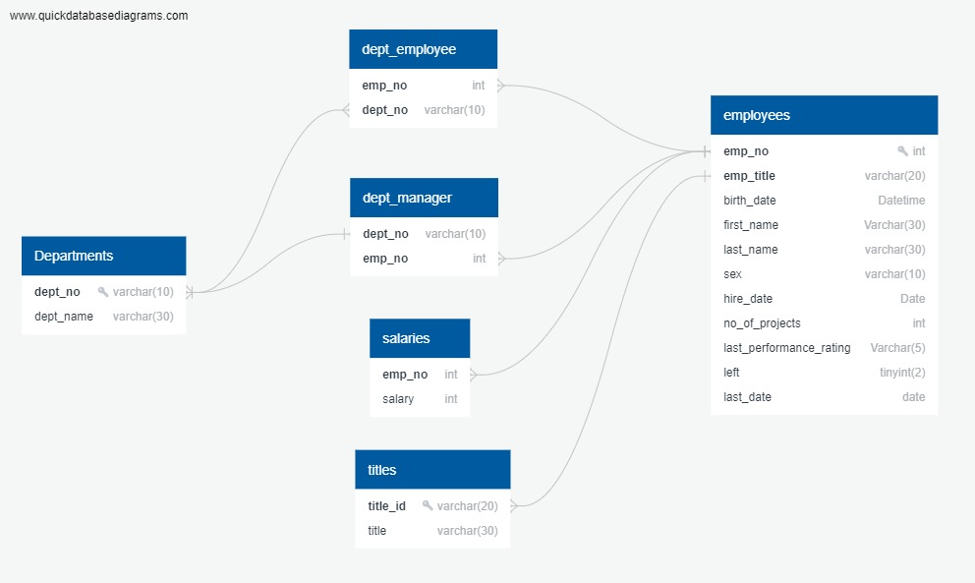
ER Diagram

Slide 7
CAPSTONE REQUIREMENTS

Slide 8
CAPSTONE REQUIREMENTS
Need to create end to end data pipeline and analyzing the data

Slide 9
METHODS AND TOOLS USED

Slide 10
TECHNOLOGY STACK
MySQL (to create database)
Linux Commands
Sqoop (Transfer data from MySQL Server to HDFS/Hive) - HDFS (to store the data)
Hive (to create database) - Impala (to perform the EDA)
SparkSQL (to perform the EDA)
SparkML (to perform model building)

Slide 11
Outputs
https://github.com/Aaditya107/Data_eng/ README.md
Creating tables: creatingtablesinsql.sql
Hive: hive-answers.sql
SparkML SparkMLcloudera.ipynb , SparkML.ipynb
Pipeline README-Pipeline.txt

Slide 12
CHALLENGES FACED

Slide 13
OBERVATIONS
Challenges faced :
In file employees.csv dates are not in correct format, either doing data cleaning at root level i . . e , in csv file using custom formatting for date or importing the data in string format and later converting string to date format using cast
Importing parquet file into DF using spark.sql.parquet as transformation from RDD to Data frame takes place
Creating pipeline.

Slide 14
THANK YOU!!!

