Slide 1
Aaditya Sheelkumar Pal
DS24142
INTRODUCTION
App development internship
at
LexCrest LegalTech Solutions Pvt. Ltd

Slide 2
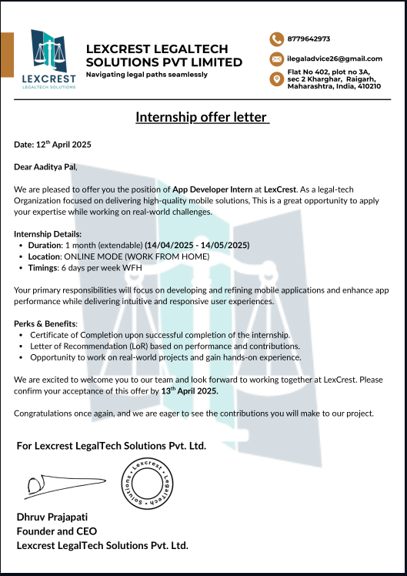
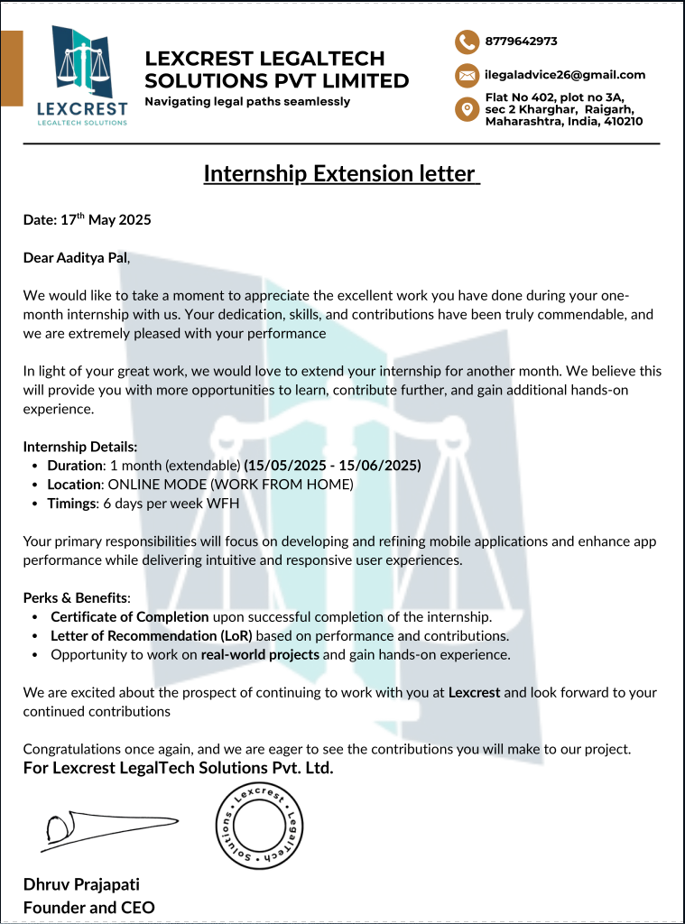
INTERNSHIP LETTER

Slide 3
Sr. No | Date | Time
1 | 15/04/2025 | 11:30 am - 3:00 pm
2 | 16/04/2025 | 11:30 am - 3:00 pm
3 | 17/04/2025 | 11:30 am - 3:00 pm
4 | 21/04/2025 | 11:30 am - 9:00 pm
5 | 22/04/2025 | 11:30 am - 9:00 pm
6 | 23/04/2025 | 11:30 am - 9:00 pm
7 | 24/04/2025 | 11:30 am - 9:00 pm
8 | 25/04/2025 | 11:30 am - 9:00 pm
9 | 26/04/2025 | 11:30 am - 9:00 pm
10 | 28/04/2025 | 11:30 am - 9:00 pm
11 | 29/04/2025 | 11:30 am - 9:00 pm
12 | 30/04/2025 | 11:30 am - 9:00 pm
13 | 01/05/2025 | 11:30 am - 9:00 pm
14 | 02/05/2025 | 11:30 am - 9:00 pm
15 | 03/05/2025 | 11:30 am - 9:00 pm
16 | 05/05/2025 | 11:30 am - 9:00 pm
17 | 06/05/2025 | 11:30 am - 9:00 pm
Sr. No | Date | Time
18 | 07/05/2025 | 11:30 am - 9:00 pm
19 | 08/05/2025 | 11:30 am - 9:00 pm
20 | 09/05/2025 | 11:30 am - 9:00 pm
21 | 10/05/2025 | 11:30 am - 9:00 pm
22 | 12/05/2025 | 11:30 am - 9:00 pm
23 | 13/05/2025 | 11:30 am - 9:00 pm
24 | 14/05/2025 | 11:30 am - 9:00 pm
25 | 15/05/2025 | 11:30 am - 9:00 pm
26 | 16/05/2025 | 11:30 am - 9:00 pm
27 | 17/05/2025 | 11:30 am - 9:00 pm
28 | 18/05/2025 | 11:30 am - 9:00 pm
29 | 19/05/2025 | 11:30 am - 9:00 pm
30 | 20/05/2025 | 11:30 am - 9:00 pm
31 | 21/05/2025 | 11:30 am - 9:00 pm
32 | 22/05/2025 | 11:30 am - 9:00 pm
33 | 23/05/2025 | 11:30 am - 9:00 pm
34 | 24/05/2025 | 11:30 am - 9:00 pm
ATTENDANCE
Total Working days : 34
Approx working hours: 295.5

Slide 4
Lexcrest LegalTech Solutions Pvt. Ltd. is a startup company founded in February 2025 and has its headquarters in Kharghar.
The organization currently is also part of the Riddl Startup incubation center at Somaiya College in Mumbai.
The organization primarily develops tech solutions geared towards solving problems in the legal space.
It has two products, one is the edtech platform called ‘iLegalLearn’ and the other one is called ‘iLegalAdvice’.
IlegalLearn is an edtech subscription based platform that is actively helping law students to prepare for exams by providing in depth information for over 1000+ case laws divided into 13+categories and access to a legal dictionary
IlegalAdvice on the other hand is committed to simplifying access to quality legal assistance across India.
The organization connects individuals and businesses with top-rated lawyers who specialize in various domains such as criminal defense, property disputes, corporate law, and intellectual property rights.
DESCRIPTION
OF ORGANIZATION

Slide 5
The work alloted to me was to develop the complete Android app for the iLegalLearn edtech platform.
This included designing the User interfaces and including and integrating all the features from the already existing website.
I also had to write the backend code for data and functionality required specifically for the application.
DESCRIPTION
OF WORK ALLOTED

Slide 6
Week 1
Understood the organizational workflow and was assigned to collaborate on the Android app, specifically the profile section.
Analyzed the existing app, proposed UI ideas and alternative deployment strategies, which were approved for implementation.
WORK DONE

Slide 7
Week 2
Analyzed the website, backend, and Android codebase to understand architecture and reusable components.
Designed UI prototypes for Edit Details, Saved Cases, and Settings pages in the profile section, refining them daily based on feedback.
WORK DONE

Slide 8
Week 3
Integrated backend with the profile page, implemented centralized local storage, and set up service classes for network requests.
Handled async errors to ensure smooth UX and added animations with post-animation operations to enhance user feedback.
WORK DONE

Slide 9
Week 4
Developed advanced profile sections like notification settings, wallet & rewards, and legal policy pages with enhanced UI.
Implemented shimmer loading for better UX and began designing and coding the authentication module including login and signup.
WORK DONE

Slide 10
Week 5
Added ‘Forgot Password’ by abstracting shared components, then tested and profiled the app to improve performance and fix UI jank.
Refactored memory management and state handling to reduce leaks, and implemented custom error handling for varied HTTP responses.
WORK DONE

Slide 11
Week 6
Integrated Razorpay payment gateway in test mode with custom checkout and summary pages after studying documentation.
Designed Case Laws section with infinite scrolling, detailed view, Google Sign-In, and implemented screenshot/screen-record restrictions.
WORK DONE

Slide 12
Gained deep understanding of Flutter’s architecture, animations, image handling, async programming, reusable components, authentication integration, and UI security features.
Understood Flutter debugging tools, performance profiling with frame and flame charts, memory management, network inspection, and environment setup on Linux with physical device debugging.
Expanded knowledge in payment gateway integration, React and PostgreSQL setup, LLM-based chatbot design, and emphasized the importance of thorough documentation.
Learned communication tricks such as using words like “exactly and”, “yes and” instead of using “no but”.
SELF-ASSESSMENT

Slide 13
Gained deep understanding of Flutter’s architecture, animations, image handling, async programming, reusable components, authentication integration, and UI security features.
Understood Flutter debugging tools, performance profiling with frame and flame charts, memory management, network inspection, and environment setup on Linux with physical device debugging.
Expanded knowledge in payment gateway integration, React and PostgreSQL setup, LLM-based chatbot design, and emphasized the importance of thorough documentation.
Learned communication tricks such as using words like “exactly and”, “yes and” instead of using “no but”.
SELF-ASSESSMENT

Slide 14
CERTIFICATES

Slide 15
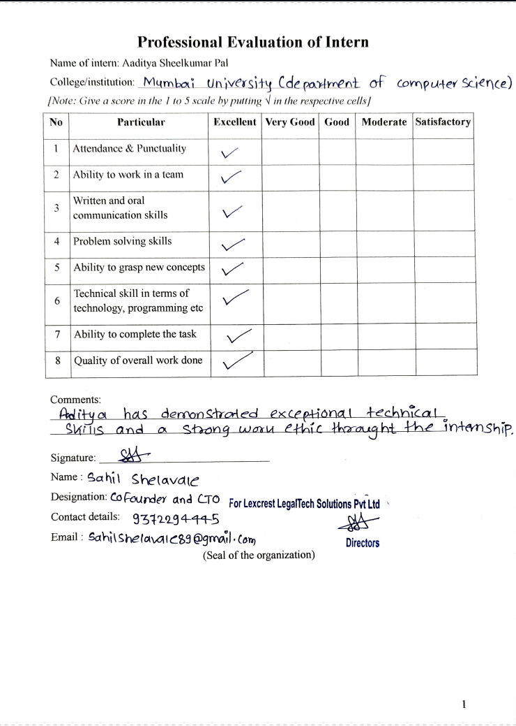
CERTIFICATES

Slide 16
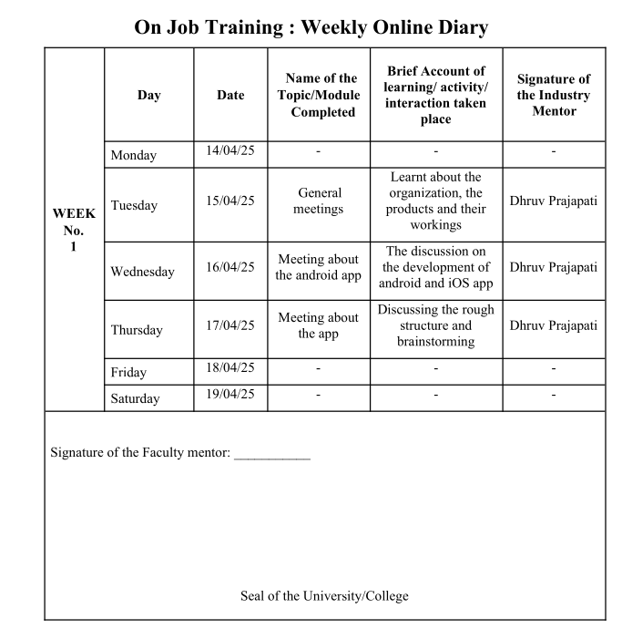
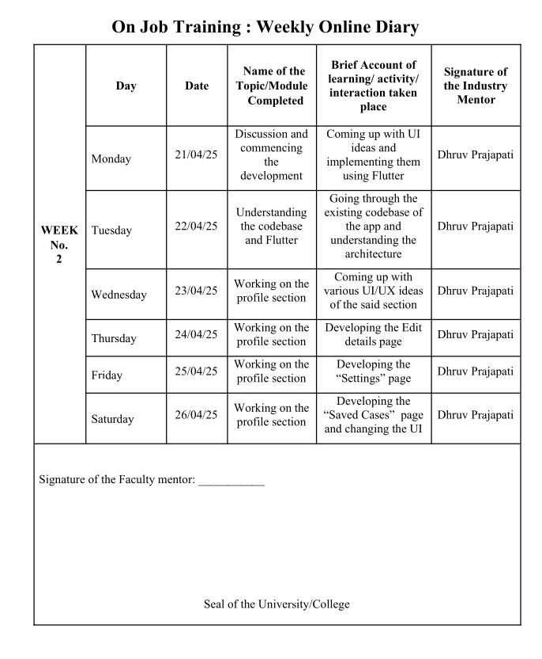
ONLINE DIARIES

Slide 17
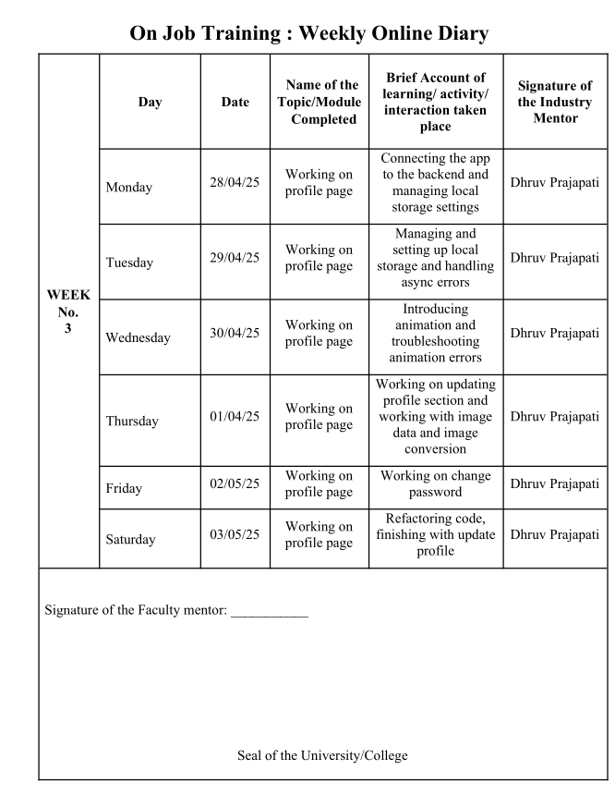
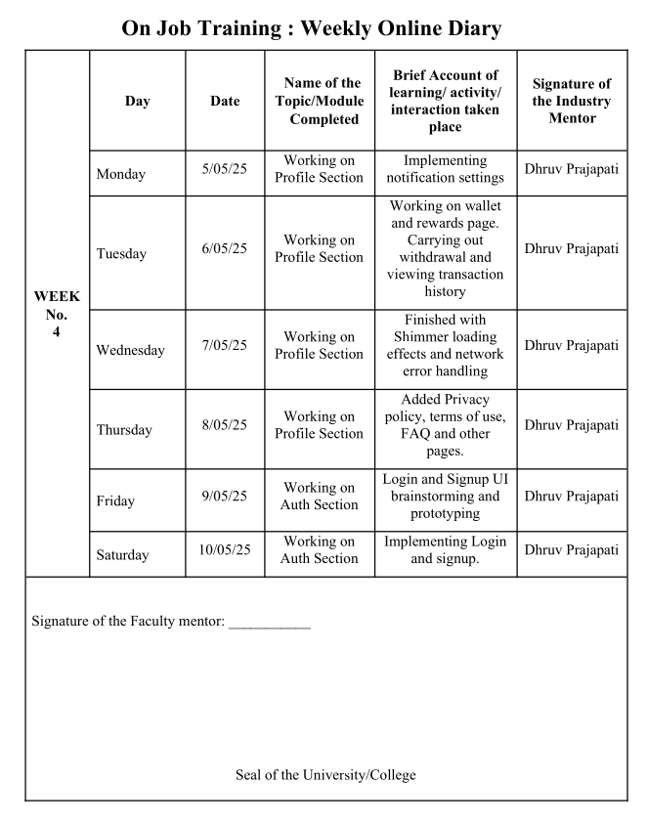
ONLINE DIARIES

Slide 18
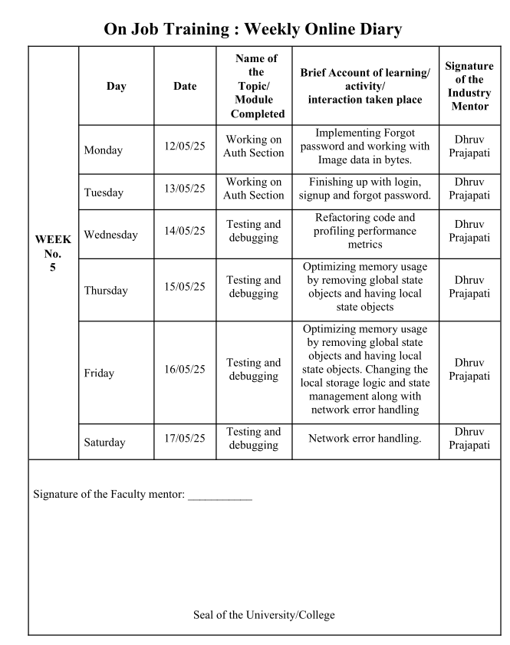
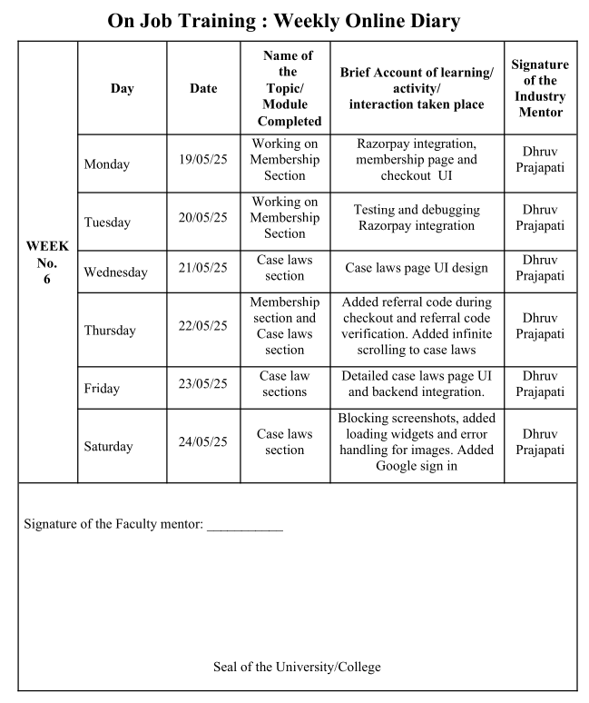
ONLINE DIARIES

