Slide 1
Elite_Coders
Team Members:-
Aaditya, https://github.com/Aaditya1978
Abhay, https://github.com/abhaydhiman
Ayush, https://github.com/Ayush-Malik
Shobit, https://github.com/Sj1218305

Slide 2

Problem Statements:-

Slide 3
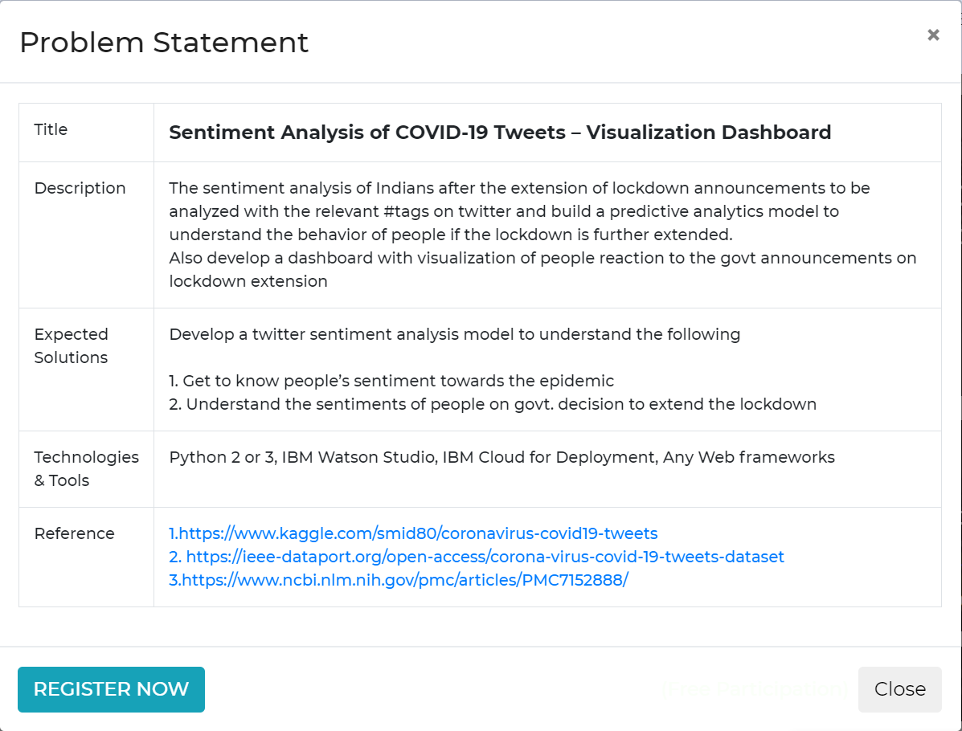
Our Problem Statement:-

Slide 4
Our solution:-
Graphs for all states
Graphs for all Phases
Predict lockdown is extended

Slide 5
Hydrator
gives tweets based on tweet ids

