Slide 1

PROJECT TITLE - Keystroke Capture Techniques and Security Implications
AADITYARAM S

Slide 2

PROBLEM STATEMENT
The dependence of modern computing on computer systems for secure authentication, digital communication, and sensitive data processing increases the necessity for understanding input interception mechanisms at the operating system level. Keystroke logging has been a critical domain of interest in cybersecurity research as it can be employed to perform both legitimate system monitoring and malicious data exfiltration. Despite such importance, the technical behavior and implications of keystroke capture are relatively unexplored by most learners.
The project presents a controlled experimental demonstration of keystroke-logging techniques, aimed at analyzing keyboard event handling, data acquisition, and storage procedures. This enhances security awareness and provides foundational research for input-based attack vectors and defense strategies.

Slide 3
PROJECT DESCRIPTION
The purpose of The Keystroke Logging Demonstration project is to investigate and demonstrate the process of capturing keystroke entries at the operating system level. The software continuously and meticulously captures keystroke entries in real time without disturbing the operations of the operating system, and each keystroke entry detected is carefully processed and recorded, allowing for the monitoring of the entries being made by the user. The entries made by the keystrokes are then stored in organized and efficient file formats such as text files and JSON files.
This project deals with the real-life implementation of keyboard event listeners, programming concepts related to events and event handling, and input/output operations performed on files by the use of Python libraries. Through this project, one will get to see the ethical and regulated simulation of logging keystrokes. This serves as a platform for analysis and understanding the implementation of these and how they might be misused. Through this project, the necessity of cybersecurity and the related design to counter malicious keylogging activity will also be understood.

Slide 4

THE END USERS
Cybersecurity students and learners
Computer science students studying system programming
Ethical hacking and security awareness trainees
Educators demonstrating input monitoring concepts

Slide 5

TECHNOLOGIES USED
Programming Language: Python
GUI Framework: Tkinter
Keyboard Monitoring Library: pynput
Data Storage: Text file (.txt) and JSON file (.json)
Operating System: Windows

Slide 6
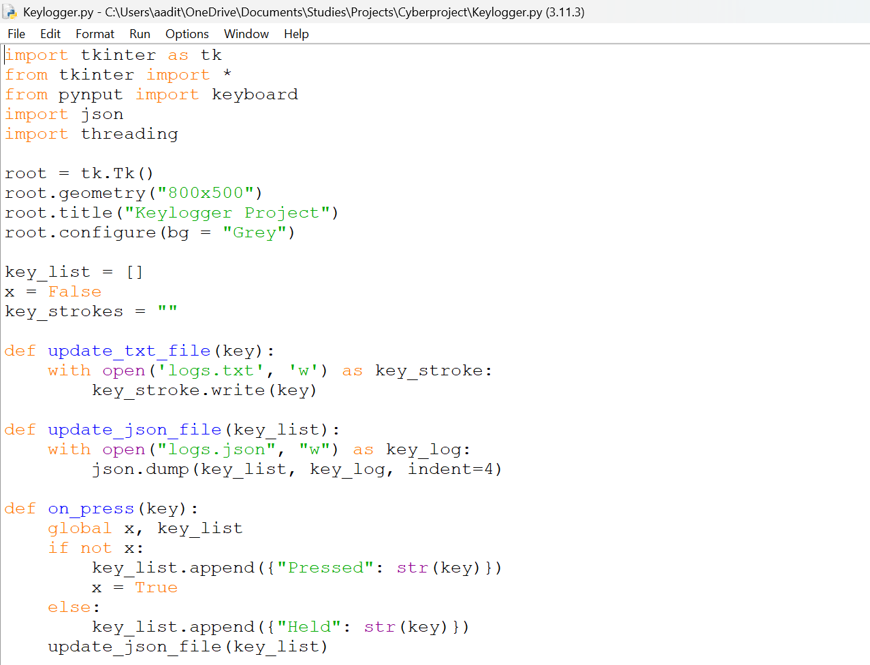
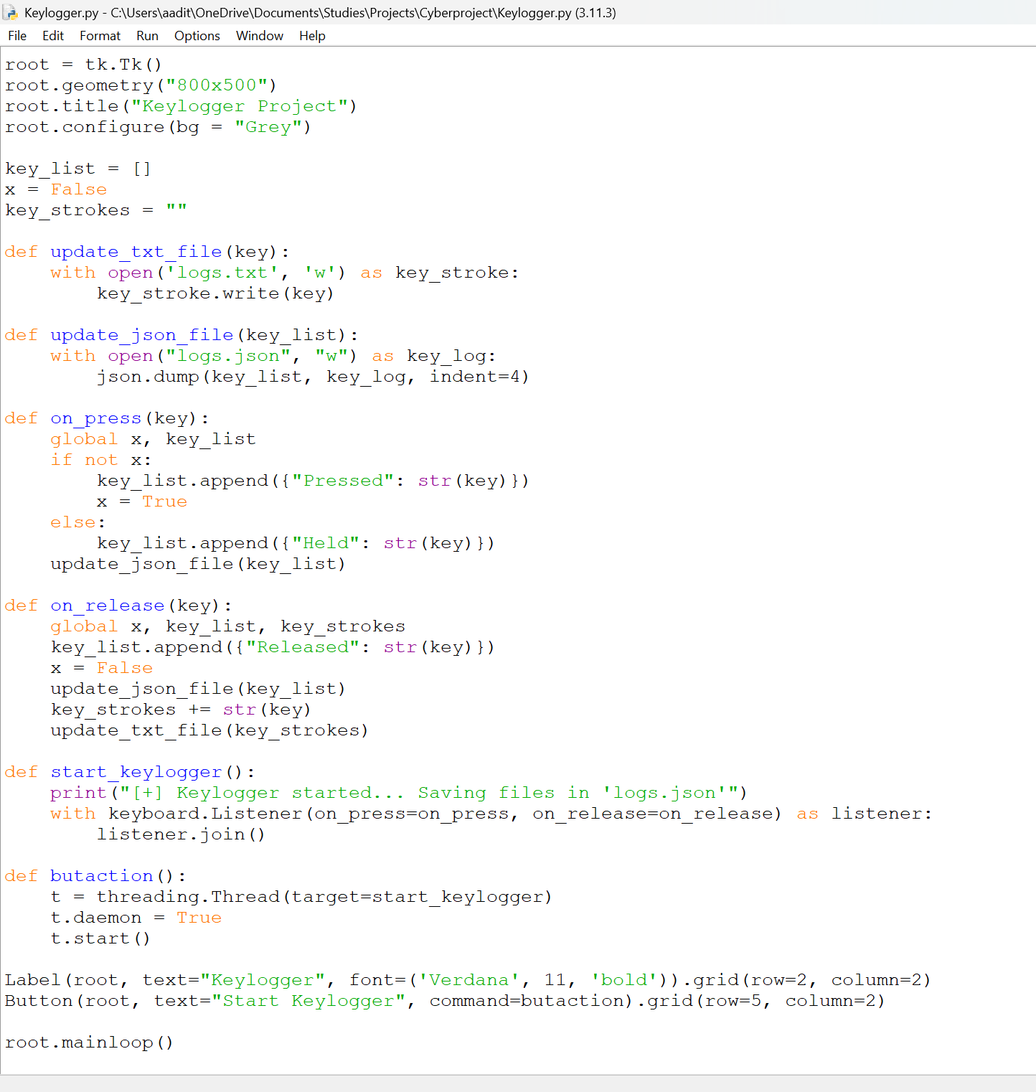
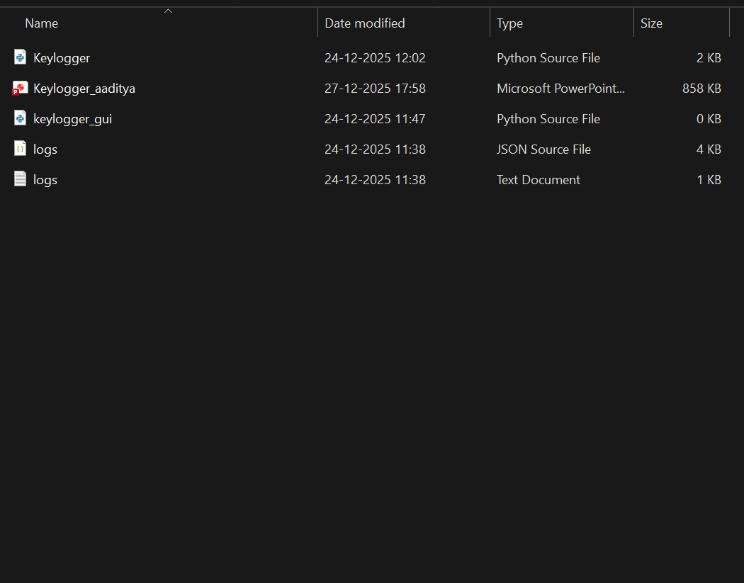
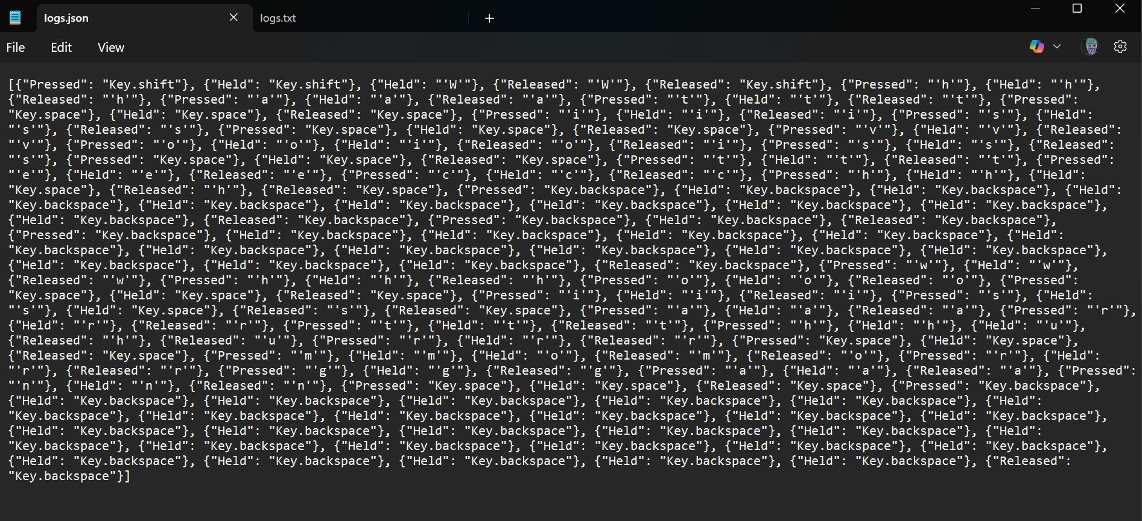
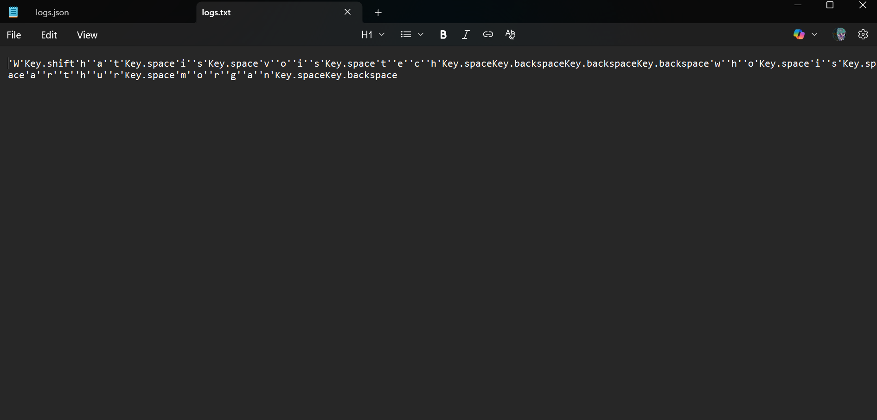
RESULTS
Demo Link : https://github.com/Aaditya2522/VoisTech/tree/main

Slide 7
Thank you
.
.

