Slide 1

CLOGGED
PUNE TRAFFIC ANALYSIS, FORECASTING AND VISUALIZATION

Slide 2
Introduction / Background
Road-level view
01
CLOGGED is a web dashboard for road-level congestion across Pune’s city core.
Two time horizons
02
It supports historical exploration across the past 365 days and forecasting across the next 30 days.
Open data, calibrated model
03
The project combines open road geometry with a calibrated congestion model.
02 / 15

Slide 3
Problem Statement
ACCESS
COST
CHALLENGE
Road by road
Paid APIs
Explore locally
Pune lacks a free, public map that shows congestion road by road and hour by hour.
Especially a Bird's Eye view of all the Roads and Segments is missing from all major map provdiders.
Commercial traffic APIs are paid and rate-limited.
The challenge is to provide an explorable city view without paid API keys.
03 / 15

Slide 4
Motivation
UNDERSTAND
PROTOTYPE
DEMONSTRATE
01
02
03
Make patterns visible
Keep it local
Model openly
Provide a low-cost prototype that can be explored locally.
Show how open geographic data and transparent modelling can support urban mobility analysis.
Help students, commuters, planners, and researchers understand how traffic behaves.
04 / 15

Slide 5
Objectives
28,535
24 h
365 d
30 d
PUNE ROAD SEGMENTS
TIME CONTROL
HISTORICAL VIEW
FORECAST VIEW
Identify slow, gridlocked, and persistently congested roads.
01
Provide search, locality filtering, road details, and visual summaries.
02
05 / 15

Slide 6
Literature Review
Project-named sources and tools
NETWORK LAYER
CALIBRATION ANCHOR
APPLICATION LAYER
OpenStreetMap
TomTom Traffic Index
Web mapping stack
Provides openly licensed road geometry for the network layer.
TomTom Traffic Index — Pune 2025 supplies the calibration anchors used by the model.
Leaflet supports interactive web mapping, while FastAPI and NumPy support the local service layer.
06 / 15

Slide 7
Research / Technical Gap
EXISTING TOOLS
Commercial tools
Not free or fully transparent for this use case.
A city-scale traffic view, without hiding the model behind a commercial service.
CLOGGED
Open prototype
A city-scale, road-level interface without a live traffic API.
RESEARCH CONTRIBUTION
A transparent, reproducible model that anyone can inspect, run locally, and extend.
07 / 15

Slide 8

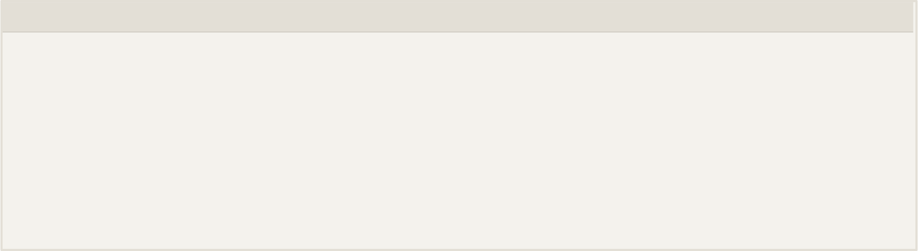
Proposed Approach / Methodology
From open road geometry to an explorable map
Assign
Extract
Assign free-flow speeds from OSM values or road-class defaults.
Extract Pune road geometry from the Geofabrik Western Zone OpenStreetMap data.
Render
Model
Serve the model through a local API and render results on an interactive map.
Apply weekday/weekend curves, road-class scaling, persistence factors, and deterministic noise.
08 / 15

Slide 9
Technologies / Tools / Techniques Discussed
Layer | Technologies | Role in the build
Data and model | Python, NumPy, Pandas, Pyrosm | Process road data and calculate congestion values.
Service layer | FastAPI, Uvicorn | Serve the local model through an API.
Interface | HTML, CSS, JavaScript, Leaflet | Render the interactive map and user controls.
Storage and interaction | GeoJSON, NPZ, SVG, canvas | Use flat files, visual summaries, and responsive selection.
SPATIAL INDEXING SUPPORTS RESPONSIVE HOVER AND CLICK SELECTION. NO DATABASE IS REQUIRED.
09 / 15

Slide 10
Key Findings / Analysis
28,535
1,655
4,698
18:00
SEGMENTS
ROAD NAMES
ARTERIAL SEGMENTS
EVENING PEAK
Four congestion buckets. Fast moving, moderate, slow, and gridlocked.
Peak model value. The evening peak near 18:00 reaches about 108% congestion.
Interpretation. The internal backtest reports correlation 0.9915 and MAE 0.988%
10 / 15

Slide 11
Advantages and Limitations
ADVANTAGES
LIMITATIONS
Zero cost
Modelled, not measured
01
01
Runs on open data with no API keys, rate limits, or recurring fees.
Congestion comes from a calibrated formula, not from sensors or probe vehicles.
Road-level detail
Self-consistency backtest
02
02
All 28,535 segments can be explored hour by hour, 365 days back and 30 days ahead.
The r ≈ 0.99 and MAE ≈ 1% compare the model with itself, not with real traffic.
Lightweight and repeatable
Approximate inputs
03
03
Two flat files and a single command. The same date and hour always give the same result.
Free-flow speeds are mostly class defaults, and the junction bottleneck flag is not yet active.
11 / 15

Slide 12
Applications
EDUCATION
COMMUTERS
PLANNING AND RESEARCH
01
02
03
Teach with maps
Spot the peaks
Prototype ideas
Show students how open geographic data and a transparent model can describe urban traffic.
Compare weekday and weekend patterns to see when and where Pune’s roads slow down.
Use the map as a low-cost testbed for bottleneck and persistent-congestion studies.
BUILT ON OPEN DATA TO MAKE PUNE’S TRAFFIC PATTERNS EASY TO EXPLORE.
12 / 15

Slide 13
Future Scope
Real probe data
01
Calibrate and validate the model against measured traffic from sensors or probe vehicles.
Fix junction detection
02
Add node columns to the road table so junction bottlenecks are flagged and the peak bump takes effect.
Smarter road grouping and coverage
03
Reduce large same-named groups of unnamed roads and add more localities beyond the current 18.
Time-aware routing
04
Use the congestion model to estimate travel times and suggest routes.
13 / 15

Slide 14
Conclusion
A free, explorable congestion map for Pune
Built openly. OpenStreetMap geometry and a TomTom-calibrated model, with no API keys or recurring cost.
Explorable. 28,535 road segments across a 365-day history and a 30-day forecast, with peaks, bottlenecks, and search.
Ready to grow. The open foundation makes it simple to add real probe data, routing, and more localities.
14 / 15

Slide 15
References
OpenStreetMap contributors. OpenStreetMap: open road and map data, licensed under the ODbL. openstreetmap.org
01
TomTom. TomTom Traffic Index, Pune 2025. tomtom.com/traffic-index
02
Geofabrik GmbH. OpenStreetMap data extract, India: Western Zone. download.geofabrik.de/asia/india
03
Agafonkin, V. Leaflet: an open-source JavaScript library for interactive maps (v1.9.4). leafletjs.com
04
Ramírez, S. FastAPI: modern, fast web framework for building APIs with Python. fastapi.tiangolo.com
05
Tenkanen, H. Pyrosm: reading OpenStreetMap PBF data into GeoDataFrames. pyrosm.readthedocs.io
06
Harris, C. R. et al. (2020). Array programming with NumPy. Nature, 585, 357–362.
07
15 / 15

