Slide 1
unit2

Slide 2
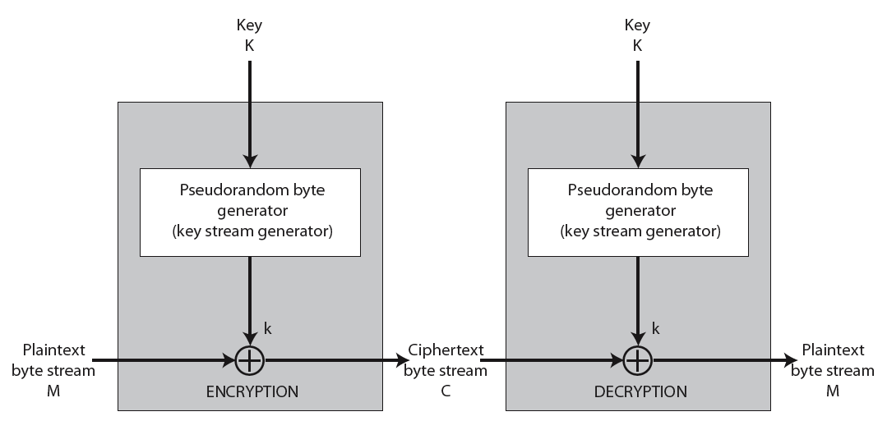
Stream Cipher Structure
Notes:
Stallings Figure 2.8 illustrates the general structure of a stream cipher, where a key is input to a pseudorandom bit generator that produces an apparently random keystream of 8- bit number
The output of the generator is called keystream and is combined one byte at a time with a plaintext stream using XOR operation.

Slide 3
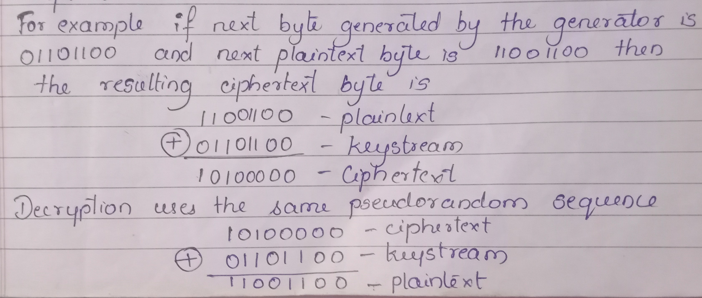

Slide 4
Stream Cipher Properties
Important design considerations are:
The encryption sequence should have longer period
‘to guard against brute force attack the key needs to be sufficiently large
Advantage: it is almost always faster as it uses less code than block cipher
Disadvantage: with stream cipher if two ciphertext are XORed, the result is the XOR of their corresponding plaintext so the cryptanalysis is often quite simple
Application: For application that require encryption/Decryption over stream of data() over a data communication channel or a browser/web-link) stream cipher is a better alternative.
Notes:
[

Slide 5
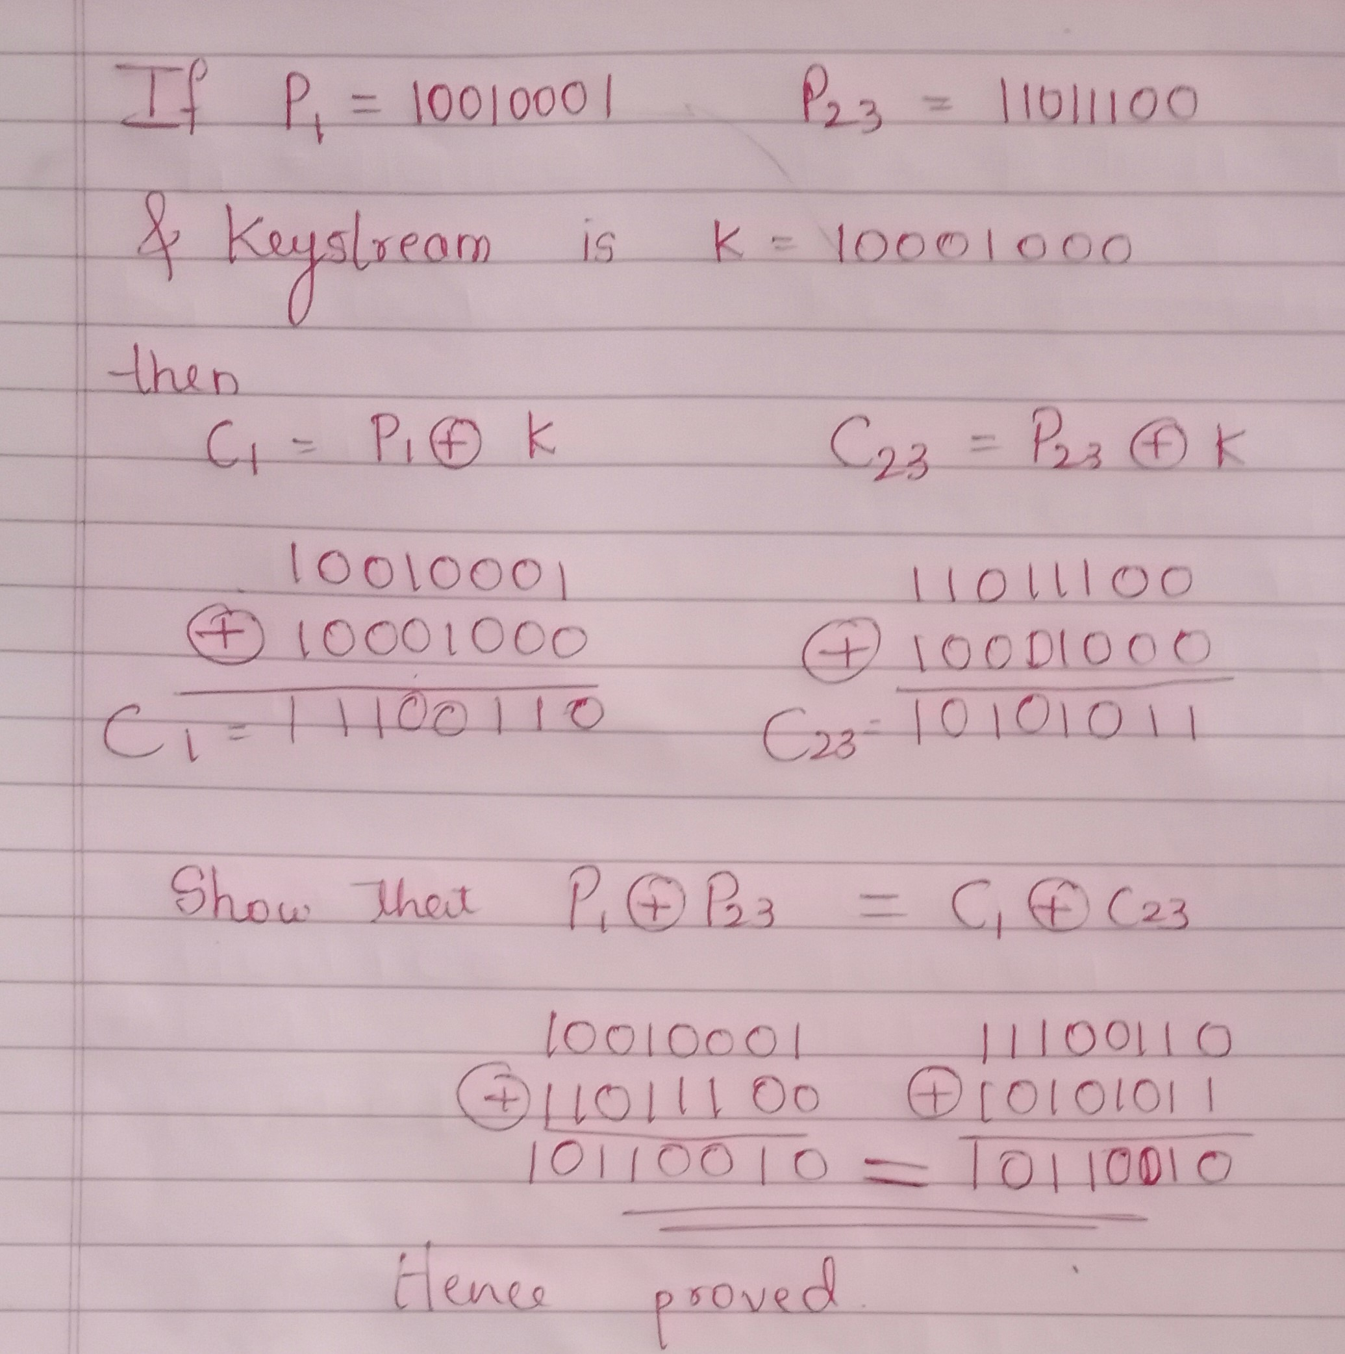

Slide 6
Modes of Operation
DES (or any block cipher) forms a basic building block, which en/decrypts a fixed sized block of data. However to use these in practise, we usually need to handle arbitrary amounts of data, which may be available in advance (in which case a block mode is appropriate), and may only be available a bit/byte at a time (in which case a stream mode is used).
To apply a block cipher in a variety of applications, five "modes of operation" have been defined by NIST (SP 800-38A).
The five modes are intended to cover a wide variety of applications of encryption for which a block cipher could be used. These modes are intended for use with any symmetric block cipher, including triple DES and AES. .
Notes:
DES (or any block cipher) forms a basic building block, which en/decrypts a fixed sized block of data. However to use these in practise, we usually need to handle arbitrary amounts of data, which may be available in advance (in which case a block mode is appropriate), and may only be available a bit/byte at a time (in which case a stream mode is used). To apply a block cipher in a variety of applications, five "modes of operation" have been defined by NIST (SP 800-38A). In essence, a mode of operation is a technique for enhancing the effect of a cryptographic algorithm or adapting the algorithm for an application, such as applying a block cipher to a sequence of data blocks or a data stream. The five modes are intended to cover a wide variety of applications of encryption for which a block cipher could be used. These modes are intended for use with any symmetric block cipher, including triple DES and AES. .

Slide 7
The Most Important Modes
Electronic Codebook Mode (ECB)
Cipher Block Chaining Mode (CBC)
Cipher Feedback Mode (CFB)
Counter Mode (CTR)
Output FeedBack mode(OFB)

Slide 8
Electronic CodeBook (ECB)
Message P is broken into independent blocks of fixed size P1,P2,P3,P4 …….PN which are encrypted using secret key K to generate ciphertext C1,C2,C3,C4….CN.
The term codebook is used because, for a given key, there is a unique ciphertext for every b-bit block of plaintext. Therefore, we can imagine a gigantic codebook in which there is an entry for every possible b-bit plaintext pattern showing its corresponding ciphertexte
Each plaintext block is encoded independently of the other blocks to generate corresponding ciphertext
C_{i} = E_{K}(P_{i})
uses: secure transmission of single values
Notes:
The simplest mode is the electronic codebook (ECB) mode, in which plaintext is handled one block at a time and each block of plaintext is encrypted using the same key. The term codebook is used because, for a given key, there is a unique ciphertext for every b-bit block of plaintext. Therefore, we can imagine a gigantic codebook in which there is an entry for every possible b-bit plaintext pattern showing its corresponding ciphertext. For a message longer than b bits, the procedure is simply to break the message into b-bit blocks, padding the last block if necessary. Decryption is performed one block at a time, always using the same key.

Slide 9
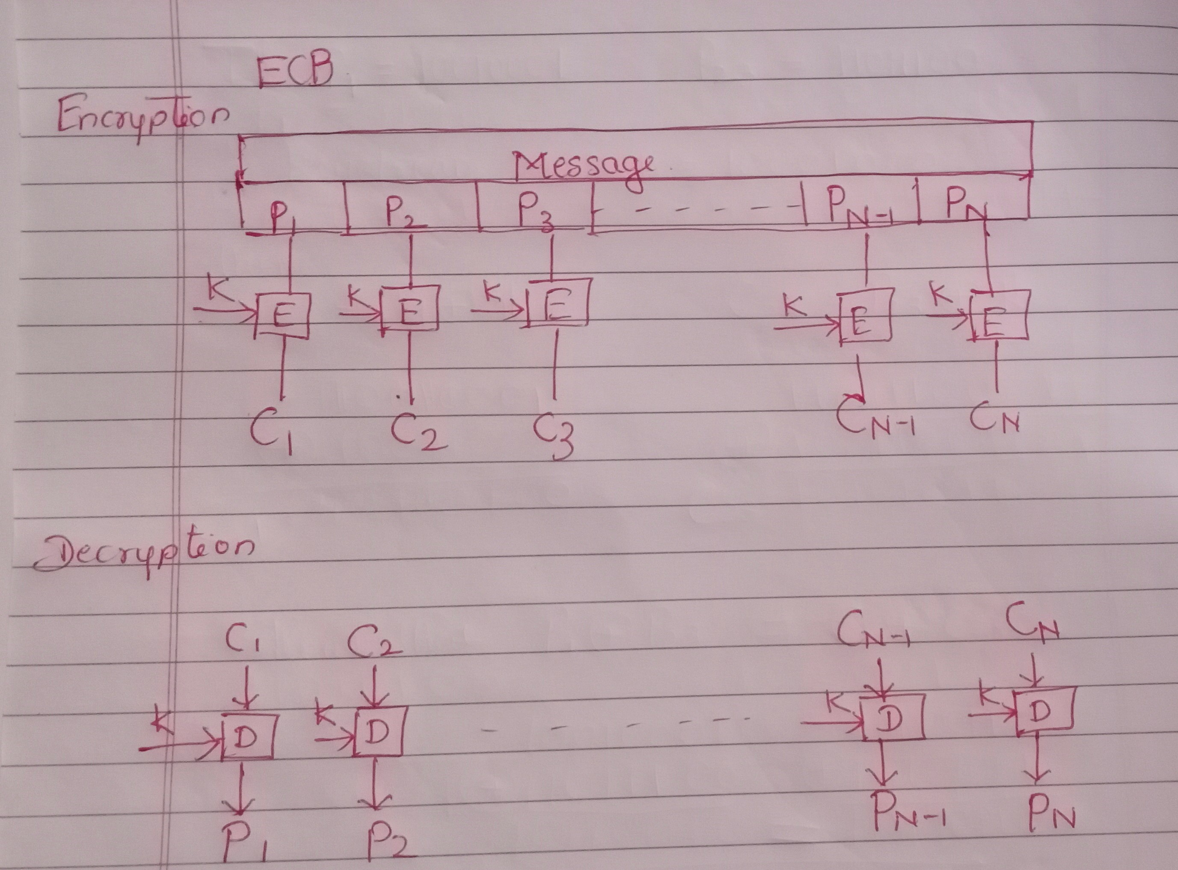

Slide 10
Limitations of ECB
Drawback: For lengthy messages, the ECB mode may not be secure. If the message is highly structured, it may be possible for a cryptanalyst to exploit these regularities. If the message has repetitive elements, with a period of repetition a multiple of b bits, then these elements can be identified by the analyst.
i.e if same b-bit block of plaintext appears more than once in the message, it always produce the same ciphertext. Because of this it is not used for lengthy message.

Slide 11
Cipher Block Chaining (CBC)
message is broken into blocks
linked together in encryption operation
each previous cipher blocks is chained with current plaintext block, hence name
use Initial Vector (IV) to start process
C_{i} = E_{K}(P_{i} XOR C_{i-1})
C₀ = IV
uses: bulk data encryption, authentication
Notes:
To overcome the problems of repetitions and order independence in ECB, want some way of making the ciphertext dependent on all blocks before it. The CBC provides this, by combining the previous ciphertext block with the current message block before encrypting. In effect, we have chained together the processing of the sequence of plaintext blocks. The input to the encryption function for each plaintext block bears no fixed relationship to the plaintext block. Therefore, repeating patterns of b bits are not exposed. For decryption, each cipher block is passed through the decryption algorithm. The result is XORed with the preceding ciphertext block to produce the plaintext block. To produce the first block of ciphertext, an initialization vector (IV) is XORed with the first block of plaintext. On decryption, the IV is XORed with the output of the decryption algorithm to recover the first block of plaintext. The IV is a data block that is that same size as the cipher block, and is either well known (often all 0's), or otherwise is sent, ECB encrypted, just before starting CBC use. CBC mode is applicable whenever large amounts of data need to be sent securely, provided that all data is available in advance (eg email, FTP, web etc).

Slide 12
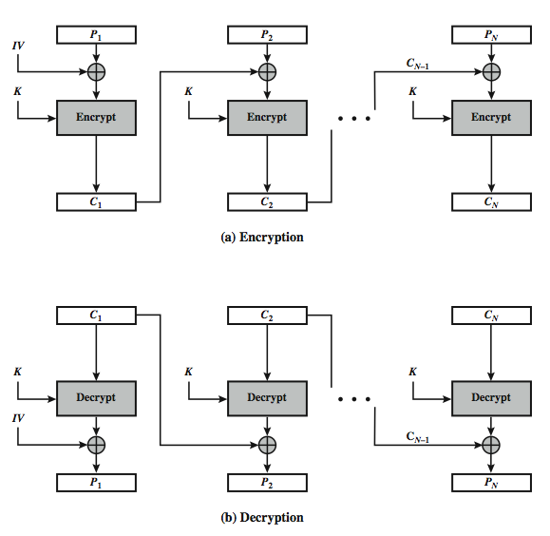
Cipher Block Chaining
Notes:
Stallings Figure 2.10 illustrates the Cipher Block Chaining (CBC) Mode.

Slide 13
Cipher FeedBack (CFB)
message is treated as a stream of bits
added to the output of the block cipher
result is feed back for next stage (hence name)
standard allows any number of bit (1,8, 64 or 128 etc) to be fed back
denoted CFB-1, CFB-8, CFB-64, CFB-128 etc
most efficient to use all bits in block (64 or 128)
C_{i} = P_{i} XOR E_{K}(C_{i-1})
C₀ = IV
uses: stream data encryption, authentication
Notes:
Cipher feedback (CFB) mode is one alternative. As with CBC, the units of plaintext are chained together, so that the ciphertext of any plaintext unit is a function of all the preceding plaintext. In this case, rather than units of b bits, the plaintext is divided into segments of s bits. The input to the encryption function is a b-bit shift register that is initially set to some initialization vector (IV). The leftmost (most significant) s bits of the output of the encryption function are XORed with the first segment of plaintext P1 to produce the first unit of ciphertext C1, which is then transmitted. In addition, the contents of the shift register are shifted left by s bits and C1 is placed in the rightmost (least significant) s bits of the shift register. This process continues until all plaintext units have been encrypted. For decryption, the same scheme is used, except that the received ciphertext unit is XORed with the output of the encryption function to produce the plaintext unit. Note that it is the encryption function that is used, not the decryption function.
As originally defined, CFB was to "consume" as much of the "random" output as needed for each message unit (bit/byte) before "bumping" bits out of the buffer and re-encrypting. This is wasteful though, and slows the encryption down as more encryptions are needed. An alternate way to think of it is to generate a block of "random" bits, consume them as message bits/bytes arrive, and when they're used up, only then feed a full block of ciphertext back. This is CFB-64 or CFB-128 mode (depending on the block size of the cipher used eg DES or AES respectively). CFB is the usual choice for quantities of stream oriented data, and for authentication use.

Slide 14
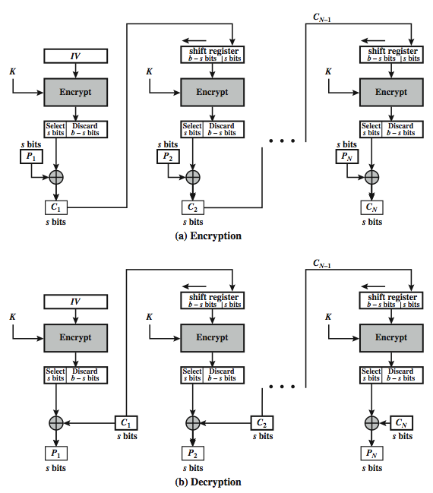
s-bit Cipher FeedBack (CFB-s)
Notes:
Stallings Figure 2.11 illustrates the operation of s-bit Cipher FeedBack (CFB) Mode.

Slide 15
Advantages and Limitations of CFB
appropriate when data arrives in bits/bytes
most common stream mode
Limitation: need to stall while doing block encryption after every n-bits
note that the block cipher is used in encryption mode at both ends
errors propagate for several blocks after the error
Notes:
CFB is the usual stream mode. As long as can keep up with the input, doing encryptions every 8 bytes. A possible problem is that if its used over a "noisy" link, then any corrupted bit will destroy values in the current and next blocks (since the current block feeds as input to create the random bits for the next)

Slide 16
Counter (CTR)
a “new” mode, though proposed early on
similar to OFB but encrypts counter value rather than any feedback value
must have a different key & counter value for every plaintext block (never reused)
O_{i} = E_{K}(i)
C_{i} = P_{i} XOR O_{i}
uses: high-speed network encryptions
Notes:
The Counter (CTR) mode is a variant of OFB, but which encrypts a counter value (hence name). Although it was proposed many years before, it has only recently been standardized for use with AES along with the other existing 4 modes. It is being used with applications in ATM (asynchronous transfer mode) network security and IPSec (IP security). A counter, equal to the plaintext block size is used. The only requirement stated in SP 800-38A is that the counter value must be different for each plaintext block that is encrypted. Typically the counter is initialized to some value and then incremented by 1 for each subsequent block. As with the OFB mode, the initial counter value must be a nonce; be different for all of the messages encrypted using the same key. Further, all counter values across all messages must be unique. If, contrary to this requirement, a counter value is used multiple times, then the confidentiality of all of the plaintext blocks corresponding to that counter value may be compromised.

Slide 17
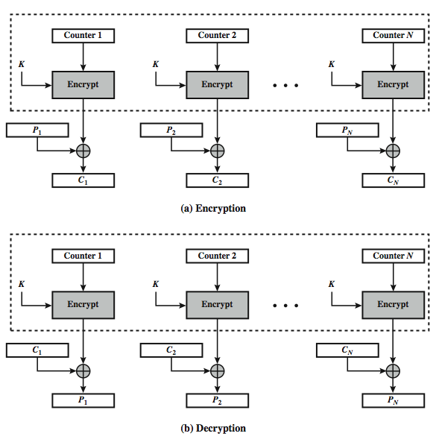
Counter (CTR)
Notes:
Stallings Figure 2.11 illustrates the Counter (CTR) Mode.

Slide 18
Advantages and Limitations of CTR
hardware efficiency: unlike chaining mode CTR can be done in parallel and hence maximum throughput can be achieved.
Software efficiency: because of parallel executions, the preprocessors can be efficiently used
random access : any block of plaintext or ciphertext can be processed in random fashion as it does not depends on preceding plaintext.
Simplicity: very simple implementation of encryption algorithm and no need of separate decryption
provable security : CTR is as secure as other modes of block cipher
Limitations:
but must ensure never reuse key/counter values, otherwise could break (cf OFB)
Notes:
CTR mode has a number of advantages in parallel h/w & s/w efficiency, can preprocess the output values in advance of needing to encrypt, can get random access to encrypted data blocks, and is simple. But like OFB have issue of not reusing the same key+counter value.

Slide 19
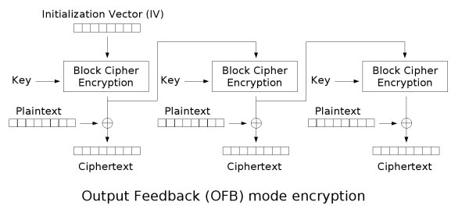
Output Feedback Mode (OFB)

Slide 20
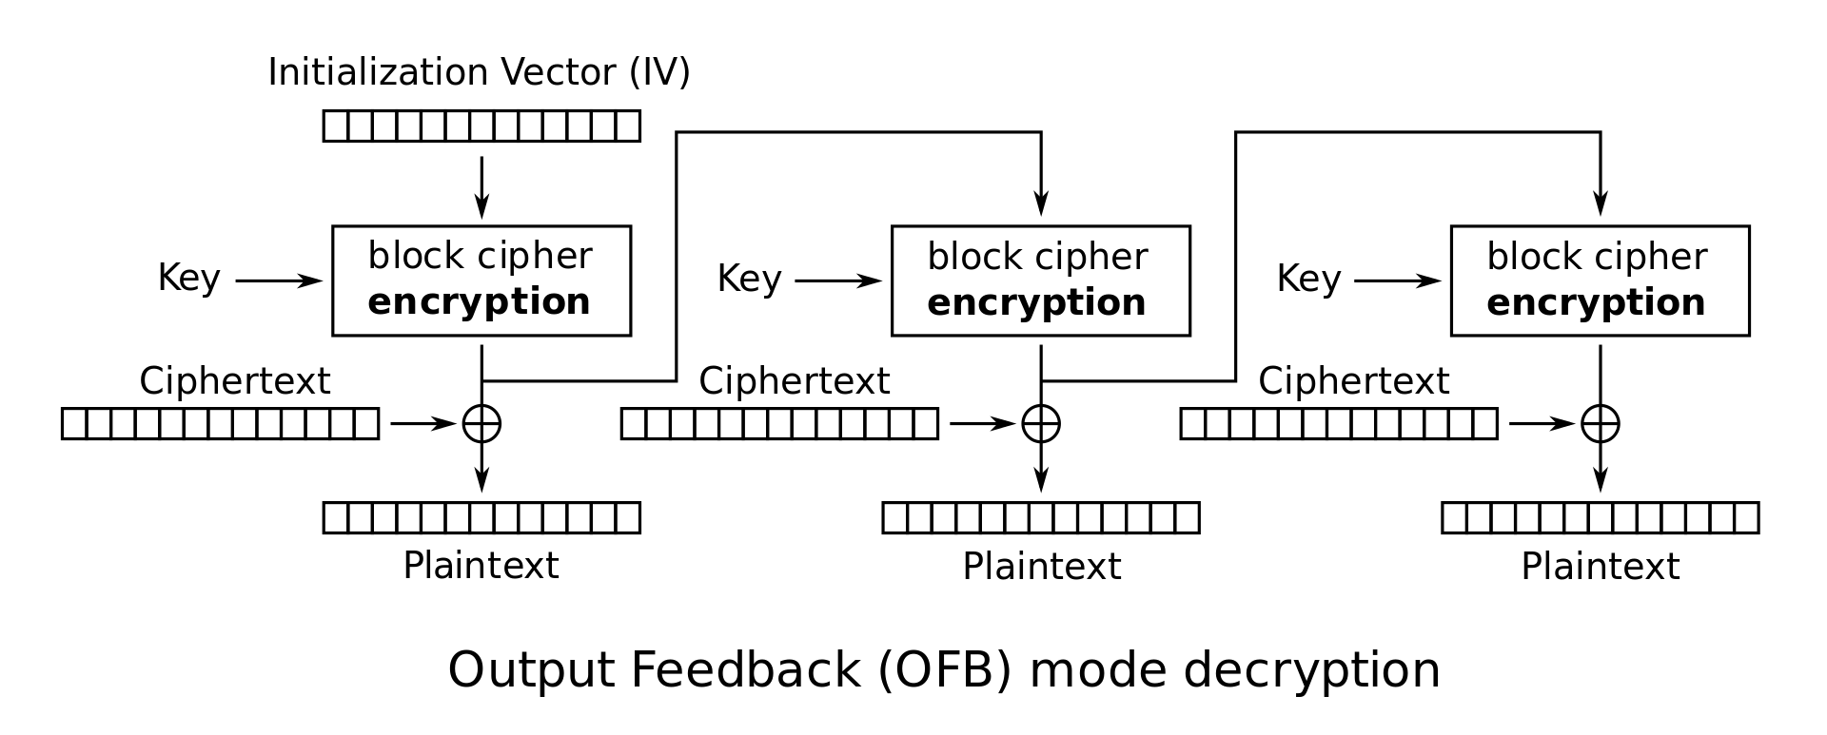

Slide 21
The output feedback (OFB) mode makes a block cipher into a synchronous stream cipher. It generates keystream blocks, which are then XORed with the plaintext blocks to get the ciphertext. Just as with other stream ciphers, flipping a bit in the ciphertext produces a flipped bit in the plaintext at the same location. This property allows many error-correcting codes to function normally even when applied before encryption.
Because of the symmetry of the XOR operation, encryption and decryption are exactly the same:

Slide 22
Approaches to Message Authentication
Definition: Message authentication is a procedure that allows the communicating parties to verify that received message is authentic
When do we say that message is authentic?
If the message is not altered during the transmission
If the message comes from intended sender only.
We may also wish to verify a message’s timeliness (it has not been artificially delayed and replayed) and sequence relative to other messages flowing between two parties
There are two approaches for message authentication
Authentication using conventional encryption
Authentication without using encryption

Slide 23
Authentication using conventional encryption
If we assume that only the sender and receiver share a key (which is as it should be), then only the genuine sender would be able to encrypt a message successfully for the other participant and receiver will be assured that message has been sent by the alleged sender only.
Furthermore, if the message includes an error-detection code and a sequence number, the receiver is assured that no alterations have been made and that sequencing is proper.
If the message also includes a timestamp, the receiver is assured that the message has not been delayed beyond that normally expected for network transit
But symmetric encryption alone is not a suitable tool for data authentication. For example, in the ECB mode of encryption, if an attacker reorders the blocks of ciphertext, then each block will still decrypt successfully. However, the reordering may alter the meaning of the overall data sequence

Slide 24
Authentication without encryption
There are several approaches to message authentication that do not rely on encryption.
In all of these approaches, an authentication tag is generated and appended to each message for transmission.
Because the message itself is not encrypted ,it can be read at the destination independent of the authentication function.
Because there is no transmission of encrypted message , message confidentiality is not provided.
To provide message confidentiality sending only encrypted message without the authentication tag also do not provide secure form of authentication
However, it is possible to combine authentication and confidentiality in a single algorithm by encrypting a message plus its authentication tag.

Slide 25
There are situations in which message authentication without confidentiality is preferable:
Applications in which same message is broadcasted to number of destinations. Ex: notification to users that network is now unavailable.
Another possible scenario is an exchange in which one side has a heavy load and cannot afford the time to decrypt all incoming messages. Authentication is carried out on a selective basis with messages being chosen at random for checking.
3. Authentication of a computer program in plaintext is an attractive service. The computer program can be executed without having to decrypt it every time, which would be wasteful of processor resources. However, if a message authentication tag were attached to the program, it could be checked whenever assurance is required of the integrity of the program.
Thus, there is a place for both authentication and encryption in meeting security requirements.

Slide 26
Message Authentication Code(MAC)
One authentication technique involves the use of a secret key to generate a small block of data, known as a message authentication code (MAC), that is appended to the message.
This technique assumes that two communicating parties, say A and B, share a common secret key K_{AB}
When A has a message to send to B, it calculates the message authentication code as a function of the message and the key: MAC_{M}=F(K_{AB}, M).The message plus code are transmitted to the intended recipient. The recipient performs the same calculation on the received message, using the same secret key, to generate a new message authentication code. The received code is compared to the calculated code

Slide 27
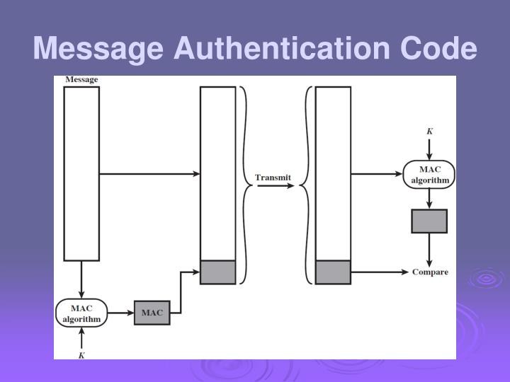

Slide 28
If we assume that only the receiver and the sender know the identity of the secret key, and if the received code matches the calculated code, then the following statements apply:
The receiver is assured that the message has not been altered. If an attacker alters the message but does not alter the code, then the receiver’s calculation of the code will differ from the received code.
The receiver is assured that the message is from the alleged sender. Because no one else knows the secret key, no one else could prepare a message with a proper code.
If the message includes a sequence number (such as used in TCP), then the receiver can be assured of the proper sequence.
A number of algorithms could be used to generate the code. The most commonly used algorithm to generate the MAC is DES. Out of 64bit code generated using DES, only last 16 or 32 bits is considered as MAC.

Slide 29
One-Way Hash Function
An alternate to Message Authentication Code is one-way hash function which uses hash function to generate authentication tag called message digest
A hash function H takes a variable length message M as input and produces a fixed size message digest MD_{M} as output
unlike MAC, hash function does not take secret key as input
To authenticate a message, the message digest itself is made authentic using any of the three following ways
Using conventional encryption
Using public key encryption
Using secret value

Slide 30
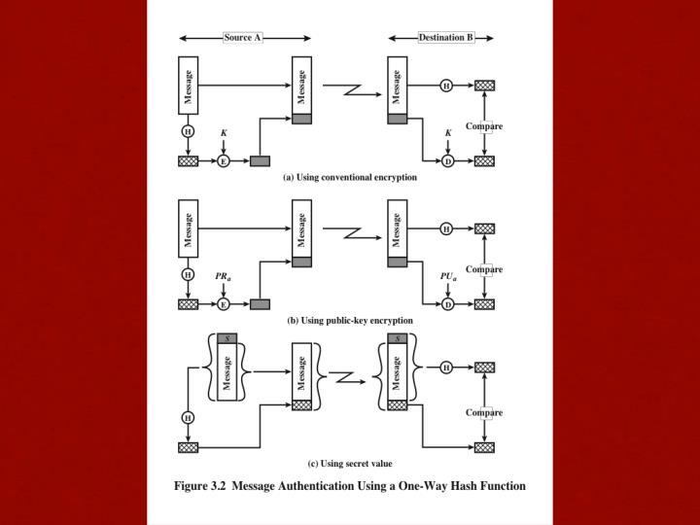
1. Using conventional encryption

Slide 31
Using public key encryption

Slide 32
Using secret value

