Slide 1
Relational Algebra
π
CS 186 Spring 2006, Lecture 8
R & G, Chapter 4
By relieving the brain of all unnecessary work, a good notation sets it free to concentrate on more advanced problems, and, in effect, increases the mental power of the race.
-- Alfred North Whitehead (1861 - 1947)

Slide 2
Administrivia
Midterm 1 – Tues 2/21, in class
Covers all material up to and including Th 2/16
Closed book – can bring 1 8.5x11” sheet of notes
No calculators – no cell phones
Midterm 2 – Th 3/21, in class
Focuses on material after MT 1
Same rules as above.
Homework 1 – 2/14
Homework 2 – Out after MT 1, Due 3/14

Slide 3
Relational Query Languages
Query languages: Allow manipulation and retrieval of data from a database.
Relational model supports simple, powerful QLs:
Strong formal foundation based on logic.
Allows for much optimization.
Query Languages != programming languages!
QLs not expected to be “Turing complete”.
QLs not intended to be used for complex calculations.
QLs support easy, efficient access to large data sets.

Slide 4
Formal Relational Query Languages
Two mathematical Query Languages form the basis for “real” languages (e.g. SQL), and for implementation:
Relational Algebra: More operational, very useful for representing execution plans.
Relational Calculus: Lets users describe what they want, rather than how to compute it. (Non-procedural, declarative.)
Understanding Algebra & Calculus is key to
understanding SQL, query processing!

Slide 5
Preliminaries
A query is applied to relation instances, and the result of a query is also a relation instance.
Schemas of input relations for a query are fixed (but query will run over any legal instance)
The schema for the result of a given query is also fixed. It is determined by the definitions of the query language constructs.
Positional vs. named-field notation:
Positional notation easier for formal definitions, named-field notation more readable.
Both used in SQL

Slide 6
Relational Algebra: 5 Basic Operations
Selection ( ) Selects a subset of rows from relation (horizontal).
Projection ( ) Retains only wanted columns from relation (vertical).
Cross-product (x) Allows us to combine two relations.
Set-difference (–) Tuples in r1, but not in r2.
Union (∪ ) Tuples in r1 and/or in r2.
Since each operation returns a relation, operations can be composed! (Algebra is “closed”.)

Slide 7
Example Instances
R1
S1
S2
Boats

Slide 8
Projection
Examples: ;
Retains only attributes that are in the “projection list”.
Schema of result:
exactly the fields in the projection list, with the same names that they had in the input relation.
Projection operator has to eliminate duplicates (How do they arise? Why remove them?)
Note: real systems typically don’t do duplicate elimination unless the user explicitly asks for it. (Why not?)

Slide 9
Projection
S2

Slide 10
Selection (σ)
Selects rows that satisfy selection condition.
Result is a relation.
Schema of result is same as that of the input relation.
Do we need to do duplicate elimination?

Slide 11
Union and Set-Difference
All of these operations take two input relations, which must be union-compatible:
Same number of fields.
`Corresponding’ fields have the same type.
For which, if any, is duplicate elimination required?

Slide 12
Union
S1
S2

Slide 13
Set Difference
S1
S2 – S1
S2

Slide 14
Cross-Product
S1 x R1: Each row of S1 paired with each row of R1.
Q: How many rows in the result?
Result schema has one field per field of S1 and R1, with field names `inherited’ if possible.
May have a naming conflict: Both S1 and R1 have a field with the same name.
In this case, can use the renaming operator:

Slide 15
Cross Product Example
R1
S1
R1 X S1 =

Slide 16
Compound Operator: Intersection
In addition to the 5 basic operators, there are several additional “Compound Operators”
These add no computational power to the language, but are useful shorthands.
Can be expressed solely with the basic ops.
Intersection takes two input relations, which must be union-compatible.
Q: How to express it using basic operators?
R ∩ S = R − (R − S)

Slide 17
Intersection
S1
S2

Slide 18
Compound Operator: Join
Joins are compound operators involving cross product, selection, and (sometimes) projection.
Most common type of join is a “natural join” (often just called “join”). R S conceptually is:
Compute R X S
Select rows where attributes that appear in both relations have equal values
Project all unique atttributes and one copy of each of the common ones.
Note: Usually done much more efficiently than this.
Useful for putting “normalized” relations back together.

Slide 19
Natural Join Example
R1
S1
R1 S1 =

Slide 20
Other Types of Joins
Condition Join (or “theta-join”):
Result schema same as that of cross-product.
May have fewer tuples than cross-product.
Equi-Join: Special case: condition c contains only conjunction of equalities.

Slide 21
“Theta” Join Example
R1
S1
=

Slide 22
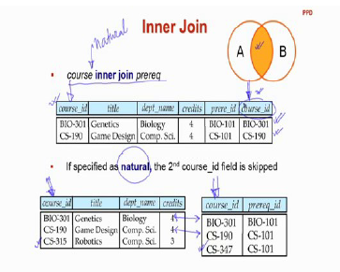

Slide 23
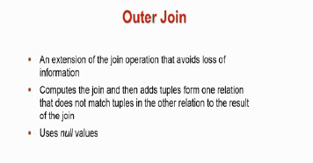

Slide 24
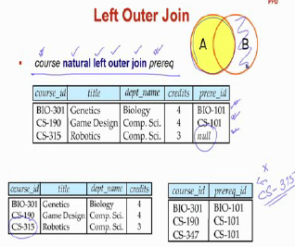

Slide 25
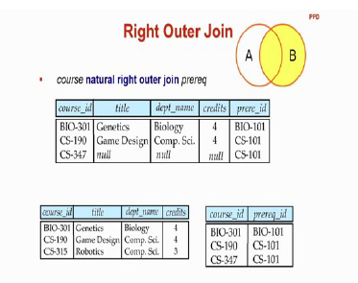

Slide 26
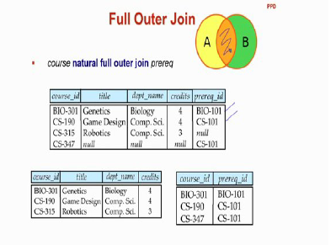

Slide 27
Compound Operator: Division
Useful for expressing “for all” queries like: Find sids of sailors who have reserved all boats.
For A/B attributes of B are subset of attrs of A.
May need to “project” to make this happen.
E.g., let A have 2 fields, x and y; B have only field y:
A/B contains all x tuples such that for every y tuple in B, there is an xy tuple in A.

Slide 29
Examples of Division A/B
B1
B2
B3
A
A/B1
A/B2
A/B3

Slide 30
Expressing A/B Using Basic Operators
Division is not essential op; just a useful shorthand.
(Also true of joins, but joins are so common that systems implement joins specially.)
Idea: For A/B, compute all x values that are not `disqualified’ by some y value in B.
x value is disqualified if by attaching y value from B, we obtain an xy tuple that is not in A.
Disqualified x values:
A/B:
Disqualified x values

Slide 31
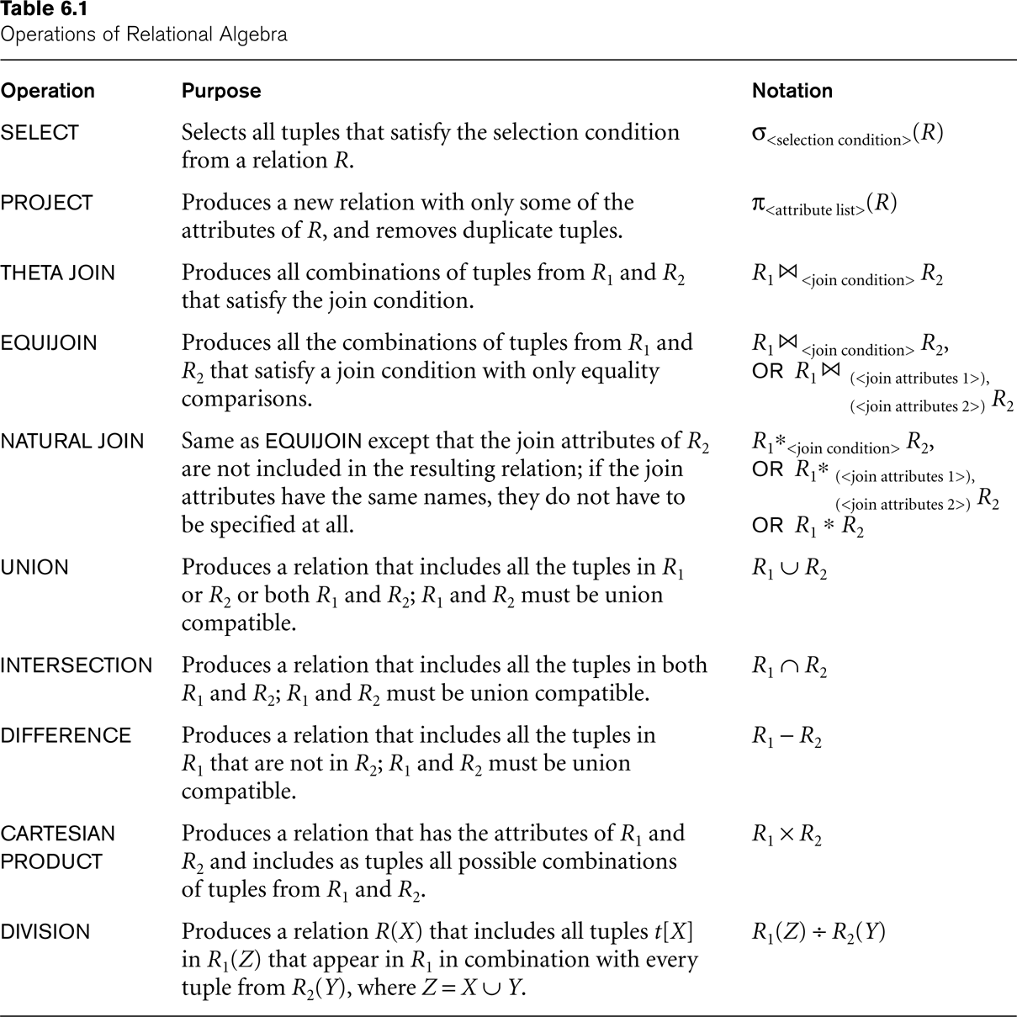

Slide 32
Examples
Reserves
Sailors
Boats

Slide 33
Find names of sailors who’ve reserved boat #103
Solution 1:
Solution 2:

Slide 34
Find names of sailors who’ve reserved a red boat
Information about boat color only available in Boats; so need an extra join:
A more efficient (???) solution:
A query optimizer can find this given the first solution!

Slide 35
Find sailors who’ve reserved a red or a green boat
Can identify all red or green boats, then find sailors who’ve reserved one of these boats:

Slide 36
Find sailors who’ve reserved a red and a green boat
Previous approach won’t work! Must identify sailors who’ve reserved red boats, sailors who’ve reserved green boats, then find the intersection (note that sid is a key for Sailors):

Slide 37
Find the names of sailors who’ve reserved all boats
Uses division; schemas of the input relations to / must be carefully chosen:
To find sailors who’ve reserved all ‘Interlake’ boats:
.....

Slide 39
Extended Relational-Algebra-Operations
Generalized Projection
Outer Join
Aggregate Functions

Slide 41
Generalized Projection
Extends the projection operation by allowing arithmetic functions to be used in the projection list. ∏ _{F1, F2, …, Fn}(E)
E is any relational-algebra expression
Each of F₁, F₂, …, F_{n} are are arithmetic expressions involving constants and attributes in the schema of E.
Given relation credit-info(customer-name, limit, credit-balance), find how much more each person can spend:
∏customer-name, limit – credit-balance (credit-info)

Slide 43
Aggregate Functions and Operations
Aggregation function takes a collection of values and returns a single value as a result.
avg: average value min: minimum value max: maximum value sum: sum of values count: number of values
Aggregate operation in relational algebra
_{G1, G2, …, Gn} g _{F1( A1), F2( A2),…, Fn( An)} (E)
E is any relational-algebra expression
G₁, G₂ …, G_{n} is a list of attributes on which to group (can be empty)
Each F_{i} is an aggregate function
Each A_{i} is an attribute name

Slide 44
Aggregate Functions and Operations
Aggregation function takes a collection of values and returns a single value as a result.
avg: average value min: minimum value max: maximum value sum: sum of values count: number of values
Aggregate operation in relational algebra
_{G1, G2, …, Gn} g _{F1( A1), F2( A2),…, Fn( An)} (E)
E is any relational-algebra expression
G₁, G₂ …, G_{n} is a list of attributes on which to group (can be empty)
Each F_{i} is an aggregate function
Each A_{i} is an attribute name

Slide 46
Aggregate Functions and Operations
Aggregation function takes a collection of values and returns a single value as a result.
avg: average value min: minimum value max: maximum value sum: sum of values count: number of values
Aggregate operation in relational algebra
_{G1, G2, …, Gn} g _{F1( A1), F2( A2),…, Fn( An)} (E)
E is any relational-algebra expression
G₁, G₂ …, G_{n} is a list of attributes on which to group (can be empty)
Each F_{i} is an aggregate function
Each A_{i} is an attribute name

Slide 48
Relational Calculus
Comes in two flavors: Tuple relational calculus (TRC) and Domain relational calculus (DRC).
Calculus has variables, constants, comparison ops, logical connectives and quantifiers.
TRC: Variables range over (i.e., get bound to) tuples.
DRC: Variables range over domain elements (= field values).
Both TRC and DRC are simple subsets of first-order logic.
Expressions in the calculus are called formulas. An answer tuple is essentially an assignment of constants to variables that make the formula evaluate to true.

Slide 49
Tuple Relational Calculus
A nonprocedural query language, where each query is of the form
{t | P (t) }
It is the set of all tuples t such that predicate P is true for t
t is a tuple variable, t[A] denotes the value of tuple t on attribute A
t ∈ r denotes that tuple t is in relation r
P is a formula similar to that of the predicate calculus

Slide 50
Predicate Calculus Formula
1. Set of attributes and constants
2. Set of comparison operators: (e.g., <, ≤, =, ≠, >, ≥)
3. Set of connectives: and (∧), or (v)‚ not (¬)
4. Implication (⇒): x ⇒ y, if x if true, then y is true
x ⇒ y ≡ ¬x v y
5. Set of quantifiers:
∃ t ∈ r (Q(t)) ≡ ”there exists” a tuple in t in relation r
such that predicate Q(t) is true
∀t ∈ r (Q(t)) ≡ Q is true “for all” tuples t in relation r

Slide 51
Banking Example
branch (branch-name, branch-city, assets)
customer (customer-name, customer-street, customer-city)
account (account-number, branch-name, balance)
loan (loan-number, branch-name, amount)
depositor (customer-name, account-number)
borrower (customer-name, loan-number)

