Slide 1

UNIT - 8
TRANSACTIONS

Slide 2

Transaction Concept
A transaction refers to a collection of operations that form a single logical unit of work
It is a unit of program execution that accesses and possibly updates various data items.
E.g. transaction to transfer $50 from account A to account B:
begin
A := A – 50
B := B + 50
end

Slide 3
Transaction is initiated by user program written in high level data manipulation language (typically SQL)
A transaction access data using reads and writes of database objects
Example of Fund Transfer:
Transfer $50 from account A to B (Initially A=100, B=100)
1. read(A)
2. A := A – 50
3. write(A)
4. read(B)
5. B := B + 50
6. write(B)

Slide 4
ACID Properties
To preserve the integrity of data, the database system must ensure:
A
Atomicity
C
Consistency
I
Isolation
D
Durability
Properties of Transaction
( ACID)

Slide 5
1) Atomicity Property:
Either all operations of the transaction are properly done in the database or none
Example of Fund Transfer :
Transaction to transfer $50 from account A to account B:
1. read(A)
2. A := A – 50
3. write(A)
4. read(B)
5. B := B + 50
6. write(B)
Atomicity requirement
If the transaction fails after step 3 and before step 6, money will be “lost” leading to an inconsistent database state
Failure could be due to software or hardware
The system should ensure that updates of a partially executed transaction are not reflected in the database
Ensuring atomicity is the responsibility of the database system itself; specifically, it is handled by a component called the transaction-management component

Slide 6
2) Consistency Property:
Execution of a transaction in isolation (i.e. with no other transaction executing concurrently) preserves the consistency of the database.
Example of Fund Transfer :
Transaction to transfer $50 from account A ($100) to account B ($ 100):
1. read(A)
2. A := A – 50
3. write(A)
4. read(B)
5. B := B + 50
6. write(B)
Consistency requirement
The sum of A and B be unchanged by the execution of the transaction
If the database is consistent before an execution of the transaction, the database remains consistent after the execution of the transaction
Erroneous transaction logic can lead to inconsistency
50
150
200

Slide 7
3) Isolation Property:
Although multiple transactions may execute concurrently, each transaction must be unaware of other concurrently executing transactions.
for every pair of transactions T_{i} and T_{j}, it appears to T_{i} that either T_{j}, finished execution before T_{i} started, or T_{j} started execution after T_{i} finished.
Intermediate transaction results must be hidden from other concurrently executed transactions.
Ensuring the isolation property is the responsibility of a component of the database system called the concurrency-control component.

Slide 8
Isolation requirement
T1 T2
1. read(A)
2. A := A – 50
3. write(A) read(A), read(B), print(A+B)
4. read(B)
5. B := B + 50
6. write(B
if between steps 3 and 6, another transaction T2 is allowed to access the partially updated database, it will see an inconsistent database (the sum A + B will be less than it should be).
Isolation can be ensured trivially by running transactions serially that is, one after the other.

Slide 9
4) Durability Property:
After a transaction completes successfully, the changes it has made to the database persist, even if there are system failures.
The durability property guarantees that once the user has been notified that the transaction has completed (i.e., the transfer of the $50 has taken place), the updates to the database by the transaction must persist even if there are software or hardware failures.
Ensuring durability is the responsibility of a component of the database system called the recovery-management component.

Slide 10
Transaction States
All transaction must be completed successfully
A transaction that completes its execution without any failure known as “Committed”
For successfully completion of a transaction, a transaction must be in one of the following states:
Active: the initial state; the transaction stays in this state while it is executing
Partially committed: after the final statement has been executed
Failed: after the discovery that normal execution can no longer proceed
Aborted: after the transaction has been rolled back and the database has been restored to its state prior to the start of the transaction
Committed: after successful completion

Slide 11
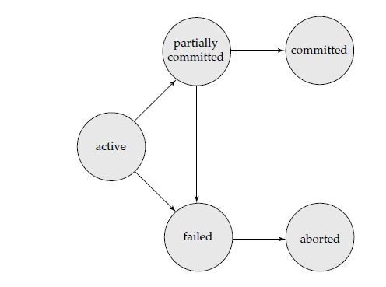
State Diagram of a Transaction

Slide 12
Transaction Termination
Committed
Aborted
Rolled Back
Committed: After successful execution of a transaction, all changes made within it are permanently saved
Aborted: If a transaction fails, all changes made within it are not saved
Rolled Back: An operation which returns the database to its previous state. Rollbacks are important for database integrity, because they mean that the database can be restored to a clean copy even after erroneous operations are performed
We cannot abort or rollback a committed transaction

Slide 13
Aborted State
(System has 2 options)
Restart Transaction
Kill Transaction
RESTART is considered to be a new transaction without having any internal logical error
KILL is commonly used to terminate a process that is blocking other important processes. In database, kill is used for rewriting the application program.

Slide 14
Implementation of Atomicity and Durability
The recovery-management component of a database system can support atomicity and durability by a variety of schemes.
We first consider a simple, but extremely inefficient scheme called the shadow copy scheme.
This scheme is based on making copies of the database, called shadow copies, assumes that only one transaction is active at a time.
The scheme also assumes that the database is simply a file on
disk. A pointer called db-pointer is maintained on disk; it points to the current copy of the database.

Slide 15
In the shadow-copy scheme, a transaction that wants to update the database first creates a complete copy of the database.
All updates are done on the new database copy, leaving the original copy, the shadow copy, untouched.
If at any point, the transaction has to be aborted, the system merely deletes the new copy. The old copy of the database has not been affected.
If all operations are successfully completed on shadow copy of the database then delete the old copy
The implementation actually depends on the write to db-pointer
The atomicity and durability properties of transactions are ensured by the shadow-copy implementation of the recovery-management component

Slide 16
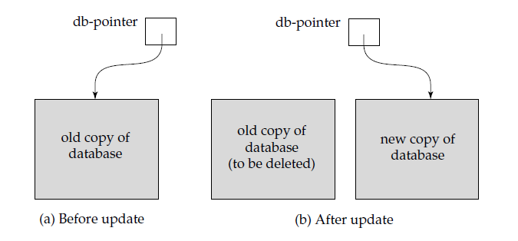
Shadow copy technique for atomicity and durability

Slide 17
Concurrent Executions
Multiple transactions are allowed to run concurrently in the system
Advantages:
increased processor and disk utilization, leading to better transaction throughput E.g. one transaction can be using the CPU while another is reading from or writing to the disk
reduced average response time for transactions: short transactions need not wait behind long ones.
When several transactions run concurrently, database consistency can be destroyed despite the correctness of each individual transaction
We present the concept of schedules to help identify those executions that are guaranteed to ensure consistency.

Slide 18
Schedules
Schedule – a sequences of instructions that specify the chronological order in which instructions of concurrent transactions are executed
“A schedule for a set of transactions must consist of all instructions of those transactions must preserve the order in which the instructions appear in each individual transaction”
A transaction that successfully completes its execution will have a commit instructions as the last statement
A transaction that fails to successfully complete its execution will have an abort instruction as the last statement
Schedule
Serial
Concurrent

Slide 19
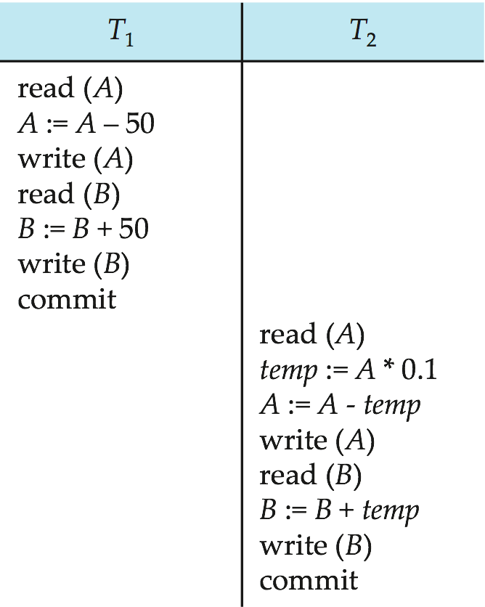
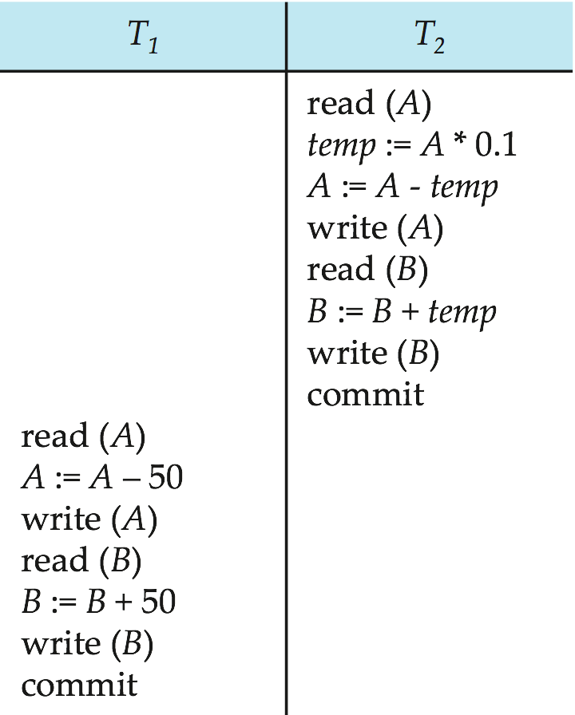
Serial Schedule
Let T₁ transfer $50 from A to B, and T₂ transfer 10% of the balance from A to B. A = $1000, B = $2000
Schedules 1
Schedules 2
Serial Schedules

Slide 20
Serial Schedule
Let T₁ transfer $50 from A to B, and T₂ transfer 10% of the balance from A to B. A = $1000, B = $2000
A + B = $3000
Schedule
T1
A: 1000-50 = 950
A = 950
B: 2000+50 = 2050
B = 2050
T2
A : 950
Temp: 950*0.1 = 95
A : 950 – 95 = 855
A= 855
B: 2050
B : 2050 + 95 = 2145
B = 2145
Final Values

Slide 21
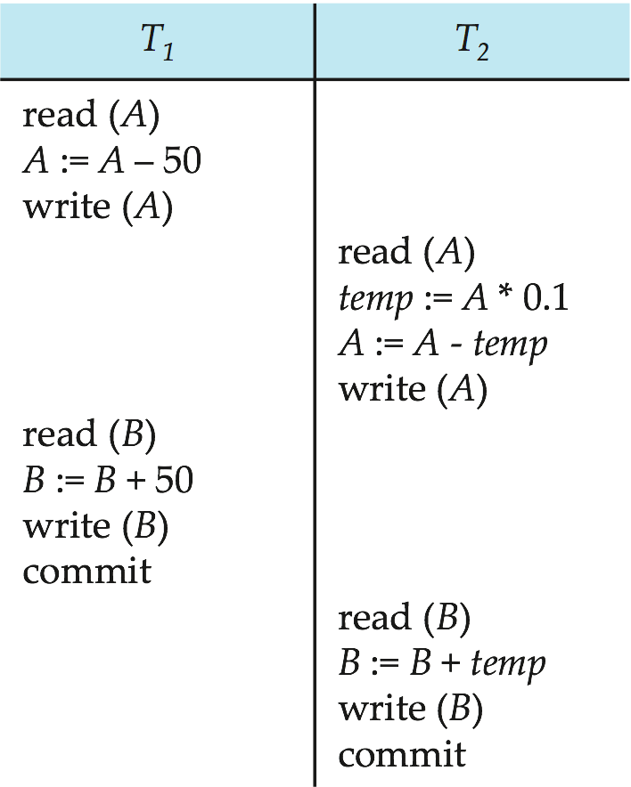
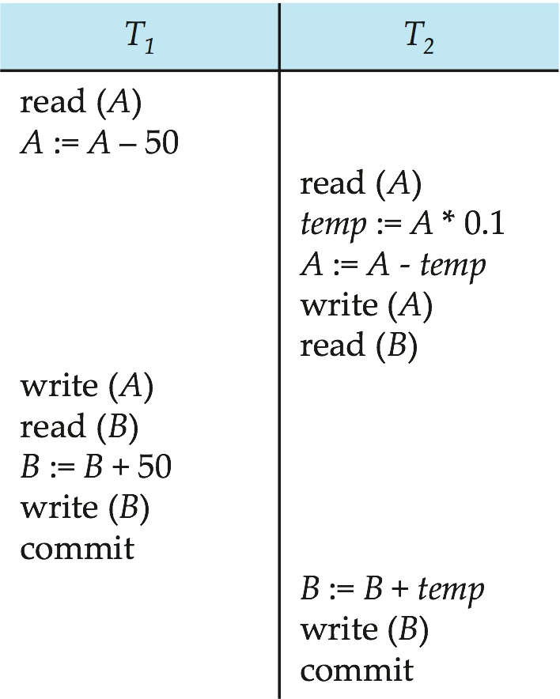
Concurrent Schedule
Schedules 3
Schedules 4
It Preserves Consistency
It does not preserve Consistency

Slide 22
Serializability
The database system must control concurrent execution of transactions, to ensure that the database state remains consistent
Thus serial execution of a set of transactions preserves database consistency
A (possibly concurrent) schedule is serializable if it is equivalent to a serial schedule.
Different forms of schedule equivalence give rise to the notions of:
1. conflict serializability
2. view serializability

Slide 23
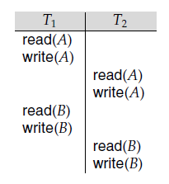
T1 | T2
Read (A) Write (A) Read (B) Write (B) | Read (A) Write (A) Read (B) Write (B)
Serializability
Concurrent Schedule
Serial Schedule

Slide 24
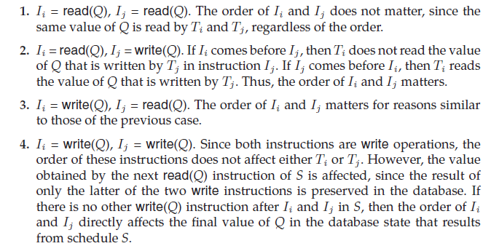
Conflict Serializability
Instructions l_{i} and l_{j} of transactions T_{i} and T_{j} respectively, conflict if and only if there exists some item Q accessed by both l_{i} and l_{j} (same data item accessed by different transaction at the same time), and at least one of these instructions is a write operation.
4 Cases to ensure conflict serializability:

Slide 25
Conflict Serializability
Conflict : different operations on same data item (Case 3)
No Conflict : different operations on different data item
Conflict equivalent leads to conflict serializability

Slide 26
Convert Conflict Equivalence into Serializability
A conflict (concurrent) schedule can be transformed into serial schedule by number of swap operations:
If Ii = Read (Q) ; Ij = Read (Q) : We can swap it
If Ii = Read (Q) ; Ij = Read (P) : We can swap it
If Ii = Read (Q) ; Ij = Write (P) : We can swap it
If Ii = Write (Q) ; Ij = Read (P) : We can swap it
if Ii=Write(Q); Ij=Write(P): we can swap it

Slide 27
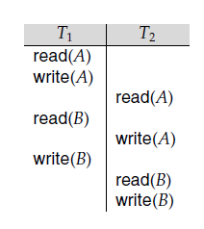
T1 | T2
Read (A) Write (A) Read (B) Write (B) | Read (A) Write (A) Read (B) Write (B)
T1 | T2
Read (A) Write (A) Read (B) Write (B) | Read (A) Write (A) Read (B) Write (B)
T1 | T2
Read (A) Write (A) Read (B) Write (B) | Read (A) Write (A) Read (B) Write (B)
Serial Schedule
After swapping

Slide 28
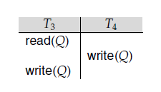
Example for Non-Conflict Schedule
Schedule
We are unable to swap instructions in the above schedule to obtain either the serial schedule < T3, T4> or the serial schedule < T4, T3> due to write operation on same data item

Slide 29
View Serializability
It always gives guarantee for serializability but it is less powerful than conflict seralizability
View-serializability considers all the connections between transactions T and U such that T writes a database element whose value U reads
The key difference between view- and conflict serializability is that when T writes a data item than no other transaction reads that same data item
All conflict serializable transactions are view serializable but reversal is not true

Slide 30
View Serializability
Consider two schedules S and S’, where the same set of transactions participates in both schedules. The schedules S and S’ are said to be view equivalent if
Three conditions are met:
If in schedule S, transaction T_{i} reads the initial value of Q, then in schedule S’ also transaction T_{i} must read the initial value of Q.
Ti | Tj
Read (Q) Read (Y) | Read (A) Write (A)
Ti | Tj
Read (Q) Read (B) | Read (A) Write (A)
Schedule S
Schedule S’

Slide 31
View Serializability
2. For each data item Q, if transaction Ti executes read(Q) in schedule S, and if that value was produced by a write(Q) operation executed by transaction Tj , then the read(Q) operation of transaction Ti must in schedule S’ , also read the value of Q that was produced by the same write(Q) operation of transaction Tj
Ti | Tj
Read (Q) | Write (Q)
Ti | Tj
Read (Q) Read (Q) | Write (Q)
Schedule S
Schedule S’
Conditions 1 & 2 ensure that each transaction reads the same data item in both schedules

Slide 32
View Serializability
3. For each data item Q, the transaction (if any) that performs the final write(Q) operation in schedule S must perform the final write(Q) operation in schedule S’
Ti | Tj
Read (Q) Write (Q) | Write (Q)
Ti | Tj
Read (Q) Write (Q) | Write (Q)
Schedule S
Schedule S’

Slide 33
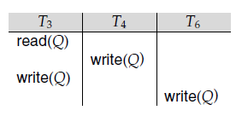
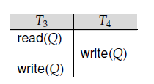
View Serializability Example
Schedule S1
Schedule S2
View
Serializable
Transactions T4 and T6 perform in schedule (S1, S2) write(Q) operations without having performed a read(Q) operation. Writes of this sort are called blind writes.
Blind writes appear in any view-serializable schedule that is not conflict serializable

Slide 34
Not view serializable

Slide 35
Testing for Serializability
When designing concurrency control schemes, we must show that schedules generated by the scheme are serializable
Testing for Conflict Serializability:
Method: Precedence Graph (directed graph) -→ G (V, E)
V = set of vertices consists of all the transactions participating in the schedule
E = set of edges consists of all edges Ti →Tj for which one of three conditions holds:
1. Ti executes write(Q) before Tj executes read(Q)
2. Ti executes read(Q) before Tj executes write(Q)
3. Ti executes write(Q) before Tj executes write(Q)

Slide 36
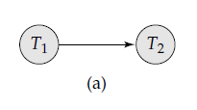
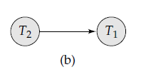
Testing for Conflict Serializability:
S2
S1
T1 | T2
Write (Q) Read (P) Write (P) | Read (Q) Write (Q)
T1 | T2
Read (Q) Write (Q) | Write (Q) Read (P) Write (P)
Precedence Graphs for S1 and S2

Slide 37
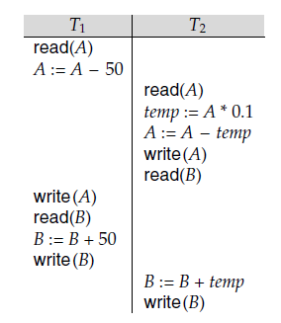
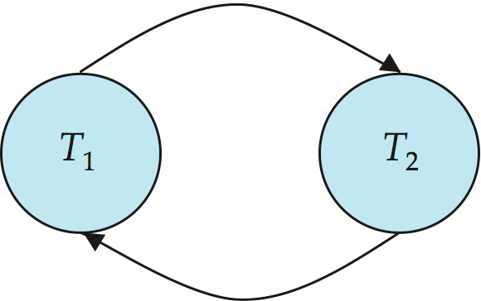
Testing for Conflict Serializability:
If the precedence graph for S has a cycle, then schedule S is not conflict serializable.
If the graph contains no cycles, then the schedule S is conflict serializable.

Slide 38
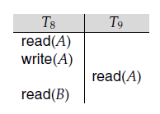
Recoverability
If a transaction Ti fails, for whatever reason, we need to undo the effect of this transaction to ensure the atomicity property of the transaction
In a system that allows concurrent execution, it is necessary also to ensure that any transaction Tj that is dependent on Ti (that is, Tj has read data written by Ti) is also aborted
Recoverable Schedules:
A recoverable schedule is one where, for each pair of transactions Ti and Tj such that Tj reads a data item previously written by Ti, the commit operation of Ti appears before the commit operation of Tj .

Slide 39
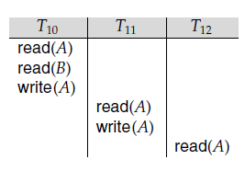
Cascadeless Schedules:
A single transaction failure leads to a series of transaction rollbacks, is called cascading rollback
Even if a schedule is recoverable, to recover correctly from the failure of a transaction Ti, we may have to roll back several transactions
Transaction T10 writes a value of A that is read by transaction T11. Transaction T11 writes a value of A that is read by transaction T12.
Suppose that, at this point, T10 fails. T10 must be rolled back. Since T11 is dependent on T10, T11 must be rolled back. Since T12 is dependent on T11, T12 must be rolled back. This phenomenon is known as cascading rollback

Slide 40
Cascadeless schedule is one where, for each pair of transactions Ti and Tj such that Tj reads a data item previously written by Ti, the commit operation of Ti appears before the read operation of Tj
Ti | Tj
Read (Q) Write (Q) Commit | Read (Q) Write (P)
Cascading rollback is undesirable

Slide 41


