Slide 1
Power Transformers Prognostics and Health Management
Mentor: Manish Chaturvedi
Aaditya Thakkar
(202301417)

Slide 2
Contributions
Outlier Detection using DBSCAN & Ridge Regression
Rogers Ratio and Random Forest
Preprocessing on DGA Dataset
Health Index Calculations

Slide 3
Outlier Detection (Oil Temperature Dataset)
Code: https://github.com/AadityaThakkar21/Prognostics-and-Health-Management-of-Power-Transformers/blob/main/main/dbscan_ridge.ipynb
Dataset Fields:
date – Timestamp
HUFL, HULL – High Useful/Useless Load
MUFL, MULL – Middle Useful/Useless Load
LUFL, LULL – Low Useful/Useless Load
OT – Oil Temperature (Target)
Dataset Meaning:
Useful Load (Active Power): Current in phase with voltage → real work.
Useless Load (Reactive Power): Out of phase → no net work but increases current.
Heating Mechanism:
Copper Loss ∝ I²R → Both active and reactive current increase temperature.
Higher-level loads (HUFL, HULL) contribute most to heating.

Slide 4
Outlier Detection (Oil Temperature Dataset)
1. Feature Engineering:
Load Magnitudes: P_high, P_mid, P_low
Rolling statistics (6h, 12h, 24h)
2. Rare Load Detection (DBSCAN):
Epsilon selected via k-distance elbow
23 clusters detected
599 rare load points (3.44%)
3. Expected Temperature Modeling (Ridge Regression):
Best window: 24h
MAE: 6.48 | R²: 0.106
Residual threshold (95%): 16.24

Slide 5
Outlier Detection (Oil Temperature Dataset)
Anomaly Criteria:
DBSCAN Outliers → Rare Load States
High Residual → Unexpected Temperature
Final Anomaly = Rare Load + Unexpected Response
Results (Total: 17,420 samples):
Rare Load Points: 599 (3.44%)
High Residual Points: 856 (4.91%)
True Anomalies: 15 (0.09%)
Model Errors: 841 (4.83%)
Interpretation:
True anomalies may indicate degradation or abnormal operation.
Model errors suggest seasonal drift or need for retraining.

Slide 6
Rogers Ratio & Random Forest (DGA Dataset)
Code:
https://github.com/AadityaThakkar21/Prognostics-and-Health-Management-of-Power-Transformers/blob/main/main/randomforest_dga.ipynb
Feature Engineering
Computed Rogers Ratios:
R1 = C2H2 / C2H4
R2 = CH4 / H2
R3 = C2H4 / C2H6
Additional feature:
TotalGas = H2 + CH4 + C2H6 + C2H4 + C2H2
Final ML features:
R1, R2, R3, TotalGas

Slide 7
Rogers Ratio & Random Forest (DGA Dataset)
1. Rogers Ratio Rule-Based Classification:
Implemented classical threshold logic
Categorizes into:
PD
Arcing
Low/Medium/High Temperature Overheating
Normal
Unknown/Other
Limitation:
Many cases fall into "Unknown/Other"
Hard thresholds → no flexibility
2. Random Forest Classifier
Model Setup:
Train-test split: 80/20 (stratified)
StandardScaler applied
RandomForest (200 trees)
Random state fixed for reproducibility
Goal:
Learn non-linear boundaries beyond fixed Rogers thresholds.

Slide 8
Rogers Ratio & Random Forest (DGA Dataset)
1. Random Forest Performance
Accuracy: 84.7%
Strong class-wise performance:
High Temp Overheating → 100% recall
Low Temp Overheating → 95% recall
Arcing → 87% recall
Weaker areas:
Partial Discharge (67% recall)
Low Energy Discharge (72% recall)
2. Rogers Method Accuracy
Accuracy: 92.6%
But only valid for 54 mapped rows
Many samples remain unmapped ("Unknown/Other")
Key Insight: Rogers performs well when rules match, but lacks full coverage.

Slide 9
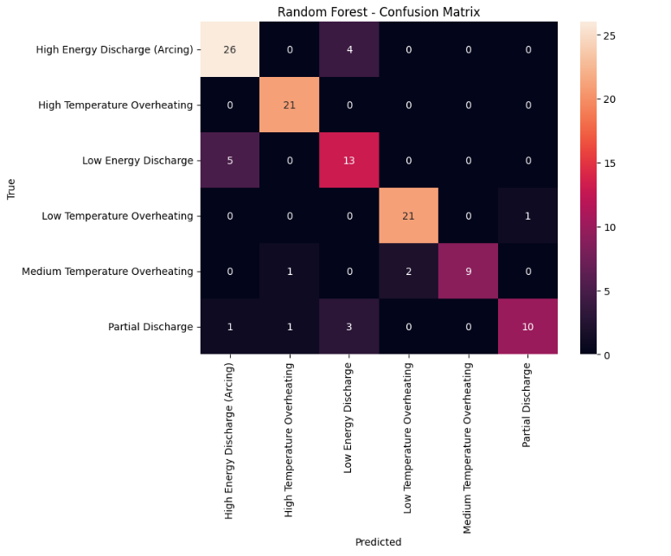
Rogers Ratio & Random Forest (DGA Dataset)

Slide 10
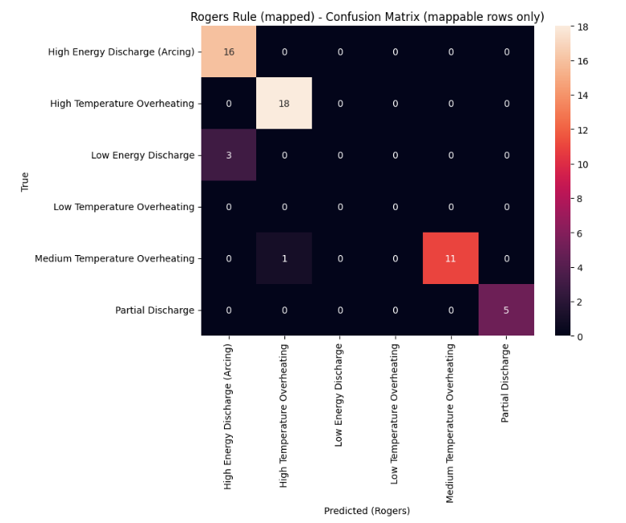
Rogers Ratio & Random Forest (DGA Dataset)

Slide 11
Preprocessing on Lancaster University Dataset (DGA Dataset)
Code:https://colab.research.google.com/drive/1mRH9hZTJWq5ZWzNfAcaZ-EbREjoV-82h?usp=sharing#scrollTo=SyM0AgT9UmrH
Hampel Filter Logic, for each point:
Compute rolling median (window centered)
Compute absolute deviation from median
Compute MAD (Median Absolute Deviation)
Define threshold: Threshold = nσ×1.4826×MAD
(1.4826 scales MAD to be comparable with standard deviation under normal distribution)
Mark point as outlier if: ∣x−median∣ > |threshold|

Slide 12
Preprocessing on Lancaster University Dataset (DGA Dataset)
Kalman Pipeline
Step 1: Detect Outliers
Rolling Z-score (window = 25)
Flag points where: ∣z∣>3.5
Step 2: Replace Outliers
Mark detected points as missing
Fit SARIMAX (AR(1) model)
Use Kalman smoothing to estimate corrected values

Slide 13
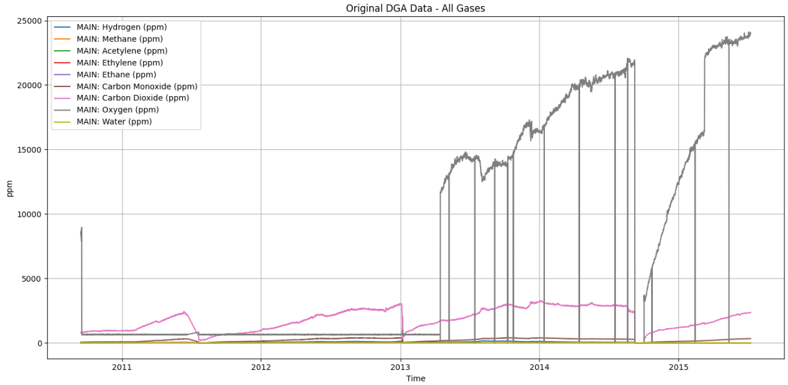
Preprocessing on Lancaster University Dataset (DGA Dataset)

Slide 14
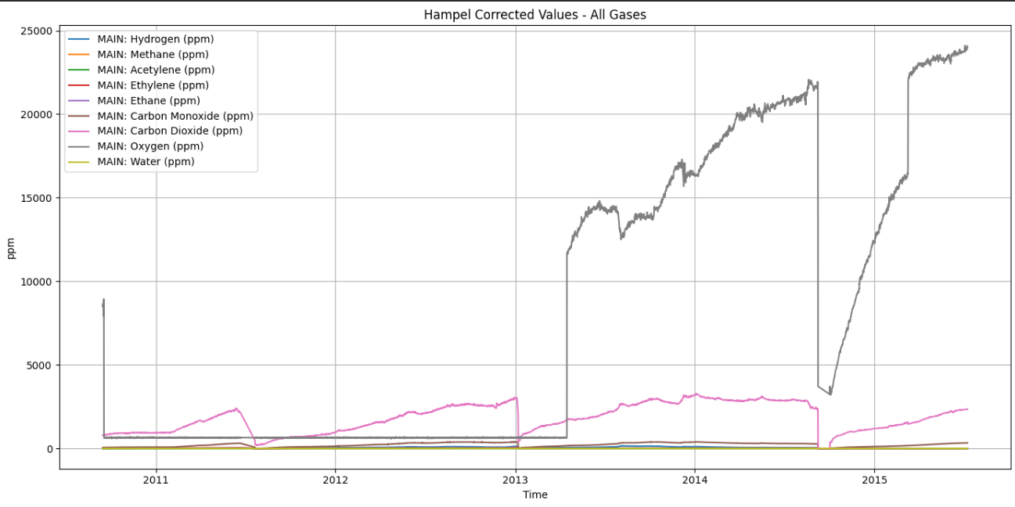
Preprocessing on Lancaster University Dataset (DGA Dataset)

Slide 15
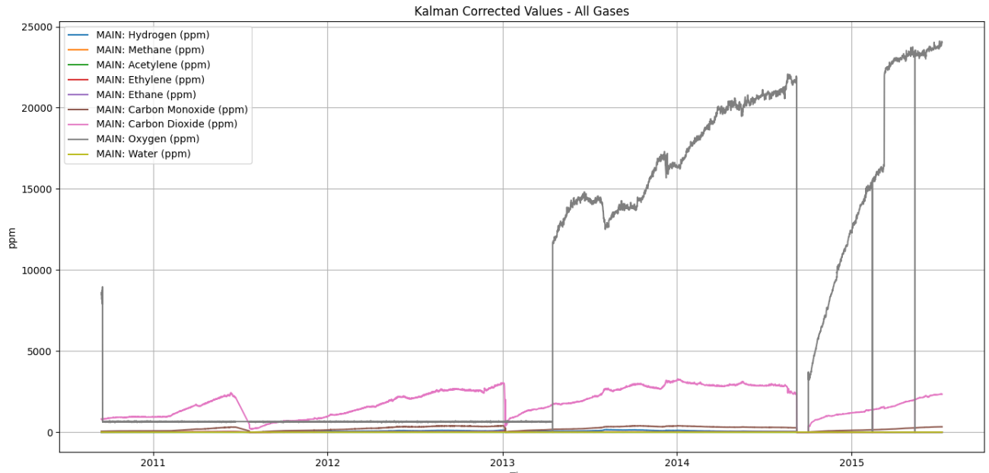
Preprocessing on Lancaster University Dataset (DGA Dataset)

Slide 16
Preprocessing on Lancaster University Dataset (DGA Dataset)
Evaluation Metrics Used:
Variance Reduction
Indicates noise suppression strength.
Correlation (Original vs Corrected)
Measures signal preservation:
High correlation → minimal distortion
Lower correlation → more aggressive smoothing

Slide 17
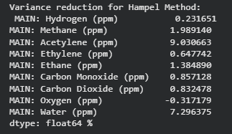
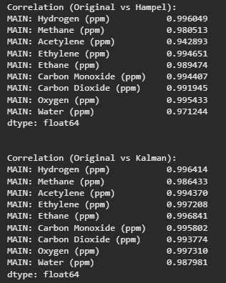
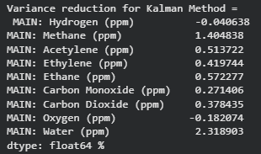
Preprocessing on Lancaster University Dataset (DGA Dataset)

Slide 18
Health Index Calculation
Paper: An Approach to Power Transformer Asset Management Using Health Index
Condition assessment and life-management techniques:
Dissolved gas analysis (DGA)
Oil quality tests
Recovery Voltage method
Excitation current test, core-to-ground test
Turns ratio test, winding resistance test
Tap charger tests (oil tests, contact resistance, motor current)
Bushing Tests (capacitance, tanδ)
Partial Discharge measurement
Frequency Response Analysis (FRA)
Furan Analysis

Slide 19
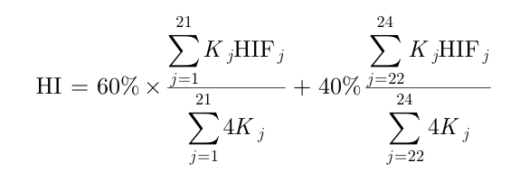
Health Index Calculation
This paper describes a practical asset HI calculation method that combines the impact of all available data and also utilises criteria based on the industry’s common practices.
Formula:

Slide 20
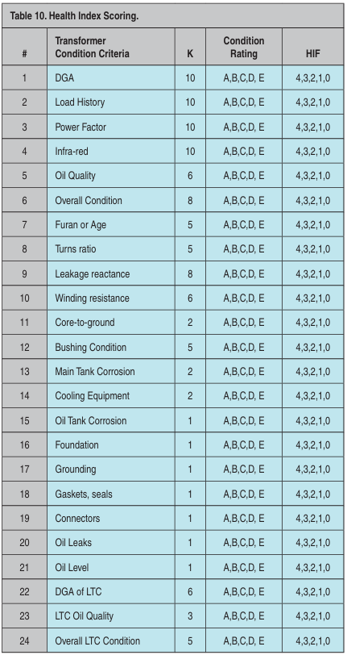
Health Index Calculation

Slide 21
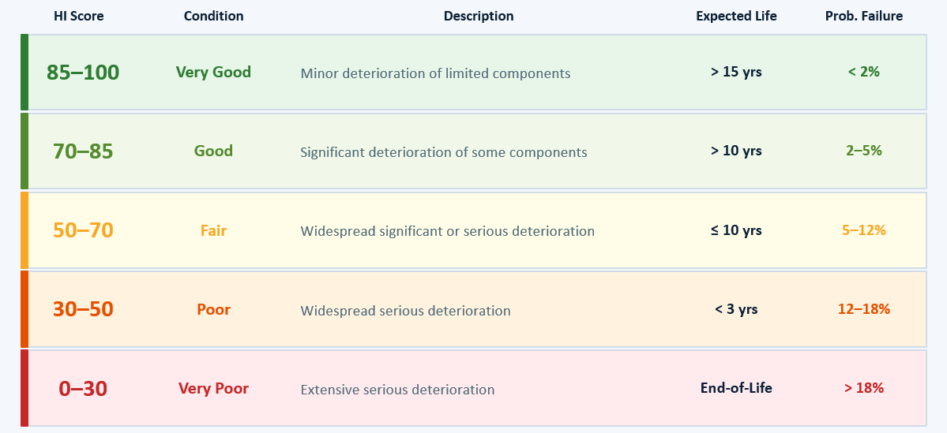
Health Index Calculation

