Slide 1
Informer: Beyond Efficient Transformer for Long Sequence Time-Series Forecasting
Authors: Haoyi Zhou et al.

Slide 2
What is Long Sequence Time-Series Forecasting (LSTF)?
Forecasting hundreds or thousands of future time steps
Critical for power systems, weather, traffic, finance
Requires strong long-range dependency modeling
Prediction errors compound rapidly with longer horizons

Slide 3
Why Existing Models Fail at LSTF
RNNs suffer from vanishing gradients and error accumulation.
CNNs have a limited effective receptive field for modeling long-range temporal dependencies.
Existing methods are mostly designed under short-term problem setting, like predicting 48 points or less.
Recently, Transformer models have shown superior performance in capturing long-range dependency than RNN models.

Slide 4
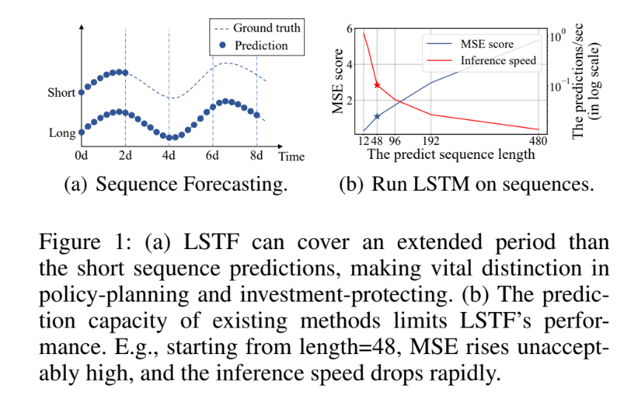
Why Existing Models Fail at LSTF

Slide 5
Why Existing Models Fail at LSTF
Self-attention shortens dependency paths to O(1), avoiding recurrence and enabling long-range dependency modeling.
However, standard self-attention incurs O(L²) time and memory complexity, making Transformers impractical for long input/output sequences.

Slide 6
Transformer Potential and Limitations
Transformers theoretically model long-range dependencies well.
Vanilla Transformer has three significant limitations in solving LSTF problem:
Self-attention incurs O(L²) time and memory complexity
The memory bottleneck in stacking layers for long inputs. The stack of J encoder/decoder layers makes total memory usage to be O(J · L²).
The speed plunge in predicting long outputs. Dynamic decoding of vanilla Transformer makes the step-by-step inference as slow as RNN-based model.
Therefore, vanilla Transformers are impractical for LSTF.

Slide 7
Informer: Core Idea
Improve Transformer efficiency and prediction capacity
ProbSparse self-attention mechanism efficiently replaces the canonical self-attention. It achieves the O(Llog L) time complexity and O(Llog L) memory usage on dependency alignments.
Self-attention distilling operation to privilege dominating attention scores in J-stacking layers and sharply reduce the total space complexity to be O((2 − ϵ)Llog L), which helps receiving long sequence input.
Generative style decoder to acquire long sequence output with only one forward step needed, simultaneously avoiding cumulative error spreading during the inference phase.

Slide 8
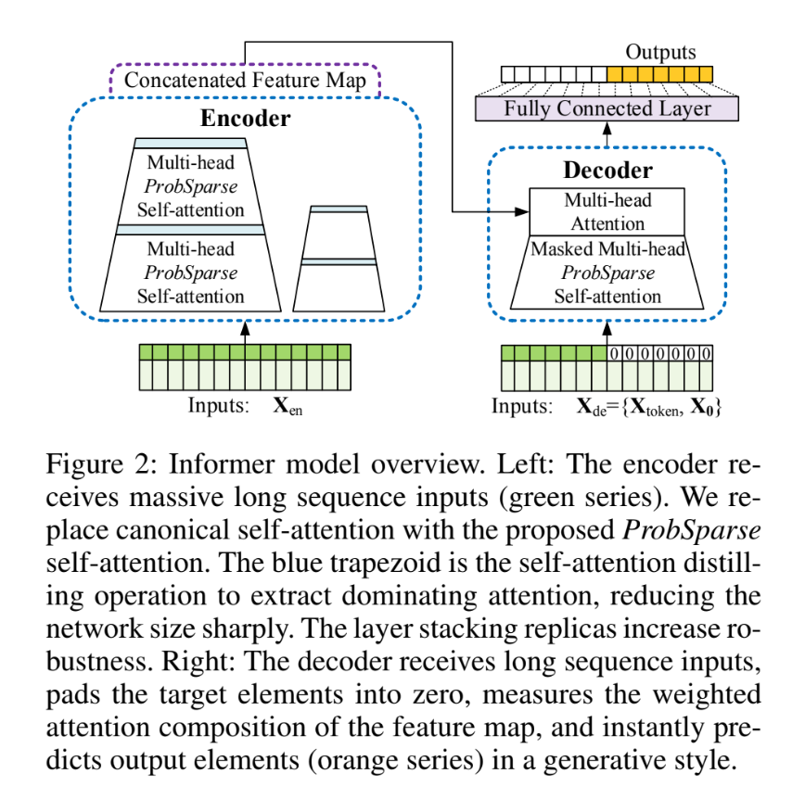
Informer: Core Idea

Slide 9
Efficient Self-attention Mechanism
Canonical Self-Attention:
The Quadratic Bottleneck: Standard self-attention relies on a scaled dot-product A(Q,K,V) = Softmax(QK^{T}/√d)V.
This requires O(L²) time complexity and memory usage, making it unaffordable for real-world Long Sequence Time-Series Forecasting (LSTF) involving massive sensor data.
This inefficiency treats all queries equally, even though many contribute only "trivial" attention

Slide 10
Efficient Self-attention Mechanism
Qualitative assessments show that self-attention probability distributions are naturally sparse.
Dominating Pairs are only a small number of dot-product pairs and contribute to the majority of the attention, while others form a "long tail" of insignificant values.
The Goal should be to distinguish important queries from trivial ones to reduce the computational load.

Slide 11
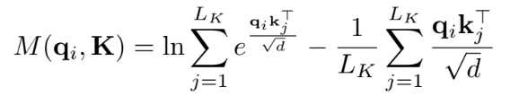
Query Sparsity Measurement
Measuring "Importance": The model uses Kullback-Leibler (KL) divergence to measure how much a query’s attention distribution (p) differs from a uniform distribution (q).
If a query's attention is close to a uniform distribution, it is redundant; if it is "diverse" (larger M score), it has a high chance of containing the dominating dot-product pairs.
Note: This measures the Log-Sum-Exp vs. the arithmetic mean of the dot products.

Slide 12
ProbSparse Self-Attention
Selective Querying instead of a full query-key lookup helps ProbSparse to allow each key to attend only to the Top-u dominant queries.
The mechanism creates a sparse matrix Q that is the same size as the original Q, but only contains the queries with the highest sparsity measurement (M) scores.
Controlled by a constant sampling factor (c), where the number of selected queries is defined as u = c⋅lnL_{Q}, which makes the ProbSparse self attention only need to calculate O(lnL_{Q}) dot-product for each query-key lookup and the layer memory usage maintains O(L_{K} lnL_{Q}).

Slide 13
ProbSparse Self-Attention
Controlled by a constant sampling factor (c), where the number of selected queries is defined as u = c⋅lnL_{Q}, which makes the ProbSparse self attention only need to calculate O(lnL_{Q}) dot-product for each query-key lookup and the layer memory usage maintains O(L_{K}lnL_{Q}).
The Challenge: Calculating the measurement M for every query would still be O(L2)

Slide 14
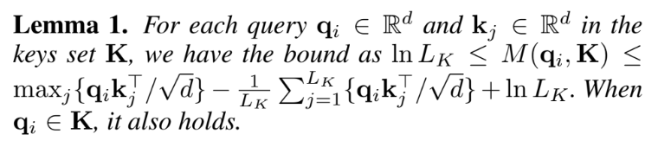
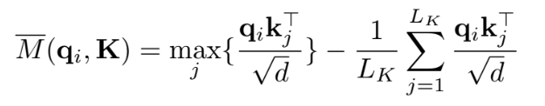
ProbSparse Self-Attention
Calculating the measurement M for every query would still be O(L²)
Based on the upper bound in Lemma 1, the authors propose a "boundary relaxation" called the Max-Mean measurement

Slide 15
ProbSparse Self-Attention
Under the "long tail" assumption (where most data is trivial), the model only needs to randomly sample a small number of dot-product pairs (U = L_{K}lnL_{Q}) to calculate these scores.
The model fills the non-sampled pairs with zeros and selects only the Top-u highest-scoring queries to move forward.
Final Complexity: When the input lengths are equal (L_{Q}=L_{K}=L), this strategy successfully reduces both time and memory usage to O(LlnL)

Slide 16
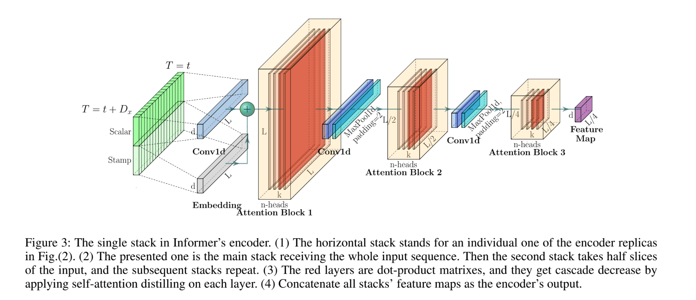
Encoder

Slide 17
Encoder
Combines Scalar values (e.g., temperature) and Stamps (temporal information) to enhance global positional and local temporal context
Self-attention Distilling: Privilege the superior combination with dominating features and make a focused self-attention feature map in the next layer.
Distilling sharply trims the input's time dimension to manage memory limitations.

Slide 18
Encoder
• The Mechanism:
Distilling Operation: Forwards information between layers using a specific sequence:
Conv1d Component: Performs 1D convolutional filters with a kernel width of 3 on the time dimension.
Max-Pooling: Employs a stride of 2 to halve the sequence length after each layer, effectively "distilling" the feature map into its most superior components.

Slide 19
Encoder
• Efficiency Impact:
Reduces total space complexity to O((2−ϵ)LlogL), making the model scalable for extremely long inputs.
Prevents Out-of-Memory failures that occur in non-distilling models during long-sequence processing.

Slide 20
Decoder
The decoder is designed to produce long-sequence outputs instantly, avoiding the slow, step-by-step process of traditional models.
Input Composition (X_{de}): The decoder is fed a combined vector consisting of:
1. Start Token (X_{token}): A known historical slice.
2. Placeholder (X₀): A series of zeros for the target sequence.
Layer Structure: It contains a stack of two identical multi-head attention layers.
Masked ProbSparse Self-Attention: This processes the decoder's own input while masking "future" positions (setting their scores to −∞) to prevent the model from seeing the values it is trying to predict during training.

Slide 21
Decoder
Multi-head Attention (Encoder-Decoder Attention): This layer measures the weighted attention composition of the feature map provided by the encoder
Generative Inference is the most significant departure from vanilla Transformers. Instead of "dynamic decoding" (predicting one point, then using it to predict the next), the Informer uses a generative style to predict the entire long sequence in one single forward step.
The results are passed through a Fully Connected Layer, which adjusts the output size based on whether the task is univariate or multivariate forecasting.

Slide 22
Datasets and Benchmarks
ETT (Electricity Transformer Temperature): 2 years of data (hourly and 15-min granularities) including oil temperature and 6 power load features.
ECL (Electricity Consuming Load): It collects the electricity consumption (Kwh) of 321 clients.
Weather: local climatological data for nearly 1,600 U.S. locations.
Metrics: Mean Squared Error (MSE) and Mean Absolute Error (MAE).

Slide 23
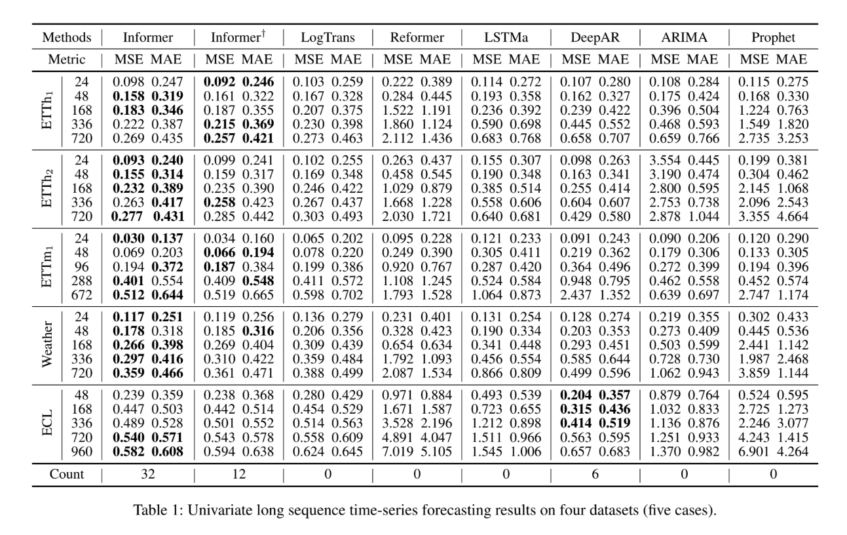
Forecasting Results

Slide 24
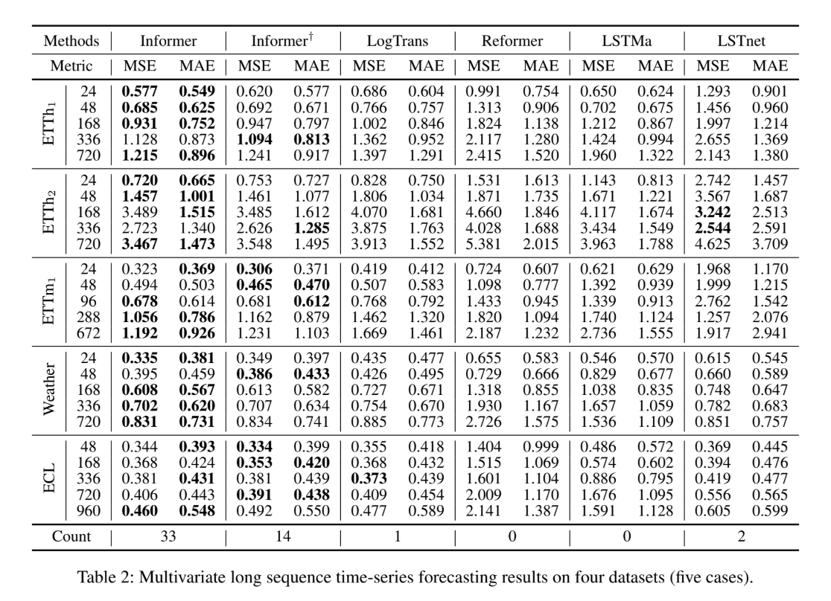
Forecasting Results

Slide 25
Results & Analysis
Informer significantly outperforms RNNs (LSTMa), CNNs (LSTnet), and other Transformer variants (Reformer, LogTrans).
Univariate Finding: MSE decreased by up to 60.1% compared to LSTMa at 720-point horizons.
Multivariate Finding: Informer is easily adaptable to multivariate cases by adjusting the final fully connected layer (FCN).
Generative decoding is much faster than the step-by-step decoding used in the Reformer and vanilla Transformer.

Slide 26
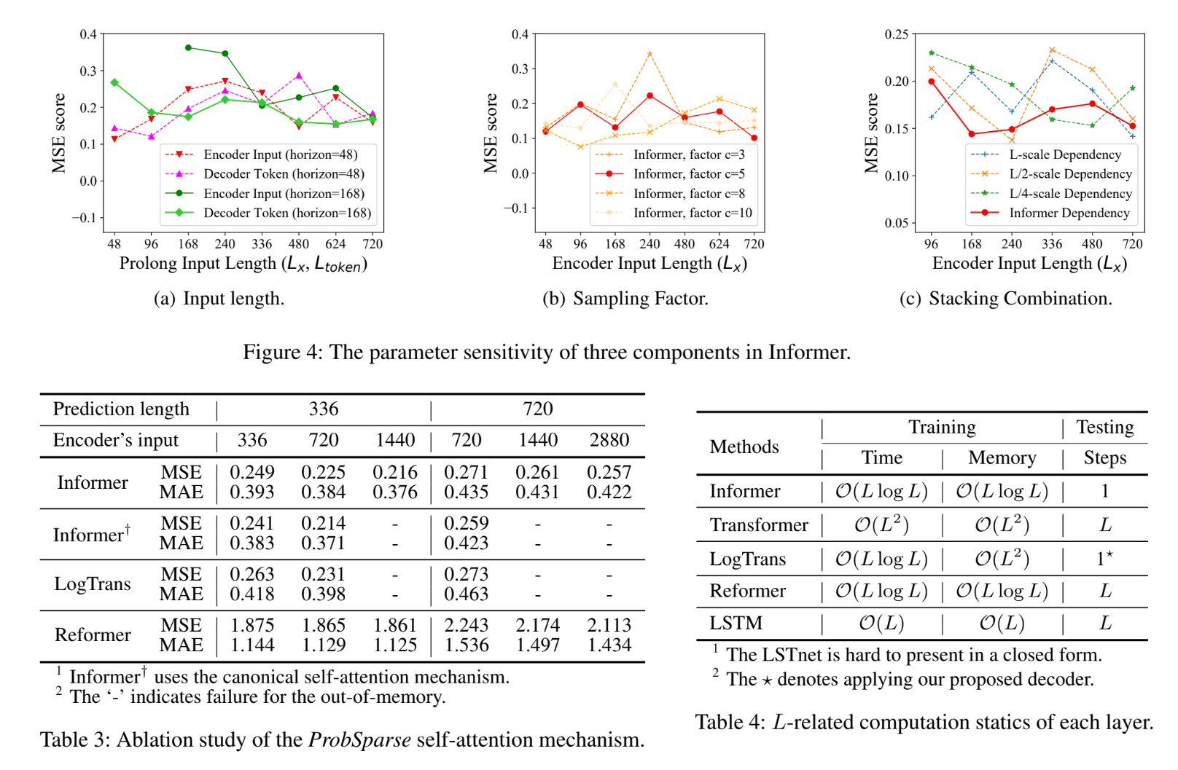
Tuning for Robustness

Slide 27
Tuning for Robustness
Optimising Input Length (Lx,Ltoken):
The model's performance is sensitive to the length of the encoder input and the decoder's start token. A longer encoder input captures more dependencies, while a longer decoder token provides rich local information.
Tuning the Sampling Factor (c):
This factor controls the information bandwidth of the ProbSparse self-attention mechanism.
Experiments show that performance generally increases with the sampling factor before stabilising at c=5.
This stability verifies the query sparsity assumption, confirming that there are redundant dot-product pairs in the attention mechanism that do not need to be calculated.

Slide 28
Tuning for Robustness
• Layer Stacking Strategy:
The Informer uses layer stacking replicas to increase the robustness of the encoder.
Replicas are designed to be complementary to the self-attention distilling operation, helping the model handle different input scales.
Sensitivity analysis of different stack combinations ({L,L/2,L/4}) reveals that the longer stack is more sensitive to inputs due to receiving more long-term information.
The selection of joining L and L/4 stacks was determined to be the most robust strategy for the Informer.

Slide 29
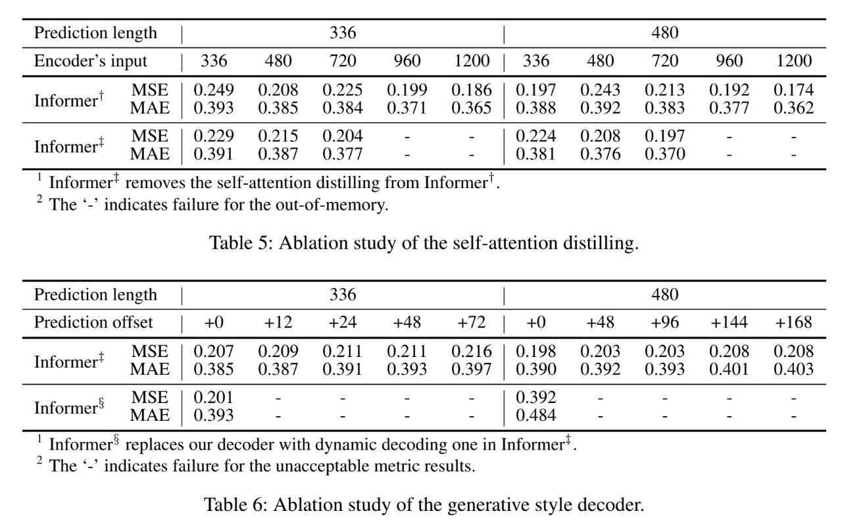
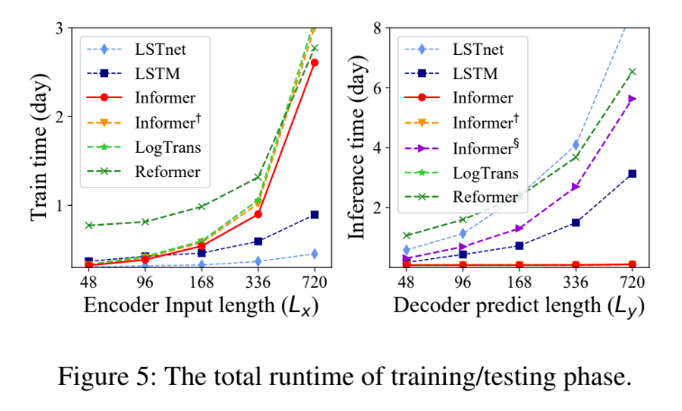
Ablation Study

Slide 30
Ablation Study
• Informer was compared against LogTrans and Reformer using restricted settings (lower batch size and dim) to isolate memory usage.
• Key Findings (from Table 3):
Superior Accuracy: ProbSparse attention consistently showed better MSE/MAE scores than its counterparts across various prediction lengths.
Extreme Scalability: While LogTrans and the canonical version (Informer†) suffered Out-of-Memory (OOM) failures at input lengths of 1440 and 2880, the Informer remained stable and functional.
• The query sparsity assumption is not just a theoretical shortcut; it is the primary reason the Informer can process extreme long-range dependencies that other models simply cannot fit into memory.

Slide 31
Ablation Study
• Informer† (canonical) vs. Informer‡ (the same model but with distilling removed).
◦ The "Wall": Without the distilling operation to "trim" the data, Informer‡ reached OOM failures as soon as input sequences exceeded 720 points.
◦ This proves that distilling is essential for LSTF, as it allows the model to handle massive inputs by discarding redundant features.
• Informer‡ (generative) vs. Informer§ (standard step-by-step dynamic decoding).
◦ The models' ability to predict with a "time offset" (predicting further and further into the future).
◦ The generative decoder resisted error accumulation even as the offset increased, while the dynamic decoder’s performance became "unacceptable" almost immediately.

Slide 32
Conclusion
Informer successfully enhances LSTF capacity through ProbSparse attention, distilling, and generative decoding.
Efficiency: Achieves O(LlogL) complexity, making long-sequence forecasting affordable on standard hardware.
Has real world value as it prevents irreversible failures in power stations by providing actionable, long-term maintenance insights.

