Slide 1
PL/SQL

Slide 2
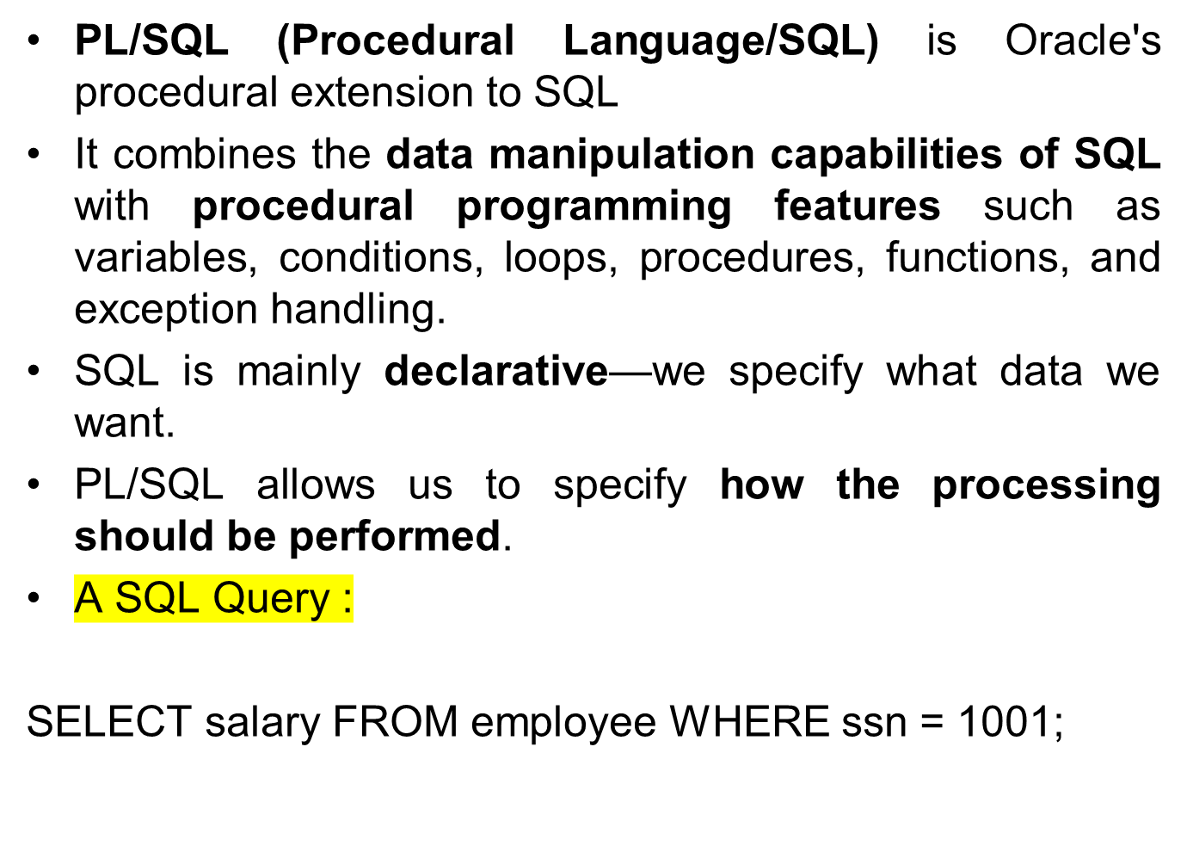
PL/SQL

Slide 3
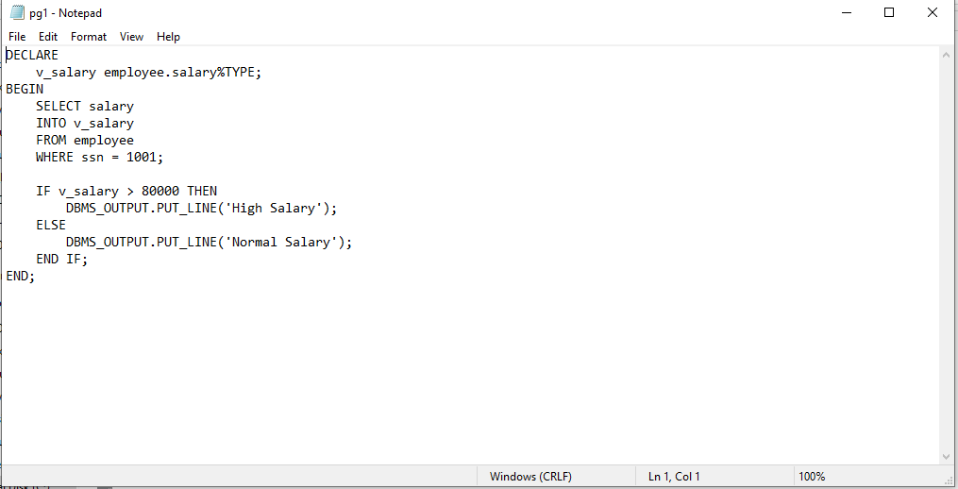
PL/SQL
With PL/SQL, we can retrieve the salary, store it in a variable, check its value, and display an appropriate message

Slide 4
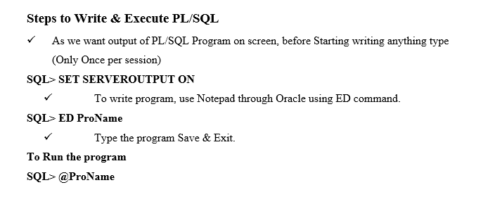
Basic Structure of PL/SQL
DECLARE
-- Declaration Section
BEGIN
-- Executable Section
EXCEPTION
-- Exception Handling Section
END;

Slide 5
Simple Program
DECLARE
v_name VARCHAR2(30);
v_salary NUMBER(10,2);
BEGIN
v_name := 'John’;
v_salary := 75000;
DBMS_OUTPUT.PUT_LINE('Name: ' || v_name);
DBMS_OUTPUT.PUT_LINE('Salary: ' || v_salary);
END;

Slide 6
Simple Program
declare
num1 number(10);
num2 number(10);
begin
num1 := &n1;
num2 := &n2;
dbms_output.put_line('The sum of two number is:'||to_char(num1+num2));
dbms_output.put_line('The difference of two number is:'|| to_char(num1-num2));
dbms_output.put_line('The product of two number is:'|| to_char(num1*num2));
dbms_output.put_line('The remainder of dividing is:'|| to_char(num1/num2));
end;

Slide 7
Using Exception
DECLARE
c_id customer.cid%type:= &c_id;
c_name customer.name%type;
c_addr customer.address%type;
BEGIN
SELECT name, address INTO c_name, c_addr
FROM customer WHERE cid = c_id;
DBMS_OUTPUT.PUT_LINE ('Name: '|| c_name);
DBMS_OUTPUT.PUT_LINE ('Address: ' || c_addr);
EXCEPTION
WHEN no_data_found THEN
dbms_output.put_line('No such customer!');
WHEN others THEN
dbms_output.put_line('Error!');
END;

Slide 8
Declaring a constant
A constant is declared using the CONSTANT keyword. It requires an initial value and does not allow that value to be changed. For example,
constant_name CONSTANT datatype := value;
PI CONSTANT NUMBER := 3.141592654;

Slide 9
Assigning SQL Query Results to PL/SQL Variables
DECLARE
c_id customers.id%type := 1;
c_name customers.name%type;
c_addr customers.address%type;
c_sal customers.salary%type;
BEGIN
SELECT name, address, salary INTO c_name, c_addr, c_sal FROM customers WHERE id = c_id;
dbms_output.put_line ('Customer ' ||c_name || ' from ' || c_addr || ' earns ' || c_sal);
END

Slide 10
BETWEEN Operator
DECLARE
x number(2) := 10;
BEGIN
IF (x between 5 and 20) THEN
dbms_output.put_line('True');
ELSE
dbms_output.put_line('False');
END IF;
IF (x BETWEEN 5 AND 10) THEN
dbms_output.put_line('True');
ELSE
dbms_output.put_line('False');
END IF;
IF (x BETWEEN 11 AND 20) THEN
dbms_output.put_line('True');
ELSE
dbms_output.put_line('False');
END IF;
END;
/

Slide 11
IN and IS NULL Operators
DECLARE
letter varchar2(1) := 'm';
BEGIN
IF (letter in ('a', 'b', 'c')) THEN
dbms_output.put_line('True');
ELSE
dbms_output.put_line('False');
END IF;
IF (letter in ('m', 'n', 'o')) THEN
dbms_output.put_line('True');
ELSE
dbms_output.put_line('False');
END IF;
IF (letter is null) THEN
dbms_output.put_line('True');
ELSE
dbms_output.put_line('False');
END IF;
END;

Slide 12
If Clause example
DECLARE
c_id customers.id%type := 1;
c_sal customers.salary%type;
BEGIN
SELECT salary INTO c_sal FROM customers WHERE id = c_id;
IF (c_sal <= 2000) THEN
UPDATE customers SET salary = salary + 1000
WHERE id = c_id;
dbms_output.put_line ('Salary updated');
END IF;
END;

Slide 13
Elseif Ladder
DECLARE
a number(3) := 100;
BEGIN
IF ( a = 10 ) THEN
dbms_output.put_line('Value of a is 10' );
ELSIF ( a = 20 ) THEN
dbms_output.put_line('Value of a is 20' );
ELSIF ( a = 30 ) THEN
dbms_output.put_line('Value of a is 30' );
ELSE
dbms_output.put_line('None of the values is matching');
END IF;
dbms_output.put_line('Exact value of a is: '|| a );
END;
/

Slide 14
CASE Statement
DECLARE
grade char(1) := 'A';
BEGIN
CASE grade
when 'A' then dbms_output.put_line('Excellent');
when 'B' then dbms_output.put_line('Very good');
when 'C' then dbms_output.put_line('Well done');
when 'D' then dbms_output.put_line('You passed');
when 'F' then dbms_output.put_line('Better try again');
else
dbms_output.put_line('No such grade');
END CASE;
END;

Slide 15
Basic Looping
DECLARE
x number := 10;
BEGIN
LOOP
dbms_output.put_line(x);
x := x + 10;
IF x > 50 THEN
exit;
END IF;
END LOOP;
dbms_output.put_line('After Exit x is: ' || x);
END;

Slide 16
EXIT WHEN
DECLARE
x number := 10;
BEGIN
LOOP
dbms_output.put_line(x);
x := x + 10;
exit WHEN x > 50;
END LOOP;
dbms_output.put_line('After Exit x is: ' || x);
END;
/

Slide 17
WHILE Loop
DECLARE
a number(2) := 10;
BEGIN
WHILE a < 20 LOOP
dbms_output.put_line('value of a: ' || a);
a := a + 1;
END LOOP;
END;
/

Slide 18
FOR Loop
DECLARE
a number(2);
BEGIN
FOR a in 10 .. 20 LOOP
dbms_output.put_line('value of a: ' || a);
END LOOP;
END;
/

Slide 19
REVERSE Loop
DECLARE
a number(2) ;
BEGIN
FOR a IN REVERSE 10 .. 20 LOOP
dbms_output.put_line('value of a: ' || a);
END LOOP;
END;

Slide 20
Cursor

Slide 21
Cursors in PL/SQL
Oracle creates a memory area, known as the context area for processing an SQL statement, which contains all the information needed for processing the statement; for example, the number of rows processed, etc.
A cursor is a pointer to this context area. PL/SQL controls the context area through a cursor. A cursor holds the rows (one or more) returned by a SQL statement. The set of rows the cursor holds is referred to as the active set.
There are two types of cursors:
  Implicit cursors
  Explicit cursors
Whenever a DML statement (INSERT, UPDATE and DELETE) is issued, an implicit cursor is associated with this statement. For INSERT operations, the cursor holds the data that needs to be inserted. For UPDATE and DELETE operations, the cursor identifies the rows that would be affected.
Implicit cursors are used not only for DML statements, but also for SELECT INTO and other SQL statements executed within PL/SQL.

Slide 22
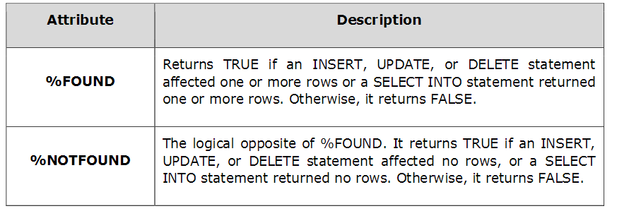
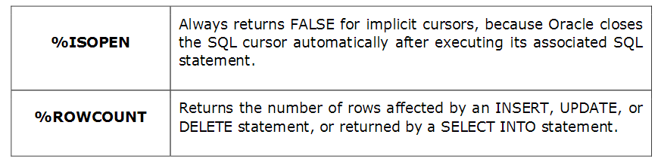

Slide 23
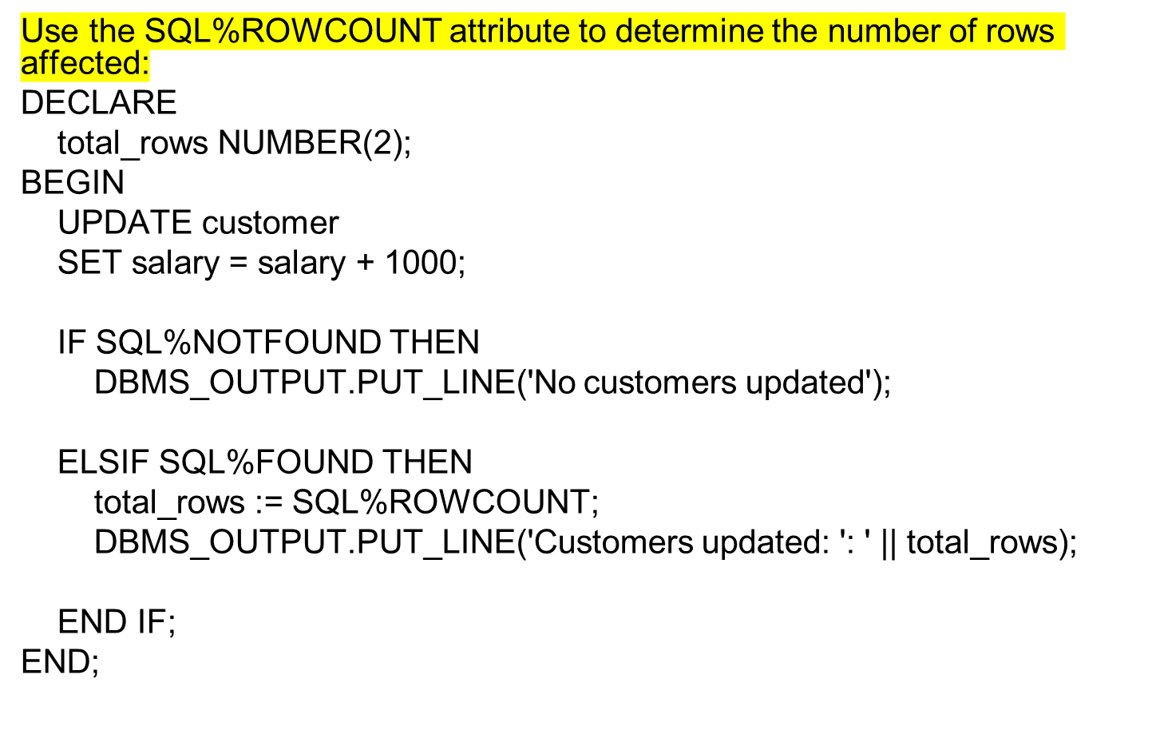

Slide 24
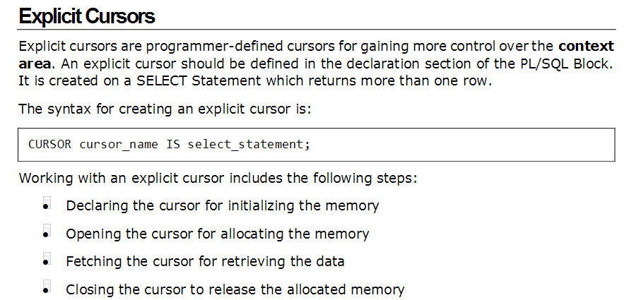


Slide 25
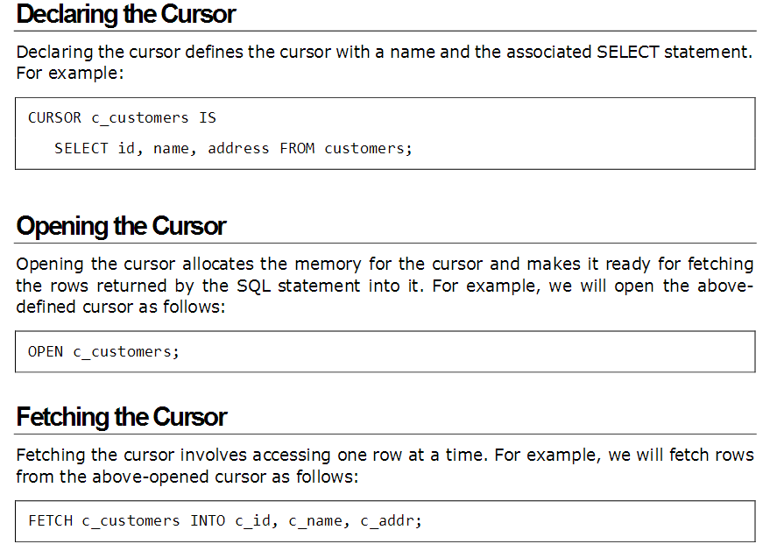

Slide 26
DECLARE
c_id customer.cid%type;
c_name customer.cname%type;
c_addr customer.caddress%type;
c_salary customer.salary%type;
CURSOR c_customers is
SELECT cid, cname, caddress, salary FROM customer;
BEGIN
OPEN c_customers;
LOOP
FETCH c_customers into c_id, c_name, c_addr, c_salary;
EXIT WHEN c_customers%notfound;
dbms_output.put_line(c_id || ' ' || c_name || ' ' || c_addr || ' ' || c_salary) ;
END LOOP;
CLOSE c_customers;
END;

Slide 27
User Defined Exceptions

Slide 28
System defined exceptions
zero_divide (ORA-01476)
cursor_already_open (ORA-06511)
invalid_cursor (ORA-01001, invalid cursor error occurs when you try to reference a cursor that does not yet exist, e.g. trying to access a cursor which is yet to open)
no_data_found (ORA-01403, it is raised when a select into statement returns no rows.)
too_many_rows (ORA-01422, when you select or fetch more than one row into a single record or variable.)

Slide 29
Example for exception
declare
c_id customer.cid%type := 200;
c_name customer.cname%type;
c_addr customer.caddress%type;
c_salary customer.salary%type;
begin
select cid,cname,caddress,salary into c_id, c_name, c_addr, c_salary from customer where cid = c_id;
dbms_output.put_line ('name: '|| c_id );
dbms_output.put_line ('address: ' || c_addr);
exception
when no_data_found then
dbms_output.put_line('No such Customer!');
when others then
dbms_output.put_line('some other error has occurred!');
end;

Slide 30
User-defined exception (an example)
DECLARE
salary_too_high EXCEPTION;
too_high CONSTANT NUMBER(5) := 20000;
v_cid customer.cid%TYPE;
v_cname customer.cname%TYPE;
v_caddress customer.caddress%TYPE;
v_salary customer.salary%TYPE;
CURSOR cuscrs IS SELECT cid, cname, caddress, salary
FROM customer;
BEGIN
OPEN cuscrs;
LOOP
FETCH cuscrs INTO v_cid, v_cname, v_caddress, v_salary;
EXIT WHEN cuscrs%NOTFOUND;
IF v_salary > too_high THEN
RAISE salary_too_high;
END IF;
END LOOP;
CLOSE cuscrs;
EXCEPTION
WHEN salary_too_high THEN
IF cuscrs %ISOPEN THEN
CLOSE cuscrs;
END IF;
RAISE_APPLICATION_ERROR(-20100, 'Salary is too high');
WHEN OTHERS THEN
IF cuscrs %ISOPEN THEN
CLOSE cuscrs;
END IF;
RAISE;
END;

Slide 31
Triggers

Slide 32
Creating Triggers
CREATE [OR REPLACE ] TRIGGER trigger_name
{BEFORE | AFTER | INSTEAD OF }
{INSERT [OR] | UPDATE [OR] | DELETE}
[OF col_name]
ON table_name
[REFERENCING OLD AS o NEW AS n]
[FOR EACH ROW]
WHEN (condition)
DECLARE
Declaration-statements
BEGIN
Executable-statements
EXCEPTION
Exception-handling-statements
END;

Slide 33
CREATE [OR REPLACE] TRIGGER trigger_name − Creates or replaces an existing trigger with the trigger_name.
{BEFORE | AFTER | INSTEAD OF} − This specifies when the trigger will be executed. The INSTEAD OF clause is used for creating trigger on a view.
{INSERT [OR] | UPDATE [OR] | DELETE} − This specifies the DML operation.
[OF col_name] − This specifies the column name that will be updated.
[ON table_name] − This specifies the name of the table associated with the trigger.
[REFERENCING OLD AS o NEW AS n] − This allows you to refer new and old values for various DML statements, such as INSERT, UPDATE, and DELETE.
[FOR EACH ROW] − This specifies a row-level trigger, i.e., the trigger will be executed for each row being affected. Otherwise the trigger will execute just once when the SQL statement is executed, which is called a table level trigger.
WHEN (condition) − This provides a condition for rows for which the trigger would fire. This clause is valid only for row-level triggers.

