Slide 1
MEMORY PALACE
Chemical Engineering
Object → Concept → Equation → Recall
114
114
9
Concepts
Objects
Subjects
Each slide: Object image + labeled visual metaphor + ONE key equation

Slide 2
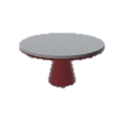
1
Iterative Solutions
🎮 Table
Leg 1 = iteration 1
Flat top = converged!
Each table leg adjustment is
one N-R iteration step
Stable table = |xₙ+₁ − xₙ| < ε
Residual reached zero
Leg 2 = iteration 2
Refine root estimate
with each step
xₙ+₁ = xₙ − f(xₙ) / f'(xₙ) [Newton-Raphson]
💡 TABLE adjusts its legs (iterations) until perfectly level (residual → 0)

Slide 3
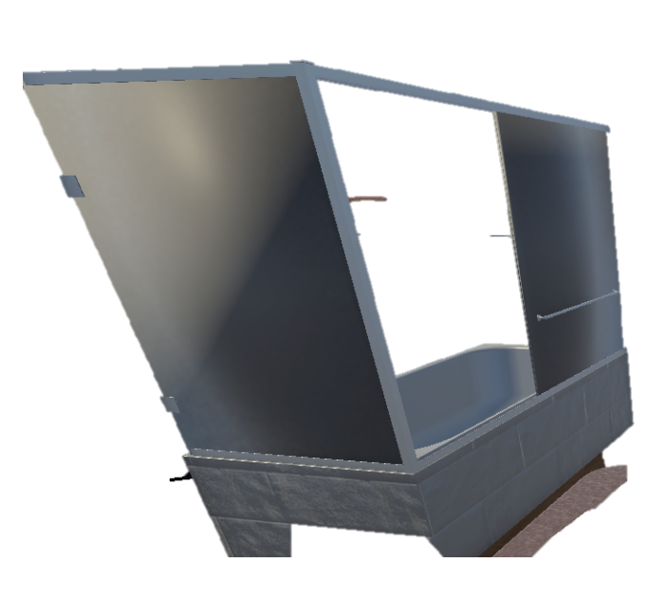
2
Manometry
🛁 Bathtub
Water level LEFT = P₁
Water level RIGHT = P₂
One side of the U-tube
manometer at pressure P₁
Other side balanced
at pressure P₂
Height diff h
Dense fluid sinks ↓
The column height
difference gives ΔP = ρgh
Like soap settling at
bath bottom
ΔP = ρ·g·h
💡 BATHTUB tilted → water shifts sides → height difference × ρg = pressure difference

Slide 4
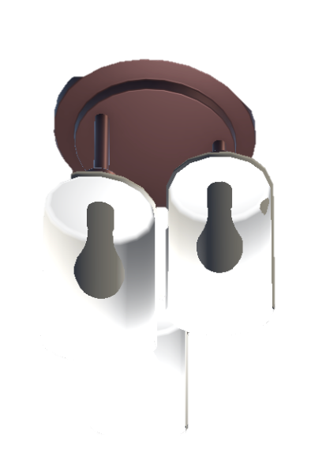
3
Material Balances
💡 Lamp
← Light OUT
Electricity IN →
Product streams exiting
the system
Feed streams entering
the system boundary
← Heat OUT
Waste/byproduct
streams leaving
Shade = boundary
System boundary: only
count flows crossing it
Accumulation = In − Out + Gen − Consumption
💡 LAMP: electricity IN = light + heat OUT. Nothing disappears. Atoms in = atoms out.

Slide 5
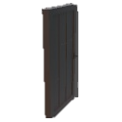
4
Degrees of Freedom
🚪 Door
Hinge = 1 DOF
One degree of motion
(angle of opening)
DOF = 0 → solvable!
Exactly specified: unique
solution exists
Lock = constraint (−1)
Each equation/spec
removes one DOF
DOF = Unknowns − Independent Equations
💡 DOOR has 1 DOF (open angle). Add a lock (constraint) → DOF = 0, fully determined.
DOF > 0 → under-specified
DOF < 0 → over-specified
Check DOF BEFORE solving!

Slide 6
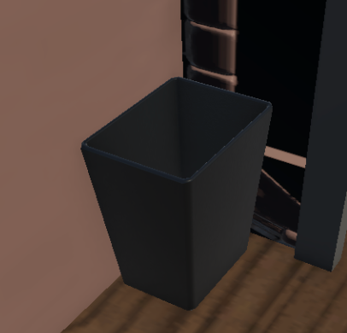
5
Recycle Mass Balances
🗑 Trash Can
Feed F →
Product D →
Fresh feed entering
the process
Desired product
leaving the system
Waste → recycle back
Unconverted material
returned to reactor inlet
Overall: F = D + B | Recycle ratio R = recycle/product
💡 TRASH CAN: scraps returned to cooking = recycle stream! Overall balance first, then units.

Slide 7
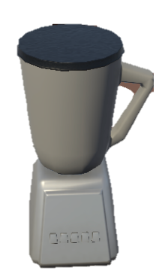
6
Chemical Reactions
🫙 Blender
Fruits IN = reactants
Initial moles nᵢ₀
fed into reactor
Smoothie = products
Final moles calculated
from extent ξ
Blades = reaction
Stoichiometric conversion
via balanced equation
Limiting = least fruit
Smallest nᵢ₀/|νᵢ|
determines max ξ
ξ = (nₐ − nₐ₀) / (−a) | nᵢ = nᵢ₀ + νᵢ·ξ
💡 BLENDER mixes reactants → blades (reaction) → products. Can't get more smoothie than fruits!

Slide 8
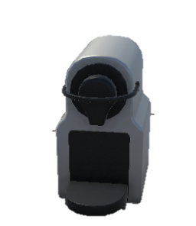
7
Reactive Material Balances
☕ Coffee Maker
Water + grounds IN
Molecular species
entering the reactor
Coffee OUT
Product species: molecular
form changed, atoms conserved
Extraction = reaction
Extent ξ tracks how
far reaction proceeds
nᵢ,ₒᵤₜ = nᵢ,ᵢₙ + νᵢ · ξ
💡 COFFEE MAKER: water + grounds → extraction reaction → coffee. Atoms always conserved.

Slide 9
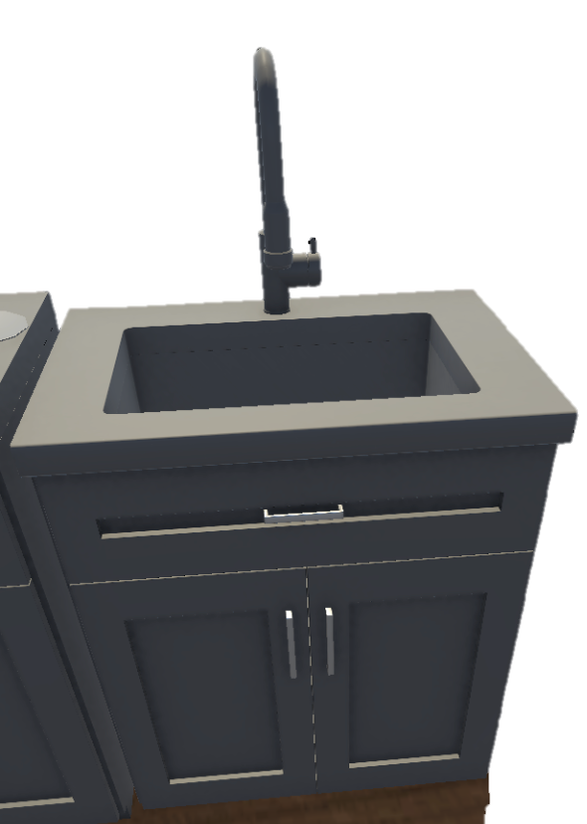
8
Purge Stream in Recycle
🪣 Sink Cabinet
Gunk = inerts accumulate
Feed inerts in
Without purge, inerts build
up in recycle loop indefinitely
Inerts enter with fresh
feed at mole fraction yᵢ
Drain = PURGE stream
Bleeds off accumulated
inerts to reach steady state
F · yᵢ = P · yᵢ,ₚᵤᵣgₑ (inert balance at steady state)
💡 SINK CABINET: gunk builds up under the sink → drain (purge) removes it to prevent overflow.

Slide 10

9
Transient Material Balances
🗿 Sculpture
Chisel = ṁ in/out
Finished = dM/dt → 0
Mass flow rates adding
or removing material
Steady state reached when
accumulation vanishes
Shape changing = dM/dt ≠= 0
Accumulation term is
non-zero: ODE in time
dM/dt = ṁᵢₙ − ṁₒᵤₜ
💡 SCULPTURE being carved: shape changes over time (transient). Finished statue = steady state.

Slide 11
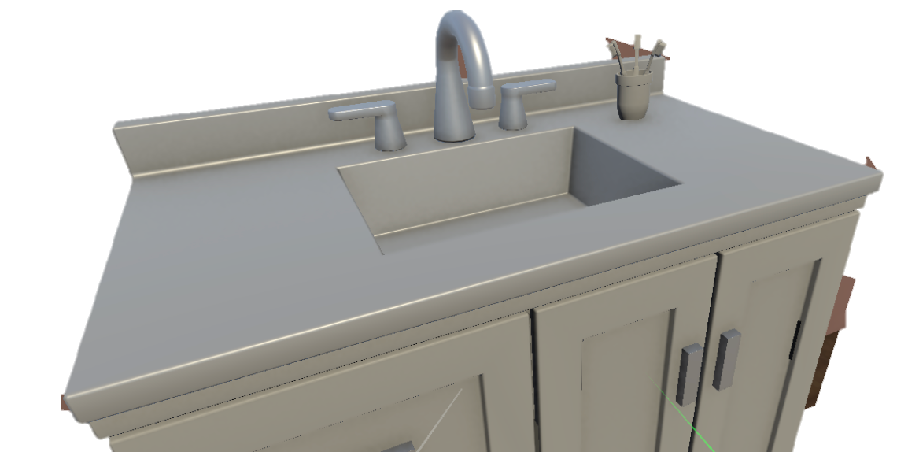
10
Wet and Dry Basis
🚿 Sink Top
Wet surface = WET basis
Wipe dry → DRY basis
Composition includes
all water content
Composition on water-free
basis (solids only)
yᵢ,wₑₜ = yᵢ,dᵣy / (1 + moisture fraction)
💡 SINK TOP: wet surface = wet basis (water included). Wipe dry → only solids left = dry basis.

Slide 12
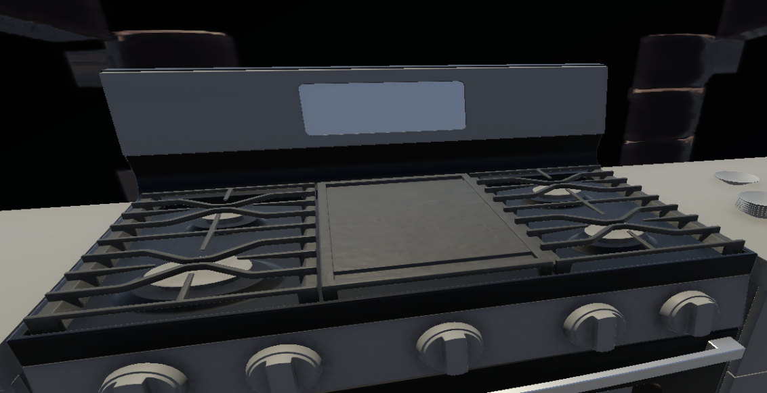
11
Combustion Reactions
🔥 Stove Top
Fuel (CH₄) IN
CO₂ + H₂O OUT
Hydrocarbon fuel
entering combustion zone
Complete combustion
products (flue gas)
Flame = combustion
% Excess Air
Rapid exothermic oxidation
of fuel with oxygen
(Airₐctual − Airₛtoich) / Airₛtoich × 100
CₓHᵧ + (x+y/4)O₂ → xCO₂ + (y/2)H₂O
💡 STOVE TOP burns gas: too little O₂ → CO (incomplete). Too much air → dilute & cool.

Slide 13

12
Ideal Gas Law
💨 Range Hood
Hot gas rises (↑T → ↑V)
Hood sucks gas out
Temperature increase causes
volume expansion at const P
Removes expanded hot
gases from kitchen
PV = nRT (R = 8.314 J/mol·K)
💡 RANGE HOOD: hot cooking gases rise (high T → high V). Hood removes them — PV = nRT governs!
STP: 1 mol = 22.4 L
Ideal: no forces, point particles
Valid: low P, high T

Slide 14
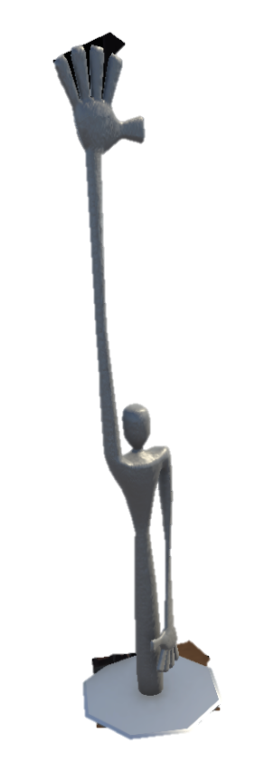
13
Equations of State
🗿 Sculpture
Real volume → b
Z = Pv/RT
Parameter b: excluded volume
from finite molecular size
Compressibility factor:
Z=1 ideal, Z≠=1 real
Surface attraction → a
Parameter a: intermolecular
attractive forces (a/v²)
(P + a/v²)(v − b) = RT [van der Waals]
💡 SCULPTURE is REAL — actual volume (b) and surface attraction (a). Ideal gas = featureless ghost.

Slide 15
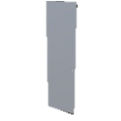
14
Lever Rule
🪟 Glass Wall
LEFT = liquid (xₗᵢq)
RIGHT = vapor (xᵥₐₚ)
Liquid-phase composition
on the tie line
Vapor-phase composition
on the tie line
YOU = overall comp.
Your position on the seesaw
determines phase fractions
V/(L+V) = (xₒᵥₑᵣₐₗₗ−xₗᵢq)/(xᵥₐₚ−xₗᵢq)
💡 GLASS WALL: look left (liquid) and right (vapor). Seesaw — distance to each phase = fraction.

Slide 16
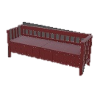
15
Phase Equilibrium
🪑 Bench
Sit = LIQUID
Lie = SOLID
One phase state: molecules
closely packed, fluid
Fixed lattice structure
lowest energy state
Stand = GAS
Low density, fills container
high kinetic energy
Gibbs Phase Rule: F = C − P + 2
💡 BENCH: sit (liquid), stand (gas), lie flat (solid). Triple point = all 3 simultaneously at one T,P.
Triple pt: F = 0 (3 phases, 1 comp)
Critical pt: ∂ P/∂ V = 0, ∂ ² P/∂ V ² = 0

Slide 17
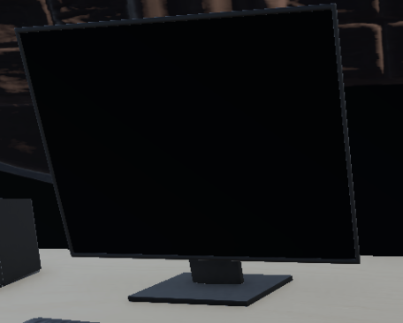
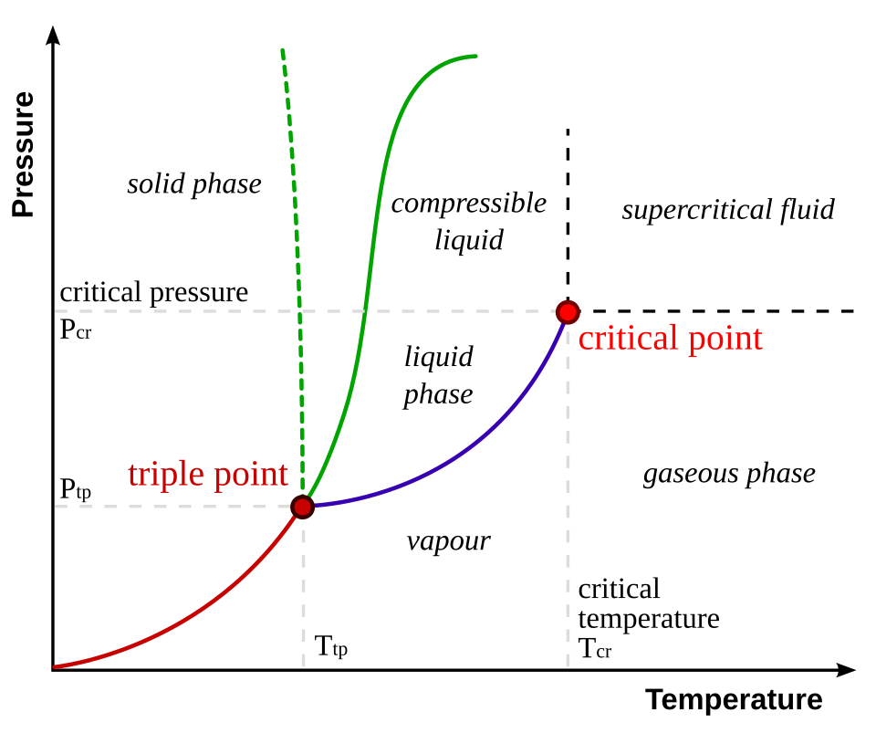
16
Clausius-Clapeyron & Antoine
📺 Screen
Curve on screen = P* vs T
Slope = ΔHᵥₐₚ
Vapor pressure increases
exponentially with T
Heat of vaporization
drives the P-T relationship
ln(P₂/P₁) = ΔHᵥₐₚ/R · (1/T₁ − 1/T₂)
💡 SCREEN displays the vapor pressure vs T curve — exponential rise. Antoine: 3-parameter precision.
Antoine: log ₁₀ (P*) = A − B / (C + T)
Clapeyron: dP / dT = ΔH / (T · Δv)

Slide 18

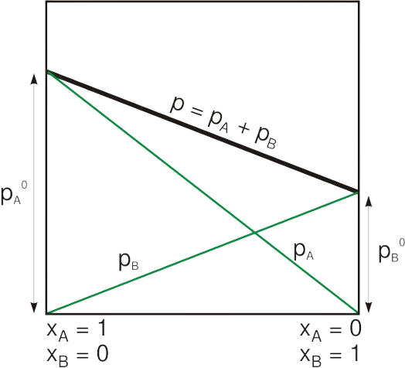
17
Raoult's Law and VLE
🔊 Speaker Sub
Channel 1 = comp. 1
Component 1 contributes
partial pressure x₁·P₁*
Channel 2 = comp. 2
Component 2 contributes
partial pressure x₂·P₂*
Mixed sound = Pₜₒₜₐₗ
Total P = sum of all
partial pressures (Dalton)
pᵢ = xᵢ·Pᵢ* | yᵢ = pᵢ/Pₜₒₜₐₗ
💡 SPEAKER blends sound channels. Raoult: each component contributes xᵢ × Pᵢ* to total pressure.
Bubble P: P = Σxᵢ · Pᵢ*
Dew P: 1/P = Σyᵢ / Pᵢ*

Slide 19
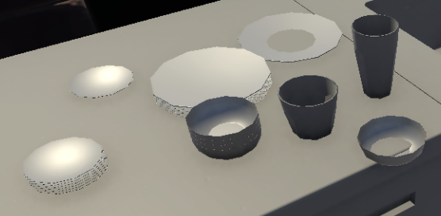
18
Colligative Properties
🍽 Stacked Plates
Each plate = 1 mol solute
Osmotic π = MRT
Colligative: depends only
on number of particles
Osmotic pressure from
dilute solution theory
More plates → ↑Tb
Boiling point elevation
proportional to molality m
ΔTb = Kb·m | ΔTf = Kf·m | π = MRT
💡 Each PLATE added (mole of solute) raises boiling point. More plates = more colligative effect!

Slide 20
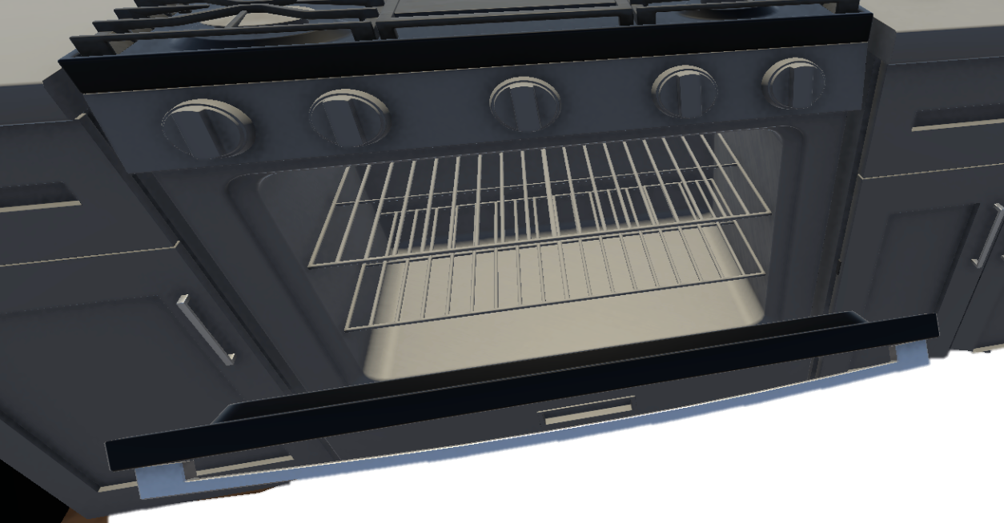
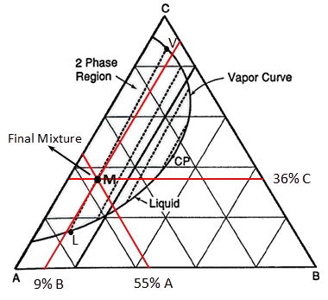
19
Ternary Phase Diagrams
🔧 Oven Grate
Vertex A = pure A
Each triangle corner
represents 100% of one comp.
Vertex C = pure C
Interior points are
mixtures of all three
Tie line = 2 phases
Connects equilibrium
compositions of two phases
xₐ + xᵦ + x꜀ = 1 (triangle vertices = pure components)
💡 OVEN GRATE: three bars, three components. Each junction on triangular grid = ternary mixture.

Slide 21
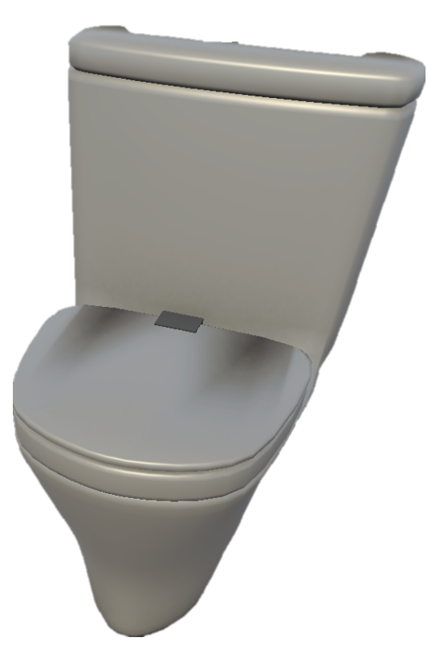
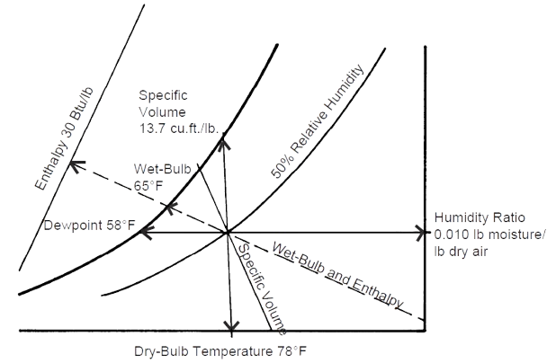
20
Psychrometric Chart
🚽 Toilet
Moisture = humidity ω
Humidity ratio: kg water
per kg dry air
Bowl condensation = dew pt
Temperature at which
φ reaches 100%
φ = Pw/Pₛₐₜ
Relative humidity: actual
vs saturation vapor pressure
ω = 0.622·Pw/(P−Pw) | φ = Pw/Pₛₐₜ(T)
💡 TOILET in bathroom: moisture everywhere. Condensation on bowl = dew point reached!

Slide 22
21
Adsorption
🪞 Wall Mirror
Glass = adsorbent
Solid surface with
finite adsorption sites
Finite sites → qₘₐₓ
Monolayer saturation:
all sites occupied
Dust = adsorbate
Gas/liquid molecules
adhering to surface
Langmuir: q = qₘₐₓ·KC / (1 + KC)
💡 MIRROR surface collects dust (adsorbate) on glass (adsorbent). Wipe off = desorption.
Freundlich: q = K·C¹/ⁿ
BET: multilayer adsorption

Slide 23
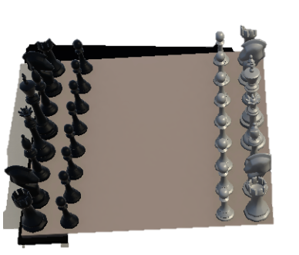
22
State Functions
♟ Chess Board
Position = STATE
Hess's Law: ΔH path-free
U, H, S, G, V depend only
on current T, P, composition
Enthalpy change same
regardless of route
Moves = PATH (q, w)
Heat q and work w depend
on the process path taken
State: U, H, S, G, V | Path: q, w
💡 CHESS: king's position = state function (doesn't matter which moves got it there).

Slide 24
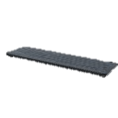
23
Steam Tables
⌨️ Keyboard
Press T key → get H
Input temperature to find
enthalpy from sat. tables
Quality x = vapor frac.
x = fraction vapor in
two-phase region (0→1)
Press P key → get S
Input pressure for
entropy, specific volume
H = Hf + x·Hfg | x = (H − Hf) / Hfg
💡 KEYBOARD lookup: press T or P key → get H, S, v. Steam tables = the keyboard of thermo.

Slide 25
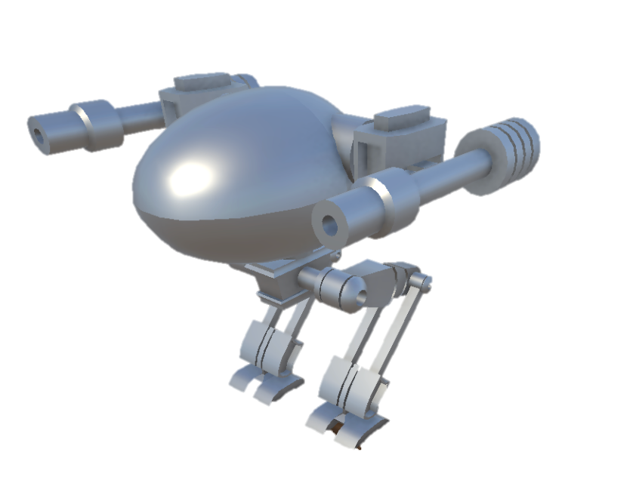
24
Mechanical Energy Balance
⚙️ Mech Device
Pressure ΔP/ρ
Potential gΔz
Pressure energy per
unit mass of fluid
Elevation change
gravitational PE
Kinetic Δv²/2
Friction F (Darcy)
Change in kinetic energy
due to velocity change
Frictional losses from
Darcy-Weisbach: f·L/D·v²/2
ΔP/ρ + Δ(v²)/2 + g·Δz + F = Wₛ
💡 MECHANICAL device: pump adds energy, turbine extracts. Extended Bernoulli + friction + shaft work.

Slide 26
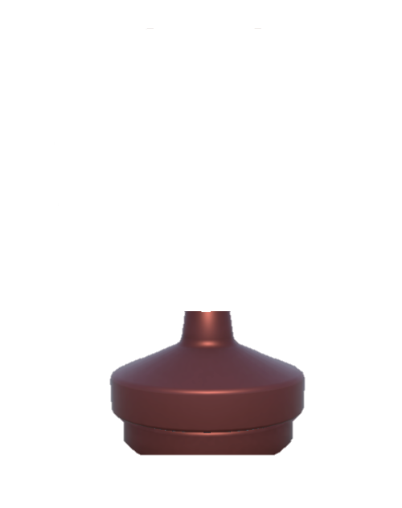
25
Heat Capacities
💡 Table Lamp
Touch → hot! Q = nCₚΔT
γ = Cₚ/Cᵥ
Heat needed to raise T
at constant pressure
Heat capacity ratio
for isentropic processes
Cₚ polynomial: a + bT + cT²
Shomate equation fits
Cₚ vs T data
Q = n·Cₚ·ΔT | Cₚ − Cᵥ = R (ideal gas)
💡 TABLE LAMP heats up: Q = nCₚΔT joules. Cₚ > Cᵥ because constant-P allows expansion work.

Slide 27
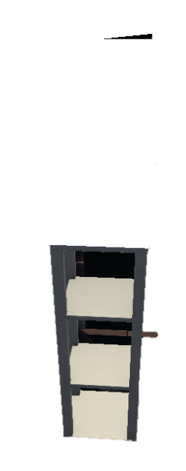
26
Energy Balance + Phase Change
✨ Glow
Heat → T rises (sensible)
ΔHᵥₐₚ, ΔHfᵤₛ
Temperature increases while
phase remains the same
Enthalpies of vaporization
and fusion respectively
GLOW = phase change
Latent heat absorbed at
constant T during transition
Qₜₒₜₐₗ = Qₛₑₙₛᵢbₗₑ + Qₗₐₜₑₙₜ = ∫Cₚ dT + ΣΔHₚₕₐₛₑ
💡 GLOWING: add heat → T rises (sensible), then GLOWS at transition (latent heat, isothermal).

Slide 28
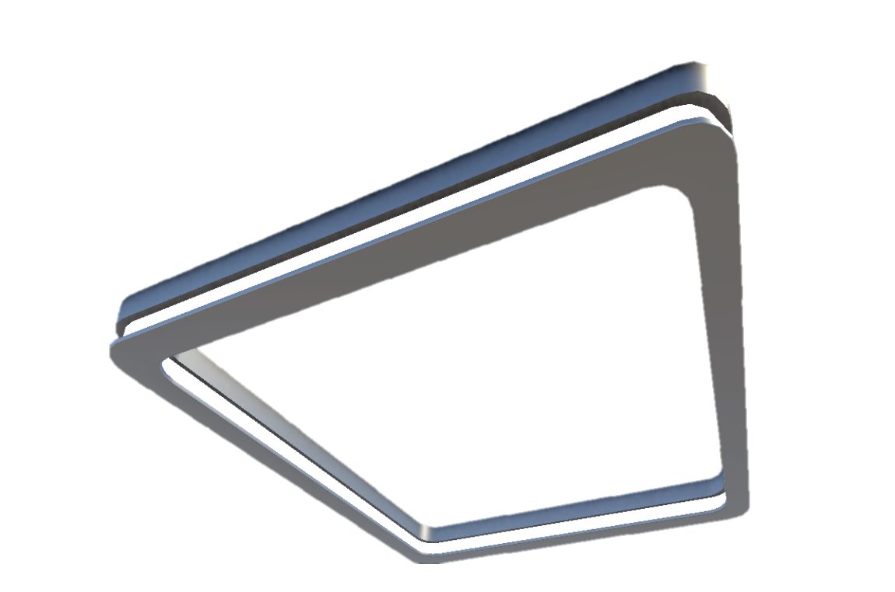
27
Flash Separations
💡 Ceiling Lamp
Vapor rises ↑ (light)
More volatile components
enriched in vapor phase
Kᵢ = yᵢ/xᵢ
Equilibrium ratio: volatility
of each component (Raoult: Pᵢ*/P)
Liquid falls ↓ (heavy)
Less volatile components
concentrate in liquid
Σ zᵢ(Kᵢ−1)/(1 + V/F·(Kᵢ−1)) = 0 [Rachford-Rice]
💡 CEILING LAMP illuminates two phases below: vapor rises UP (light), liquid falls DOWN (heavy).

Slide 29
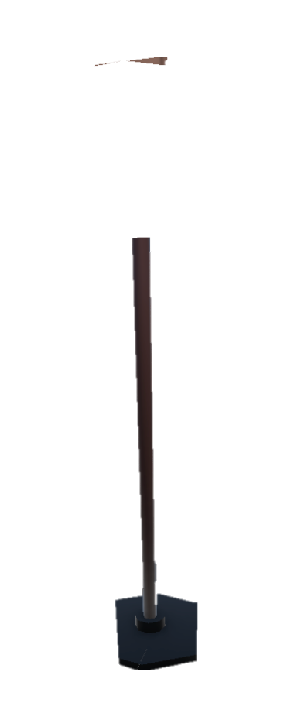
28
Heats of Reaction
🔦 Floor Lamp
Plug in = reactants
Light out = −ΔH (exo)
Starting materials with
known heats of formation
Negative ΔH releases
energy to surroundings
+ΔH = endothermic
Positive ΔH absorbs
energy from surroundings
ΔH°ᵣₓₙ = Σνᵢ·ΔH°f,ₚᵣₒd − Σνᵢ·ΔH°f,ᵣₑₐcₜ
💡 FLOOR LAMP: plug in reactants → energy released as light (exothermic, −ΔH). Hess's Law!

Slide 30
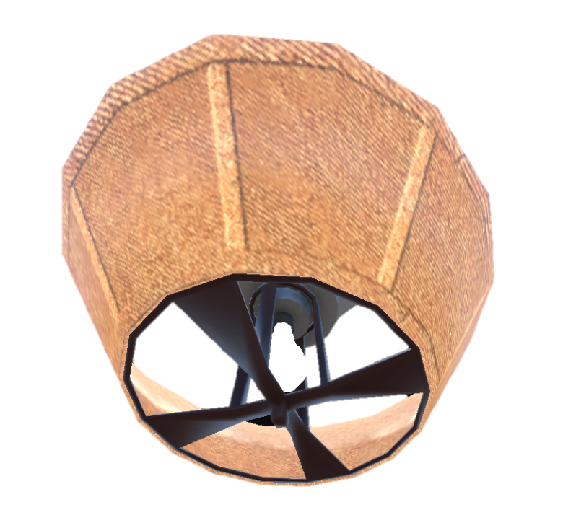
29
Energy Balance + Reaction
🔆 Lamp Shade
Shade = heat exchanger
Light = ΔHᵣₓₙ·ξ
Controls heat transfer
between reactor and surroundings
Heat generated/consumed
proportional to extent ξ
Adiabatic: Q=0
No heat exchange: all
rxn heat stays in system
Q = ΔHᵣₓₙ · ξ + ΔHₛₑₙₛᵢbₗₑ
💡 SHADE controls how much heat/light escapes the reactor. Balances generation vs removal.

Slide 31
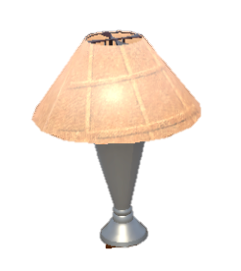
30
Adiabatic Flame Temperature
🕯 Table Lamp
Sealed box = adiabatic
Max T = Tadiabatic
No heat escapes:
perfect insulation (Q=0)
Highest possible flame T
achieved with zero heat loss
Less excess air → higher Tad
Extra air dilutes products
and absorbs heat → lower T
ΔHᵣₓₙ + ∫(Tᵣₑf → Tₐd) n·Cₚ dT = 0 (Q = 0)
💡 LAMP sealed in insulating box: all energy → heat → maximum temperature Tad.

Slide 32
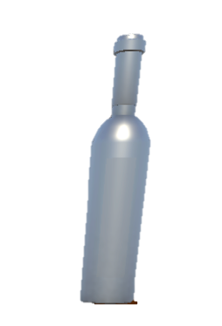
31
1st Law – Closed Systems
🍷 Wine Bottle
Sealed = closed system
Cork pops = W out
No mass crosses the
system boundary
Boundary work done by
system: W = ∫P dV
Heat Q in →
ΔU stored internally
Energy added as heat
(positive Q into system)
Whatever isn't work
changes internal energy
ΔU = Q − W
💡 WINE BOTTLE sealed (closed system). Heat wine (Q) → expands → cork pops (W = P·ΔV).

Slide 33

32
Buoyancy
🥂 Wine Glass
Buoyant force ↑
Float if ρobj < ρfluid
Upward force = weight of
displaced fluid volume
Object less dense than fluid
will be buoyed upward
Weight ↓
Gravity pulling object
downward by its mass
Fb = ρfₗᵤᵢd · g · Vₛᵤbₘₑᵣgₑd
💡 WINE GLASS in water: does it float? ρglass > ρwater → sinks! Archimedes' principle.

Slide 34
33
Properties of Fluids
🥃 White Wine Glass
Pour → viscosity μ
ρ = m/V
Dynamic viscosity: resistance
to shear deformation (Pa·s)
Density: mass per unit
volume (kg/m³)
Meniscus = σ
Surface tension: force per
unit length at interface (N/m)
μ = τ / (du/dy) | ν = μ/ρ | σ = F/L
💡 WHITE WINE pours easily (low μ). Oil is thick (high μ). Meniscus in glass = surface tension σ.

Slide 35
34
Hydrostatic Pressure
🍷 Wine Glass
Top: P₀ (atmospheric)
Surface exposed to
atmospheric pressure
h = depth ↓
Measured downward from
free surface
Bottom: P₀ + ρgh
Pressure increases linearly
with depth h
P = P₀ + ρ·g·h
💡 WINE GLASS: pressure at bottom > top. Deeper wine = more weight pressing down = higher P.

Slide 36
35
Submerged Gates
🚪 Door (underwater)
Force Fᵣ = ρg·ȳ·A
Resultant hydrostatic force
on the submerged surface
Center of pressure ycₚ ↓
Point where resultant acts:
always below centroid
Centroid ȳ
Depth of geometric center
of the submerged area
Fᵣ = ρg·ȳ·A | ycₚ = ȳ + Iɢ/(ȳ·A)
💡 UNDERWATER DOOR: water pushes harder at bottom. Center of pressure always below centroid.

Slide 37
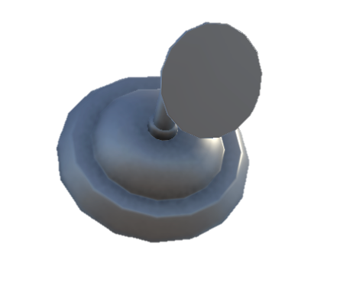
36
Bernoulli's Equation
🚿 Shower Head
Wide pipe: slow, high P
Large cross-section: low velocity
high static pressure
P + ½ρv² + ρgz = const
Energy conservation along
a streamline (inviscid, steady)
Narrow nozzle: fast, low P
Constriction accelerates flow:
venturi effect drops pressure
P + ½ρv² + ρgz = constant
💡 SHOWER HEAD: narrow holes → fast stream (↑v, ↓P by Bernoulli). Wide pipe = slow, high P.

Slide 38
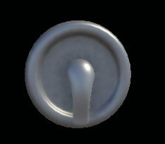
37
Viscosity & Shear Stress
🔧 Shower Handle
Twist = shear stress τ
Re = ρvD/μ
Force per unit area
parallel to surface
Reynolds number: ratio
of inertial to viscous forces
Resistance = viscosity μ
Newton's law: proportionality
constant between τ and du/dy
τ = μ · (du/dy)
💡 SHOWER HANDLE: twist = shear stress τ. Hard to turn (honey) = high μ. Easy (water) = low μ.

Slide 39
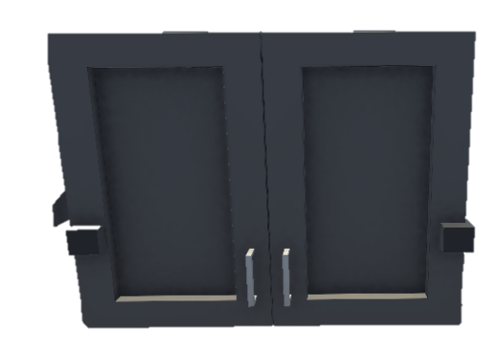
38
Conservation of Mass
🗄 Wall Cabinet
IN: ρ₁A₁v₁
OUT: ρ₂A₂v₂
Mass flow rate entering:
density × area × velocity
Mass flow rate leaving:
must equal inlet at SS
Area ↓ → velocity ↑
Continuity: pipe narrows
→ flow speeds up
ρ₁A₁v₁ = ρ₂A₂v₂ (incompressible: A₁v₁ = A₂v₂)
💡 WALL CABINET: nothing appears or disappears inside. What goes in must come out!

Slide 40
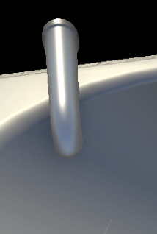
39
Intro to Pipe Flow
🚿 Faucet
Gentle = LAMINAR
Re = ρvD/μ
Re < 2100: smooth ordered
layers, predictable flow
Dimensionless ratio:
inertial forces / viscous forces
Full blast = TURBULENT
Re > 4000: chaotic mixing
eddies, enhanced transport
Re = ρvD/μ | Laminar: Re<2100 | Turbulent: Re>4000
💡 FAUCET: low flow = smooth laminar stream. Full blast = splashing turbulent chaos!

Slide 41
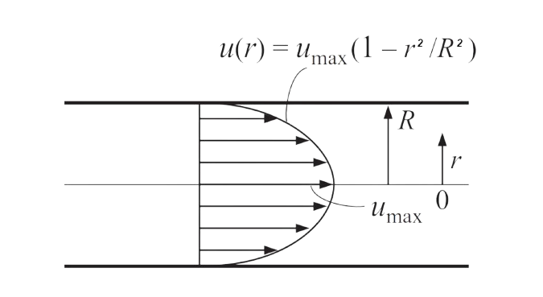
40
Velocity Profiles in Pipe
🚰 Faucet
Center = fastest vₘₐₓ
Maximum velocity at the
centerline of the pipe
Wall = zero (no-slip)
Fluid sticks to pipe wall:
v = 0 at r = R
Parabolic profile
Laminar: parabola shape
Turbulent: flatter (1/7 law)
Laminar: v(r) = vₘₐₓ(1−(r/R)²) | vₐᵥg = vₘₐₓ/2
💡 FAUCET: center flows fastest, zero at wall (no-slip). Parabolic profile = laminar.

Slide 42
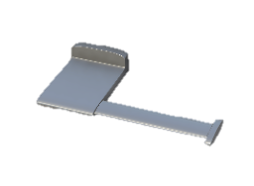
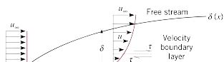
41
Boundary Layer
🧻 TP Holder
No-slip at wall: v=0
Pin = leading edge
Velocity goes from 0 at
surface to U∞ at edge of δ
δ starts at zero at
the leading edge
Further → δ grows
BL thickness increases
with distance downstream
δ = 5x/√Reₓ (laminar) | Transition: Reₓ ≈ 5×10⁵
💡 TOILET PAPER unrolling: boundary layer builds as you pull. Near pin = thin δ, further = thick.

Slide 43
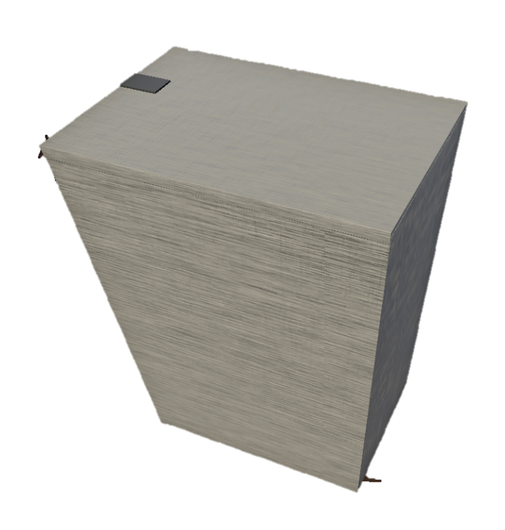
42
Entrance Length
🗑 Hamper Flap
Entry = developing
After Lₑ = fully developed
Velocity profile changing
with position x
Profile no longer changes:
correlations valid beyond Lₑ
Lₑ/D = 0.06·Re (laminar) | Lₑ/D ≈ 4.4·Re¹/⁶ (turb.)
💡 HAMPER FLAP: open it → flow chaotic near entry. After Lₑ distance, settles into final pattern.

Slide 44
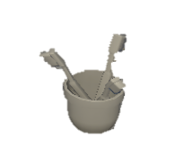
43
Pressure Drop in Pipes
🥛 Toothbrush Cup
f = friction factor
Power = Q·ΔP/η
From Moody chart: f(Re, ε/D)
Laminar: f = 64/Re
Pump power required to
overcome frictional losses
L/D = pipe geometry
Longer pipe / smaller diameter
= more friction loss
ΔP = f·(L/D)·(ρv²/2) [Darcy-Weisbach]
💡 TOOTHBRUSH CUP: fill by pumping water up pipe. Friction wastes energy — Darcy-Weisbach calculates it.

Slide 45
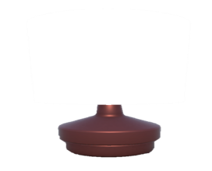
44
Equivalent Length
💡 Bedroom Lamp
Direct wire = pipe L
K = loss coefficient
Straight pipe contributes
friction over length L
Tabulated for each fitting:
valve, elbow, tee, etc.
Extension cord = Lₑq
Fittings expressed as
equivalent extra pipe length
Lₑq = K·D/f | ΔPₜₒₜₐₗ = f·(L + ΣLₑq)/D · (ρv²/2)
💡 BEDROOM LAMP with extension cord: cord adds resistance. Each valve/elbow = extra cord length.

Slide 46
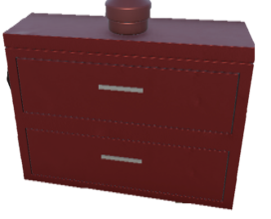
45
Multipipe Systems
🗄 Bedroom Cabinet
Side-by-side = PARALLEL
Same pressure drop across
each branch; flows add up
Stacked = SERIES
Same flow through each;
pressure drops add up
Series: Q same, ΔP = ΣΔPᵢ | Parallel: ΔP same, Q = ΣQᵢ
💡 CABINET: drawers side-by-side (parallel, same ΔP) or stacked (series, same Q).

Slide 47
46
Linear Momentum
🔊 Speaker Sub
Cone push = force F
External forces: pressure,
gravity, wall reactions
Pipe bends, nozzles
Direction change creates
forces on pipe supports
Air pushed = ṁ·Δv
Momentum flux change
across control volume
ΣF = ṁ(vₒᵤₜ − vᵢₙ)
💡 SPEAKER CONE pushes air (momentum transfer). Force on cone = rate of change of air momentum.

Slide 48
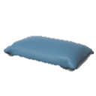
47
Pressure Field at Rest
🛏 Pillow
No motion → v=0
Static fluid: all velocity
and acceleration terms vanish
Gravity only → ∇P = ρg
Pressure gradient equals
fluid weight per unit volume
∇P = ρg (Navier-Stokes at rest: v=0 → all velocity terms vanish)
💡 PILLOW at rest: no motion, just gravity pressing down. N-S simplifies to ∇P = ρg.

Slide 49
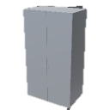
48
Velocity Profiles (N-S)
🗄 Closet Dresser
Bottom drawer = wall (v=0)
No-slip boundary condition:
fluid stationary at wall
Parabolic = Poiseuille
Pressure-driven pipe flow
with parabolic velocity profile
Top drawer = fastest
Maximum velocity at
centerline or moving plate
Couette: u = U·y/H | Poiseuille: u = (R²−r²)/(4μ)·(−dP/dx)
💡 CLOSET DRESSER: clothes organized in layers = organized laminar flow layers from wall to center.

Slide 50
49
Dimensional Analysis
🪞 Mirror
Re = inertia/viscous
Reynolds number: determines
laminar vs turbulent regime
Nu = conv/cond heat
Nusselt: ratio of convective
to conductive heat transfer
Fr = inertia/gravity
Froude number: important
for free-surface flows
Π groups = n − k | Re = ρvL/μ | Nu = hL/k
💡 MIRROR reflects: dimensionless numbers reflect physical similarity between different flows.

Slide 51
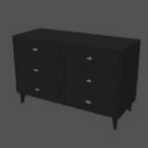
50
Modeling & Similitude
🗃 Apt Dresser
Mini furniture = model
Match Re or Fr
Small-scale replica built
for testing in lab
Dynamic similarity: match
the dominant dimensionless group
Geometric: Lₘ/Lₚ = λ
All lengths scaled by
the same factor λ
Reₘₒdₑₗ = Reₚᵣₒₜₒₜyₚₑ or Frₘₒdₑₗ = Frₚᵣₒₜₒₜyₚₑ
💡 DRESSER = scale model of a room. Match Re (viscous) or Fr (free-surface) for similarity.

Slide 52
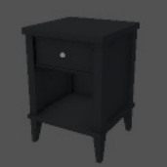
51
1st Law Closed (Processes)
🪑 End Table
Const T: ΔU=0
Isothermal ideal gas:
all heat becomes work
Adiabatic: Q=0
Insulated: internal energy
changes only via work
Const V: W=0
Isochoric: no volume change
so no boundary work
Isothermal: Q = W = nRT·ln(V₂/V₁) | Adiabatic: Q = 0, ΔU = −W
💡 END TABLE: fixed contents, closed top. Heat (Q) → stores (ΔU) or does work (W).

Slide 53
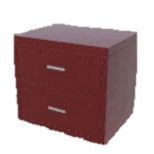
52
1st Law – Open Systems
☕ End Table
Cups IN = ṁᵢₙ · hᵢₙ
Cups OUT = ṁₒᵤₜ · hₒᵤₜ
Enthalpy carried in by
mass flow streams
Enthalpy leaving with
exit mass flows
H = U + PV (enthalpy)
Accounts for both internal
energy and flow work
Q̇ − Ẇₛ = ṁ[Δh + Δv²/2 + gΔz]
💡 END TABLE in café: cups come and go (open system). H = U + PV includes flow work.

Slide 54
53
Unsteady Energy on Tanks
🪑 Bench
Loading = ṁᵢₙ·hᵢₙ
Energy input from
incoming mass flows
d(mU)/dt ≠ 0
Accumulation term is non-zero:
transient energy balance ODE
d(mU)/dt = Q̇ − Ẇ + ṁᵢₙ·hᵢₙ − ṁₒᵤₜ·hₒᵤₜ
💡 BENCH loaded over time: weight (internal energy) increases. Unsteady = load changes with t.

Slide 55

54
Entropy
📺 TV
Clear signal = low S
Ordered state: fewer
microstates, low entropy
ΔSᵤₙᵢᵥ ≥ 0 always
Second Law: universe entropy
never decreases
Static noise = high S
Disordered state: many
microstates, high entropy
dS = δQᵣₑᵥ/T | ΔSᵤₙᵢᵥₑᵣₛₑ ≥ 0 (2nd Law)
💡 TV: scrambled signal = high entropy. Clear picture = low S. Signals get noisier (ΔS↑ always).

Slide 56
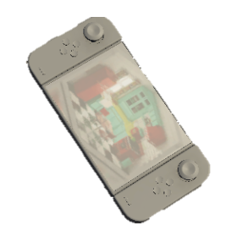
55
Turbines & Compressors
🎮 Game Controller
Joystick OUT = turbine
Extracts shaft work from
high-pressure fluid
η < 1 (irreversibility)
Isentropic efficiency accounts
for real-world friction/heat losses
Buttons IN = compressor
Adds shaft work to
increase fluid pressure
ηₜᵤᵣb = (h₁−h₂)/(h₁−h₂ₛ) | ηcₒₘₚ = (h₂ₛ−h₁)/(h₂−h₁)
💡 CONTROLLER: turbine = output (joystick pushes out power). Compressor = input (buttons pressed in).

Slide 57
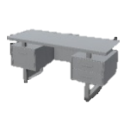
56
Rev. & Irrev. Expansion
💻 Computer Table
Neat = reversible
Wᵣₑᵥ > Wᵢᵣᵣₑᵥ (exp.)
Maximum work extracted
or minimum work input
Reversible expansion always
yields more useful work
Messy = irreversible
Less work out, more in;
entropy generated
Wᵣₑᵥ = nRT·ln(V₂/V₁) (isothermal) | Wᵢᵣᵣₑᵥ = Pₑₓₜ·ΔV
💡 NEAT DESK = reversible (max efficiency). MESSY DESK = irreversible (wasted effort).

Slide 58

57
Isentropic Process
🖱 Computer Mouse
Smooth glide = isentropic
No friction, no heat loss:
entropy constant (ΔS=0)
γ = Cₚ/Cᵥ
Heat capacity ratio:
always > 1 for real gases
Friction = irreversible
Real processes generate
entropy from dissipation
PV^{γ} = const | T₂/T₁ = (P₂/P₁)⁽ˠ⁻¹⁾/ˠ
💡 MOUSE: smooth frictionless glide = reversible + adiabatic = isentropic. Drag = entropy.

Slide 59
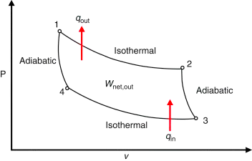

58
Carnot Cycle
🪟 Window Frame
Outside = Tₗ (cold)
Low-temperature sink
(heat rejection)
Bigger ΔT → more η
Maximum theoretical efficiency
for any heat engine
Inside = Tʜ (hot)
High-temperature thermal
reservoir (heat source)
η꜀ₐᵣₙₒₜ = 1 − Tₗ/Tʜ
💡 WINDOW: hot inside (Tʜ), cold outside (Tₗ). Carnot extracts work from ΔT. No engine beats it!
COPʜₚ = Tʜ / (Tʜ−Tₗ)
COPᵣₑf = Tₗ / (Tʜ−Tₗ)

Slide 60


59
Rankine Cycle
🏺 Vase
Fill = pump
Steam → turbine
Liquid water pressurized
with minimal work input
Steam expands through turbine
extracting shaft work
Heat = boiler
Cool back = condenser
Heat added at high P:
liquid → superheated steam
Vapor condensed back to
liquid, rejecting heat to sink
η = (Wₜᵤᵣbᵢₙₑ − Wₚᵤₘₚ) / Qbₒᵢₗₑᵣ
💡 VASE: fill water (pump) → heat (boiler) → steam pushes (turbine) → condense → repeat.

Slide 61


60
Refrigeration Cycle
❄️ Fridge
Inside cold = evaporator
Refrigerant absorbs heat Qₗ
at low T inside the fridge
COP > 1 possible!
Unlike efficiency, COP can
exceed unity (not % limited)
Back hot = condenser
Rejects heat Qʜ to kitchen
at high T behind fridge
COP = Qₗ / Ẇcₒₘₚ = (h₁−h₄) / (h₂−h₁)
💡 FRIDGE: cold inside (evaporator absorbs Qₗ), hot back (condenser rejects Qʜ). COP > 1!

Slide 62

61
Throttling (Joule-Thomson)
🪞 Mirror Plate
Same H reflected
Isenthalpic: enthalpy unchanged
across throttle valve
μJₜ> 0 → cools
Positive J-T coefficient:
gas cools on expansion (for refrig.)
P drops, T may drop
Irreversible expansion:
no work extracted
h₁ = h₂ (isenthalpic) | μJₜ = (∂T/∂P)ʜ
💡 MIRROR reflects same enthalpy (h₁=h₂), but pressure and temperature redistribute through valve.

Slide 63

62
Fundamental Relations
🗄 Wall Cabinet
Drawer U: keys S,V
Drawer G: keys T,P
Internal energy: natural
variables are entropy & volume
Gibbs energy: most useful
at constant T,P (lab conditions)
Drawer H: keys S,P
Drawer A: keys T,V
Enthalpy: natural variables
are entropy & pressure
Helmholtz energy: useful
for constant T,V systems
dU = TdS − PdV | dH = TdS + VdP | dA = − SdT − PdV | dG = − SdT + VdP
💡 CABINET: 4 drawers (U,H,A,G), each opens with 2 keys (natural variables). Maxwell = diagonals.

Slide 64
63
Liquefaction
🗄 Storage Cabinet
Gas in (warm)
Liquid drips (LN₂, LNG)
High-pressure gas enters
above inversion temperature
Fraction y liquefied;
rest recycled for more cooling
Door crack = throttle
Isenthalpic expansion
cools the gas (J-T effect)
y (liq. fraction) = (h₂ − h₁) / (h₂ − hf)
💡 CABINET stores liquefied gas. Gas squeezed through door crack (throttle) → cools → liquefies.

Slide 65

64
Property Phase Diagrams
🗄 Double-Door Cabinet
Left door = axis 1
Right door = axis 2
Pressure (PV) or Temperature
(TS) on vertical axis
Volume (PV) or Entropy
(TS) on horizontal axis
Dome = two-phase
Under the dome: liquid-vapor
coexistence region
PV diagram: area = W | TS diagram: area = Qᵣₑᵥ
💡 DOUBLE DOOR: two panels = two axes (P-V or T-S). Dome shape = two-phase region.

Slide 66
65
Departure Functions
🥛 Drinking Glass
Thin ideal = Hⁱg
Z = Pv/RT
Ideal gas enthalpy:
no intermolecular interactions
Compressibility factor
measures deviation from ideal
Extra thickness = departure
Correction for real gas:
accounts for molecular forces
H − Hⁱg = RT² ∫(∂Z/∂T)ₚ d(lnP)
💡 GLASS: thick base = departure from thin ideal glass. Real fluid = ideal + departure correction.

Slide 67
66
Fugacity
🥛 Drinking Glass
Escaping tendency = f
f = φ·P
Fugacity: effective pressure
corrected for non-ideality
Fugacity coefficient φ from
equation of state
At low P: f → P
Ideal limit: fugacity equals
pressure as P → 0
f = φ·P | Phase equil: fₗ = fᵥ
💡 Real liquid escapes with fugacity f, not just vapor pressure. f = corrected pressure for real behavior.

Slide 68
67
Partial Molar Quantities
🥣 Bowl
Add 1 spoon salt → ΔV
M̄ᵢ = partial molar
Partial molar volume: volume
change per mole of i added
Contribution of component i
to total mixture property
Gibbs-Duhem: Σxᵢ·dM̄ᵢ=0
Constraint: partial molar
properties not independent
M̄ᵢ = (∂(nM)/∂nᵢ)ₜ,ₚ,ₙⱼ | Mₘᵢₓ = Σxᵢ·M̄ᵢ
💡 BOWL of mixed ingredients: each component contributes M̄ᵢ to total bowl property.

Slide 69
68
Fugacities of Mixtures
🍽 Plate
Each food = component
φ̂ᵢ from mixture EOS
Individual species fugacity
in the mixture phase
Fugacity coefficient from PR/SRK
accounts for unlike interactions
f̂ᵢ = yᵢ·φ̂ᵢ·P (vapor) | VLE: f̂ᵢL = f̂ᵢV
💡 PLATE with mixed foods: each item exerts its own escaping tendency (fugacity) in the mixture.

Slide 70
69
Chemical Potential
🥣 Stacked Bowls
Bowl 1 level = μ^α
Bowl 2 level = μ^{β}
Chemical potential in phase α:
partial molar Gibbs energy
Chemical potential in phase β:
must equal μ^α at equilibrium
Equal levels = equil.
Drives mass transfer from
high to low μ until balanced
μᵢ = (∂G/∂nᵢ)ₜ,ₚ | Equil: μᵢ^{α} = μᵢ^{β}
💡 STACKED BOWLS: at equilibrium, liquid level (μ) same in all bowls. High μ → flows to low μ.

Slide 71

70
VLE Non-Ideal (γ)
🗄 Corner Cabinet
Straight = ideal (γ=1)
γ>1: pos. dev. | γ<1: neg.
Raoult's Law: ideal solution
no activity coefficient needed
Margules, Wilson, NRTL
models predict γ values
Corner angle = γ ≠ 1
Activity coefficient corrects
for molecular interactions
P·yᵢ = xᵢ · γᵢ · Pᵢ* [Modified Raoult's]
💡 CORNER CABINET: hard access = non-ideal mixtures deviate from Raoult. γ = angle correction factor.

Slide 72

71
Osmosis & Reverse Osmosis
🍞 Toaster
Lever = applied P
π = osmotic pressure
External pressure applied
to overcome osmotic pressure
Equilibrium pressure from
solute concentration (π=MRT)
Slots = membrane
Semipermeable membrane:
only solvent passes through
π = MRT | RO: apply P > π to push solvent through membrane
💡 TOASTER: push lever (pressure) to force bread (water) through slots (membrane). Push = desalinate!

Slide 73

72
Henry's Law & Absorption
💡 Ceiling Lamp
Light above = gas phase
High H → low solubility
Gas-phase partial pressure
drives dissolution
Large Henry's constant
means gas barely dissolves
Room below = liquid
Liquid solvent absorbs
gas at mole fraction xᵢ
pᵢ = Hᵢ · xᵢ (Henry's Law)
💡 CEILING LAMP: light (gas) shines DOWN into room (liquid). Some light absorbed. Dim lamp = less absorption.

Slide 74

73
Enthalpy of Mixing
🪑 Office Chair
Good mix → ΔH<0
Exothermic mixing:
strong unlike interactions
Bad mix → ΔH>0
Endothermic mixing:
like-like preferred over unlike
GE = RT · Σxᵢ · ln(γᵢ) | ΔHₘᵢₓ = Hₘᵢₓ − Σxᵢ·Hᵢ
💡 MIX two foam types in CHAIR: comfortable (ΔH<0, neg. dev.) or not (ΔH>0, pos. dev.).

Slide 75
74
Cubic EOS for VLE
💤 Pillow
Compressed = liquid root
Smallest volume root:
represents liquid phase
Middle root = unstable
Spinodal region: physically
meaningless, always discard
Fluffy = vapor root
Largest volume root:
represents vapor phase
PR: P = RT/(v−b) − a(T)/[v(v+b)+b(v−b)]
💡 PILLOW: soft (liquid root) vs fluffy (vapor root). Cubic gives 3 roots; discard unstable middle.

Slide 76

75
Gibbs Energy & Phase Sep.
🪵 Table Top
Smooth = stable
Concave up Gₘᵢₓ curve:
single-phase thermodynamically stable
Spinodal: ∂²G/∂x²=0
Boundary of unstable region;
binodal found by common tangent
Crack = phase separation
Concave down region:
system spontaneously demixes
∂²G/∂x² < 0 → unstable → phase separation
💡 TABLE TOP: smooth = stable single phase. Cracked = phase-separated. Common tangent = equilibrium.

Slide 77

76
Partially Miscible Liquids
🛋 Sofa
Person 1 = phase I
Liquid phase α with
composition on binodal
Above UCST → mix
Upper critical solution T:
full miscibility above it
Person 2 = phase II
Liquid phase β with
different binodal composition
At equil: μᵢ^{I} = μᵢ^{II} | UCST: above → fully miscible
💡 SOFA: two people share but stay in zones (partially miscible). Warm room (↑T) → they can mix.

Slide 78
77
Immiscible Liquids
🛋 Main Sofa
Never share = immiscible
Zero mutual solubility:
two permanent liquid layers
Steam distillation
Exploit immiscibility to
boil at T lower than either pure
P = Pₐ* + Pᵦ* → Boil at T < either pure Tb
💡 Two people who NEVER share space (immiscible). Boil together → both in vapor at lower T.

Slide 79


78
Eutectic Phase Diagrams
🪑 Side Table
Solid top = solid phase
Solidus region below
eutectic horizontal line
Eutectic pt: lowest Tₘ
Invariant point: Pb-Sn solder,
food science applications
Cup = liquid phase
Liquidus region above
the melting curve
Eutectic: 3 phases in equil. (F=0) | Lowest melting composition
💡 SIDE TABLE: solid top (solid) + liquid cups (liquid). Eutectic = composition that melts at lowest T.

Slide 80
79
Azeotropes
🪟 Window Frame
Fixed frame = stuck comp.
Break: P-swing or entrainer
Liquid and vapor have
identical compositions
Change P to shift azeotrope
or add third component
EtOH-H₂O: 95.6%
Classic minimum-boiling
azeotrope at 78.1°C
Azeotrope: xᵢ = yᵢ (can't separate by simple distillation)
💡 WINDOW FRAME: stuck, can't move further. Azeotrope = stuck composition during distillation.

Slide 81
80
Gas-Phase Chemical Equil.
🪟 Window
Inside = reactants
Outside = products
Starting materials at
standard state
Kₚ > 1: products favored
Kₚ < 1: reactants favored
van't Hoff: d(lnK)/dT
ΔH°/(RT²): tells how K
changes with temperature
ΔG° = −RT·ln(Kₚ) | Kₚ = Π(Pᵢ/P°)νᵢ
💡 WINDOW: outside = products, inside = reactants. Kₚ tells how far the window opens (→ products).

Slide 82
81
Heterogeneous Equil.
🪟 Window
Frame = solid (a=1)
Outside gas → in Kₚ
Pure solids/liquids: activity
fixed at unity by convention
Only species with variable
activity appear in K expression
Q vs K: direction
Q < K → forward (make products)
Q > K → reverse (make reactants)
Pure solid/liquid: a = 1 → Kₚ = PCO2 (CaCO₃ decomp.)
💡 WINDOW: frame itself is solid (a=1, always there). Only gases appear in Kₚ expression.

Slide 83

82
Thermal Effects in Rxns
🛏 Sheet
Exothermic: K ↓ with T
Le Chatelier: heating shifts
exo reaction ← backward
Tₐd = T₀ + |ΔH|X/(ΣnCₚ)
Adiabatic temperature rise
from exothermic reaction
Endothermic: K ↑ with T
Heating pushes endo
reaction → forward
ln(K₂/K₁) = −ΔH°/R · (1/T₂ − 1/T₁) [van't Hoff]
💡 SHEET: temperature distributed across reactor. van't Hoff shows how K(T) shifts with temperature.

Slide 84
83
Multiple Reaction Equil.
🚪 Door (multi-lock)
Lock 1 = rxn 1 equil.
First independent reaction
with its own Kₚ value
Key set = extents ξⱼ
Gibbs free energy minimization
finds all ξⱼ simultaneously
Lock 2 = rxn 2 equil.
Second coupled reaction;
extents ξⱼ are coupled
Minimize Gₜₒₜₐₗ subject to atom balance constraints
💡 DOOR with multiple locks: each lock = one equilibrium reaction. Must open all simultaneously (ξⱼ).

Slide 85
84
Nonlinear Regression
🚪 Door (key-fitting)
Wrong key = high SSR
Poor parameter estimates:
large sum of squared residuals
r = k·Cₐ^α·Cᵦ^β
Power law rate: fit α, β
and pre-exponential k
Right key = min SSR
Optimal parameters found
by Levenberg-Marquardt
SSR = Σ(yₒbₛ − yₘₒdₑₗ)² → minimize over parameters
💡 DOOR: try different key shapes (parameters k, α, β) until it fits (minimizes SSR). Right key = data fits!

Slide 86
85
Multiple Rxns & Selectivity
🚪 Door (multi-keyhole)
Desired lock = target rxn
Rate of desired product
formation rdₑₛᵢᵣₑd
PFR favors higher-order
High Cₐ in PFR benefits
higher-order desired reactions
Other locks = side rxns
Undesired parallel/series
reactions consuming feed
Selectivity S = rdₑₛᵢᵣₑd / rᵤₙdₑₛᵢᵣₑd
💡 DOOR with multiple keyholes: insert key carefully to open DESIRED lock only (maximize selectivity S).

Slide 87
86
Langmuir-Hinshelwood
🚪 Door (dual-key)
Key A adsorbs → Kₐ
Reactant A adsorbs to
catalyst active site
Both in → reaction!
Surface reaction between
two adsorbed species
Key B adsorbs → Kᵦ
Reactant B adsorbs to
adjacent catalyst site
r = k·Kₐ·Cₐ·Kᵦ·Cᵦ / (1 + Kₐ·Cₐ + Kᵦ·Cᵦ)²
💡 DOOR: two keys (A,B) must BOTH be inserted (both adsorb on surface) before door opens (reaction!).

Slide 88

87
Thiele Modulus & η
🪑 Chair (foam)
Thick foam = high Φ
Large Thiele: reaction fast
relative to diffusion
Small pellet → η ≈ 1
Reduce particle size to
eliminate diffusion limitation
η << 1 (diffusion limited)
Effectiveness factor low:
interior sites starved of reactant
Φ = R√(k/Dₑ) | η = tanh(Φ)/Φ
💡 CHAIR foam cushion: must press through foam (pore diffusion) to reach base (active site). Deep = low η.

Slide 89
88
Isothermal Batch Reactor
🪑 Chair (sit & wait)
Sit down = load reactants
Charge reactor with initial
concentration Cₐ₀
Stand up = unload products
Remove products after
desired conversion achieved
Wait time t for X
Integrate design equation
to find required batch time
t = Cₐ₀ ∫dX / (−rₐ)
💡 CHAIR: sit down (load reactants), wait time t for conversion X, stand up (unload). No one enters!

Slide 90
89
CSTR
🪑 Cafeteria Chair
Continuous in/out
Steady flow: feed enters,
product exits continuously
Rate at EXIT conditions
rₐ evaluated at exit (low)
concentration → larger V needed
Well-mixed → Cₑₓᵢₜ=Cᵣₑₐcₜₒᵣ
Perfect mixing: composition
uniform throughout tank
V = Fₐ₀ · X / (−rₐ)|ₑₓᵢₜ
💡 Cafeteria CHAIR: always occupied, well-mixed. Exit = reactor concentration. Rate at EXIT conditions!

Slide 91
90
PFR (Plug Flow Reactor)
🪑 Queue Chair
Enter front (inlet)
Exit back (outlet)
Feed enters at one end;
concentration highest here
Products exit after
traveling full reactor length
PFR > CSTR for same X
PFR always smaller volume
for positive-order reactions
V/Fₐ₀ = ∫(₀→X) dX / (−rₐ)
💡 CHAIR in a queue: first in, first out. Each fluid element waits exactly V/Q time. No mixing, no cutting!

Slide 92

91
Semibatch Reactor
📚 Wall Shelf
A already in reactor
One reactant initially charged
as batch component
Controls selectivity & heat
Low Cᵦ maintains high
selectivity for desired product
Add B slowly over time
Second reactant fed gradually
to control selectivity/temperature
dNₐ/dt = Fₐ,ᵢₙ + rₐ · V (variable V)
💡 WALL SHELF: start empty (A inside), add books (B) over time. Controlled addition prevents overload.

Slide 93
92
PFR Energy Balance
🪟 Window (PFR view)
T(z) profile visible
Temperature varies along
reactor length z
Coupled: dX/dV & dT/dV
Solve simultaneously with
numerical ODE solver (RK4)
Exothermic: T ↑ along L
Risk of hot spot:
runaway if cooling insufficient
dT/dV = [Q̇ − ΔHᵣₓₙ·rₐ] / (Fₐ₀·ΣΘᵢCₚᵢ)
💡 Look through PFR window: T and X change together (coupled ODEs). Hot exothermic PFR fogs the window!

Slide 94
93
CSTR Energy Balance
🪟 Window (CSTR)
G(T) = heat generation
S-shaped curve from Arrhenius
temperature dependence of rate
Intersection = SS
Where G=R: possible
multiple intersections
R(T) = heat removal
Linear: ṁCₚ(T−T₀)
+ UA(T−Tₐ) from cooling
G(T) = R(T) [heat generation = heat removal at SS]
💡 Heat generated G (S-curve) vs heat removed R (line). Intersections = steady state(s)!

Slide 95

94
Multiple Steady States
💡 Wall Lamp
ON = high-T SS
Upper stable operating point:
high conversion, high temperature
Bistability + hysteresis
Path to SS depends on history:
ignition ≠ extinction temperature
OFF = low-T SS
Lower stable point: low
conversion, near feed temperature
dG/dT > dR/dT → unstable | Ignition & extinction points
💡 WALL LAMP: ON (high-T SS) or OFF (low-T SS). Flick switch → jumps between states. Bistability!

Slide 96

95
Packed Bed Pressure Drop
💡 Ceiling Lamp
Gas flow ↑ through bed
ε = void fraction
Superficial velocity u through
particle-packed column
Bed porosity (0.35-0.5):
fraction of bed that is empty space
Packing = resistance
Viscous (Blake-Kozeny) +
inertial (Burke-Plummer) terms
Ergun: −dP/dz = 150μu(1−ε)²/(Dₚε³) + 1.75ρu²(1−ε)/(Dₚε³)
💡 Gas pushes UP through bulb filaments (packing). Pressure drops fighting through. Ergun quantifies.

Slide 97
96
PSSH & Rate-Determining Step
🪟 Glass Door
See-through = PSSH
Door speed = RDS
Reactive intermediate concentration
approximately constant
Rate-determining step:
slowest elementary step = bottleneck
Solve for [I], simplify
Set d[I]/dt=0, eliminate [I]
from overall rate expression
PSSH: d[I]/dt ≈ 0 | Rate = rate of RDS (slowest step)
💡 GLASS DOOR: see-through → intermediates transparent (pseudo-steady). RDS = how fast door opens.

Slide 98

97
Enzyme Kinetics
🧺 Towel Rack
Hooks = active sites
Kₘ = [S] at r = Vₘₐₓ/2
Enzyme's catalytic sites:
limited number available
Michaelis constant: substrate
conc. giving half-max rate
Towels = substrate [S]
Substrate concentration
determines reaction rate
r = Vₘₐₓ · [S] / (Kₘ + [S]) [Michaelis-Menten]
💡 TOWEL RACK: hooks (enzyme active sites) grab towels (substrate). All hooks busy → Vₘₐₓ (saturated).
Lineweaver-Burk: 1/r = Kₘ/(Vₘₐₓ[S]) + 1/Vₘₐₓ

Slide 99

98
Polymerization Kinetics
🧶 Bath Mat
Single fibre = monomer
Init → Prop → Term
Monomer [M] consumed in
propagation step
Three stages: radical generation,
chain growth, chain termination
Woven mat = polymer
Growing chains build molecular
weight via propagation
Rₚ = kₚ·[M]·√(2Rᵢ/kₜ) | Chain growth
💡 BATH MAT: individual fibres (monomers) woven into long chains (polymer). Init → Prop → Termination.

Slide 100

99
Solving ODEs
💡 Floor Lamp
Plug (t=0) = initial cond.
Bulb = final answer
Starting point y₀ at time
t₀ (known initial value)
Solution y(tfinal) obtained
after marching through time
Steps along cord = h
Step size h: smaller = more
accurate but more computation
Euler: yₙ+₁ = yₙ + h·f(tₙ, yₙ) | RK4: 4 stages
💡 FLOOR LAMP: follow power cord from plug (t = 0) to bulb (t = final). Each cord step = Euler/RK step.

Slide 101
100
Residence Time Distribution
💡 Floor Lamp
Photon in = tracer injection
E(t) = exit age dist.
Pulse or step input of tracer
to characterize non-ideal flow
Probability distribution of
residence times in the reactor
σ² = spread/mixing
Variance measures departure
from ideal PFR or CSTR
E(t) distribution | τ = V/Q | PFR: δ(t−τ) CSTR: e^{⁻t/τ}/τ
💡 How long does each photon (molecule) stay in the room (reactor)? RTD = distribution of residence times.

Slide 102
101
Polymerization Reactors
🪟 Window
Window fogs = gel effect
Viscosity increase slows
termination → rate accelerates
PFR → narrow MWD
Plug flow: all chains see
same residence time → narrow PDI
CSTR → Flory-Schulz MWD
Backmixed gives broader
MW distribution (PDI≈2)
Gel effect (Trommsdorff): viscosity ↑ → kₜ ↓ → auto-acceleration
💡 Watch polymer forming through window. Gel effect = window fogs up (viscosity ↑ dramatically).

Slide 103

102
Batch Distillation
🗃 Fridge Drawer
Light comp. rises first
More volatile component
enriched in distillate overhead
Rayleigh tracks this
Integrate along VLE curve
to find remaining pot composition
Pot gets heavier
Still pot composition shifts
toward less volatile as batch proceeds
Rayleigh: ln(L/L₀) = ∫dx / (y* − x)
💡 FRIDGE DRAWER: lighter volatiles float up first. Still pot gets heavier as lights are removed.

Slide 104
103
Multistage Distillation
🏗 Column (stairs)
Each stair = 1 equil. stage
Equilibrium stage: leaving
streams in VLE
Fenske: Nₘᵢₙ at total R
Minimum stages at total
reflux (max separation power)
Higher R → more purity
Reflux ratio trades energy
cost for product purity
y = R/(R+1)·x + x^{ᴅ}/(R+1) [Operating line]
💡 Climbing stairs (stages): each stair gets closer to pure product. More stairs or higher R = higher purity.

Slide 105

104
McCabe-Thiele Diagram
💡 Wall Lamp
Staircase = stages
Each step between op. line
and equil. curve = 1 stage
Count steps = N stages
Graphical determination of
total theoretical trays needed
q-line: feed condition
q=1: sat. liquid feed
q=0: sat. vapor feed
Rect: y = R/(R+1)·x + x^{ᴅ}/(R+1) | q-line for feed
💡 WALL LAMP illuminates McCabe-Thiele diagram. Count staircase steps between operating line and equil. curve.

Slide 106

105
Absorption Columns
🏭 Column
Gas UP ↑
Gas phase flows upward
through packed column
Counter-current = max ΔC
Opposing flows maximize
driving force for mass transfer
Liquid DOWN ↓
Solvent flows down: absorbs
gas component at each height
Z = NOG × HOG | NOG = ∫dy/(y − y*)
💡 Car wash: dirty gas flows up, clean solvent flows down. Each wash zone = 1 transfer unit. Counter-current!

Slide 107

106
Stripping Columns
🗄 Corner Wall Cabinet
Dissolved gas = hiding
S > 1 → effective
Dissolved solute in liquid
needs to be removed
Stripping factor > 1 ensures
enough driving force for removal
Stripping = pulls out
Strip gas (steam, air) contacts
liquid to drive out dissolved gas
Stripping factor S = mG/L | S > 1 for effective stripping
💡 CORNER CABINET: strips out hard-to-reach dissolved gases from liquid. Reverse of absorption.

Slide 108

107
Hunter-Nash (LLE)
🔺 Ternary triangle
Feed F
Step between tie lines
Feed mixture of solute
and carrier to be extracted
Connect operating point through
tie lines to count stages
Solvent S
Immiscible solvent selectively
extracts the solute
F + S = R + E | Operating point on extended (F,S) line
💡 Ternary triangle = map. Operating point = compass bearing. Each extraction = one step on triangle.

Slide 109

108
Single-Effect Evaporator
☁️ Evaporator
Feed F in
Dilute solution entering
the evaporator
Vapor V out ↑
Conc. liquid L out ↓
Water evaporated off:
driven by steam heating
Concentrated product stream:
F·xꜰ = L·xₗ (solute balance)
F = L + V | F·xꜰ = L·xₗ | SE = V/S ≈ 0.8-0.9
💡 Single pot of soup: steam heats pot (F), water evaporates (V), soup concentrates (L).

Slide 110
109
Multi-Effect Evaporator
☁️×3 Triple Effect
Effect 1: fresh steam
Effect 3: uses vapor from 2
Live steam input: highest
T and P in the series
Cascading: each subsequent
effect runs at lower T and P
Effect 2: uses vapor from 1
Vapor from effect 1 serves
as heating medium for effect 2
SE ≈ N (N effects → N times better steam economy)
💡 Three pots in series: steam from pot 1 heats pot 2, from 2 heats 3. Energy recycled between effects!

Slide 111

110
Lumped Capacitance
🕯 Candle
Small object = Bi < 0.1
τ = ρVc/(hA)
Biot number small: internal
conduction >> external convection
Thermal time constant:
how fast object responds to T change
Uniform T (lumped)
No spatial gradient inside:
whole object at one temperature
T(t) = T∞ + (Tᵢ − T∞)·exp(−t/τ) | Bi = hLc/k < 0.1
💡 CANDLE: small object, uniform T everywhere (lumped). Blow out → T drops exponentially with time.

Slide 112

111
Transient Conduction (Sphere)
🌐 Sphere
Surface cools first
Center stays hot
Convection removes heat from
outer surface immediately
Internal conduction limits
how fast heat reaches center
Fo = αt/r₀²
Fourier number: dimensionless time
for conduction penetration depth
Fo = αt/r₀² | Bi = hr₀/k | One-term approx. + Heisler charts
💡 Sphere cooling: surface cools fast, center stays hot. Fo tracks how far heat has diffused inward.

Slide 113
112
Semi-Infinite Solid
🏔 Mountain
Surface: Tₛ applied
Penetration δ ≈ √(αt)
Sudden surface temperature change
at t=0 (step input)
Thermal penetration depth grows
with square root of time
Beyond 2√(αt): undisturbed
erf(2)≈1: material at depth
> 2√(αt) still at initial T
T(x,t) = Tₛ + (Tᵢ − Tₛ)·erf(x/√(4αt))
💡 Heat wave at surface penetrates deeper with time. Error function = how far the temperature front moved.

Slide 114
113
Convection over Flat Plate
🏊 Flat Plate
Leading edge: thin BL
Downstream: turbulent BL
Near plate start: laminar
thermal boundary layer develops
Beyond Reₓ ≈ 5×10⁵:
turbulent with higher h
Nu = hL/k
Nusselt number: dimensionless
heat transfer coefficient
Nuₓ = 0.332·Reₓ^{0.5}·Pr¹/³ (laminar) | h = Nu·k/L
💡 Swimmer's hand: near wrist (leading edge) = thin laminar BL. Downstream fingertips → turbulent BL.

Slide 115
114
Free Convection
🌡 Radiator
Hot surface → ρ ↓ → rises
Ra < 10⁸: laminar
Thermal expansion reduces density:
buoyancy force drives upward flow
Rayleigh number determines
laminar vs turbulent free convection
Cold fills in below
Cooler denser air replaces
rising warm air (natural circulation)
Ra = Gr·Pr | Gr = gβ(Tₛ−T∞)L³/ν²
💡 Hot radiator: warm air rises (ρ↓), cold fills in below. Buoyancy ghost drives the flow. Gr = ghost strength.

