Slide 1

Chemical
Engineering
Core Concepts
With Equations, Diagrams & Key Formulas
114 Topics
from Fundamentals to Advanced

Slide 2
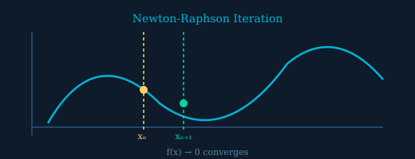

Numerical Methods
Iterative Solutions of Nonlinear Equations
01 / 114
Find roots of nonlinear equations f(x)=0 using iterative methods. Convergence when |xₙ₊₁ − xₙ| < ε.
KEY POINTS
1 Newton-Raphson: quadratic convergence 2 Bisection: robust but slow 3 Convergence tolerance ε ~10⁻⁶ 4 Excel Solver for multi-variable systems
FORMULA REFERENCE
Newton-Raphson: quadratic convergence
Bisection: robust but slow
Chemical Engineering Core Concepts
Iterative Solutions of Nonlinear Equations

Slide 3

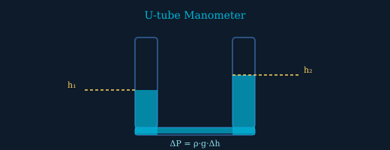
Fluid Statics
Manometry
02 / 114
Measure pressure differences using manometer height differences and fluid densities. Multi-fluid analysis uses sequential pressure additions.
1
2
3
4
U-tube: ΔP = (ρ_man − ρ_fluid)·g·h
Multi-fluid: add each ρgh term
Gauge pressure = absolute − atmospheric
Inclined manometers amplify sensitivity
Chemical Engineering Core Concepts
Manometry

Slide 4

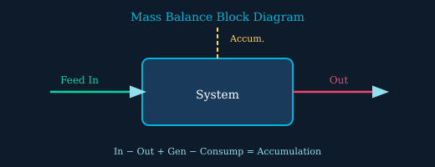
Process Fundamentals
Material Balances
03 / 114
Apply conservation of mass to chemical process streams. Steady-state with no reaction: input equals output.
Choose system boundary carefully
Steady-state: dM/dt = 0
Tie components simplify calculations
Basis = 100 mol or 100 kg typically
FORMULA
Ṁᵢₙ − Ṁₒᵤₜ + Ṁ_gen − Ṁ_consump = dM/dt
Chemical Engineering Core Concepts
Material Balances

Slide 5
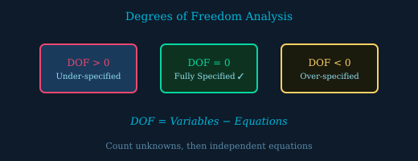

Process Analysis
Degrees of Freedom
04 / 114
Count unknowns vs. independent equations before solving. DOF = 0 means the system is fully specified.
KEY POINTS
1 List all stream variables 2 Count independent equations 3 DOF > 0: need more specifications 4 DOF < 0: redundant or inconsistent
FORMULA REFERENCE
List all stream variables
Count independent equations
Chemical Engineering Core Concepts
Degrees of Freedom

Slide 6

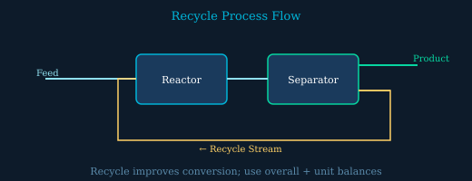
Process Design
Recycle Mass Balances
05 / 114
Solve recycle loops by writing overall and per-unit balances. Overall conversion can be much higher than single-pass conversion.
1
2
3
4
Cut the recycle: write overall balance first
Per-pass conversion < overall conversion
Recycle ratio R = recycle/product
Tear stream approach in simulation
Chemical Engineering Core Concepts
Recycle Mass Balances

Slide 7

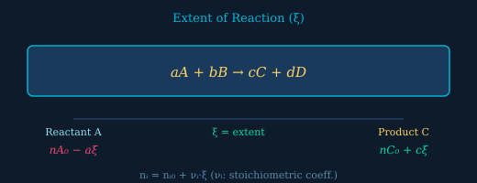
Stoichiometry
Chemical Reactions
06 / 114
Track moles of each species using stoichiometric coefficients and extent of reaction ξ. Negative νᵢ for reactants.
νᵢ > 0 products, νᵢ < 0 reactants
Limiting reactant: ξ_max = n₀/|ν|_limiting
Conversion X = −Δn_A / n_A₀
Yield = moles desired / moles if no side rxn
FORMULA
nᵢ = nᵢ₀ + νᵢ · ξ
Chemical Engineering Core Concepts
Chemical Reactions

Slide 8
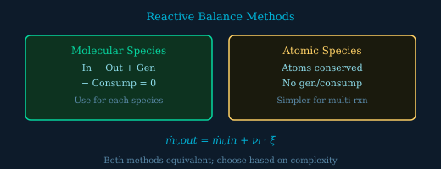

Reaction Balances
Reactive Material Balances
07 / 114
Incorporate chemical reactions into process balances using molecular species balance or atomic species balance methods.
KEY POINTS
1 Molecular: write balance per compound 2 Atomic: atoms conserved always 3 Extent approach: one ξ per reaction 4 Independent reactions = rank of stoich. matrix
FORMULA REFERENCE
Molecular: write balance per compound
Atomic: atoms conserved always
Chemical Engineering Core Concepts
Reactive Material Balances

Slide 9

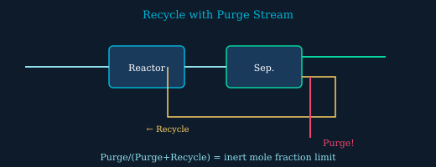
Process Design
Purge Stream in Recycle Systems
08 / 114
Add a purge stream to prevent inert buildup in recycle loops. At steady state, purge rate equals inert feed rate.
1
2
3
4
Without purge: inerts accumulate indefinitely
Purge-to-recycle ratio set by economics
Lower purge → higher recycle costs
Inert steady-state: ṅ_purge·y_inert = ṅ_inert,feed
Chemical Engineering Core Concepts
Purge Stream in Recycle Systems

Slide 10

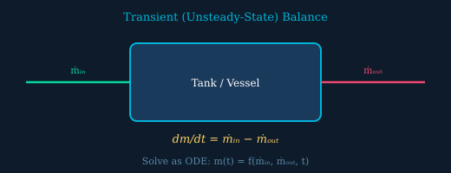
Dynamic Systems
Material Balances on Transient Processes
09 / 114
Set up and solve ODEs for unsteady-state mass accumulation — tank filling, draining, semibatch mixing.
Accumulation = net input rate
Separate variables for constant rates
ODE solver for variable flow rates
Initial condition m(0) = m₀ required
FORMULA
dm/dt = ṁᵢₙ − ṁₒᵤₜ
Chemical Engineering Core Concepts
Material Balances on Transient Processes

Slide 11
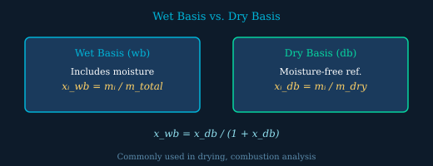

Composition Measurement
Wet and Dry Basis
10 / 114
Convert between wet basis (includes moisture) and dry basis (moisture-free reference) compositions for drying and combustion analysis.
KEY POINTS
1 Wet basis: all components incl. water 2 Dry basis: reference without moisture 3 Critical in flue gas analysis 4 Orsat analyzer reports dry basis
FORMULA REFERENCE
Wet basis: all components incl. water
Dry basis: reference without moisture
Chemical Engineering Core Concepts
Wet and Dry Basis

Slide 12

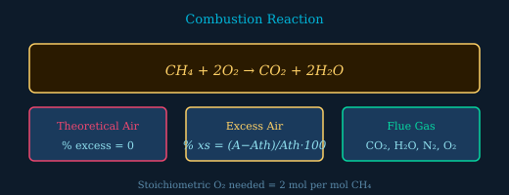
Combustion Engineering
Combustion Reactions
11 / 114
Calculate flue gas compositions and air-to-fuel ratios. Excess air ensures complete combustion; too much cools the flame.
1
2
3
4
Complete: all C→CO₂, H→H₂O
Theoretical air: % excess = 0
Higher excess air → lower efficiency
Stack O₂ measures actual excess
Chemical Engineering Core Concepts
Combustion Reactions

Slide 13

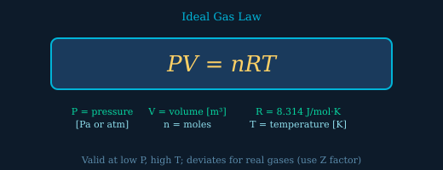
Gas Phase Systems
Ideal Gas Law
12 / 114
The ideal gas law relates pressure, volume, moles, and temperature. Valid at low pressure and high temperature where intermolecular forces are negligible.
Molar volume at STP: 22.4 L/mol
Compressibility factor Z = PV/nRT = 1 ideal
Dalton's Law: P_total = Σ Pᵢ (partial P)
Fails near critical point
FORMULA
PV = nRT
Chemical Engineering Core Concepts
Ideal Gas Law

Slide 14
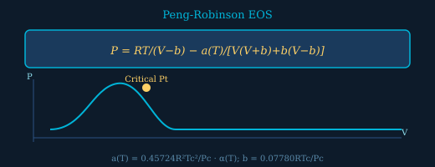

Real Gas Behavior
Equations of State
13 / 114
Cubic equations of state predict PVT behavior of real gases and liquids. The Peng-Robinson EOS is standard in petroleum engineering.
KEY POINTS
1 vdW: first cubic EOS (1873) 2 SRK: improved α(T) function 3 PR EOS: best for liquid density 4 Z³ − (1−B)Z² + (A−3B²−2B)Z − (AB−B²−B³) = 0
FORMULA REFERENCE
vdW: first cubic EOS (1873)
SRK: improved α(T) function
Chemical Engineering Core Concepts
Equations of State

Slide 15

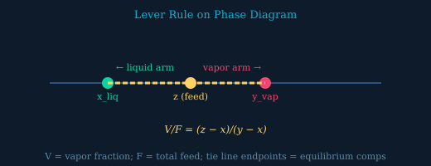
Phase Diagrams
Lever Rule
14 / 114
Determine vapor and liquid fractions in a two-phase region using the lever rule — a material balance on a phase diagram tie line.
1
2
3
4
V = vapor fraction, L = liquid fraction
V + L = 1 (total balance)
z = overall composition (feed)
Works on Pxy, Txy, and ternary diagrams
Chemical Engineering Core Concepts
Lever Rule

Slide 16

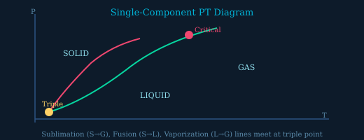
Phase Diagrams
Single-Component Phase Equilibrium
15 / 114
Identify equilibrium phases and conditions using single-component PT diagrams. The Gibbs phase rule governs the number of independent variables.
C = components, P = phases
Single component: C = 1
Two phases: F = 1 (T or P fixes state)
Triple point: F = 0 (unique T and P)
FORMULA
Gibbs Phase Rule: F = C − P + 2
Chemical Engineering Core Concepts
Single-Component Phase Equilibrium

Slide 17
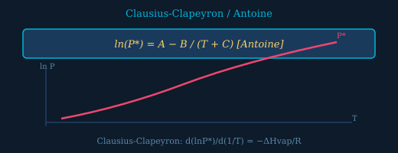

Vapor Pressure
Clausius-Clapeyron & Antoine Equations
16 / 114
Estimate vapor pressure as a function of temperature using Antoine constants (tabulated) or the Clausius-Clapeyron integrated form.
KEY POINTS
1 Antoine: 3-parameter empirical fit 2 Clausius-Clapeyron: d(lnP)/d(1/T) = −ΔHvap/R 3 Valid over limited T range (check bounds) 4 NIST Chemistry WebBook for constants
FORMULA REFERENCE
Antoine: 3-parameter empirical fit
Clausius-Clapeyron: d(lnP)/d(1/T) = −ΔHvap/R
Chemical Engineering Core Concepts
Clausius-Clapeyron & Antoine Equations

Slide 18

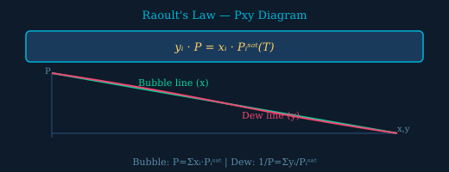
Vapor-Liquid Equilibrium
Raoult's Law and VLE
17 / 114
Model VLE for ideal solutions with Raoult's Law. Construct Pxy and Txy diagrams and perform bubble/dew point calculations.
1
2
3
4
Bubble point: all liquid just starts to vaporize
Dew point: all vapor just starts to condense
Relative volatility α₁₂ = P₁ˢᵃᵗ/P₂ˢᵃᵗ
Txy: bubble T < dew T at same composition
Chemical Engineering Core Concepts
Raoult's Law and VLE

Slide 19

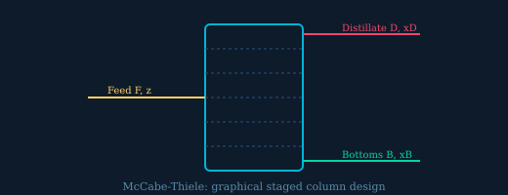
Solution Chemistry
Solids in Solution & Colligative Properties
18 / 114
Dissolved solutes lower freezing point, raise boiling point, and create osmotic pressure — all proportional to solute molality.
Kb (water) = 0.512 °C·kg/mol
Kf (water) = 1.86 °C·kg/mol
Osmotic π = iMRT
i > 1 for electrolytes (dissociation)
FORMULA
ΔTb = Kb·m·i
Chemical Engineering Core Concepts
Solids in Solution & Colligative Properties

Slide 20
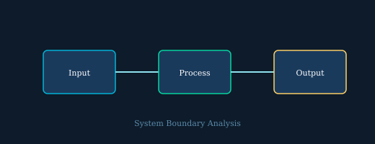

Three-Component Systems
Ternary Phase Diagrams
19 / 114
Represent three-component mixtures on equilateral triangles. Two-phase regions bounded by binodal curve; tie lines connect equilibrium phases.
KEY POINTS
1 Each vertex = pure component 2 Binary pairs on each edge 3 Plait point = critical composition 4 Used in liquid-liquid extraction design
FORMULA REFERENCE
Each vertex = pure component
Binary pairs on each edge
Chemical Engineering Core Concepts
Ternary Phase Diagrams

Slide 21

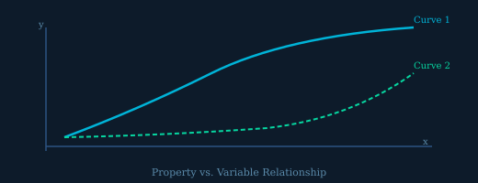
Humidity & Drying
Water-Air VLE & Psychrometric Chart
20 / 114
Characterize moist air using humidity ratio and the psychrometric chart. Critical for drying, HVAC, and cooling tower design.
1
2
3
4
Dry-bulb T: regular thermometer
Wet-bulb T: evaporative cooling limit
Dew point: T where condensation begins
Adiabatic saturation line on psych chart
Chemical Engineering Core Concepts
Water-Air VLE & Psychrometric Chart

Slide 22


Surface Separations
Adsorption
21 / 114
Model gas/liquid adsorption onto solid surfaces using Langmuir (monolayer) or Freundlich (empirical) isotherms for adsorbent design.
q = loading [mol/g], C = concentration
q_m = monolayer capacity
K = Langmuir equilibrium constant
Freundlich: q = K·C^(1/n) (empirical)
FORMULA
q = q_m·K·C/(1+K·C)
Chemical Engineering Core Concepts
Adsorption

Slide 23
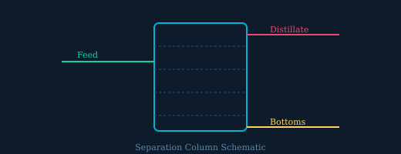

Thermodynamic Foundations
State Functions
22 / 114
State functions like U, H, S, G depend only on the current state, not how you got there. Path functions Q and W depend on the process.
KEY POINTS
1 State: P, T, V, U, H, S, G, A 2 Path: Q (heat), W (work) 3 dU = exact differential → closed loop = 0 4 Foundation for all thermodynamic calculations
FORMULA REFERENCE
State: P, T, V, U, H, S, G, A
Path: Q (heat), W (work)
Chemical Engineering Core Concepts
State Functions

Slide 24

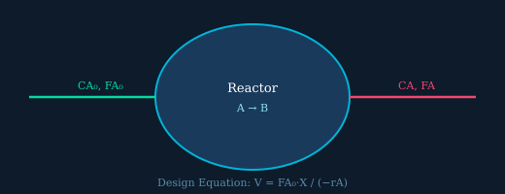
Water Properties
Steam Tables
23 / 114
Look up thermodynamic properties of water from saturated and superheated steam tables using temperature, pressure, or quality as inputs.
1
2
3
4
Saturated tables: f = liquid, g = vapor
Superheated: T > T_sat at given P
Quality x = mass fraction vapor (0 to 1)
NIST REFPROP or textbook appendices
Chemical Engineering Core Concepts
Steam Tables

Slide 25

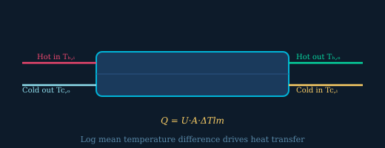
Piping Systems
Mechanical Energy Balance
24 / 114
Extended Bernoulli equation accounts for pump/turbine work and friction losses for real piping system design.
h_p = Ẇ_pump/(ṁg) pump head
h_f = f(L/D)(v²/2g) Darcy friction
NPSH: prevent cavitation in pumps
System curve intersects pump curve at operating point
FORMULA
P₁/ρg + v₁²/2g + z₁ + h_p = P₂/ρg + v₂²/2g + z₂ + h_f
Chemical Engineering Core Concepts
Mechanical Energy Balance

Slide 26
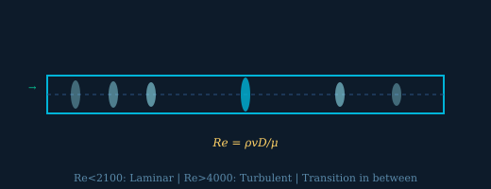

Thermal Properties
Heat Capacities
25 / 114
Use heat capacity correlations to calculate enthalpy and internal energy changes for gases, liquids, and solids across temperature ranges.
KEY POINTS
1 Cp − Cv = R for ideal gases 2 Cp/Cv = γ (adiabatic index) 3 Shomate eq: a,b,c,d from NIST 4 Mean heat capacity simplifies integrals
FORMULA REFERENCE
Cp − Cv = R for ideal gases
Cp/Cv = γ (adiabatic index)
Chemical Engineering Core Concepts
Heat Capacities

Slide 27

Latent Heat
Energy Balances with Phase Changes
26 / 114
Construct enthalpy paths through phase changes by combining sensible heat (Cp·ΔT) and latent heat steps.
1
2
3
4
Construct path: heat → phase change → heat
ΔHvap water = 2257 kJ/kg at 100°C
ΔHfus water = 334 kJ/kg at 0°C
Trouton's rule: ΔHvap/Tb ≈ 88 J/mol·K
Chemical Engineering Core Concepts
Energy Balances with Phase Changes

Slide 28

VLE Calculations
Flash Separations
27 / 114
Solve flash drum calculations by finding vapor fraction V and phase compositions using K-values (Kᵢ = yᵢ/xᵢ).
Kᵢ = Pᵢˢᵃᵗ/P from Raoult's Law
V = 0: bubble point; V = 1: dew point
Rachford-Rice: monotonic → easy to solve
Iterative: guess T or P → compute V → check
FORMULA
Σyᵢ − Σxᵢ = 0 (Rachford-Rice)
Chemical Engineering Core Concepts
Flash Separations

Slide 29

Reaction Thermodynamics
Heats of Reaction
28 / 114
Calculate standard heats of reaction from heats of formation. Exothermic: ΔH < 0, heat released. Endothermic: ΔH > 0, heat absorbed.
KEY POINTS
1 ΔH°f for elements in standard state = 0 2 Kirchhoff: ΔHrxn(T) = ΔH°rxn + ∫ΔCp dT 3 Hess's Law: combine known reactions 4 Bond energies give approximate ΔHrxn
FORMULA REFERENCE
ΔH°f for elements in standard state = 0
Kirchhoff: ΔHrxn(T) = ΔH°rxn + ∫ΔCp dT
Chemical Engineering Core Concepts
Heats of Reaction

Slide 30

Reactor Thermodynamics
Energy Balances with Reaction
29 / 114
Combine sensible heat and heat of reaction in energy balances for reactive systems. Choose a reference temperature for the path.
1
2
3
4
Reference T: choose T_in or 25°C
Exothermic reactor: requires cooling
Adiabatic: Q = 0, solve for T_out
Multiple reactions: sum ξⱼ·ΔHrxn,j
Chemical Engineering Core Concepts
Energy Balances with Reaction

Slide 31

Combustion Thermodynamics
Adiabatic Flame Temperature
30 / 114
Maximum temperature reached in adiabatic combustion. Decreases with excess air and moisture; increases with preheating and oxygen enrichment.
Q = 0 (no heat loss)
H_reactants(Tin) = H_products(Tad)
Excess air lowers Tad significantly
Preheated air or O₂ enrichment raises Tad
FORMULA
Q = 0: ΔH_reactants = ΔH_products
Chemical Engineering Core Concepts
Adiabatic Flame Temperature

Slide 32

Thermodynamics
First Law — Closed Systems (Intro)
31 / 114
Energy conservation for closed systems: heat added minus boundary work done equals change in internal energy.
KEY POINTS
1 Closed system: no mass flow in/out 2 Rigid vessel: W = 0 → ΔU = Q 3 Isobaric: W = PΔV 4 Sign convention: Q>0 in, W>0 out
FORMULA REFERENCE
Closed system: no mass flow in/out
Rigid vessel: W = 0 → ΔU = Q
Chemical Engineering Core Concepts
First Law — Closed Systems (Intro)

Slide 33

Fluid Statics
Buoyancy
32 / 114
Archimedes' principle: buoyant force equals weight of fluid displaced. Objects float when buoyancy exceeds weight.
1
2
3
4
Fb = ρ_fluid·g·V_disp
Sinks: ρ_obj > ρ_fluid
Floats: ρ_obj < ρ_fluid (partial submersion)
Stable: center of buoyancy above center of gravity
Chemical Engineering Core Concepts
Buoyancy

Slide 34

Fluid Mechanics Fundamentals
Properties of Fluids
33 / 114
Key fluid properties: density, viscosity, surface tension, and vapor pressure govern fluid behavior in all process equipment.
Dynamic viscosity μ [Pa·s or cP]
Kinematic ν = μ/ρ [m²/s or cSt]
Surface tension γ [N/m]
Vapor pressure: cavitation risk if P < Pvap
FORMULA
ν = μ/ρ (kinematic viscosity)
Chemical Engineering Core Concepts
Properties of Fluids

Slide 35

Fluid Statics
Hydrostatic Pressure
34 / 114
Pressure in a static fluid increases linearly with depth regardless of container shape — only depth and fluid density matter.
KEY POINTS
1 P is depth-dependent only (not shape) 2 ΔP = ρgh for incompressible fluid 3 Pressure head: h = P/(ρg) 4 Multi-layer: add each ρᵢgᵢhᵢ contribution
FORMULA REFERENCE
P is depth-dependent only (not shape)
ΔP = ρgh for incompressible fluid
Chemical Engineering Core Concepts
Hydrostatic Pressure

Slide 36

Fluid Statics
Submerged Gates
35 / 114
The resultant hydrostatic force acts at the center of pressure, which is always below the centroid of the submerged surface.
1
2
3
4
F = pressure at centroid × area
ȳ = depth to centroid
I_xc = second moment of area about centroid
y_cp > ȳ always (center of pressure deeper)
Chemical Engineering Core Concepts
Submerged Gates

Slide 37

Fluid Dynamics
Bernoulli's Equation
36 / 114
Energy conservation for ideal fluid flow along a streamline — pressure, kinetic, and potential energy sum to a constant.
P: pressure energy per unit weight
v²/2g: velocity head
z: elevation head
Venturi: ΔP measures flow velocity
FORMULA
P/ρg + v²/2g + z = H (constant)
Chemical Engineering Core Concepts
Bernoulli's Equation

Slide 38

Fluid Rheology
Viscosity and Shear Stress
37 / 114
Newton's law of viscosity relates shear stress to velocity gradient. Newtonian fluids have constant viscosity independent of shear rate.
KEY POINTS
1 μ = dynamic viscosity [Pa·s] 2 dv/dy = velocity gradient (shear rate) 3 Newtonian: μ constant (water, air) 4 Power law: τ = K·(dv/dy)ⁿ for non-Newtonian
FORMULA REFERENCE
μ = dynamic viscosity [Pa·s]
dv/dy = velocity gradient (shear rate)
Chemical Engineering Core Concepts
Viscosity and Shear Stress

Slide 39

Fluid Mechanics
Conservation of Mass
38 / 114
The continuity equation ensures mass is conserved in fluid flow. For incompressible flow, volumetric flow rate is constant along a streamline.
1
2
3
4
Incompressible: ρ = constant
ṁ = ρ·A·v = constant in steady pipe flow
Q = A·v = volumetric flow rate
Contraction: smaller A → larger v
Chemical Engineering Core Concepts
Conservation of Mass

Slide 40

Transport Phenomena
Introduction to Pipe Flow
39 / 114
Reynolds number determines the flow regime in pipes. Laminar flow is orderly; turbulent flow has chaotic mixing that enhances heat and mass transfer.
Re = inertial / viscous forces
Transition zone: 2100 < Re < 4000
Hydraulic diameter for non-circular: Dh = 4A/P
Higher Re → higher friction factor f
FORMULA
Re = ρ·v·D/μ = v·D/ν
Chemical Engineering Core Concepts
Introduction to Pipe Flow

Slide 41

Velocity Profiles
Velocity in Pipe Flow
40 / 114
Laminar pipe flow has a parabolic velocity profile. Turbulent flow has a flatter profile with enhanced mixing near the wall.
KEY POINTS
1 v_max at centerline (r=0) 2 v = 0 at wall (no-slip condition) 3 Turbulent: v_avg ≈ 0.8 v_max 4 1/7 power law for turbulent: v/v_max = (1−r/R)^(1/7)
FORMULA REFERENCE
v_max at centerline (r=0)
v = 0 at wall (no-slip condition)
Chemical Engineering Core Concepts
Velocity in Pipe Flow

Slide 42

External Flow
Boundary Layer over a Flat Surface
41 / 114
The boundary layer grows from zero at the leading edge. Laminar BL is thin and predictable; turbulent BL has higher drag and better heat transfer.
1
2
3
4
δ = boundary layer thickness
Re_x = ρUx/μ (local Reynolds number)
Cd_laminar = 1.328/√Re_L
Turbulent δ ∝ x^(4/5) grows faster
Chemical Engineering Core Concepts
Boundary Layer over a Flat Surface

Slide 43

Developing Flow
Entrance Length in Pipe Flow
42 / 114
Entrance length is the distance needed for the velocity profile to fully develop from a uniform inlet. Heat transfer correlations differ in entry vs. developed regions.
Laminar: long entry (10s of diameters)
Turbulent: shorter entry (~10-60 D)
Entry region: higher Nusselt number
Fully developed: profile shape doesn't change
FORMULA
Laminar: L_e = 0.06·Re·D
Chemical Engineering Core Concepts
Entrance Length in Pipe Flow

Slide 44

Pipe Design
Pressure Drop & Power in Pipe Flow
43 / 114
Darcy-Weisbach equation calculates frictional pressure drop. The Moody chart provides friction factor f as a function of Re and relative roughness.
KEY POINTS
1 Friction factor f from Moody chart 2 Laminar: f = 64/Re (exact) 3 Turbulent: Colebrook-White equation 4 ε/D = relative roughness (ε = pipe roughness)
FORMULA REFERENCE
Friction factor f from Moody chart
Laminar: f = 64/Re (exact)
Chemical Engineering Core Concepts
Pressure Drop & Power in Pipe Flow

Slide 45

Minor Losses
Equivalent Length in Pipe Systems
44 / 114
Convert minor losses from fittings (elbows, valves, tees) into equivalent pipe lengths for unified pressure drop calculations.
1
2
3
4
K values tabulated for fittings
Gate valve fully open: K ≈ 0.2
90° elbow: K ≈ 0.9
Total h_f = Darcy ΔP + Σ minor losses
Chemical Engineering Core Concepts
Equivalent Length in Pipe Systems

Slide 46

Pipe Networks
Multipipe Systems
45 / 114
Analyze networks of pipes in series (same flow, additive pressure drop) or parallel (same pressure drop, additive flow rates).
Series: bottleneck at highest resistance
Parallel: flow distributes by resistance
Hardy-Cross: iterative network solver
Pump location affects network behavior
FORMULA
Series: Q same, ΔP = Σ ΔPᵢ
Chemical Engineering Core Concepts
Multipipe Systems

Slide 47

Fluid Dynamics
Linear Momentum
46 / 114
Apply Newton's second law as the linear momentum equation to find forces on pipe bends, nozzles, and impinging jets.
KEY POINTS
1 Control volume momentum balance 2 Include ALL forces: pressure, gravity, reaction 3 Pipe bend: compute Fx and Fy separately 4 Jet force: F = ρQ(v_out − v_in)
FORMULA REFERENCE
Control volume momentum balance
Include ALL forces: pressure, gravity, reaction
Chemical Engineering Core Concepts
Linear Momentum

Slide 48

Navier-Stokes Reduction
Pressure Field & Fluid at Rest
47 / 114
The Navier-Stokes equation simplifies to ∇P = ρg for a stationary fluid, directly giving the hydrostatic pressure distribution.
1
2
3
4
N-S: ρ(Dv/Dt) = −∇P + μ∇²v + ρg
Static: Dv/Dt = 0, μ∇²v = 0
Result: dP/dz = −ρg (hydrostatics)
Horizontal: dP/dx = dP/dy = 0
Chemical Engineering Core Concepts
Pressure Field & Fluid at Rest

Slide 49

Analytical Solutions
Velocity Profiles from Navier-Stokes
48 / 114
Solve N-S equations with no-slip boundary conditions to derive exact velocity profiles for laminar flows in simple geometries.
No-slip: v = 0 at wall always
Poiseuille flow: pipe, pressure-driven
Couette flow: between plates, shear-driven
Parabolic profile → Q = πR⁴ΔP/(8μL)
FORMULA
Poiseuille: v(r) = (R²−r²)/(4μ)·(−dP/dz)
Chemical Engineering Core Concepts
Velocity Profiles from Navier-Stokes

Slide 50

Similarity Theory
Dimensional Analysis & Pi Terms
49 / 114
Buckingham Pi theorem reduces the number of variables needed to describe a phenomenon by grouping them into dimensionless Pi numbers.
KEY POINTS
1 7 base units: M, L, T, Θ, I, N, J 2 Re = ρvL/μ (inertia/viscous) 3 Fr = v/√(gL) (inertia/gravity) 4 Nu = hL/k (convection/conduction)
FORMULA REFERENCE
7 base units: M, L, T, Θ, I, N, J
Re = ρvL/μ (inertia/viscous)
Chemical Engineering Core Concepts
Dimensional Analysis & Pi Terms

Slide 51

Scale-Up Methods
Modeling and Similitude
50 / 114
Design scale model experiments by matching relevant dimensionless numbers. Full similitude requires geometric, kinematic, and dynamic similarity.
1
2
3
4
Geometric: same shape (scale factor λ)
Kinematic: same velocity ratios
Dynamic: same Re, Fr, We etc.
Often impossible to match all simultaneously
Chemical Engineering Core Concepts
Modeling and Similitude

Slide 52

Thermodynamics
First Law — Closed Systems
51 / 114
The first law of thermodynamics for a closed system: change in internal energy equals heat transferred to the system minus work done by the system.
Isochoric (const. V): W = 0, ΔU = Q
Isobaric (const. P): W = PΔV, Q = nCpΔT
Isothermal ideal gas: ΔU = 0, Q = W
Adiabatic: Q = 0, ΔU = −W
FORMULA
ΔU = Q − W
Chemical Engineering Core Concepts
First Law — Closed Systems

Slide 53

Steady-State Energy Balance
First Law — Open Systems
52 / 114
For steady-state open systems (turbines, pumps, nozzles, heat exchangers), the energy balance includes enthalpy, kinetic, and potential energy terms.
KEY POINTS
1 Turbines: work out, Ẇs < 0 2 Compressors: work in, Ẇs > 0 3 Nozzle: ΔKE = −ΔĤ (Q=0, Ẇ=0) 4 Heat exchanger: Ẇ = 0, Δ(ṁh) = Q̇
FORMULA REFERENCE
Turbines: work out, Ẇs < 0
Compressors: work in, Ẇs > 0
Chemical Engineering Core Concepts
First Law — Open Systems

Slide 54

Transient Thermodynamics
Unsteady Energy Balances on Tanks
53 / 114
Track energy accumulation in a tank being filled or drained — the internal energy of the system changes with time.
1
2
3
4
Filling from supply: T rises if h_supply > u_tank
Draining: tank cools if adiabatic
Rigid tank assumption simplifies analysis
Solve ODE: dU/dt = ṁᵢₙhᵢₙ for filling
Chemical Engineering Core Concepts
Unsteady Energy Balances on Tanks

Slide 55

Second Law of Thermodynamics
Entropy
54 / 114
Entropy is a state function that measures irreversibility. The entropy of the universe always increases for any real process.
Reversible: ΔS_univ = 0
Irreversible: ΔS_univ > 0
ΔS ideal gas = nCv·ln(T₂/T₁) + nR·ln(V₂/V₁)
Entropy generation = source of lost work
FORMULA
dS ≥ δQ/T (Clausius inequality)
Chemical Engineering Core Concepts
Entropy

Slide 56

Work Devices
Turbines and Compressors
55 / 114
Isentropic efficiency compares actual device performance to the ideal reversible adiabatic case. Turbines produce work; compressors consume work.
KEY POINTS
1 Isentropic: adiabatic + reversible 2 Turbine: ηT = (h₁−h₂)/(h₁−h₂s) 3 Compressor: ηC = (h₂s−h₁)/(h₂−h₁) 4 Intercooling reduces compressor work
FORMULA REFERENCE
Isentropic: adiabatic + reversible
Turbine: ηT = (h₁−h₂)/(h₁−h₂s)
Chemical Engineering Core Concepts
Turbines and Compressors

Slide 57

Work Analysis
Reversible & Irreversible Expansion/Compression
56 / 114
Reversible processes produce maximum work (or require minimum work). Irreversibility always increases the work input required for compression.
1
2
3
4
Isothermal reversible: W = nRT·ln(V₂/V₁)
Adiabatic rev.: W = ΔU = nCv(T₂−T₁)
Irreversible: gas expands against P_ext
Polytropic: PVⁿ = const (n between 1 and γ)
Chemical Engineering Core Concepts
Reversible & Irreversible Expansion/Compression

Slide 58

Isentropic Processes
Adiabatic Reversible Expansion/Compression
57 / 114
Isentropic processes follow PVᵞ = const for ideal gases. Used for turbine/compressor outlet calculations and acoustic wave analysis.
γ = 1.4 for diatomic gases (N₂, O₂, air)
γ = 1.67 for monatomic (Ar, He)
W = Cv(T₂−T₁) per mole
Steam: use steam tables (not ideal gas law)
FORMULA
T₂/T₁ = (P₂/P₁)^((γ−1)/γ)
Chemical Engineering Core Concepts
Adiabatic Reversible Expansion/Compression

Slide 59

Ideal Power Cycle
Carnot Cycle
58 / 114
The Carnot cycle sets the maximum possible efficiency for a heat engine operating between two temperature reservoirs.
KEY POINTS
1 4 reversible steps: 2 isothermal + 2 adiabatic 2 η depends only on T_H and T_L [Kelvin] 3 No real engine exceeds Carnot efficiency 4 Higher T_H or lower T_L → better efficiency
FORMULA REFERENCE
4 reversible steps: 2 isothermal + 2 adiabatic
η depends only on T_H and T_L [Kelvin]
Chemical Engineering Core Concepts
Carnot Cycle

Slide 60

Steam Power Plants
Rankine Cycle
59 / 114
The Rankine cycle is the basis for all steam power plants. Four components: boiler, turbine, condenser, pump.
1
2
3
4
State 1: saturated liquid (condenser out)
State 2: compressed liquid (pump out)
State 3: superheated steam (boiler out)
State 4: wet steam (turbine out)
Chemical Engineering Core Concepts
Rankine Cycle

Slide 61

Cooling & Heat Pumps
Refrigeration Cycle
60 / 114
The vapor-compression cycle moves heat from cold to hot reservoir using compressor work. COP > 1 because heat is pumped, not generated.
Compressor: raises T and P of refrigerant
Condenser: rejects heat Q_H to environment
Expansion valve: drops P (throttling)
Evaporator: absorbs Q_L from cold space
FORMULA
COP_R = Q_L / W_net
Chemical Engineering Core Concepts
Refrigeration Cycle

Slide 62

Pressure Reduction
Throttling & Joule-Thomson Expansion
61 / 114
Throttling through a valve is isenthalpic. For real gases, temperature changes according to the Joule-Thomson coefficient μ_JT.
KEY POINTS
1 Ideal gas: ΔT = 0 (μ_JT = 0) 2 Real gas: μ_JT can be + or − 3 Inversion T: above it, gas heats on expansion 4 Used in liquefaction cycles (μ_JT > 0)
FORMULA REFERENCE
Ideal gas: ΔT = 0 (μ_JT = 0)
Real gas: μ_JT can be + or −
Chemical Engineering Core Concepts
Throttling & Joule-Thomson Expansion

Slide 63

Advanced Thermodynamics
Fundamental Property Relations
62 / 114
Derive Maxwell relations from the four thermodynamic potentials to relate unmeasurable properties (S) to measurable ones (P, V, T).
1
2
3
4
dU = TdS − PdV
dH = TdS + VdP
dA = −SdT − PdV
dG = −SdT + VdP
Chemical Engineering Core Concepts
Fundamental Property Relations

Slide 64

Cryogenic Engineering
Liquefaction
63 / 114
Liquefy gases by cooling below inversion temperature then throttling. The Claude cycle uses expansion turbines for pre-cooling to improve efficiency.
Must cool gas below inversion T first
Linde: simple, low efficiency
Claude: turbine expansion → higher yield
LNG, LOX, LH₂ production methods
FORMULA
Linde: throttle below inversion T
Chemical Engineering Core Concepts
Liquefaction

Slide 65

Property Charts
Thermodynamic Property Phase Diagrams
64 / 114
Different property diagrams provide different insights: PV for work, TS for heat and entropy, PH for refrigeration cycles.
KEY POINTS
1 PV: work = enclosed area for cycles 2 TS: heat = area; reversible cycles 3 PH (Mollier): standard for refrigerants 4 Phase envelope: bubble and dew curves
FORMULA REFERENCE
PV: work = enclosed area for cycles
TS: heat = area; reversible cycles
Chemical Engineering Core Concepts
Thermodynamic Property Phase Diagrams

Slide 66

Real Gas Property Calc.
Departure Functions
65 / 114
Calculate real gas enthalpy and entropy by adding departure functions to ideal gas reference values using generalized correlations.
1
2
3
4
Departure = actual − ideal gas reference
Use PR EOS: H^R = RT²(∂lnφ/∂T)_P·n
Pitzer: H^R/(RTc) = H^R(0)/RTc + ω·H^R(1)/RTc
ω = acentric factor (tables for compounds)
Chemical Engineering Core Concepts
Departure Functions

Slide 67

Phase Equilibrium
Fugacity of a Single Component
66 / 114
Fugacity is the 'corrected pressure' that accounts for non-ideal behavior. Phase equilibrium requires equal fugacities in all phases.
f → P as P → 0 (ideal gas limit)
ln(φ) = (1/RT)∫₀ᴾ(V − RT/P)dP
Fugacity coefficient φ from EOS
Poynting correction for liquids at high P
FORMULA
f = φ·P (pure component)
Chemical Engineering Core Concepts
Fugacity of a Single Component

Slide 68

Mixture Thermodynamics
Partial Molar Quantities
67 / 114
Partial molar properties quantify how extensive mixture properties change with composition — the basis for activity coefficient models.
KEY POINTS
1 M̄ᵢ depends on T, P, and composition 2 V̄ᵢ = partial molar volume 3 Ḡᵢ = μᵢ (chemical potential) 4 Method of intercepts: graphical determination
FORMULA REFERENCE
M̄ᵢ depends on T, P, and composition
V̄ᵢ = partial molar volume
Chemical Engineering Core Concepts
Partial Molar Quantities

Slide 69

Mixture Phase Equilibrium
Fugacities of Mixtures
68 / 114
Compute component fugacities in mixtures using equations of state with mixing rules for multi-component vapor-liquid equilibrium.
1
2
3
4
φ̂ᵢ = mixture fugacity coefficient
Mixing rules: a_mix = ΣΣxᵢxⱼaᵢⱼ
kᵢⱼ = binary interaction parameter
Used in process simulators (Aspen, HYSYS)
Chemical Engineering Core Concepts
Fugacities of Mixtures

Slide 70

Equilibrium Criterion
Chemical Potential
69 / 114
Chemical potential is the fundamental thermodynamic driving force for mass transfer and phase/reaction equilibrium.
μᵢ = Ḡᵢ (partial molar Gibbs energy)
Mass transfers from high to low μ
μᵢ = μᵢ° + RT·ln(aᵢ) (activity aᵢ)
Reaction equilibrium: ΣνᵢμᵢT = 0
FORMULA
μᵢ = (∂G/∂nᵢ)_{T,P,nⱼ}
Chemical Engineering Core Concepts
Chemical Potential

Slide 71

Activity Coefficients
VLE for Non-Ideal Solutions
70 / 114
Activity coefficients correct for non-ideal liquid-phase behavior. γ > 1: positive deviation (weaker interactions); γ < 1: negative deviation.
KEY POINTS
1 Margules (1 suffix): ln(γ₁) = A·x₂² 2 Wilson: good for miscible, polar systems 3 NRTL: for partially miscible systems 4 UNIFAC: group-contribution method
FORMULA REFERENCE
Margules (1 suffix): ln(γ₁) = A·x₂²
Wilson: good for miscible, polar systems
Chemical Engineering Core Concepts
VLE for Non-Ideal Solutions

Slide 72

Membrane Separations
Osmosis and Reverse Osmosis
71 / 114
Osmotic pressure drives water through semi-permeable membranes. Applying pressure greater than π reverses the flow — the basis of RO desalination.
1
2
3
4
π = iMRT (van't Hoff equation)
Seawater π ≈ 27 bar
RO requires ΔP > π (30-70 bar for seawater)
Rejection = 1 − C_permeate/C_feed
Chemical Engineering Core Concepts
Osmosis and Reverse Osmosis

Slide 73

Gas-Liquid Operations
Absorption & Henry's Law
72 / 114
Henry's Law describes dilute gas absorption into liquid. Column design uses number of transfer units (NTU) and height of a transfer unit (HTU).
H large: sparingly soluble (O₂ in water)
H small: highly soluble (NH₃, SO₂)
H increases with T → less soluble at high T
Column height = HTU × NTU
FORMULA
pᵢ = Hᵢ·xᵢ (Henry's Law, dilute)
Chemical Engineering Core Concepts
Absorption & Henry's Law

Slide 74

Solution Non-Ideality
Enthalpy of Mixing & Raoult Deviations
73 / 114
Excess Gibbs energy links activity coefficients to deviations from Raoult's Law. Positive GE causes azeotrope formation at maximum-boiling azeotrope.
KEY POINTS
1 Positive deviation (γ>1): weaker A-B vs A-A, B-B 2 Negative deviation (γ<1): stronger cross interactions 3 ΔHmix ≠ 0 for non-ideal solutions 4 Excess properties: actual − ideal solution
FORMULA REFERENCE
Positive deviation (γ>1): weaker A-B vs A-A, B-B
Negative deviation (γ<1): stronger cross interactions
Chemical Engineering Core Concepts
Enthalpy of Mixing & Raoult Deviations

Slide 75

Equation-of-State VLE
Cubic EOS for VLE
74 / 114
Use cubic EOS (Peng-Robinson) to compute fugacity coefficients in both phases for rigorous VLE calculations without activity coefficient models.
1
2
3
4
PR EOS gives 3 Z roots; choose correct ones
Smallest Z root = liquid; largest = vapor
φ̂ᵢ from fugacity integral of EOS
Iterate until φ̂^L = φ̂^V at each composition
Chemical Engineering Core Concepts
Cubic EOS for VLE

Slide 76

Stability Analysis
Gibbs Free Energy & Phase Separation
75 / 114
Liquid-liquid phase separation occurs when the Gibbs energy of mixing has a region of negative curvature. Spinodal = instability limit; binodal = equilibrium limit.
Common tangent → binodal compositions
Inflection points → spinodal boundary
Metastable: between spinodal and binodal
Applies to polymer blends and alloys
FORMULA
∂²G_mix/∂x² < 0 → unstable
Chemical Engineering Core Concepts
Gibbs Free Energy & Phase Separation

Slide 77

LLE Phase Behavior
Partially Miscible Liquids Phase Diagrams
76 / 114
Some liquid pairs are miscible at high T but separate into two phases at lower T (UCST) or vice versa (LCST). Tie lines give equilibrium compositions.
KEY POINTS
1 UCST: upper critical solution temperature 2 LCST: lower critical (rarer, polymer systems) 3 Two-phase region bounded by binodal curve 4 Tie lines: horizontal in T-x diagram
FORMULA REFERENCE
UCST: upper critical solution temperature
LCST: lower critical (rarer, polymer systems)
Chemical Engineering Core Concepts
Partially Miscible Liquids Phase Diagrams

Slide 78

Steam Distillation
Immiscible Liquids Phase Diagrams
77 / 114
Immiscible liquids exert independent vapor pressures. Boiling occurs below the boiling point of either pure component — the basis of steam distillation.
1
2
3
4
Each liquid exerts its own P*
Three-phase: L₁ + L₂ + V at unique T
Steam distillation: purify high-bp organics
Heteroazeotrope at three-phase T and comp.
Chemical Engineering Core Concepts
Immiscible Liquids Phase Diagrams

Slide 79

Eutectic Systems
Solid-Solid-Liquid Phase Diagrams
78 / 114
Binary eutectic diagrams show how two solids compete with a shared liquid phase. The eutectic point is the lowest melting composition.
Eutectic composition: lowest melting point
Hypoeutectic: left of eutectic
Hypereutectic: right of eutectic
Applications: solders, salt de-icing, alloys
FORMULA
Eutectic: L ↔ α + β at fixed T,x
Chemical Engineering Core Concepts
Solid-Solid-Liquid Phase Diagrams

Slide 80

Distillation Limits
Azeotropes
79 / 114
Azeotropes form where vapor and liquid have identical compositions — making conventional distillation impossible beyond this point.
KEY POINTS
1 Max boiling: γ < 1 (negative deviation) 2 Min boiling: γ > 1 (positive deviation) 3 EtOH-water: min boiling at 95.6% EtOH 4 Break by adding entrainer (pressure swing, extraction)
FORMULA REFERENCE
Max boiling: γ < 1 (negative deviation)
Min boiling: γ > 1 (positive deviation)
Chemical Engineering Core Concepts
Azeotropes

Slide 81

Reaction Equilibrium
Gas-Phase Chemical Equilibrium
80 / 114
The equilibrium constant Kp is determined by standard Gibbs energy change. Le Chatelier's principle predicts shifts due to T, P, or concentration changes.
1
2
3
4
Kp dimensionless (use P/P° = P/1 bar)
T increases Kp if endothermic (van't Hoff)
Pressure shifts equilibrium if Δν ≠ 0
Inert gas at const V: no effect on equilibrium
Chemical Engineering Core Concepts
Gas-Phase Chemical Equilibrium

Slide 82

Multi-Phase Reactions
Heterogeneous Chemical Equilibrium
81 / 114
In heterogeneous equilibria, pure solids and liquids have unit activity and do not appear in the equilibrium expression.
CaCO₃ decomposition: Kp = P_CO₂
Only gas-phase species in Kp expression
Roasting reactions: thermite, cement
Catalytic reactions: solid catalyst (activity=1)
FORMULA
Pure solid activity = 1
Chemical Engineering Core Concepts
Heterogeneous Chemical Equilibrium

Slide 83

Temperature & Equilibrium
Thermal Effects in Chemical Reactions
82 / 114
Temperature profoundly affects equilibrium. Exothermic reactions favor low T; endothermic favor high T. The van't Hoff equation quantifies this.
KEY POINTS
1 Exothermic (ΔH<0): Kp decreases with T 2 Endothermic (ΔH>0): Kp increases with T 3 Adiabatic T_eq: solve energy + equilibrium simultaneously 4 Ammonia synthesis: low T favors eq., high T for rate
FORMULA REFERENCE
Exothermic (ΔH<0): Kp decreases with T
Endothermic (ΔH>0): Kp increases with T
Chemical Engineering Core Concepts
Thermal Effects in Chemical Reactions

Slide 84

Coupled Equilibria
Chemical Equilibrium for Multiple Reactions
83 / 114
For systems with multiple simultaneous reactions, minimize total Gibbs free energy subject to elemental conservation constraints.
1
2
3
4
Approach 1: coupled Kp equations
Approach 2: Gibbs minimization (more general)
Stoichiometry: independent reactions only
Software: Aspen, FactSage, GASEQ
Chemical Engineering Core Concepts
Chemical Equilibrium for Multiple Reactions

Slide 85

Parameter Estimation
Nonlinear Regression
84 / 114
Fit kinetic rate law parameters to experimental data by minimizing the sum of squared residuals using iterative optimization.
Initial guess critical for convergence
Arrhenius: k = A·exp(−Ea/RT)
Use log-linearization for initial guess
Confidence intervals: assess parameter uncertainty
FORMULA
min Σ(y_exp − y_model)²
Chemical Engineering Core Concepts
Nonlinear Regression

Slide 86

Reaction Optimization
Multiple Reactions and Selectivity
85 / 114
Optimize selectivity in competing reaction networks by choosing reactor type, temperature, and concentration profiles strategically.
KEY POINTS
1 Parallel: A→D (desired), A→U (undesired) 2 Series: A→D→U (minimize overreaction) 3 High CA favors higher-order desired reactions 4 CSTR vs PFR: compare CA profiles
FORMULA REFERENCE
Parallel: A→D (desired), A→U (undesired)
Series: A→D→U (minimize overreaction)
Chemical Engineering Core Concepts
Multiple Reactions and Selectivity

Slide 87

Heterogeneous Catalysis
Langmuir-Hinshelwood Kinetics
86 / 114
Surface-catalyzed reactions follow Langmuir-Hinshelwood kinetics where adsorption, surface reaction, and desorption are sequential steps.
1
2
3
4
Adsorption: A + S ⇌ A·S
Surface rxn: A·S + B·S → P·S
Desorption: P·S ⇌ P + S
Denominator reflects competition for active sites
Chemical Engineering Core Concepts
Langmuir-Hinshelwood Kinetics

Slide 88

Internal Mass Transfer
Diffusion & Reaction in Porous Catalysts
87 / 114
Internal diffusion through catalyst pores can limit the observed reaction rate. The Thiele modulus compares reaction to diffusion rates.
η = 1: no diffusion limitation
η < 1: diffusion limits reaction
Strong: η ≈ 1/Φ for Φ >> 1
De = effective diffusivity in pores (tortuosity)
FORMULA
Φ = R√(k/D_e) (Thiele modulus)
Chemical Engineering Core Concepts
Diffusion & Reaction in Porous Catalysts

Slide 89

Reactor Design
Isothermal Batch Reactors
88 / 114
Design isothermal batch reactors by integrating the mole balance. Reaction time depends on rate law and desired conversion.
KEY POINTS
1 Design equation: N_A0·dX/dt = −r_A·V 2 0th order: t = CA0·X/k 3 1st order: t = −ln(1−X)/k 4 2nd order: t = X/(k·CA0·(1−X))
FORMULA REFERENCE
Design equation: N_A0·dX/dt = −r_A·V
0th order: t = CA0·X/k
Chemical Engineering Core Concepts
Isothermal Batch Reactors

Slide 90

Continuous Reactor Design
Isothermal CSTR
89 / 114
CSTR operates at exit concentration everywhere (perfect mixing). Design equation is algebraic — evaluate rate at exit conditions.
1
2
3
4
τ = CA0·X/(−rA|exit)
CSTR less efficient than PFR for positive-order kinetics
Multiple CSTRs approach PFR performance
Levenspiel plot: CSTR area = rectangle, PFR = integral
Chemical Engineering Core Concepts
Isothermal CSTR

Slide 91

Reactor Design
Isothermal Plug Flow Reactors
90 / 114
PFR has no axial mixing — concentration varies along the length. The integral design equation requires knowing the rate law explicitly.
Each element of fluid reacts for residence time dV/v₀
PFR < CSTR volume for positive-order reactions
Levenspiel plot: PFR = area under curve
Can handle pressure drop (coupled ODE)
FORMULA
FA₀·dX/dV = −rA
Chemical Engineering Core Concepts
Isothermal Plug Flow Reactors

Slide 92

Special Reactors
Isothermal Semibatch Reactors
91 / 114
Semibatch reactor has one reactant charged initially, second added continuously. Useful for controlling selectivity and managing exotherms.
KEY POINTS
1 Fed-batch fermentation: add nutrients continuously 2 Control selectivity: keep CB low to favor desired product 3 Volume changes with time: dV/dt = v₀ 4 Product inhibition: remove product continuously
FORMULA REFERENCE
Fed-batch fermentation: add nutrients continuously
Control selectivity: keep CB low to favor desired product
Chemical Engineering Core Concepts
Isothermal Semibatch Reactors

Slide 93

Non-Isothermal PFR
Energy Balance in Steady-State PFR
92 / 114
Temperature and conversion are coupled in a non-isothermal PFR. Exothermic reactions create hot spots; proper cooling avoids runaway.
1
2
3
4
Hot spot: temperature maximum in exothermic PFR
Runaway: if cooling insufficient → T escapes
Co-current vs counter-current cooling
Adiabatic PFR: U = 0, simplest case
Chemical Engineering Core Concepts
Energy Balance in Steady-State PFR

Slide 94

CSTR Thermal Design
Energy Balances in Stirred Tank Reactors
93 / 114
Heat generation curve G(T) and heat removal line R(T) are plotted on the same graph. Intersections give possible steady states.
G(T): S-shaped curve for exothermic rxn
R(T): straight line (slope = ṁCp + UA)
Intersections = steady states
Stable SS: G slope < R slope at intersection
FORMULA
G(T) = (−ΔHrxn)·FA₀·X
Chemical Engineering Core Concepts
Energy Balances in Stirred Tank Reactors

Slide 95

Reactor Stability
Multiple Steady States in Non-Isothermal CSTR
94 / 114
Three intersections of G and R curves give two stable and one unstable steady state. Ignition and extinction can cause abrupt jumps between states.
KEY POINTS
1 Lower SS: stable, low conversion 2 Middle SS: unstable (saddle point) 3 Upper SS: stable, high conversion 4 Light-off temperature: ignition point
FORMULA REFERENCE
Lower SS: stable, low conversion
Middle SS: unstable (saddle point)
Chemical Engineering Core Concepts
Multiple Steady States in Non-Isothermal CSTR

Slide 96

Fixed Bed Design
Pressure Drop in Packed Bed Reactors
95 / 114
Pressure drop in packed beds affects gas-phase reaction rates via concentration. The Ergun equation combines viscous and inertial contributions.
1
2
3
4
ε ≈ 0.4 for random packed spheres
High ΔP → lower concentration → lower rate
Modified PFR equation includes P(z)
Carman-Kozeny: low Re limit of Ergun
Chemical Engineering Core Concepts
Pressure Drop in Packed Bed Reactors

Slide 97

Reaction Mechanisms
Steady-State Approximation & Rate-Determining Step
96 / 114
Simplify multi-step rate expressions by assuming intermediates are at steady state (PSSH) or identifying the slowest step as rate-limiting.
PSSH: d[I]/dt = 0 for reactive intermediates
RDS: slowest step controls overall rate
Pre-equilibrium: fast step before RDS
Enzyme kinetics (MM) derived via PSSH
FORMULA
d[I]/dt ≈ 0 (intermediate I)
Chemical Engineering Core Concepts
Steady-State Approximation & Rate-Determining Step

Slide 98

Biochemical Engineering
Enzyme Kinetics
97 / 114
Enzymes are biological catalysts. The Michaelis-Menten model describes rate as a function of substrate concentration with saturation behavior.
KEY POINTS
1 Km = substrate [S] at V_max/2 2 V_max = k_cat·[E]_total 3 Lineweaver-Burk: 1/v vs 1/[S] linear 4 Competitive inhibitor: increases apparent Km
FORMULA REFERENCE
Km = substrate [S] at V_max/2
V_max = k_cat·[E]_total
Chemical Engineering Core Concepts
Enzyme Kinetics

Slide 99

Polymer Engineering
Polymerization Kinetics
98 / 114
Step-growth polymerization requires high conversion for high MW. Chain-growth is faster but gives broader molecular weight distributions.
1
2
3
4
Step-growth: all oligomers react equally
Chain-growth: initiation → propagation → termination
PDI = Mw/Mn ≈ 2 for step-growth at high p
Radical chain: PDI ≈ 1.5 (termination by combination)
Chemical Engineering Core Concepts
Polymerization Kinetics

Slide 100

Numerical Methods
Solving Ordinary Differential Equations
99 / 114
Numerical ODE solvers are essential for non-isothermal reactors, batch reactors, and transient systems where analytical solutions don't exist.
Euler: y_{n+1} = yₙ + h·f(tₙ,yₙ) (simple)
RK4: 4th order accuracy, standard choice
Stiff ODEs: implicit solvers (ode15s, LSODA)
scipy.integrate.solve_ivp (Python)
FORMULA
RK4: k₁=f(t,y), k₂=f(t+h/2,y+hk₁/2)
Chemical Engineering Core Concepts
Solving Ordinary Differential Equations

Slide 101

Non-Ideal Reactors
Residence Time Distribution
100 / 114
RTD characterizes non-ideal mixing and flow patterns in real reactors by analyzing tracer response curves from pulse or step experiments.
KEY POINTS
1 Ideal PFR: E(t) = δ(t−τ) 2 Ideal CSTR: E(t) = (1/τ)exp(−t/τ) 3 Tanks-in-series: n tanks from E(t) fit 4 Dispersion model: axial mixing parameter
FORMULA REFERENCE
Ideal PFR: E(t) = δ(t−τ)
Ideal CSTR: E(t) = (1/τ)exp(−t/τ)
Chemical Engineering Core Concepts
Residence Time Distribution

Slide 102

Polymer Production
Polymerization Reactors
101 / 114
Reactor choice affects molecular weight distribution in polymerization. CSTRs give narrow MWD for step-growth; batch gives broader distributions.
1
2
3
4
Step-growth in CSTR: Mw/Mn → 2 (Flory)
Chain-growth in CSTR: narrow PDI
Semi-batch: control of exotherm
PFR for chain-growth: approximates batch
Chemical Engineering Core Concepts
Polymerization Reactors

Slide 103

Differential Distillation
Single-Stage Batch Distillation
102 / 114
In simple batch distillation (Rayleigh equation), vapor is richer in more volatile component as distillation proceeds and pot composition changes.
More volatile: enriched in early distillate
Pot becomes depleted in light component
Average distillate x̄D < x_D,initial
Limited separation: use reflux for better purity
FORMULA
Rayleigh: ln(L₀/L) = ∫dx/(y*−x)
Chemical Engineering Core Concepts
Single-Stage Batch Distillation

Slide 104

Batch Columns
Multistage Batch Distillation
103 / 114
Adding stages with reflux greatly improves separation. The minimum reflux ratio gives infinite stages; total reflux gives minimum stages.
KEY POINTS
1 Higher R → better separation, more energy 2 Fenske eq: N_min·ln(α) = ln[(xD(1-xB))/(xB(1-xD))] 3 Underwood equation: R_min from pinch 4 Batch column: product purity varies with time
FORMULA REFERENCE
Higher R → better separation, more energy
Fenske eq: N_min·ln(α) = ln[(xD(1-xB))/(xB(1-xD))]
Chemical Engineering Core Concepts
Multistage Batch Distillation

Slide 105

Binary Distillation Design
McCabe-Thiele Diagrams
104 / 114
McCabe-Thiele method graphically determines the number of equilibrium stages needed for a binary distillation with a given reflux ratio.
1
2
3
4
Step stages between equilibrium curve & op. lines
q-line: feed condition (q=1 saturated liquid)
Pinch: op. line touches equilibrium curve
Optimal feed stage: intersection of op. lines
Chemical Engineering Core Concepts
McCabe-Thiele Diagrams

Slide 106

Gas-Liquid Operations
Absorption Columns
105 / 114
Absorption column design uses the number of overall gas-phase transfer units (NTU) and height of a transfer unit (HTU) to determine packing height.
HTU = G/(K_ya·A) (packing dependent)
NTU increases with tighter separation
Operating line: above equilibrium curve (absorption)
Flooding velocity sets column diameter
FORMULA
N_OG = ∫(dy)/(y−y*)
Chemical Engineering Core Concepts
Absorption Columns

Slide 107

Desorption Operations
Stripping Columns
106 / 114
Stripping removes dissolved gases from liquid using steam or inert gas. The operating line lies below the equilibrium curve.
KEY POINTS
1 Operating line: below equilibrium curve 2 S > 1 needed for stripping to be feasible 3 Steam stripping for VOC removal from water 4 Air stripping: aeration for dissolved gases
FORMULA REFERENCE
Operating line: below equilibrium curve
S > 1 needed for stripping to be feasible
Chemical Engineering Core Concepts
Stripping Columns

Slide 108

Liquid-Liquid Extraction
Hunter-Nash Method for LLE
107 / 114
The Hunter-Nash graphical method uses a ternary phase diagram to step off extraction stages and find minimum solvent ratio.
1
2
3
4
Plot on right-triangle ternary diagram
Operating point: intersection of operating lines
Step off stages from raffinate to extract
Min. solvent: operating point at plait point
Chemical Engineering Core Concepts
Hunter-Nash Method for LLE

Slide 109

Evaporation Operations
Single-Effect Evaporators
108 / 114
Single-effect evaporators use one kg of steam to evaporate approximately one kg of water — steam economy ≈ 1.
BPE reduces ΔT driving force
Steam economy ≈ 1 (poor efficiency)
Energy balance: steam heat = sensible + latent
LMTD correction for non-isothermal effects
FORMULA
S·λs = L·Cp(T-Tf) + V·λ
Chemical Engineering Core Concepts
Single-Effect Evaporators

Slide 110

Energy-Efficient Evaporation
Multi-Effect Evaporators
109 / 114
Each effect reuses vapor from the previous effect as heating steam, achieving economy up to n kg evaporated per kg steam consumed.
KEY POINTS
1 Forward feed: feed flows with steam direction 2 Backward feed: counter-current arrangement 3 Economy improves with more effects (capital trade-off) 4 Triple-effect most common in industry
FORMULA REFERENCE
Forward feed: feed flows with steam direction
Backward feed: counter-current arrangement
Chemical Engineering Core Concepts
Multi-Effect Evaporators

Slide 111

Transient Heat Transfer
Lumped Capacitance Transient Conduction
110 / 114
When Bi < 0.1, spatial temperature gradients within a solid are negligible — the lumped capacitance model gives exponential cooling/heating.
1
2
3
4
Bi = hLc/k < 0.1 (required condition)
Lc = V/As (characteristic length)
τ small: fast response (thin, conductive objects)
Applications: quenching, thermometry, food cooling
Chemical Engineering Core Concepts
Lumped Capacitance Transient Conduction

Slide 112

Heat Transfer
Transient Conduction in Sphere with Spatial Effects
111 / 114
For large Biot numbers, temperature varies with position inside a sphere. Heisler charts or one-term Fourier series provide solutions.
Fo > 0.2: one-term approximation valid
Heisler charts: T_center and average T
C₁, ζ₁: tabulated vs. Bi
α = k/(ρCp) = thermal diffusivity [m²/s]
FORMULA
Fo = αt/r₀² (Fourier number)
Chemical Engineering Core Concepts
Transient Conduction in Sphere with Spatial Effect

Slide 113

Short-Time Heat Transfer
Transient Conduction into Semi-Infinite Solid
112 / 114
Sudden surface temperature change creates a temperature wave that penetrates into a semi-infinite solid via the error function solution.
KEY POINTS
1 erfc = 1 − erf (complementary error function) 2 Penetration depth: T change felt at distance 4√(αt) 3 α large (metals) → fast penetration 4 Applications: welding, fire safety analysis, casting
FORMULA REFERENCE
erfc = 1 − erf (complementary error function)
Penetration depth: T change felt at distance 4√(αt)
Chemical Engineering Core Concepts
Transient Conduction into Semi-Infinite Solid

Slide 114

External Forced Convection
Convective Heat Transfer over a Flat Plate
113 / 114
Forced convection over a flat plate is solved using boundary layer theory. Nusselt number correlations give the heat transfer coefficient.
1
2
3
4
Nu = hL/k (dimensionless h)
Re_L = U∞·L/ν (plate Reynolds number)
Pr = ν/α = Cp·μ/k (Prandtl number)
Turbulent: Nu = 0.037·Re^0.8·Pr^(1/3)
Chemical Engineering Core Concepts
Convective Heat Transfer over a Flat Plate

Slide 115

Natural Convection
Free Convection
114 / 114
Natural convection is driven by buoyancy from density differences due to temperature gradients. Rayleigh number governs the heat transfer rate.
β = volumetric thermal expansion coeff.
Ra < 10⁹: laminar; Ra > 10⁹: turbulent
C and n from Churchill-Chu correlation
Applications: cooling fins, building heat loss, electronics
FORMULA
Ra = Gr·Pr = gβΔTL³/(να)
Chemical Engineering Core Concepts
Free Convection

