Slide 1

Analysis of Employability and Salary Distribution Based on Specialization and Gender in the AMCAT Dataset
C. ADITYA GANESH

Slide 2
About me
CHAGANTI ADITYAGANESH
I am MCA Graduate in COMPUTER APPILICATIONS in 2024.
As a passionate data enthusiast, I aspire to excel in both data science and data analysis. With a keen interest in deriving actionable insights from data, I aim to leverage advanced analytical techniques and machine learning to solve complex problems while also focusing on interpreting and visualizing data to drive informed decision-making.
Linkedin Profile URL: https://www.linkedin.com/in/adityaganesh-chaganti/
Github profile URL : https://github.com/Aadityaganesh?tab=repositories

Slide 3
OBJECTIVE
The objective of this analysis is to understand the factors that influence career outcomes for graduates, particularly focusing on salary distribution, specializations, designations, and how demographics such as gender and academic performance (10th, 12th, CGPA, etc.) affect employability and role selection. By examining these factors, we aim to derive insights into how different branches and skills correlate with salary levels and job roles in various sectors, such as IT, engineering, and others.

Slide 4
SUMMARY
Dataset Overview: The dataset is released by Aspiring Minds, covering employment outcomes for engineering graduates (AMEO 2015).
Main Focus: It includes key employment factors like salary, job titles, and locations, alongside scores in cognitive, technical, and personality traits.
Data Structure:
Dependent Variables: Salary, job titles, and job cities.
Independent Variables: Skills (cognitive, technical, personality), demographics, and academic details.
Size: Contains around 40 variables and 4000 data points.
Data Types: Both continuous and categorical variables (e.g., Salary, GPA, Gender, Specialization).
Goal: To analyze employment patterns and skills that contribute to job outcomes for engineering graduates.

Slide 5
PROBLEM STATEMENT
The key challenge addressed in this analysis is to investigate the relationship between graduates' academic background (branch, degree, and specialization), demographic factors (like gender), and their employment outcomes, including salary. Specifically, we aim to test claims about salary ranges for engineering roles and assess if gender plays a role in the choice of specialization. We also explore the impact of different personality traits and cognitive skills on job performance and hiring trends.

Slide 6
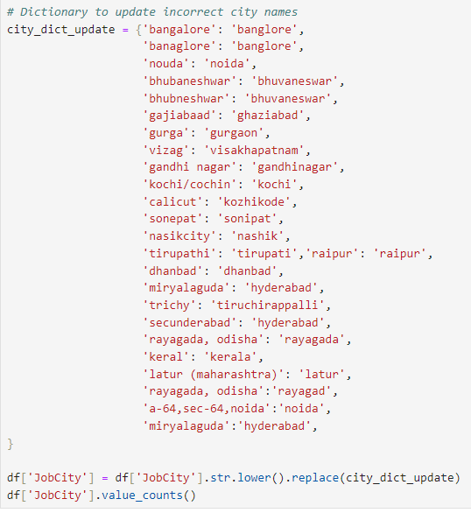
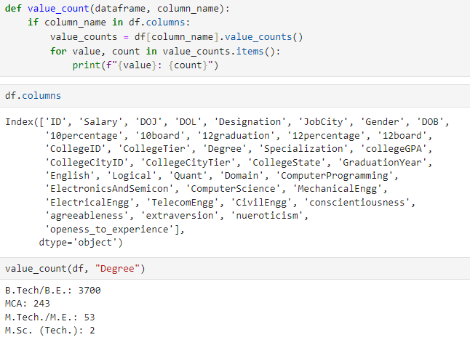
DATA TRANSFORMATION
Conducted data transformation by adding a new 'Branch' column, implementing a function for value counts to enhance understanding, and creating a dictionary to correct misspelled words.

Slide 7
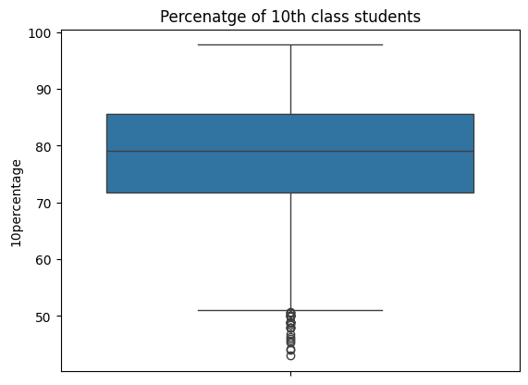
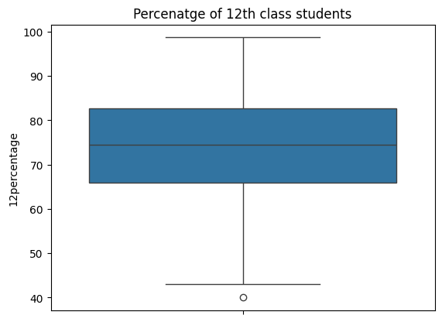
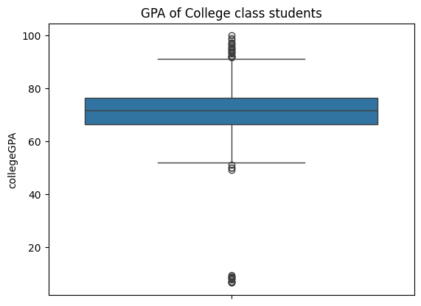
UNIVARIATE ANALYSIS
The distribution of percentages for students in 10th, 12th, and college GPA show a consistent range, with most students scoring between 70-90% in 10th and 12th, and a slightly lower range in GPA.

Slide 8
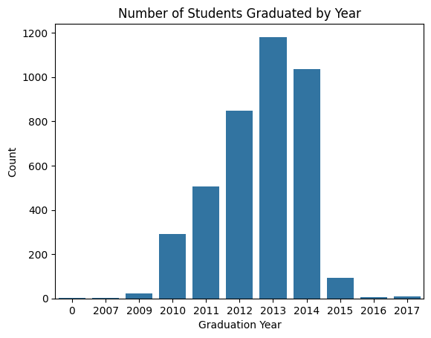
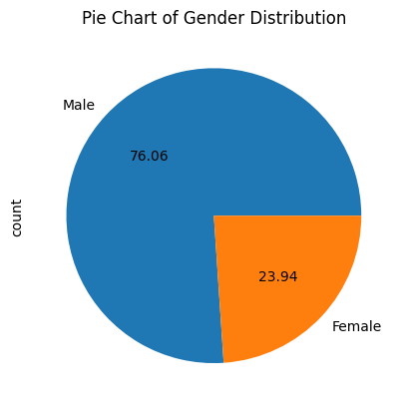
UNIVARIATE ANALYSIS
The bar chart shows that the majority of students graduated between 2012 and 2014, with a peak in 2013.
The pie chart reveals that the dataset is skewed towards male students, with about 76% being male and 24% female.

Slide 9
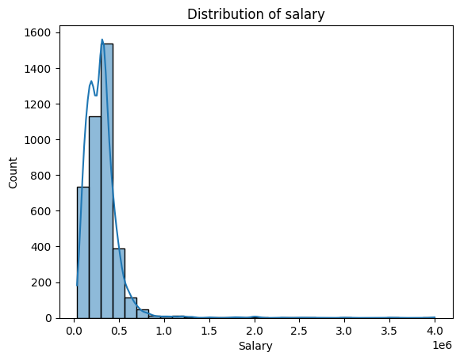
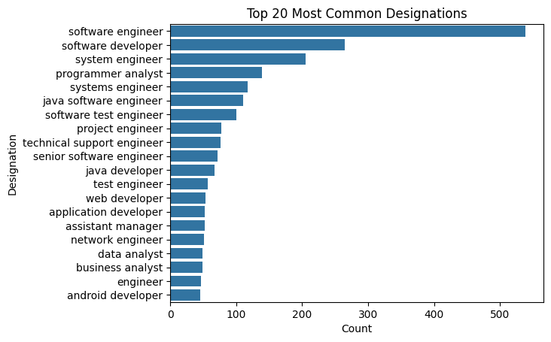
UNIVARIATE ANALYSIS
The salary distribution plot shows that most candidates earn between 2 to 5 lakhs per year, with a few outliers earning much higher salaries.
The plot indicates that "Software Engineer" is the most common designation, followed by "Software Developer" and "System Engineer," among the top 20 roles.

Slide 10
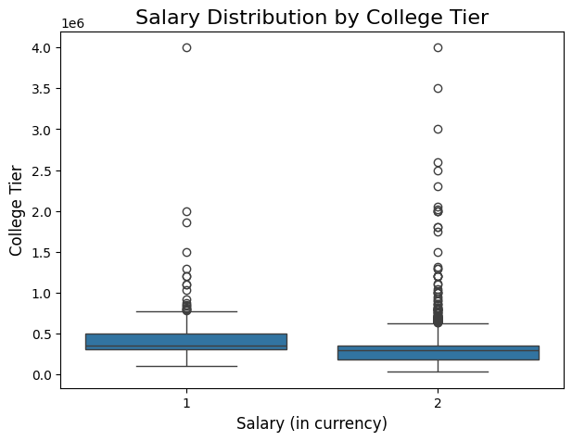
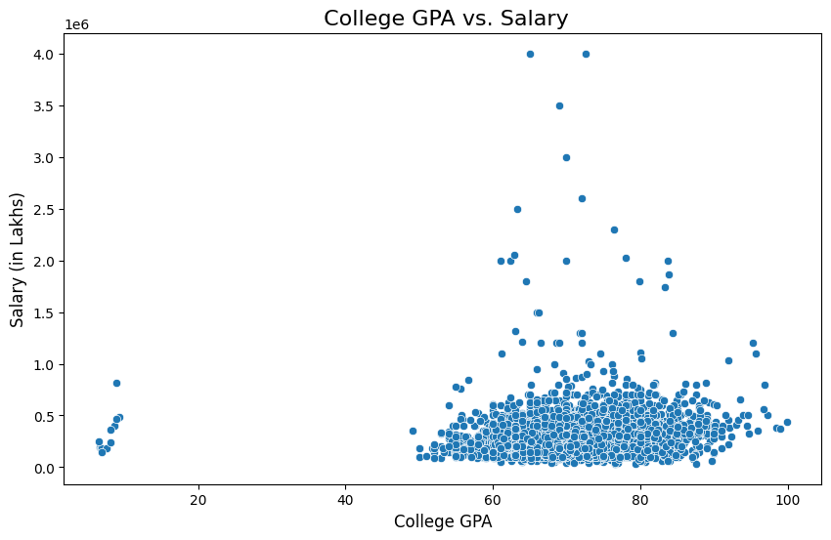
BI-VARIATE ANALYSIS
The data reveals a clear salary gap between college tiers, with graduates from Tier 1 schools more likely to secure high-paying roles
There is some positive correlation between higher GPAs and better salaries, the relationship is not strictly linear,

Slide 11
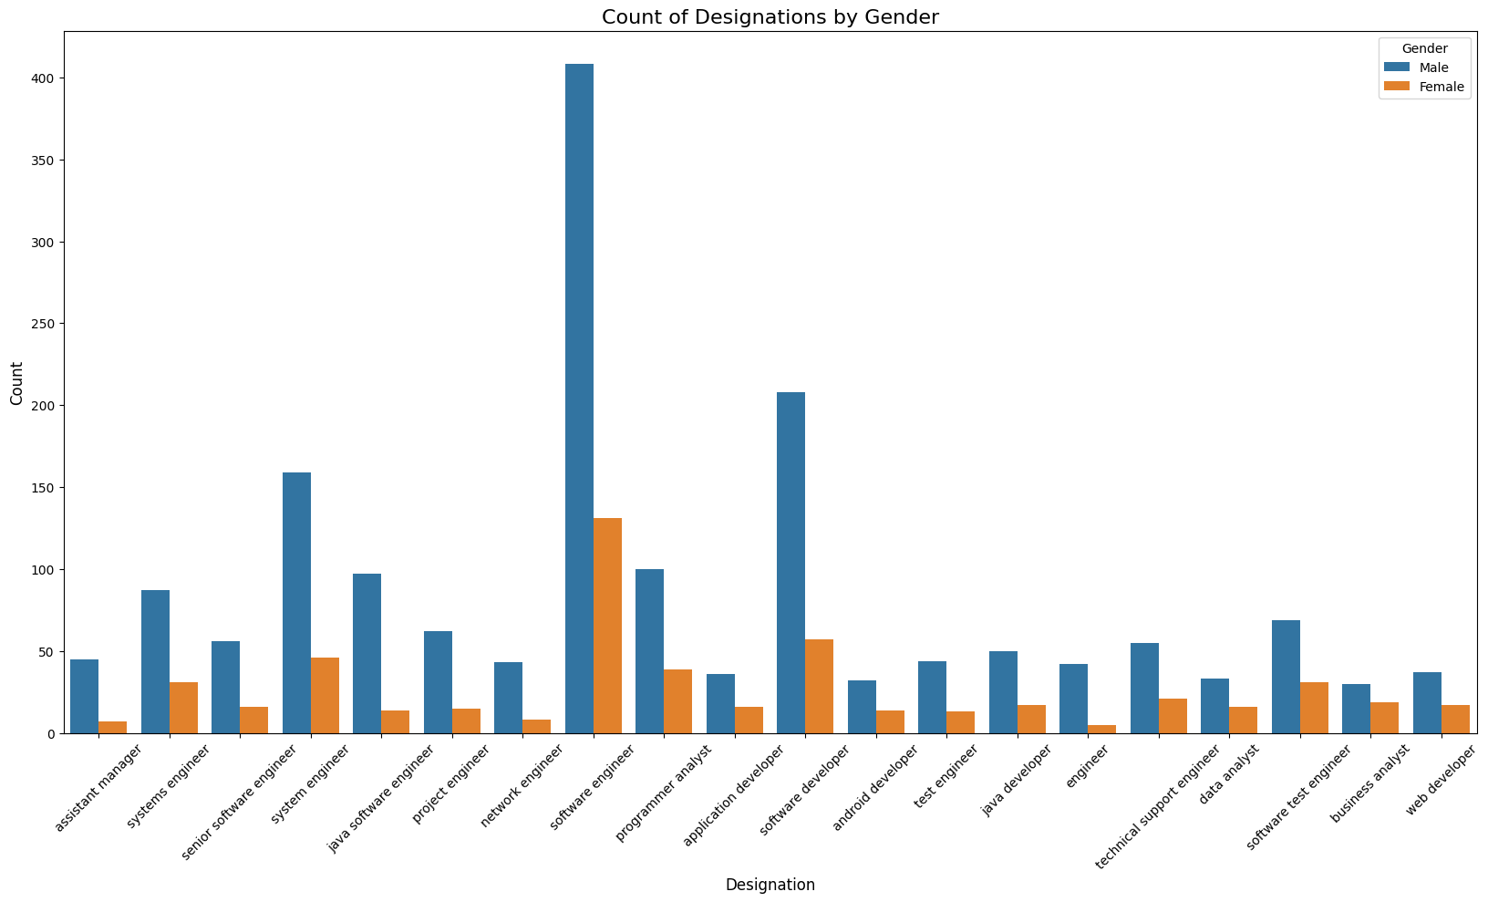
BI-VARIATE ANALYSIS
Males dominate key engineering roles like Software Engineer and System Engineer, but there is notable female representation in roles such as Software Developer and Programmer Analyst.

Slide 12
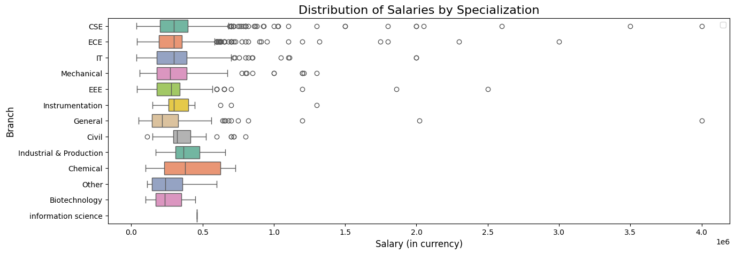
BI-VARIATE ANALYSIS
Specializations like Computer Science and Electronics tend to offer higher median salaries compared to others, reflecting greater demand in the job market.

Slide 13
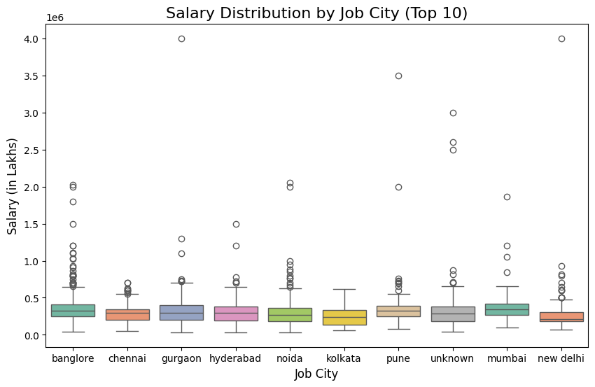
BI-VARIATE ANALYSIS
Major job cities like Bangalore, Hyderabad, and Pune offer higher median salaries compared to others, indicating their prominence as hubs for high-paying engineering jobs.

Slide 14
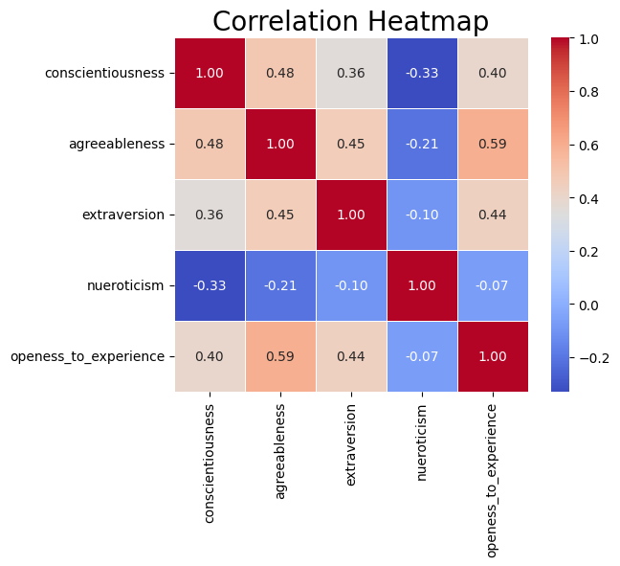
MULTIVARIATE ANALYSIS
The heatmap reveals how different personality traits are interrelated. For example, traits like conscientiousness and openness to experience show moderate correlation, suggesting individuals strong in one may exhibit tendencies in the other.

Slide 15
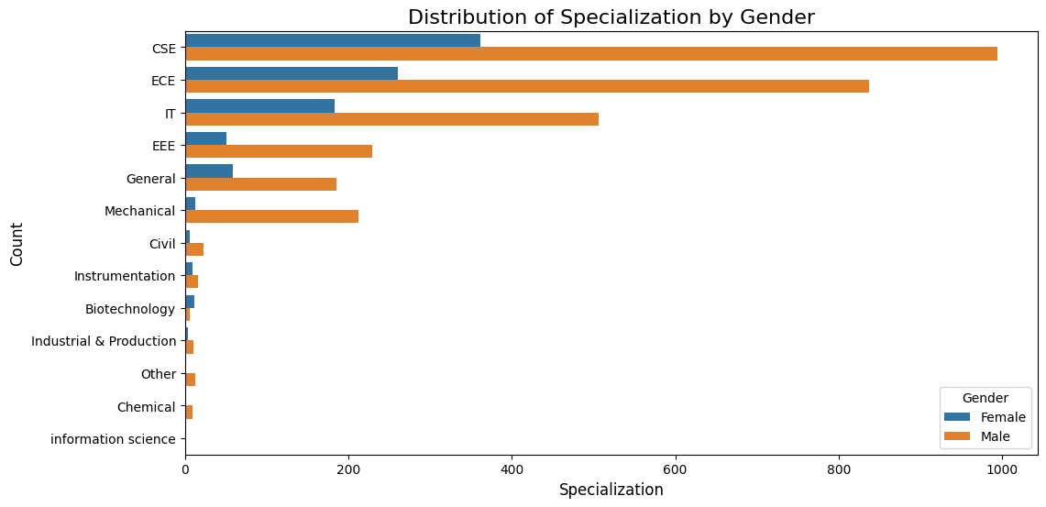
RESEARCH QUESTION
Does the preference of Branch(Specialization) depend on the Gender?
Fields like CSE, IT, EEE, ECE, and Mechanical Engineering males significantly outnumber females, showing that these fields are more male-dominated. While certain fields like Biotechnology may attract more females, the overall trend across engineering disciplines reveals a significant gender imbalance, particularly in technical fields.

Slide 16
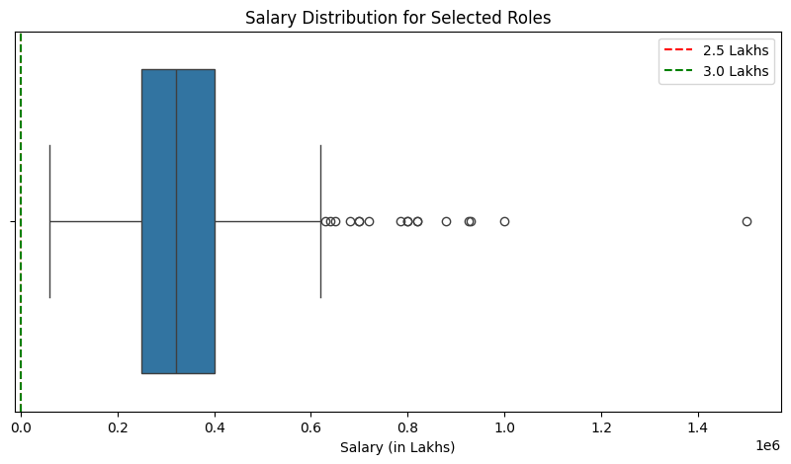
RESEARCH QUESTION
Assess the validity of the Times of India article claiming that fresh Computer Science Engineering graduates can earn ₹2.5 to ₹3 Lakhs in roles like Programming Analyst and Software Engineer.
Fresh graduates in positions such as Programming Analyst, Software Engineer, Hardware Engineer, and Associate Engineer typically earn salaries ranging from ₹2.5 to ₹3 Lakhs, with an average salary of approximately ₹3.41 Lakhs.

Slide 17
CONCLUSION
The AMCAT analysis reveals significant insights into how various factors, including demographics, academic performance, and cognitive and technical skills, influence employability and salary distribution for engineering graduates. The dataset from Aspiring Minds (AMEO 2015) shows that males dominate technical roles, and cities like Bangalore and Hyderabad offer higher salaries. Specializations in Computer Science and Electronics provide better salary prospects compared to others.

Slide 18

THANK YOU

