Slide 1
4.3 Reasoning with Uncertainty

Slide 2
Outline of Presentation
Reasoning and Predicate Logic
Uncertainty
Non-monotonic Reasoning
Default Reasoning
Dempster – Shafer Theory
Conclusion
Bayes Theorem
Reasoning under Uncertainty

Slide 3
Humans & Reasoning !!!
We take pride in the way we reason !!!
What exactly is reasoning?
    A ‘process’ of thinking/arguing ‘logically’.
      Verifications or Adaptation.
      New deductions.
Reasoning under Uncertainty

Slide 4
Predicate Logic?
Symbolic representation of facts.
Deduction of new facts.
Certainty.
Reasoning under Uncertainty

Slide 5
Logic Based Expert Systems
In diagnosis of diseases, where system decides the disease, given the symptoms.
What if:
  No information for given set of symptoms.
  Facts are not enough.
  Multiple diseases.
  A new case in medical history.
In such cases, the reasoning by expert systems using Predicate Logic fails.
Reasoning under Uncertainty

Slide 6
Uncertainty
Predicate logic used - only if there is no uncertainty.
But uncertainty is omnipresent.
The sources of uncertainty:
  Data or Expert Knowledge
  Knowledge Representation
  Rules or Inference Process
Reasoning under Uncertainty

Slide 7
Uncertainty in Knowledge
Prior Knowledge.
Imprecise representation.
Data derived from defaults/assumptions.
Inconsistency between knowledge from different experts.
“Best Guesses”.
Reasoning under Uncertainty

Slide 8
Representation and Reasoning
Knowledge Representation
  Restricted model of the real system.
  Limited expressiveness of the representation mechanism.
Rules or Inference Process
  Conflict Resolution
  Subsumption
  Derivation of the result may take very long.
Reasoning under Uncertainty

Slide 9
Solution
Intelligence in Reasoning
  Adaptability.
    Capability of adding and retracting beliefs as new information is available.
  This requires non-monotonic reasoning.
Reasoning under Uncertainty

Slide 10
Non-monotonic Reasoning
In a non-monotonic system:
  We make assumptions about unknown facts.
  The addition of new facts can reduce the set of logical conclusions.
  S is a conclusion of D, but is not necessarily a conclusion of D + {new fact}.
  Humans use non-monotonic reasoning constantly!
Reasoning under Uncertainty

Slide 11
Knowledge Base
Conflicting consequences of a set of facts:
  Rank all the assumptions and use rank to determine which to believe.
  Tag given (and some other) facts as protected, these cannot be removed or changed.
When a new fact is given:
  Get the explanation (list of contradicting facts).
  Maintain consistency.
Reasoning under Uncertainty

Slide 12
Probability in Reasoning
Probabilities to determine when contradiction arises.
  Label each fact with a probability of being true.
  Change the probabilities of existing facts to reflect new facts.
Use certainty instead of probability to label facts.
Reasoning under Uncertainty

Slide 13
Default Reasoning
Construction of sensible guesses when some useful information is lacking and no contradictory evidence is present.
Reasoning under Uncertainty
Notes:
We define a default rule

Slide 14
How it does so?
It tries to reason with the given knowledge and generates the most likely result.
Use ‘ Whatever is available '.
Reasoning under Uncertainty
Notes:
New facts, added later on can make the previous conclusions stronger or conflicting.

Slide 15
A Classic Example
  Can Tweety fly???
Birds typically fly
Tweety is a bird.
  Tweety flies
Birds typically fly
Penguins are birds
Penguins typically do not fly
Tweety is a Penguin.
  Tweety does not fly.
Reasoning under Uncertainty

Slide 16
Nonmonotonic Logic (NML)
  Can Tweety fly???
Bird(x) ^ M fly(x)-> fly(x)
Bird(Tweety)
penguin(x) -> bird(x)
penguin(x) -> ~fly(x)
penguin(Tweety)
Reasoning under Uncertainty
M is known as MODAL operator.
Read it as: 'If it is consistent to assume'

Slide 17
IDEA
If there is no reason to believe otherwise, assume that fly (x) is TRUE.
The default is that everything is normal.
Now we only need to supply additional information for exceptions.
Reasoning under Uncertainty

Slide 18
Problem with NML
Russian Roulette Example
Reasoning under Uncertainty

Slide 19
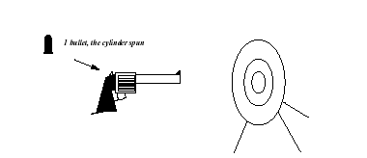
Would you take the bet ?
A revolver is loaded with 1 bullet (it has 5 empty chambers), and the cylinder is spun.
With these stakes:
  If correct, the system wins $1.
  If wrong, the system loses $1.
Reasoning under Uncertainty

Slide 20

Another Scenario..
Again the revolver is loaded with exactly 1 bullet and the cylinder is spun.
With these new stakes:
  If correct, the system wins $1.
  If wrong, the system loses its life.
Reasoning under Uncertainty

Slide 21
So, where does the problem lie?
Reasoning under Uncertainty
In these two scenarios the uncertainty is the same, but it is not rational to draw the same conclusion.

Slide 22
Rational Default Reasoning
Assign a degree of belief
Define a acceptance rule
  if P(S | e) > b then accept the bet.
Here, b will be calculated using the payoff.
A tentative conclusion is an assertion about the desirability of a bet, not a direct assertion about a sentence.
Reasoning under Uncertainty

Slide 23

Solution of Russian Roulette
Decision theory gives the answer:
  Compare the probability of the sentence to the breakeven probability determined by the payoff.
  b = 1/(1 + 1) = 0.5
    P(gun_will_not_fire | 1_bullet_and_spun) > 0.5
  b =
    The system should ignore a better-than-even probability and refuse to bet.
Reasoning under Uncertainty

Slide 24
What we observed?
Using Default Reasoning, we are able to reach at some conclusion.
It works well under the non-monotonic knowledge base.
Its basic idea is that common-sense reasoning applies regularity assumptions as long as these are not explicitly ruled out.
So, we need to quantify exceptions explicitly.
Reasoning under Uncertainty
Notes:
Basically we are defining a generic model and exceptions are mentioned explicitly.

Slide 25
Dempster Shafer (D-S) Theory
Provides a numerical method to represent and reason about uncertainty.
“Absence of evidence is not an evidence of absence”.
Provides a way to combine evidence from two or more sources and to draw conclusions from them.
Reasoning under Uncertainty

Slide 26

Basics
Frame of Discernment - Sample space of DS theory denoted by
Propositions - Subsets of frame of discernment
Probability values are assigned to the propositions.
Basic Probability Assignments - Probability values assigned to the propositions denoted by m.
Focal Elements - Propositions with non-zero probability assignment.
Core – Union of focal elements.
Reasoning under Uncertainty

Slide 27
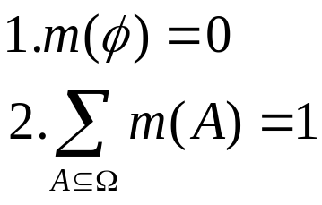
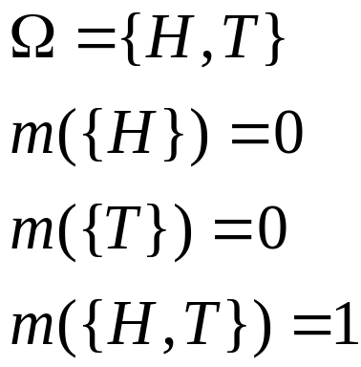
Basic Probability Assignment
Properties of BPA:
Ex. I am not sure if
the coin is fair or biased.
Reasoning under Uncertainty

Slide 28
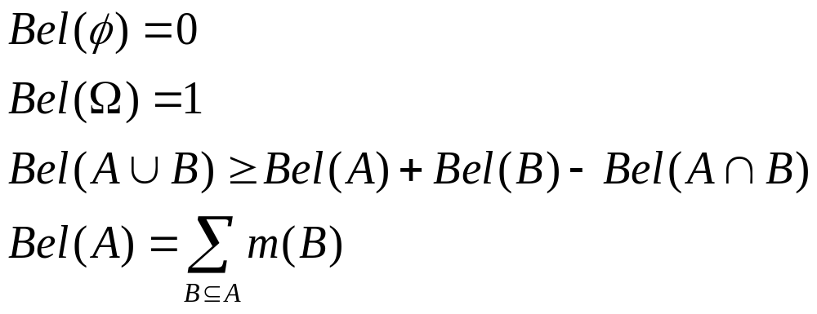
Belief function
Function to express the extent to which we are confident about the occurrence of a proposition.
Bel(A) is the total belief committed to A.
Reasoning under Uncertainty

Slide 29
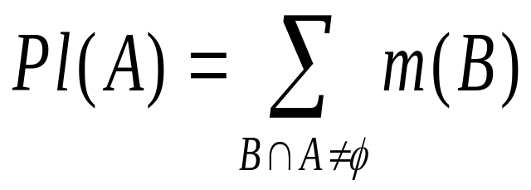
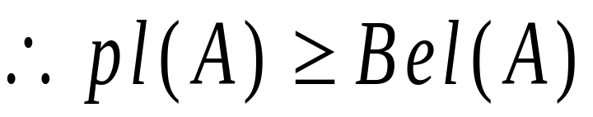
Plausibility
Function to express the extent to which a proposition is credible or plausible.
[Bel(A), Pl(A)] represents the credibility status of A
Pl(A) - Bel(A) represents uncertainty in the occurrence of A
Reasoning under Uncertainty

Slide 30
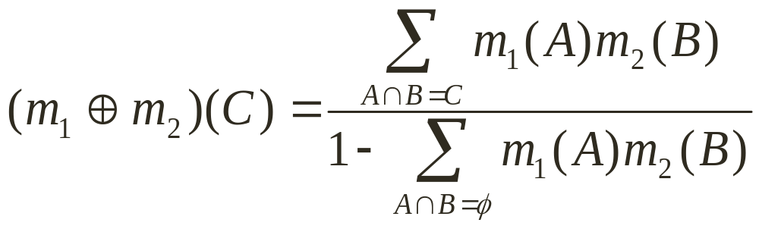
Dempster’s rule of Combination
Allows us to combine Basic Probability Assignment (m) values from two arguments and draw conclusions.
m₁ and m₂ are two independent BPAs.
Reasoning under Uncertainty

Slide 31
Example
 | m₁{H}=0.3 | m₁{T}=0 | m₁{H,T}=0.7
m₂{H}=0.5 | {H}, 0.15 | { }, 0 | {H}, 0.35
m₂{T}=0.5 | { }, 0.15 | {T}, 0 | {T}, 0.35
m₂{H,T}=0 | {H}, 0 | {T}, 0 | {H,T}, 0
Reasoning under Uncertainty
(m₁ (+) m₂)({H}) = (0.15+0.35)/(1-(0.15+0)) = 0.58.
(m₁ (+) m₂)({T}) = (0.35)/(1-(0.15+0)) = 0.42.

Slide 32
Advantages & Disadvantages
Advantages
Uncertainty and ignorance can be expressed.
Dempster’s rule can be used to combine evidences.
Disadvantages
Computational complexity of applying Dempster’s rule is high.
Reasoning under Uncertainty

Slide 33
Conclusions
Uncertainty is omnipresent.
We can use symbolic and statistical methods like Default Reasoning and Dempster – Shafer theory to handle uncertainty to some extent.
Default Reasoning guarantees a conclusion for the given knowledge base and desired fact. Although for handling exceptions they have to be explicitly quantified.
Dempster – Shafer theory combines evidences from different sources to draw conclusion.
Reasoning under Uncertainty

Slide 34
References
Russell and Norvig (1993), “Artificial Intelligence – A modern approach”. Pearson Education, Inc. Second Edition
Pelletier F.J., and R. Elio (1997). What should default reasoning be, by default? Computational Intelligence 13:165-188
Glenn Shafer(1976), “A mathematical theory of evidence”. Princeton : Princeton University Press.
Carl M. Kadie, "Rational Non-Monotonic Reasoning." in Proceedings of the Fourth Workshop on Uncertainty in Artificial Intelligence, Minneapolis, August 1988 http://research.microsoft.com/~carlk/papers/uncert.ps
Reasoning under Uncertainty

Slide 35
Probabilistic reasoning in Artificial intelligence
Uncertainty:
we have learned knowledge representation using first-order logic and propositional logic with certainty, which means we were sure about the predicates. With this knowledge representation, we might write A→B, which means if A is true then B is true, but consider a situation where we are not sure about whether A is true or not then we cannot express this statement, this situation is called uncertainty.
Reasoning under Uncertainty

Slide 36
So to represent uncertain knowledge, where we are not sure about the predicates, we need uncertain reasoning or probabilistic reasoning.
Causes of uncertainty:
Following are some leading causes of uncertainty to occur in the real world.
Information occurred from unreliable sources.
Experimental Errors
Equipment fault
Temperature variation
Climate change.

Slide 37
Probabilistic reasoning:
Probabilistic reasoning is a way of knowledge representation where we apply the concept of probability to indicate the uncertainty in knowledge.
In probabilistic reasoning, we combine probability theory with logic to handle the uncertainty.
We use probability in probabilistic reasoning because it provides a way to handle the uncertainty that is the result of someone's laziness and ignorance.
In the real world, there are lots of scenarios, where the certainty of something is not confirmed, such as "It will rain today," "behavior of someone for some situations," "A match between two teams or two players." These are probable sentences for which we can assume that it will happen but not sure about it, so here we use probabilistic reasoning.
Reasoning under Uncertainty

Slide 38
Need of probabilistic reasoning in AI:
When there are unpredictable outcomes.
When specifications or possibilities of predicates becomes too large to handle.
When an unknown error occurs during an experiment.
In probabilistic reasoning, there are two ways to solve problems with uncertain knowledge:
Bayes' rule
Bayesian Statistics
Probability: Probability can be defined as a chance that an uncertain event will occur. It is the numerical measure of the likelihood that an event will occur. The value of probability always remains between 0 and 1 that represent ideal uncertainties.
Reasoning under Uncertainty

Slide 39

0 ≤ P(A) ≤ 1, where P(A) is the probability of an event A.
P(A) = 0, indicates total uncertainty in an event A.
P(A) =1, indicates total certainty in an event A.
We can find the probability of an uncertain event by using the below formula.
Reasoning under Uncertainty

Slide 40
P(¬A) = probability of a not happening event.
P(¬A) + P(A) = 1.
Event: Each possible outcome of a variable is called an event.
Sample space: The collection of all possible events is called sample space.
Random variables: Random variables are used to represent the events and objects in the real world.
Prior probability: The prior probability of an event is probability computed before observing new information.
Posterior Probability: The probability that is calculated after all evidence or information has taken into account. It is a combination of prior probability and new information.
Reasoning under Uncertainty

Slide 41


Conditional probability:
Conditional probability is a probability of occurring an event when another event has already happened.
Let's suppose, we want to calculate the event A when event B has already occurred, "the probability of A under the conditions of B", it can be written as:
Where P(A⋀B)= Joint probability of A and B
P(B)= Marginal probability of B.
If the probability of A is given and we need to find the probability of B, then it will be given as:
Reasoning under Uncertainty

Slide 42
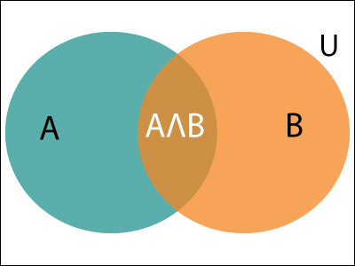
It can be explained by using the below Venn diagram, where B is occurred event, so sample space will be reduced to set B, and now we can only calculate event A when event B is already occurred by dividing the probability of
P(A⋀B) by P( B )
Reasoning under Uncertainty

Slide 43

Example:
In a class, there are 70% of the students who like English and 40% of the students who likes English and mathematics, and then what is the percent of students those who like English also like mathematics?
Solution:
Let, A is an event that a student likes Mathematics
B is an event that a student likes English.
Hence, 57% are the students who like English also like Mathematics.
Reasoning under Uncertainty

Slide 44
Bayes' theorem in Artificial intelligence.
Bayes' theorem:
Bayes' theorem is also known as Bayes' rule, Bayes' law, or Bayesian reasoning, which determines the probability of an event with uncertain knowledge.
In probability theory, it relates the conditional probability and marginal probabilities of two random events.
Bayes' theorem was named after the British mathematician Thomas Bayes. The Bayesian inference is an application of Bayes' theorem, which is fundamental to Bayesian statistics.
It is a way to calculate the value of P(B|A) with the knowledge of P(A|B).
Bayes' theorem allows updating the probability prediction of an event by observing new information of the real world.
Reasoning under Uncertainty

Slide 45

Example: If cancer corresponds to one's age then by using Bayes' theorem, we can determine the probability of cancer more accurately with the help of age.
Bayes' theorem can be derived using product rule and conditional probability of event A with known event B:
As from product rule we can write:
P(A ⋀ B)= P(A|B) P(B) or
Similarly, the probability of event B with known event A:
P(A ⋀ B)= P(B|A) P(A)
Equating right hand side of both the equations, we will get:
The above equation (a) is called as Bayes' rule or Bayes' theorem. This equation is basic of most modern AI systems for probabilistic inference.
Reasoning under Uncertainty

Slide 46

It shows the simple relationship between joint and conditional probabilities. Here,
P(A|B) is known as posterior, which we need to calculate, and it will be read as Probability of hypothesis A when we have occurred an evidence B.
P(B|A) is called the likelihood, in which we consider that hypothesis is true, then we calculate the probability of evidence.
P(A) is called the prior probability, probability of hypothesis before considering the evidence
P(B) is called marginal probability, pure probability of an evidence.
In the equation (a), in general, we can write P (B) = P(A)*P(B|Ai), hence the Bayes' rule can be written as:
Where A₁, A₂, A₃,........, A_{n} is a set of mutually exclusive and exhaustive events.
Reasoning under Uncertainty

Slide 47

Applying Bayes' rule:
Bayes' rule allows us to compute the single term P(B|A) in terms of P(A|B), P(B), and P(A). This is very useful in cases where we have a good probability of these three terms and want to determine the fourth one. Suppose we want to perceive the effect of some unknown cause, and want to compute that cause, then the Bayes' rule becomes:
Reasoning under Uncertainty

Slide 48

Example-1:
what is the probability that a patient has diseases meningitis with a stiff neck?
Given Data:
A doctor is aware that disease meningitis causes a patient to have a stiff neck, and it occurs 80% of the time. He is also aware of some more facts, which are given as follows:
The Known probability that a patient has meningitis disease is 1/30,000.
The Known probability that a patient has a stiff neck is 2%.
Let a be the proposition that patient has stiff neck and b be the proposition that patient has meningitis. , so we can calculate the following as:
P(a|b) = 0.8
P(b) = 1/30000
P(a)= .02
Hence, we can assume that 1 patient out of 750 patients has meningitis disease with a stiff neck.
Reasoning under Uncertainty

Slide 49


Example-2
From a standard deck of playing cards, a single card is drawn. The probability that the card is king is 4/52, then calculate posterior probability P(King|Face), which means the drawn face card is a king card.
Solution:
P(king): probability that the card is King= 4/52= 1/13
P(face): probability that a card is a face card= 3/13
P(Face|King): probability of face card when we assume it is a king = 1
Putting all values in equation (i) we will get:
Reasoning under Uncertainty

Slide 50
Application of Bayes' theorem in Artificial intelligence:
Following are some applications of Bayes' theorem:
It is used to calculate the next step of the robot when the already executed step is given.
Bayes' theorem is helpful in weather forecasting.
It can solve the Monty Hall problem.
Reasoning under Uncertainty

Slide 51
Bayesian Belief Network in artificial intelligence
Bayesian belief network is key computer technology for dealing with probabilistic events and to solve a problem which has uncertainty. We can define a Bayesian network as:
"A Bayesian network is a probabilistic graphical model which represents a set of variables and their conditional dependencies using a directed acyclic graph."
It is also called a Bayes network, belief network, decision network, or Bayesian model.
Bayesian networks are probabilistic, because these networks are built from a probability distribution, and also use probability theory for prediction and anomaly detection.
Real world applications are probabilistic in nature, and to represent the relationship between multiple events, we need a Bayesian network. It can also be used in various tasks including prediction, anomaly detection, diagnostics, automated insight, reasoning, time series prediction, and decision making under uncertainty.
Reasoning under Uncertainty

Slide 52
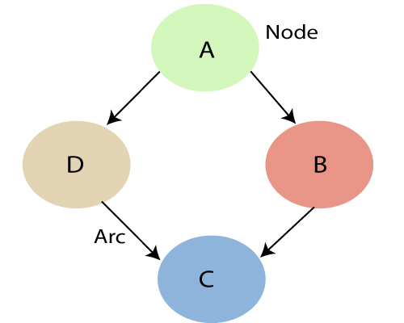
Bayesian Network can be used for building models from data and experts opinions, and it consists of two parts:
Directed Acyclic Graph
Table of conditional probabilities.
The generalized form of Bayesian network that represents and solve decision problems under uncertain knowledge is known as an Influence diagram.
A Bayesian network graph is made up of nodes and Arcs (directed links), where:
Reasoning under Uncertainty

Slide 53
Each node corresponds to the random variables, and a variable can be continuous or discrete.
Arc or directed arrows represent the causal relationship or conditional probabilities between random variables. These directed links or arrows connect the pair of nodes in the graph.
These links represent that one node directly influence the other node, and if there is no directed link that means that nodes are independent with each other
  In the above diagram, A, B, C, and D are random variables represented by the nodes of the network graph.
  If we are considering node B, which is connected with node A by a directed arrow, then node A is called the parent of Node B.
  Node C is independent of node A.
Reasoning under Uncertainty

Slide 54
Joint probability distribution:
If we have variables x1, x2, x3,....., xn, then the probabilities of a different combination of x1, x2, x3.. xn, are known as Joint probability distribution.
P[x₁, x₂, x₃,....., x_{n}], it can be written as the following way in terms of the joint probability distribution.
= P[x₁| x₂, x₃,....., x_{n}]P[x₂, x₃,....., x_{n}]
= P[x₁| x₂, x₃,....., x_{n}]P[x₂|x₃,....., x_{n}]....P[x_{n-1}|x_{n}]P[x_{n}].
In general for each variable Xi, we can write the equation as:
P(X_{i}|X_{i-1},........., X₁) = P(X_{i} |Parents(X_{i} ))
Reasoning under Uncertainty

Slide 55
Let's understand the Bayesian network through an example by creating a directed acyclic graph:
Example: Harry installed a new burglar alarm at his home to detect burglary. The alarm reliably responds at detecting a burglary but also responds for minor earthquakes. Harry has two neighbors David and Sophia, who have taken a responsibility to inform Harry at work when they hear the alarm. David always calls Harry when he hears the alarm, but sometimes he got confused with the phone ringing and calls at that time too. On the other hand, Sophia likes to listen to high music, so sometimes she misses to hear the alarm. Here we would like to compute the probability of Burglary Alarm.
Problem:
Calculate the probability that alarm has sounded, but there is neither a burglary, nor an earthquake occurred, and David and Sophia both called the Harry.
Reasoning under Uncertainty

Slide 56
Solution:
The Bayesian network for the above problem is given below. The network structure is showing that burglary and earthquake is the parent node of the alarm and directly affecting the probability of alarm's going off, but David and Sophia's calls depend on alarm probability.
The network is representing that our assumptions do not directly perceive the burglary and also do not notice the minor earthquake, and they also not confer before calling.
The conditional distributions for each node are given as conditional probabilities table or CPT.
Each row in the CPT must be sum to 1 because all the entries in the table represent an exhaustive set of cases for the variable.
In CPT, a Boolean variable with k boolean parents contains 2^{K} probabilities. Hence, if there are two parents, then CPT will contain 4 probability values
Reasoning under Uncertainty

Slide 57
List of all events occurring in this network:
Burglary (B)
Earthquake(E)
Alarm(A)
David Calls(D)
Sophia calls(S)
We can write the events of problem statement in the form of probability: P[D, S, A, B, E], can rewrite the above probability statement using joint probability distribution:
P[D, S, A, B, E]= P[D | S, A, B, E]. P[S, A, B, E]
=P[D | S, A, B, E]. P[S | A, B, E]. P[A, B, E]
= P [D| A]. P [ S| A, B, E]. P[ A, B, E]
= P[D | A]. P[ S | A]. P[A| B, E]. P[B, E]
= P[D | A ]. P[S | A]. P[A| B, E]. P[B |E]. P[E]
Reasoning under Uncertainty

Slide 58
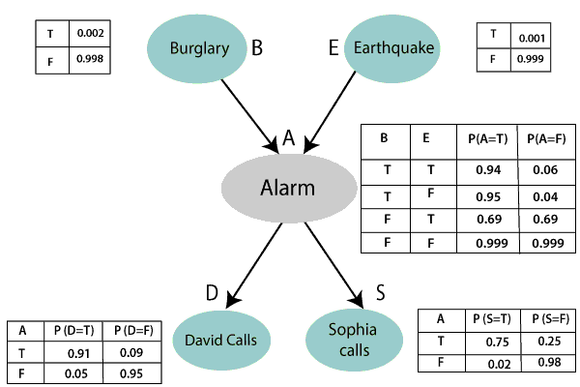
Reasoning under Uncertainty

Slide 59
Let's take the observed probability for the Burglary and earthquake component:
P(B= True) = 0.002, which is the probability of burglary.
P(B= False)= 0.998, which is the probability of no burglary.
P(E= True)= 0.001, which is the probability of a minor earthquake
P(E= False)= 0.999, Which is the probability that an earthquake not occurred.
We can provide the conditional probabilities as per the below tables:
Reasoning under Uncertainty

Slide 60
Conditional probability table for Alarm A:
The Conditional probability of Alarm A depends on Burglar and earthquake:
B | E | P(A= True) | P(A= False)
True | True | 0.94 | 0.06
True | False | 0.95 | 0.04
False | True | 0.31 | 0.69
False | False | 0.001 | 0.999
Reasoning under Uncertainty

Slide 61
Conditional probability table for David Calls:
The Conditional probability of David that he will call depends on the probability of Alarm.
A | P(D= True) | P(D= False)
True | 0.91 | 0.09
False | 0.05 | 0.95
Reasoning under Uncertainty

Slide 62
Conditional probability table for Sophia Calls:
The Conditional probability of Sophia that she calls is depending on its Parent Node "Alarm.
A | P(S= True) | P(S= False)
True | 0.75 | 0.25
False | 0.02 | 0.98
Reasoning under Uncertainty

Slide 63
From the formula of joint distribution, we can write the problem statement in the form of probability distribution:
P(S, D, A, ¬B, ¬E) = P (S|A) *P (D|A)*P (A|¬B ^ ¬E) *P (¬B) *P (¬E).
= 0.75* 0.91* 0.001* 0.998*0.999
= 0.00068045.
Hence, a Bayesian network can answer any query about the domain by using Joint distribution.
The semantics of Bayesian Network:
There are two ways to understand the semantics of the Bayesian network, which is given below:
1. To understand the network as the representation of the Joint probability distribution.
It is helpful to understand how to construct the network.
2. To understand the network as an encoding of a collection of conditional independence statements.
It is helpful in designing inference procedure.
Reasoning under Uncertainty

Slide 64
Example 1
One of two boxes contains 4 red balls and 2 green balls and the second box contains 4 green and two red balls. By design, the probabilities of selecting box 1 or box 2 at random are 1/3 for box 1 and 2/3 for box 2.
A box is selected at random and a ball is selected at random from it.
a) Given that the ball selected is red, what is the probability it was selected from the first box?
b) Given that the ball selected is red, what is the probability it was selected from the second box?
c) Compare the results in parts a) and b) and explain the answer.
Reasoning under Uncertainty

Slide 65
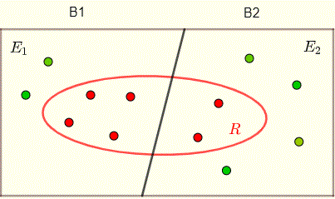
solution
Let us call the first box B1 and the second box B2
Let event E1 be "select box 1" and event E2 "select box 2".
Let event R be "select a red ball".
All the above information is included in the diagram below.
The probabilities of selecting one of the two boxes would are given (above) by
Reasoning under Uncertainty

Slide 66
The probabilities of selecting one of the two boxes would are given (above) by
P(E1)=1/3 and P(E2)=2/3
The conditional probability that a selected ball is red given that it is selected from box 1 is given by
P(R|E1)=4/6=2/3 , 4 balls out of 6 are red in box 1
The conditional probability that a selected ball is red given that it is selected from box 2 is given by
P(R|E2)=2/6=1/3 , 2 balls out of 6 are red in box 2
Reasoning under Uncertainty

Slide 67
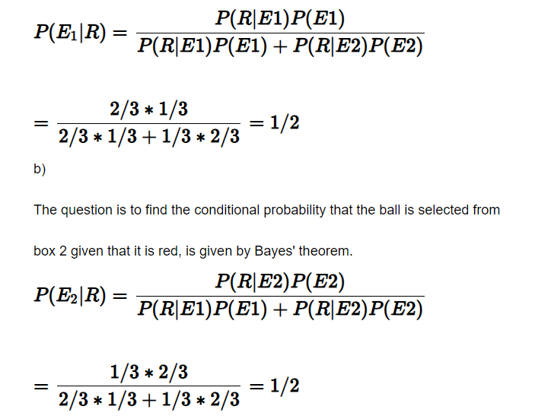
a) The question is to find the conditional probability that the ball is selected from box 1 given that it is red, is given by Bayes' theorem.
Reasoning under Uncertainty

