Slide 1
Color Themes
1
Choose a color theme you like. You can see how the dashboard design looks with each color theme below, based on the color indexes. Pick the color theme row by row. If you're having trouble understanding, scroll down to find the matching index number.
For example, if you like the first color theme, check out the first dashboard to see how those colors look when used in it. You should also follow the same arrangement of visuals as shown.
You can pick your own colors if you'd like, but make sure they are different from what's shown in the video.
2
3
4
5
6

Slide 2
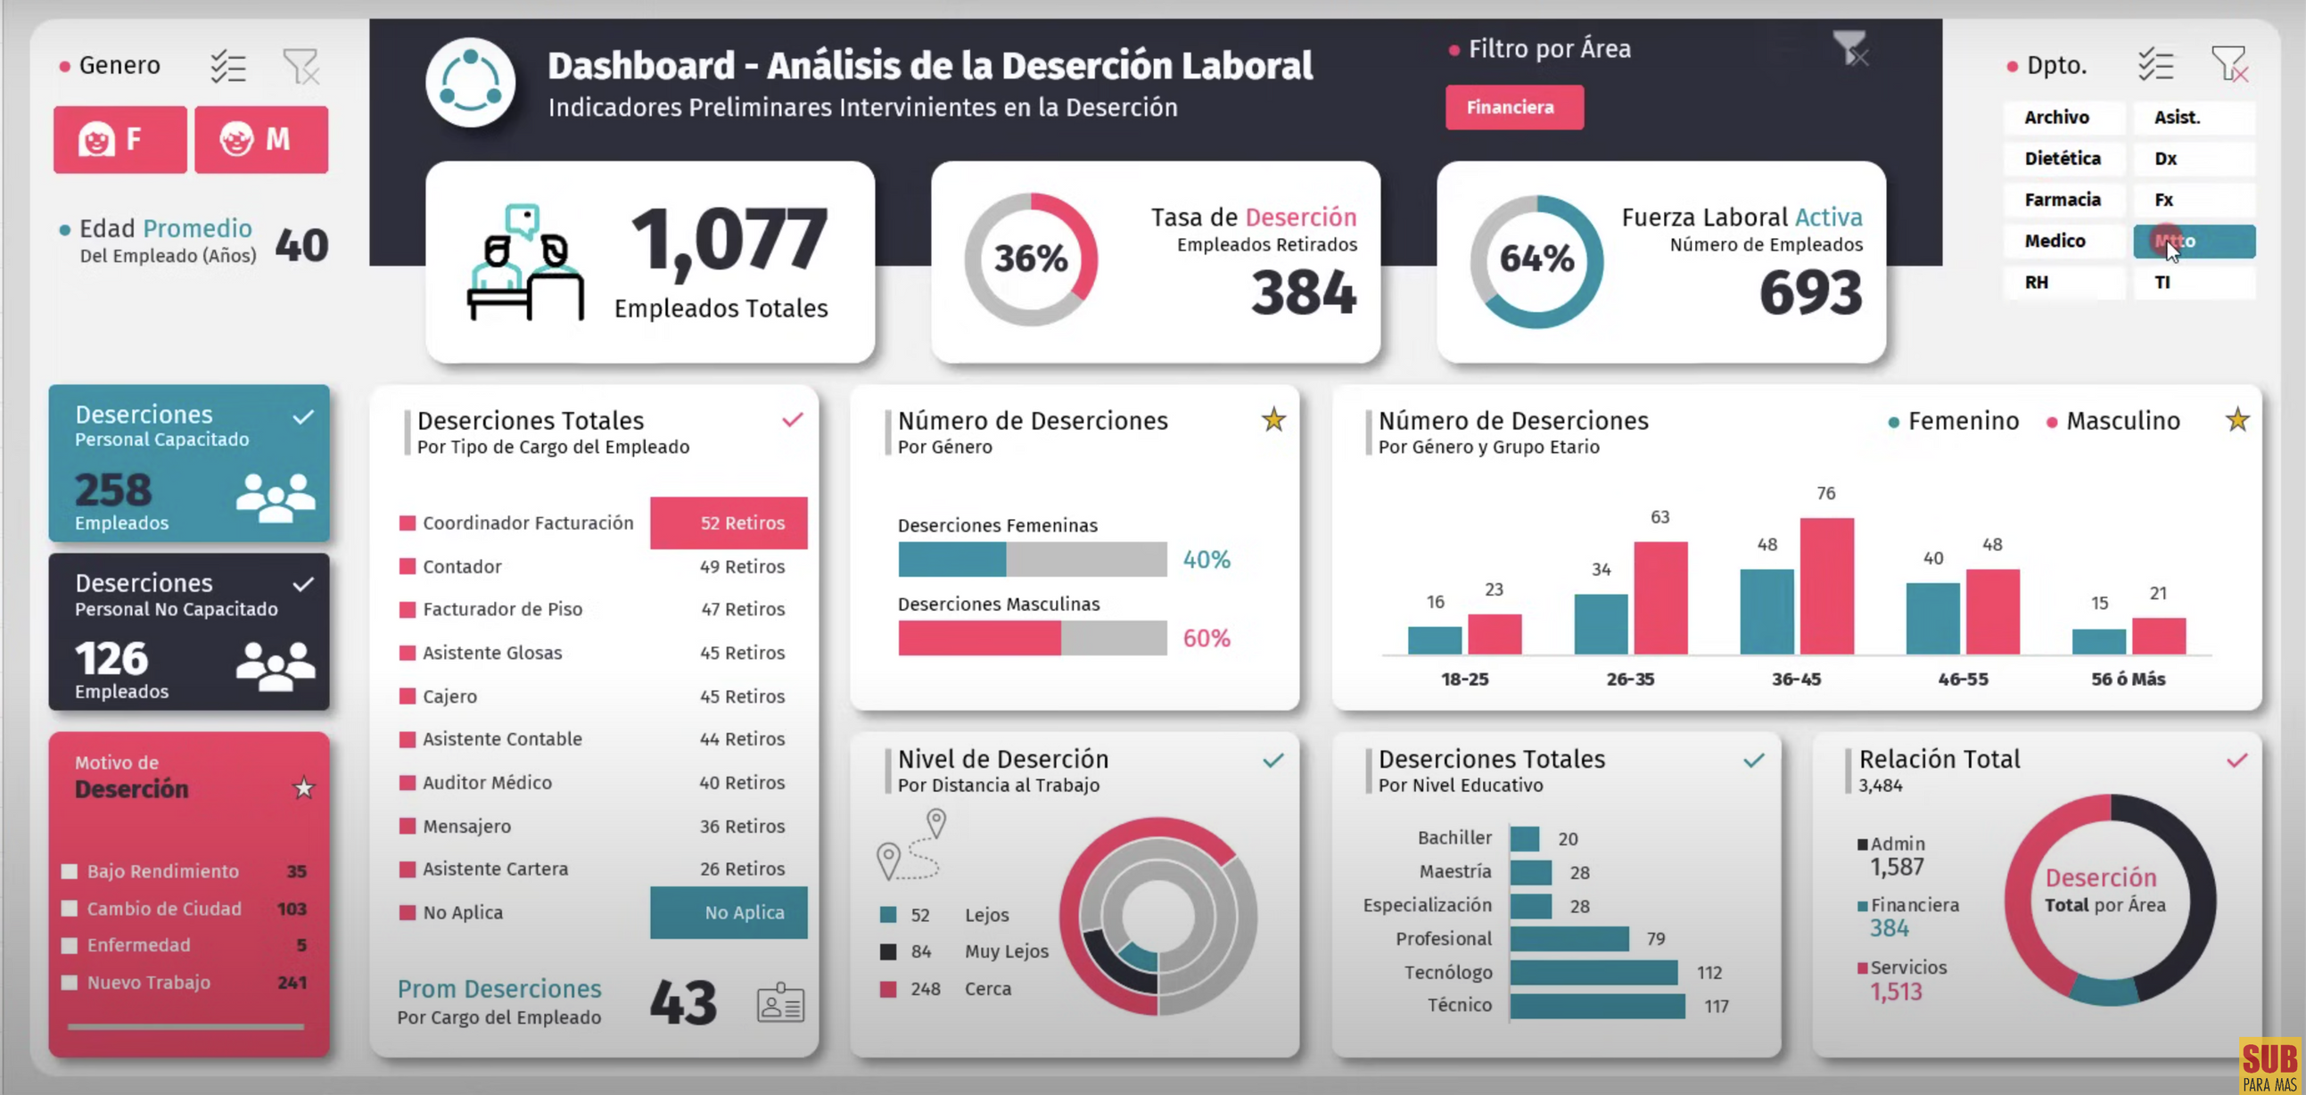

Slide 3
Financial Analysis Dashboard

