Slide 1






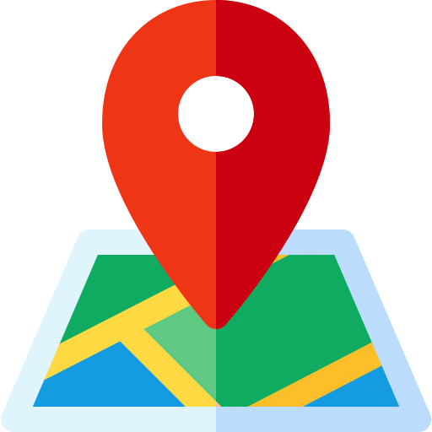

Property Management Dashboard
Real Estate insights, simplified.
Overview
Location
About

Slide 2
Property Management Dashboard
Real Estate insights, simplified.
Overview
Location
About

Slide 3
Property Management Dashboard
Real Estate insights, simplified.
Overview
Location
About

