Slide 1

DataX Labs · Data Analyst Internship
Indian E-Commerce
Sales Dashboard
Task 3: Dashboard Design
An interactive Power BI dashboard built for business stakeholders, covering sales, profit, average and growth signals across states, categories, and payment modes.
Prepared by Aafra

Slide 2



Objective & Approach
Objective
Approach
Clean & model the dataset and define relationships across Orders, Customers, and Products
Design an interactive dashboard for business stakeholders that surfaces sales, profit, and growth signals at a glance and supports drill-down into state, category, and customer-level detail.
1
Select KPIs that map to business questions such as Sales, Profit, Quantity, Average and overall Growth
2
Dataset
Build visuals: time-series trend, category/payment breakdowns, state comparison
Indian e-commerce Sales & Financial dataset sourced from Kaggle order-level records across states, product categories, sub-categories, customers, and payment modes.
3
Layer in slicers (Quarter, State) for stakeholder-driven exploration
4
Tool
Apply a consistent color theme and add icon accents for visual polish
5
Power BI Desktop (free)

Slide 3





KPIs Selected — and Why
₹438K
₹37K
5,615
24.64
Total Amount
Total Profit
Total Quantity
Average Profit
Headline revenue figure the single number stakeholders check first.
Profitability, not just top-line flags where margin is thin or negative.
Volume signal pairs with revenue to reveal pricing/discounting effects.
Per-order profitability a quick health check independent of scale.
Design choice
The task brief also calls out Growth as a KPI. Rather than a static YoY card, growth is represented dynamically through the Profit by Month trend line letting stakeholders see month-over-month movement directly, including the dip through May–September and the recovery into Q4.

Slide 4
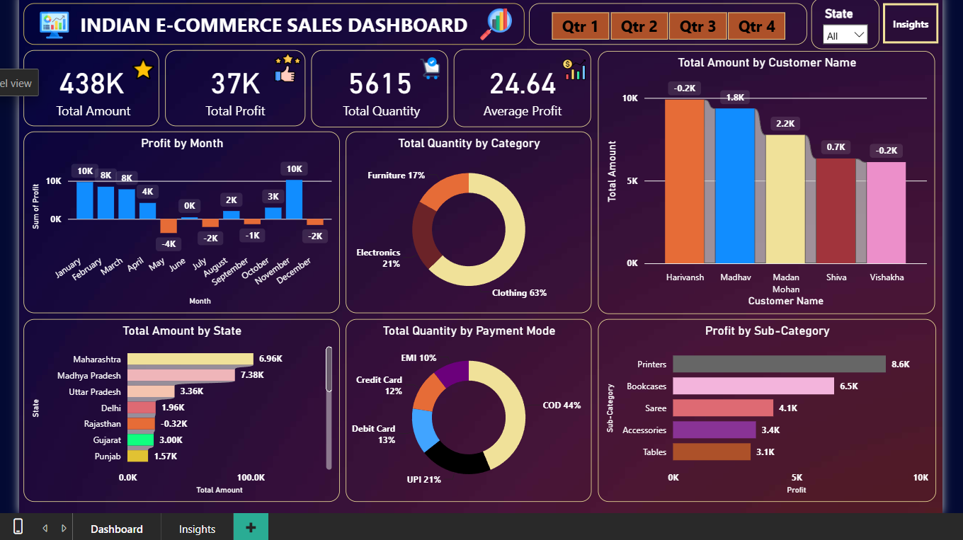
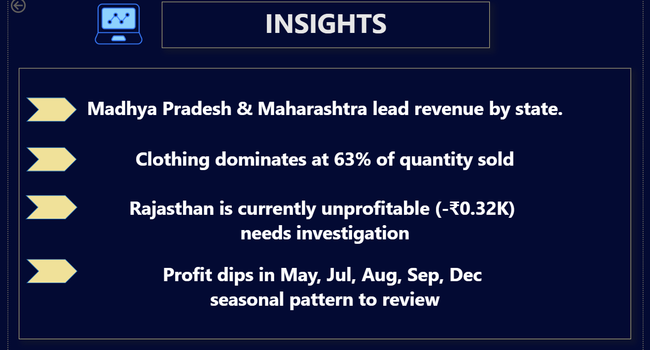
The Dashboard
One page, four KPI cards, six supporting visuals, two slicers

Slide 5





Interactivity & Visual Design
Slicers & Filters
Time-Series Trend
Category & Payment Breakdown
Quarter (Qtr 1-4) button slicer and a State dropdown let stakeholders filter every visual on the page in one click.
Monthly profit trend surfaces seasonality sharp dips May-Sep, strong recovery in Q4.
Donut charts show category mix (Clothing 63%) and payment mode split (COD 44%, UPI 21%).
Geographic Comparison
Consistent Color Theme
Icon Accents
Horizontal bar ranks all 7 states by revenue, flagging Rajasthan's negative profit at a glance.
Navy/purple base with a single orange accent used consistently for slicers and highlights.
Small icons on each KPI card (star, cart, thumbs-up) improve scannability without adding clutter.

Slide 6

Key Insights
Where it's working
Where to watch
Madhya Pradesh (₹7.38K) and Maharashtra (₹6.96K) lead revenue by state, together outperforming the next three states combined.
Rajasthan is currently unprofitable (-₹0.32K) despite positive revenue worth investigating discounting or return rates there.
Clothing dominates category mix at 63% of quantity sold the core product line.
Profit turned negative in May, July, August, September, and December a recurring mid-year and year-end dip that merits a seasonal promotion or cost review.
COD (44%) and UPI (21%) together cover two-thirds of payment volume, reflecting typical Indian e-commerce payment behavior.
Two customers (Harivansh, Vishakha) show slightly negative net amounts, suggesting high return or refund activity on their orders.
Printers (₹8.6K) and Bookcases (₹6.5K) are the strongest sub-categories by profit.
Furniture (17%) and Electronics (21%) trail Clothing sharply potential cross-sell opportunity to rebalance category mix.

Slide 7

Outcome
This project reinforced how a small set of well-chosen KPIs, paired with interactivity and a disciplined color theme, turns raw transactional data into a dashboard business stakeholders can actually act on from spotting a loss-making state to catching a seasonal profit dip.
Full project — code, dataset, screenshots & README
https://github.com/Aafrakhan/E-Commerce-Sales-Dashboard-task3
Thank you
Aafra · DataX Labs Data Analyst Internship

