Slide 1
Employee Attrition
Prevention Report
IBM HR Analytics Dataset
• Predictive Modeling & HR Recommendations
1,470
237
16.1%
76.5%
Employees Analyzed
Employees Left
Attrition Rate
Best Model Accuracy
Prepared from Logistic Regression & Decision Tree classifiers

Slide 2
Overview
This report analyzes 1,470 employee records to identify the strongest predictors of attrition and translate them into concrete retention actions. Two classification models were built and compared a Logistic Regression baseline and a Decision Tree and their outputs were used to rank the top drivers of resignation.
01
Model Accuracy Report
Accuracy, precision, recall & F1 for both models
02
Confusion Matrices
Where each model gets predictions right and wrong
03
Top Drivers of Attrition
Feature importance ranking from the Decision Tree
04
Prevention Suggestions
Concrete HR actions mapped to each driver
2

Slide 3
Model Accuracy Report
Two models were trained on an 80/20 stratified train-test split (1,176 training / 294 test records).
Recommended Model
Logistic Regression
Metric | Logistic Regression | Decision Tree
Accuracy | 0.690 | 0.765
Precision (Attrition) | 0.307 | 0.351
Recall (Attrition) | 0.745 | 0.553
F1 Score (Attrition) | 0.435 | 0.430
Decision Tree scores higher on overall accuracy, but Logistic Regression catches far more of the employees who actually leave (74.5% recall vs. 55.3%). Missing an at-risk employee is costlier than a false alarm, so LR is the better choice for flagging at-risk employees.
3

Slide 4
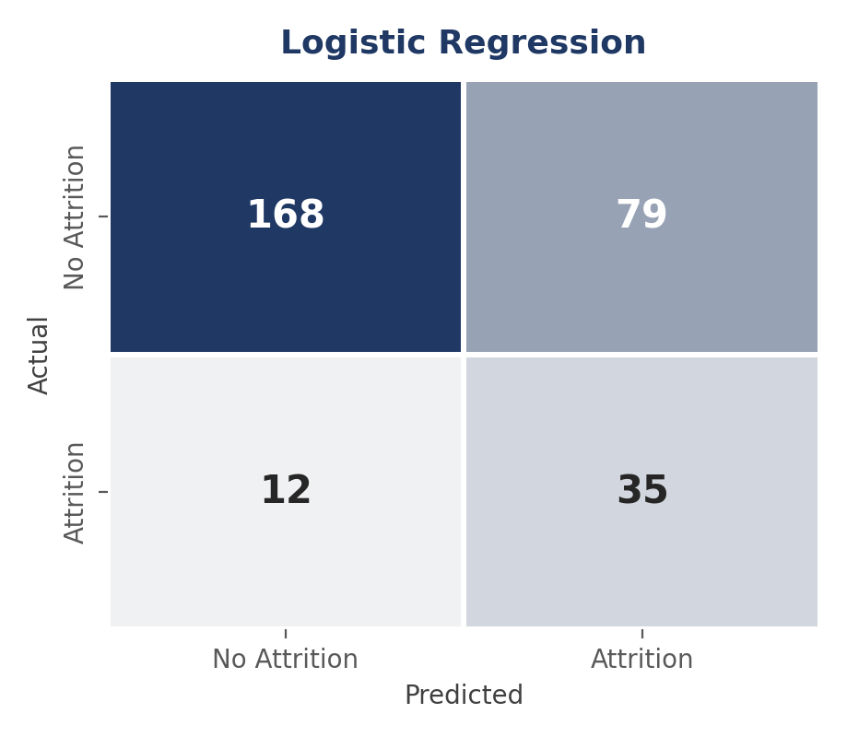
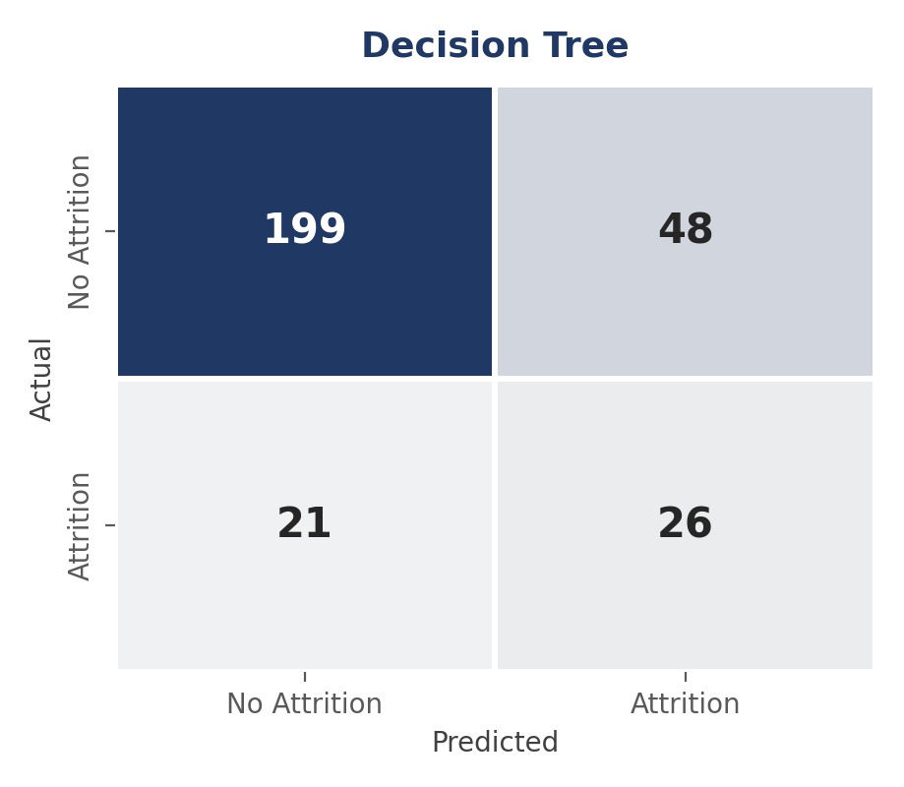
Confusion Matrices
Test set: 294 employees (247 stayed, 47 left). Logistic Regression correctly flagged 35 of 47 leavers (missing 12); Decision Tree correctly flagged 26 of 47 (missing 21).
4

Slide 5
Top Drivers of Attrition
Feature importance from the Decision Tree model
5

Slide 6
Attrition Prevention Suggestions
Total Working Years : top driver (0.200)
1
Attrition is concentrated among employees earlier in their overall career. Build a structured 6–18 months onboarding and mentorship track, with regular manager check-ins during this higher-risk window.
Over Time : 2nd driver (0.168)
2
Employees working overtime attrit at roughly twice the rate of those who don't. Audit workload in the highest-attrition roles (Sales Representative, Laboratory Technician) and consider staffing adjustments or overtime caps.
Age : 3rd driver (0.107)
3
Younger employees show higher attrition risk. Pair early-career hires with mentors and set clear 6–12 months growth milestones.
HR Analytics : Employee Attrition Prevention Report
6

Slide 7
Attrition Prevention Suggestions
Stock Option Level — 4th driver (0.102)
4
Employees with low or no stock options leave more often. Consider extending option eligibility to more levels/tenures, or alternative retention bonuses.
Num. Companies Worked — 5th driver (0.093)
5
A history of frequent job changes correlates with higher attrition risk. Flag this at hiring to schedule earlier, proactive retention conversations.
Monthly Income — 6th driver (0.082)
6
Lower relative income correlates with attrition. Run a pay-band equity review, prioritizing roles and departments with above-average attrition.
Additional Observation
Job Satisfaction level 1 (lowest) employees account for a disproportionate share of attrition relative to their group size. Consider a lightweight quarterly satisfaction pulse survey with an automatic manager-follow-up trigger for low scores.
7

