Slide 1

OCRUG Hackathon 2019
May 18 — 19, 2019 Paul Merage Business School • University of California, Irvine

Slide 2
Goals of the Hackathon
The focus is on education & teamwork
Competition is used to frame the event, give a concrete goal to work toward
Please freely share your experience and expertise, help others when you can
What might success look like?
You’ve tackled a real world data set, and done something interesting with it
You’ve learned something new about R and data analysis
You’ve connected with others and grown from the experience

Slide 3
Rules
All participants must abide by our code of conduct
All work presented by the teams must be based upon work performed at the hackathon
Feel free to help others, even across teams
You’re free to come and go as you like, but suggest working together with your team as much as possible
Please be courteous of the facilities, handle your trash, etc.
https://github.com/ocrug/hackathon-2019/blob/master/code-of-conduct.md

Slide 4
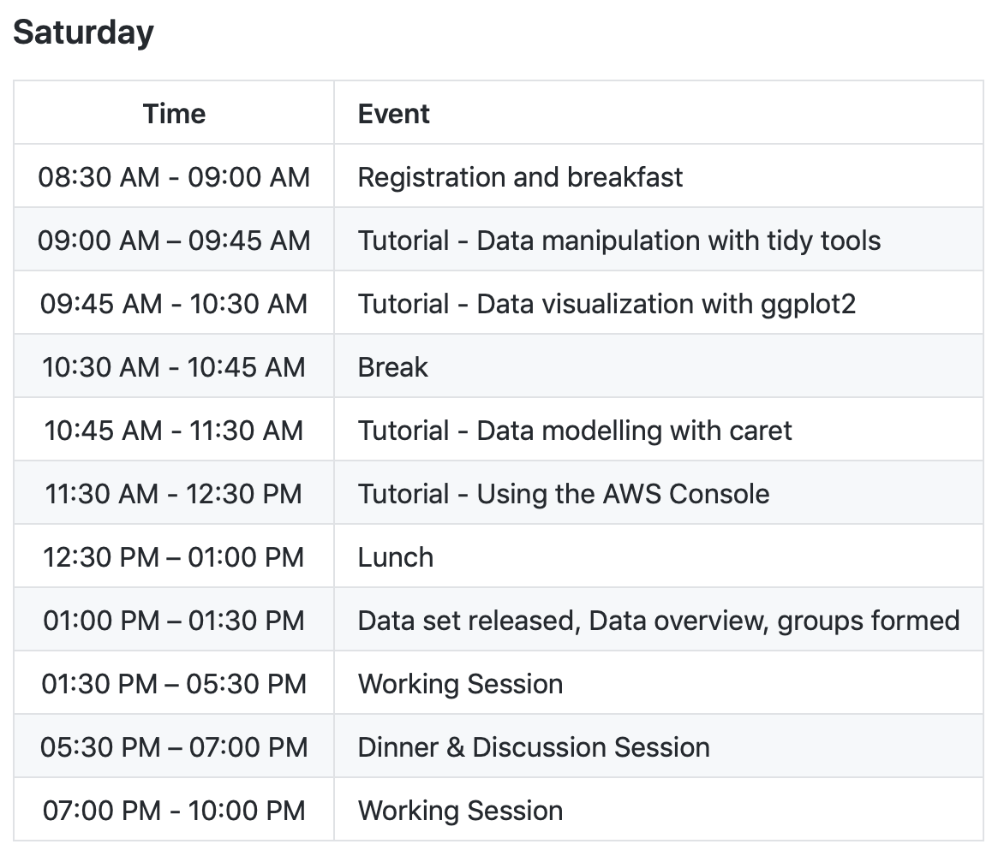
Schedule

Slide 5
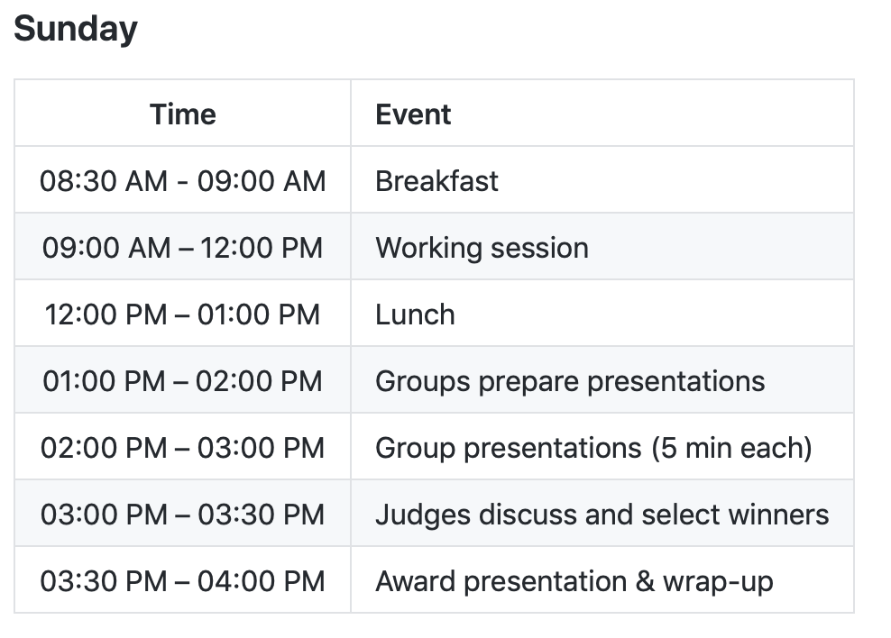
Schedule

Slide 6
Awards Categories
Best Insight
Best Visualization
Best Model
Most Helpful Person
More info on the judging guidelines:
https://github.com/ocrug/hackathon-2019/blob/master/admin/judging_guidelines.md

Slide 7
Presentations
All teams will submit a short 2 - 3 page PDF summary of their findings
Teams will have 5 minutes to present their work
The panel of judges will review the work and decide on the awards
Try to have a good idea about what you’ll be presenting by Saturday night!

Slide 8
Logistics
Feel free to come and go as you like
We have several breakout rooms if you’d like a quieter environment, the patio if you’d like some air
Please be mindful of others in the building
Let us know if you see anything that might need our attention
We’ll be using the OCRUG Slack group for general questions — #hackathon-2019

Slide 9




Thanks to our Sponsors!
Data Science Go

Slide 10
Questions?

