Slide 1
Secure data hiding in image using steganography
CAPSTONE PROJECT
Presented By:
Aaftab Ahmad
University of Lucknow
Faculty Of Engineering And Technology

Slide 2
OUTLINE
Problem Statement
Technology used
Wow factor
End users
Result
Conclusion
Git-hub Link
Future scope

Slide 3
Problem Statement
In the current era of digital communication, safeguarding the confidentiality and integrity of sensitive information has become a critical challenge.
Traditional encryption methods alone are sometimes insufficient to prevent unauthorized access, especially in environments where the mere presence of encrypted data can attract unwanted attention.
Steganography, the practice of concealing information within other non-suspicious data, offers an additional layer of security by hiding the existence of the encrypted message itself.
The objective of this project is to develop a robust and efficient system for the encryption, embedding, extraction, and decryption of sensitive information using steganographic techniques.

Slide 4
Technology used
Operating System: Windows 11
Programming Language: Python
IDE: IDLE
Libraries: CV2, pillow, os,tkinter
Device: Laptop

Slide 5
Wow factors
Encryption
Cover image
Decryption
Steganography
Hashing Technique
Graphical User Interface

Slide 6
End users
Students(Use only for education purpose)
Industry officials (To enhance their knowledge)

Slide 7
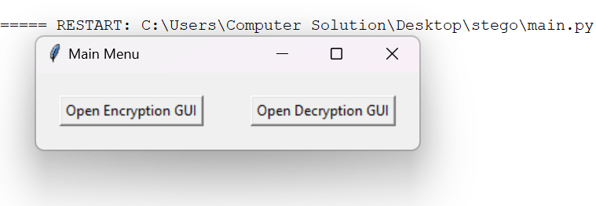
Results

Slide 8
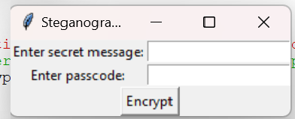

Slide 9

Cover(encrypted) Image

Slide 10
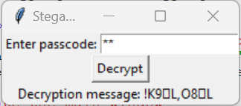

Slide 11
Conclusion
The development of a GUI-based steganography tool for the encryption and decryption of messages in images has proven to be an invaluable endeavor.
By merging the principles of cryptography and steganography, this project underscores the potential for creating secure, user-friendly applications that safeguard sensitive information.
The graphical user interface simplifies the process, making it accessible to users with varying levels of technical expertise.

Slide 12
GitHub Link
Make sure that there should be readme file

Slide 13
THANK YOU

