Slide 1

Machine Learning Internship Project
“Employee Burnout Risk Prediction System”
Submitted By
Mr. Aaftab
Submitted To
LEARNDEPTH ACADEMY LLP

Slide 2
CONTENTS
Introduction
Problem Statement
Data description
Exploratory Data Analysis
Data Visualization
Data Preprocessing & Model
Model Evaluation
Key Insights & Scenario Analysis
Conclusion & Recommendation
Slide No : 01

Slide 3
Introduction
Employee burnout affects productivity and well-being.
High stress and workload increase burnout risk.
Machine Learning can help identify employees at risk
Early prediction enables preventive action
Slide No : 02

Slide 4
Problem Statement
Objective:
Develop a Machine Learning model to predict to employee burnout risk based on workplace and lifestyle factors.
Benefits:
reduce employee turnover
Improve productivity
Support employee wellness initiatives
Slide No : 03

Slide 5
Data Description
Dataset Information:
Total Records: 1000
Feature: 13
Target Variable: burnout_risk_score
Important Features:
Age
Weekly work hours
Stress Level
Sleep Hours
Exercise Hours
Productivity Score
Slide No : 04

Slide 6
Exploratory Data Analysis
Exploratory Data Analysis(EDA):
missing value analysis
Statistical summary
Correlation analysis
Distributed analysis
Slide No : 05

Slide 7
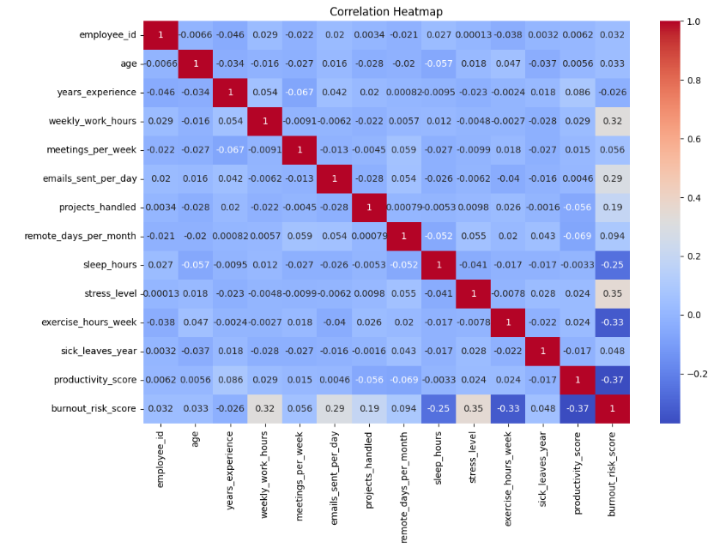
Heatmap
Slide No : 06

Slide 8
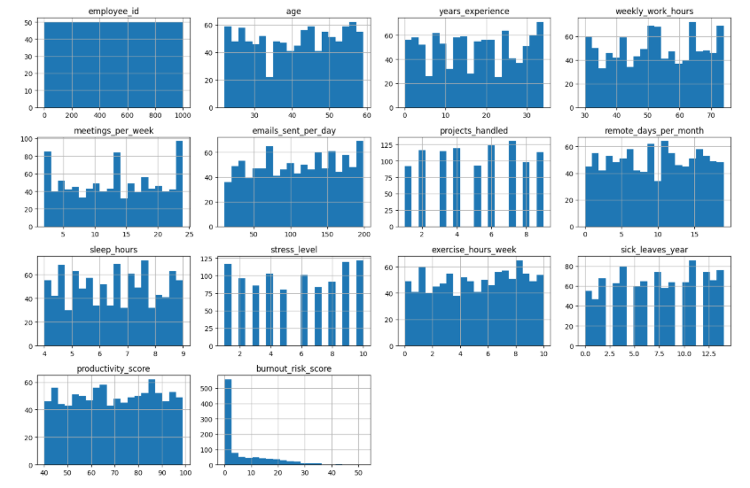
Data Visualization
Histogram
Slide No : 07

Slide 9
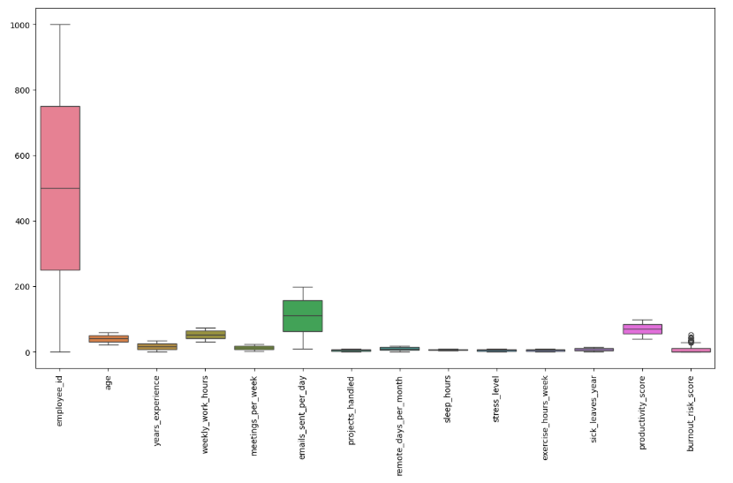
Box Plot
Slide No : 08

Slide 10
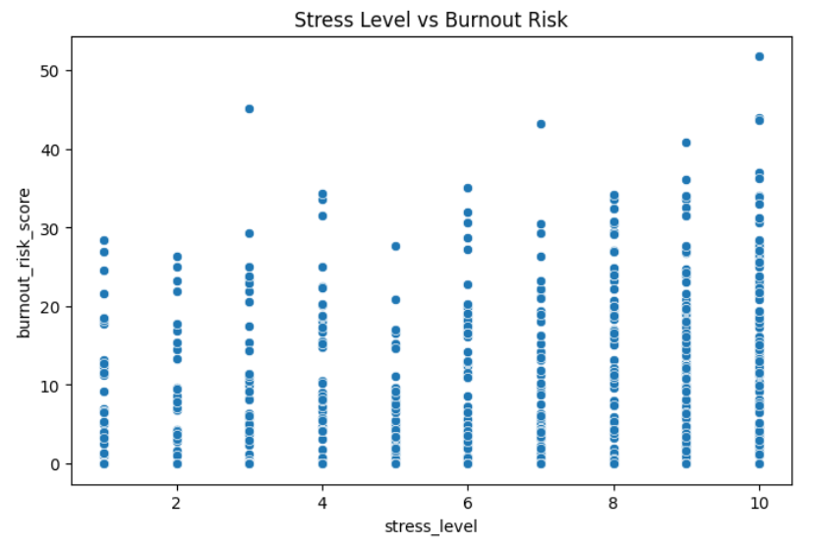
Scatter Plot
Observation:
Higher stress levels are associated with higher burnout risk.
Slide No : 09

Slide 11
Data Preprocessing & Model
Data preprocessing:
Removed employee_id
Feature selection
Train_Test_split(80:20)
Model used:
Linear Regression
Reasons:
target variable is continuous.
simple and effective regression algorithm.
Slide No : 10

Slide 12
Model Evaluation
Metric | Value
MAE | 4.65
MSE | 34.02
RMSE | 5.83
R² Score | 0.6147
Interpretation:
The model explains 61.47% of the variation in burnout risk.
Slide No : 11

Slide 13
Key Insights & Scenario Analysis
Key insights:
High stress increase burnout.
More work hours increase burnout.
Sleep and exercise reduce burnout.
Scenario Analysis:
Reduce work hours by 10%
Increase sleep by 1 hour/day
Increase exercise by 3 hour/week
Result:
Excise showed the highest reduction in burnout risk.
Slide No : 12

Slide 14
Conclusion & Recommendation
Conclusion:
Successfully developed a burnout prediction model.
Achieved R² score of 0.6147.
Identified major burnout factors.
Recommendations:
Reduce excessive workload.
Encourage healthy sleep habits.
Promote fitness and wellness programs.
Monitors employee strees levels regularly.
Slide No : 13

