Slide 1
Topic:Forensic Recovery of SQL Server Database: Practical Approach
- HOYONG CHOI , SANGJIN LEE , AND DOOWON JEONG
Group → Roll No:1911066
Name :Aagman Suri

Slide 2
Database forensics is becoming more important for investigators with the increased use of the information system. Although various database forensic methods such as log analysis and investigation model development have been studied, among the database forensic methods, recovering deleted data is a key technique in database investigation for DB tampering and anti-forensics.

Slide 3
Why is there a need of new method?
Previous studies mainly focused on transaction or journal log to recover deleted data, but if logs are set to be deleted periodically or logs containing critical evidence are overwritten by new logs, the log-based recovery method can not be used practically

Slide 4
For this reason, an engine-based recovery method that analyzes data file at a raw level has been also introduced. There is research to recover small-sized databases such as SQLite, but there is no prior work describing the structure of data file and technology to recover deleted data of large databases used by enterprises or large organizations. In this context, theye investigated Microsoft SQL Server (MSSQL), which is one of the most used large databases. Their method focuses on a storage engine of MSSQL. Through analyzing the storage engine, theye identify the internal structure of MSSQL data files and the storage mechanism. Based on these findings, a method to recover tables and records is presented by empirical examination.

Slide 5
Database forensics is a branch of digital forensics that analyzes the structure of database and examines contents
It has motivated forensic researchers since database manages important data of personal or enterprise. With the increased use of Internet of Things (IoT) devices, database allows countless users to access a variety of applications and stores the users’ data and log. database forensics is becoming more important for a forensic investigator

Slide 6
Among the database forensic methods, recovering deleted records plays an important role in finding the evidence, because it can recover data that existed in the past or that was intentionally deleted for anti-forensics
Especially, attackers try to the database tampering to take away sensitive information or try to delete the information

Slide 7
The techniques to recover deleted records are divided into two main categories:
the log-based method and
engine-based method

Slide 8
Many researchers proposed the log-based methods that analyze the transaction log or journal log. The approach showed a notable achievement, but there is a limit that logs containing critical evidence may not exist on the database
The logs are recorded by the administrator’s security settings, so if the logs are set to be deleted periodically or to be small fixed-size, it is impossible to recover deleted data by analyzing the logs. For this reason, engine-based methods that analyze the structure of the data file and then recover deleted data were also studied

Slide 9
On the other hand, there is no research describing an engine-based recovery method for large databases, mainly used in enterprises or large organizations, such as MSSQL
This is because the Database Management Systems (DBMS) structure of the large databases is complex and the source code of the DBMS is not open to the public, making it difficult to identify the structure of data file and storage mechanism

Slide 10
INTERNAL STRUCTURE OF THE MSSQL STORAGE

Slide 11
The MSSQL consists of two kinds of files.
One is a data file (.mdf,.ndf) that stores actual data,
and the other is a transaction log file (.ldf) that stores log data
The transaction log may not be acquired during data collection and it may be modified or deleted by the attacker In addition, it may not be possible to obtain enough data to investigate incidents due to a policy for log size limitation Given the situation, they focus on the data file where the raw data is stored.
When the table or record is stored in the data file, MSSQL uses a storage engine that has not been changed even if the MSSQL version was updated. To analyze the storage engine, they reverse-engineered MSSQL.

Slide 12
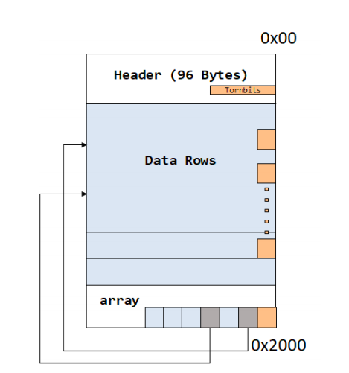
Page structure

Slide 13
A. PAGE:
The page is the smallest unit of MSSQL data file and its default size is 8,192 (0×2000) bytes. Above Fig shows the overall structure of the page. It consists of the page header, data row, and the row offset array.

Slide 14
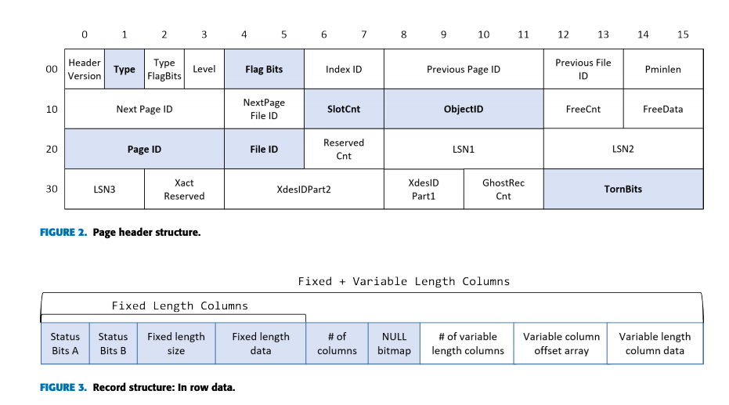
The page header is 96 bytes in size. The first 64 bytes, described in Fig. 2, contain the page metadata and the remaining 32 bytes are filled with 0 × 00. Among the fields of the page header, 7 fields are used to recover records: Type, Flag Bits, SlotCnt, Page Object ID, Page ID, File ID, and Checksum

Slide 15
1) The Type field indicates the type of the page. It is known that there are 14 types of the page this paper focuses on data page (Type 1), text mixed page (Type 3), and text page (Type 4). The Type 1 page stores data records. The data value can be classified into normal value and large object value the Type 1 page can store the normal value. The Type 3 and 4 pages are used to manage the LOB data
Large Objects (LOBs) are a set of datatypes that are designed to hold large amounts of data

Slide 16
The Flag Bits field indicates how the Checksum field is used. If the Flag Bits value is 0 × 200, the Checksum field is used for validating the page. However, if the value is 0×100, the Tornbit is stored in the Checksum field
The SlotCnt field represents the number of normal records on the page.
The Page Object ID field is used to store an identifier of the object such as a table, index, and so on. Therefore, by analyzing the Page Object ID, it is determined to which page the data of the table is allocated

Slide 17
The Page ID indicates the page number. By calculating the ‘Page ID’×‘size of page (0 × 2000)’, the page’s location is identified
The File ID represents the file identification number
The row offset array indicates the location where records are stored on the page.

Slide 18
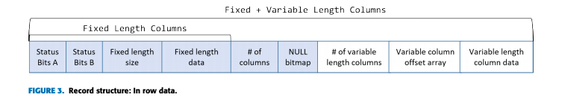
B. RECORD
In MSSQL, a record of the table is stored in a data row of the Type 1 page
The way to store the record is determined by the size of the record. If the size of the record is less than 8,060 bytes, the record is stored with In Row Data method.
Fig. 3 shows the structure of record stored with the In Row Data.
As seen in the figure, at the front of the record, fixed-length columns such as int, float, and date are stored. And then, the variable-length columns such as varchar

Slide 19
The first 2 bytes of the row, called Status Bits A and Status Bits B, are the bitmaps containing the information about the row.
The bitmaps indicate row type , MSSQL version, and the presence of variable-length columns. The next two bytes indicate the size of the fixed-length data. After the fixed-length data portion, the number of columns and the NULL bitmap is stored.

Slide 20
LARGE DATA
When the size of the record exceeds 8,060 bytes, MSSQL stores the record on multiple pages. In this case, the value of the record in the Type 1 page indicates the location of another page where the large data is stored. The page that stores the large data is Type 3 and Type 4 pages.
There are three different ways to store large data, depending on the data type and length: Row-overflow Data, LOB Data, and MAX-length Data.

Slide 21
Row-overflow Data called restricted-length Large object data is used when the data type is varchar(n), varbinary(n), or nvarchar(n). Row-overflow data refers to the large data whose record size exceeds 8,060 bytes, but the size of each column data is less than 8,060 Bytes
For example, if the schema of a table consists of varchar(8000) and nvarchar(4000), the size of each column data is less than 8,060 bytes but the total record size is 16,000 bytes. Therefore, MSSQL stores the record in Row-overflow Data form. However, the record can be stored as In Row Data when the size of the actual record data does not exceed 8,060 bytes even if the predefined size is more than 8,060 bytes

Slide 22
LOB Data called unrestricted-length large object data is used when the type is text, ntext, image, varchar, nvarchar, or varbinary.
MAX-length Data is also unrestricted-length large object data like LOB Data. When MAX specifier is used as a parameter of the data type varchar, varbinary, or nvarchar, the record is stored as MAX-length Data. It means that the size of the record can exceed 8,060 bytes like LOB Data, but there is a difference from LOB Data. When data of 8,060 bytes or less is stored in a record defined as a data type using MAX specifier, it is stored in the same manner as In Row Data. When more than 8,060 bytes of data are stored, the data is stored as MAX-length Data.

Slide 23
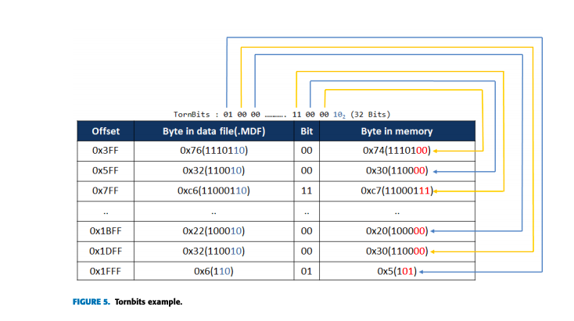
TORNBITS There are two ways to verify the page’s integrity in MSSQL; One is Checksum and the other is TornPageDetection. When creating a database, the user can choose three options: Checksum, TornPageDetection, and None. In particular, the TornPageDetection uses the byte substitution. It is applied to the pages of data files such as.mdf and.ndf, so interpreting the Tornbits is important when parsing records. When the Tornbits option is applied, the last two bits of particular bytes are replaced by the last two bits of the Tornbits.
the last two bits of bytes from 0 × 3FF to 0 × 1FFF at 0 × 200 interval are replaced 102, the last two bits of the Tornbits. And then the original binary data of the bytes are recorded in the TornBits. When the page is loaded into memory, the original data stored in the TornBits are also loaded; in this way, MSSQL verifies the integrity of the page.

Slide 24
MSSQL SYSTEM TABLES

Slide 25
This section describes the system tables that are required to recover the deleted records. Among many system tables, five system tables are used for recovery in this paper: syscolpars, sysschobjs, sysiscols, sysrowsets, sysallocunits
They have analyzed the schema structure of system tables based on MSSQL 2017. Some versions have different schema structures of system tables, but the columns required for record recovery remain unchanged regardless of the MSSQL version. So, the recovery method proposed is independent of versions

Slide 26
SYSCOLPARS In the syscolpars, column information of all tables of the database, including system tables and user tables, is stored. By analyzing the syscolpars, column’s name, the order in which columns are stored, size, and type are identified
SYSSCHOBJS The sysschobjs stores all table information used in the database. It contains the table name, the number of columns, the table type (system table or user table), and the Table Object ID.
SYSISCOLS The sysiscols stores the index column information of the table. Generally, the column data of a record is stored in the data file in the order specified by the user, which is identified in the syscolpars. However, when an index is created on the table (e.g. designating a primary key), column data of records are stored in a different order . This characteristic is an important issue when recovering deleted records
SYSROWSETS The sysrowsets stores Partition ID for each table. Partition ID is used to obtain the Allocation Unit ID from the sysallocunits. Among the columns of sysrowsets, the idmajor column represents the Table Object ID and the rowsetid column represents the Partition ID. The Partition ID of the table to be analyzed can be obtained by comparing the Table Object ID obtained from the sysrowsets with the Table Object ID obtained from the sysschobjs.
SYSALLOCUNITS The sysallocunits manages Allocation Unit IDs. The Allocation Unit ID of the table can be obtained via the Partition ID obtained from the sysrowsets. The Allocation Unit ID is used to acquire the Page Object ID of the table. Among the columns of sysallocunits, the ownerid column represents the Partition ID and the auid column represents the Allocation Unit ID

Slide 27
RECOVERY METHOD

Slide 28
This section introduces a method to recover deleted records by analyzing the internal structure of the data file and system tables as described earlier. The proposed method is version-independent because it is based on the storage mechanism that is constant even if the version of MSSQL is updated. There are four phases in the method: scanning pages, collecting system table information, collecting user table information, and recovering deleted records. We implement the proposed method in this paper as open-source tool

Slide 29
SCANNING PAGES In this phase, all pages of the data files are scanned in page units. By scanning the files, all Page IDs and Page Object IDs are identified.
COLLECTING SYSTEM TABLE INFORMATION This phase aims to collect the column information of the system tables such as sysschobjs, sysiscols, sysrowsets, and sysallocunits by parsing syscolpars. Although the schema of the system tables varies by MSSQL version, the column names that are needed to recover deleted records are constant. Therefore, by identifying the column names stored in syscolpars, columns required for recovery are acquired regardless of the MSSQL version.

Slide 30
COLLECTING USER TABLE INFORMATION In this phase, the information of the user table to be recovered is obtained by parsing the system table analyzed. This phase is further divided into four phases.
1) TABLE INFORMATION IN SYSSCHOBJS By using the columns information identified in the previous phase, sysschobjs can be parsed and analyzed. In this phase, the user table’s information such as table name, Table Object ID, and the number of columns is identified.
2) COLUMN INFORMATION I N SYSCOLPARS Through matching syscolpars with sysschobjs, the column information of the user table is identified. The data type, length, name, the order in which columns data are stored, parameters of specific data types (time, numeric, and datetime) are obtained in this phase. Based on the information, a temporary table is created to store the recovered records, by using CREATE TABLE query.

Slide 31
3) CLUSTERED INDEX COLUMN INFORMATION IN SYSISCOLS After obtaining the column information, the index column information is collected from the syscolpars and sysiscols. In this phase, the order in which the column data are stored is identified. Particularly, in the sysiscols, the clustered index information should be checked.
4) LOCATION INFORMATION IN SYSROWSETS AND SYSALLOCUNITS To identify Allocation Unit ID, sysrowsets and sysallocunits tables are parsed.
The Page Object ID is calculated.
indexid = allocUnitld > >48
pageObjectld = (allocUnitld − (indexid << 48)) >>16 --- (1)
To obtain the Page ID to which user table is allocated, the Page Object ID of each page obtained while scanning pages is compared with the Page Object ID obtained in Equation 1. Finally, the start offset of the page is calculated by a formula,
Page ID×page unit size(0 × 2000).

Slide 32
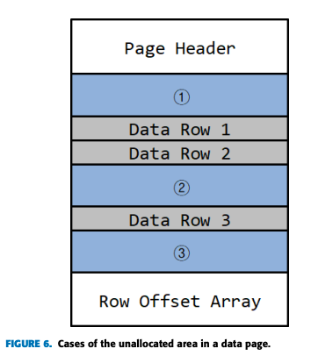
RECOVERING DELETED RECORDS
In this phase, records of the user table are recovered. It is further divided into three phases.
1) ACCESSING DATA PAGE The page (Type 1) to which the data is allocated is identified through the location information of the user table acquired in LOCATION INFORMATION IN SYSROWSETS AND SYSALLOCUNITS
2) IDENTIFYING UNALLOCATED AREA Fig. 6 shows three cases where the unallocated area can exist in a data page. In the first case, the unallocated area exists when more than one record below the page header was deleted. The second is that the unallocated area exists between the records. The third is that the unallocated area exists between the last record and the row offset array. The following is a procedure for determining the unallocated area according to these cases.

Slide 33
1) After storing the row offset array values in array (Slot) and arranging it in ascending order, the record length is calculated using column information from Section COLUMN INFORMATION IN SYSCOLPARS
2) If the value of the (Slot[i] + record length + 1) is equal to the value of Slot[i + 1], it is judged that there is no unallocated area between the records
3) If the value of Slot[i + 1] is larger than (Slot[i] + record length + 1), it is determined that there is the unallocated area between the i-th record and the (i + 1)-th record

Slide 34
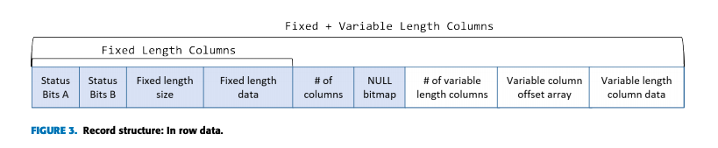
RECONSTRUCTING DELETED RECORDS
Based on the record structure shown in Fig. 3, the data is analyzed by separating the fixed-length column and the variable-length column, and then an INSERT query is generated.
The algorithm to reconstruct deleted records is shown in Algorithm 1.
First, it calculates the size of the unallocated data area (LUnalloc). Next, the length of the record to be recovered in the unallocated area (LRecord ) is calculated.
Then, to get the data of each column, the starting position of the divided fixed-length (OStstic) and variable-length column (OVariable) data area is calculated with reference to the Fig. 3.
When accessing column data, data is acquired according to the column order and data size of each column through schema information (SSchema) obtained from Section COLUMN INFORMATION IN SYSCOLPARS and CLUSTERED INDEX COLUMN INFORMATION IN SYSISCOLS. Finally, the acquired data (D) is decoded according to the data type and used to make an INSERT query (q).
Since there may be more than one record in the unallocated area, the length of the recovered record (LRecord ) is stored in LTotal and compared to the size of the unallocated area (LUnalloc). If the value LTotal is greater than or equal to the value LUnalloc, recovery of the record in the input unallocated area is finished.

Slide 35
EXPERIMENT
While there is no article introducing the internal structure of the MSSQL storage, we assess the performance of the proposed method through comparative analysis with commercial tools, used in the practical forensic field, such as ApexSQL Recover ,Stellar Repair for MSSQL ,and SysTools SQL Recovery
To identify the algorithms used in these commercial tools, reverse engineering of software protection should be conducted. it does not comply with the ethical research standards. They created data sets with various data types, security settings, and scenarios and then indirectly verify the tools whether they can deal with each element. As there is no sample data set for evaluating the algorithm for MSSQL recovery, we created four data sets based on SQL Server 2017 that is the most widely used version.
The data set A and A0 , which consist of only In Row Data records, and the data set B and B0 , which consist of both In Row Data and the large data records. As mentioned in TORNBITS, there are two ways to verify the page’s integrity in MSSQL
the data set A and B use the Checksum and the data set A0 and B0 use the TornPageDetection.

Slide 36
Based on the data sets, we evaluate recovery rates according to the following six cases.
Case 1: Delete 1,000 records.
Case 2: Delete 3,000 records.
Case 3: Delete 5,000 records.
Case 4: Insert 1,000 records after deleting 5,000 records.
Case 5: Insert 3,000 records after deleting 5,000 records.
Case 6: Insert 5,000 records after deleting 5,000 records.
In case 1∼3 records were randomly deleted, and these cases are designed to check the difference in recovery rate as the number of deleted records increases.
In case 4∼6, 1,000, 3,000, and 5,000 records were inserted into the data set created in case 3, and these cases were designed to check the difference in recovery rate according to the number of records inserted after deletion.
In case 4∼6, we verify how well the tools handle issues related to the large data.
Therefore, by measuring the recovery rates in case 4∼6, we verify how well the tools handle issues related to the large data

Slide 37
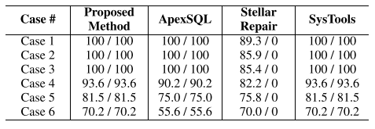
in case 1∼3 which are no insert operation after deletion, the recovery rate is 100% except for Stellar Repair for MSSQL
In case 4∼6, deleted records are recovered partially. It shows that the recovery rate decreases as the number of records inserted after deletion increases
This tendency is natural because it is more likely that the deleted data is overwritten as new data is inserted

Slide 38
Conclusion:
In this paper, they have researched MSSQL, which is the most used DBMS globally.
They have described the internal structure of MSSQL including large data, tornbits.
To recover deleted records regardless of the MSSQL version, several system tables have been analyzed.
They have proposed a method to recover deleted records.
Finally, the performance of our method has been verified by comparing the commercial recovery tools.

Slide 39
REFERENCES
[1] M. S. Olivier, ‘‘On metadata context in database forensics,’’ Digit. Invest., vol. 5, nos. 3–4, pp. 115–123, Mar. 2009. [2] M. Díaz, C. Martín, and B. Rubio, ‘‘State-of-the-art, challenges, and open issues in the integration of Internet of Things and cloud computing,’’ J. Netw. Comput. Appl., vol. 67, pp. 99–117, May 2016. [3] D. Litchfield, ‘‘Oracle forensics part 1: Dissecting the redo logs,’’ NGSSoftware Insight Secur. Res. (NISR), Next Gener. Secur. Softw. Ltd., Sutton, U.K., Tech. Rep., 2007. [4] S. Tripathi and B. B. Meshram, ‘‘Digital evidence for database tamper detection,’’ J. Inf. Secur., vol. 3, no. 2, pp. 113–121, 2012. [5] P. Frühwirt, P. Kieseberg, S. Schrittwieser, M. Huber, and E. Weippl, ‘‘InnoDB database forensics: Enhanced reconstruction of data manipulation queries from redo logs,’’ Inf. Secur. Tech. Rep., vol. 17, no. 4, pp. 227–238, May 2013. [6] J. Sablatura and B. Zhou, ‘‘Forensic database reconstruction,’’ in Proc. IEEE Int. Conf. Big Data (Big Data), Dec. 2017, pp. 3700–3704. [7] A. Al-Dhaqm, S. A. Razak, S. H. Othman, A. Nagdi, and A. Ali, ‘‘A generic database forensic investigation process model,’’ Jurnal Teknologi, vol. 78, nos. 6–11, pp. 45–57, Jun. 2016. [8] M. H. Bhagwani, R. V. Dharaskar, and V. Thakare, ‘‘Comparative analysis of database forensic algorithms,’’ in Proc. IJCA Nat. Conf. Knowl., Innov. Technol. Eng. (NCKITE), Jul. 2015, vol. NCKITE 2015, no. 3, pp. 33–36. [9] A. Al-Dhaqm, S. Abd Razak, D. A. Dampier, K.-K. R. Choo, K. Siddique, R. A. Ikuesan, A. Alqarni, and V. R. Kebande, ‘‘Categorization and organization of database forensic investigation processes,’’ IEEE Access, vol. 8, pp. 112846–112858, 2020. [10] J. Yoon and S. Lee, ‘‘A method and tool to recover data deleted from a MongoDB,’’ Digit. Invest., vol. 24, pp. 106–120, Mar. 2018. [11] A. Golhar, S. Janvir, R. Chopade, and V. Pachghare, ‘‘Tamper detection in Cassandra and Redis database—A comparative study,’’ in Proc. Int. Conf. Comput. Sci. Appl. Singapore: Springer, 2020, pp. 99–107. [12] J. Wagner, A. Rasin, K. Heart, T. Malik, J. Furst, and J. Grier, ‘‘Detecting database file tampering through page carving,’’ in Proc. 21st Int. Conf. Extending Database Technol., 2018, pp. 1–12. [13] R. Chopade and V. K. Pachghare, ‘‘Ten years of critical review on database forensics research,’’ Digit. Invest., vol. 29, pp. 180–197, Jun. 2019. [14] S. K. Jung, J. W. Jang, D. W. Jeong, and S. J. Lee, ‘‘A study on the improvement method of deleted record recovery in MySQL InnoDB,’’ KIPS Trans. Comput. Commun. Syst., vol. 6, no. 12, pp. 487–496, 2017. [15] S. Nemetz, S. Schmitt, and F. Freiling, ‘‘A standardized corpus for SQLite database forensics,’’ Digit. Invest., vol. 24, pp. S121–S130, Mar. 2018. [16] C. Meng and H. Baier, ‘‘Bring2Lite: A structural concept and tool for forensic data analysis and recovery of deleted SQLite records,’’ Digit. Invest., vol. 29, pp. S31–S41, Jul. 2019. [17] L. Zhang, S. Hao, and Q. Zhang, ‘‘Recovering SQLite data from fragmented flash pages,’’ Ann. Telecommun., vol. 74, nos. 7–8, pp. 451–460, Aug. 2019. [18] J. Kim, A. Park, and S. Lee, ‘‘Recovery method of deleted records and tables from ESE database,’’ Digit. Invest., vol. 18, pp. S118–S124, Aug. 2016. [19] R. Bria, A. Retnowardhani, and D. N. Utama, ‘‘Five stages of database forensic analysis: A systematic literature review,’’ in Proc. Int. Conf. Inf. Manage. Technol. (ICIMTech), Sep. 2018, pp. 246–250. [20] DB-Engines Ranking—Popularity Ranking of Database Management Systems. Accessed: Dec. 24, 2020. [Online]. Available: https://db-engines. com/en/ranking [21] H. K. Khanuja and D. Adane, ‘‘A framework for database forensic analysis,’’ Comput. Sci. Eng., Int. J., vol. 2, no. 3, pp. 27–41, 2012. [23] D. A. Flores and A. Jhumka, ‘‘Implementing chain of custody requirements in database audit records for forensic purposes,’’ in Proc. IEEE Trustcom/BigDataSE/ICESS, Aug. 2017, pp. 675–682. [24] A. Al-Dhaqm, S. Razak, S. H. Othman, K.-K. R. Choo, W. B. Glisson, A. Ali, and M. Abrar, ‘‘CDBFIP: Common database forensic investigation processes for Internet of Things,’’ IEEE Access, vol. 5, pp. 24401–24416, 2017. [25] J. Wagner, A. Rasin, B. Glavic, K. Heart, J. Furst, L. Bressan, and J. Grier, ‘‘Carving database storage to detect and trace security breaches,’’ Digit. Invest., vol. 22, pp. S127–S136, Aug. 2017. [26] J. Wagner, A. Rasin, T. Malik, K. Heart, H. Jehle, and J. Grier, ‘‘Database forensic analysis with DBCarver,’’ in Proc. 8th Biennial Conf. Innov. Data Syst. Res., 2017, pp. 1–10. [27] J. Wagner, A. Rasin, and J. Grier, ‘‘Database image content explorer: Carving data that does not officially exist,’’ Digit. Invest., vol. 18, pp. S97–S107, Aug. 2016. [28] K. Fowler, SQL Server Forenisc Analysis. London, U.K.: Pearson, 2008. [29] H. K. Khanuja and D. D. S. Adane, ‘‘Forensic analysis of databases by combining multiple evidences,’’ Int. J. Comput. Technol., vol. 7, no. 3, pp. 654–663, Jun. 2013. [30] E. Toombs, ‘‘Microsoft SQL server forensic analysis,’’ Ph.D. dissertation, Utica College, Utica, NY, USA, 2015. [31] D. Litchfield, ‘‘Oracle forensics part 2: Locating dropped objects,’’ NGSSoftware Insight Secur. Res. (NISR), Next Gener. Secur. Softw. Ltd., Sutton, U.K., Tech. Rep., 2007. [32] D. Litchfield, ‘‘Oracle forensics part 3: Isolating evidence of attacks against the authentication mechanism,’’ NGSSoftware Insight Secur. Res. (NISR), Next Gener. Secur. Softw. Ltd., Sutton, U.K., Tech. Rep., 2007. [33] D. Litchfield, ‘‘Oracle forensics part 4: Live response,’’ NGSSoftware Insight Secur. Res. (NISR), Next Gener. Secur. Softw. Ltd., Sutton, U.K., Tech. Rep., 2007. [34] D. Litchfield, ‘‘Oracle forensics part 5: Finding evidence of data theft in the absence of auditing,’’ NGSSoftware Insight Secur. Res. (NISR), Next Gener. Secur. Softw. Ltd, Sutton, U.K., Tech. Rep., 2007. [35] D. Litchfield, ‘‘Oracle forensics part 6: Examining undo segments, flashback and the oracle recycle bin,’’ NGSSoftware Insight Secur. Res. (NISR), Next Gener. Secur. Softw. Ltd, Sutton, U.K., Tech. Rep., 2007. [36] D. Litchfield, ‘‘Oracle forensics part 7: Using the oracle system change number in forensic investigations,’’ NGSSoftware Insight Secur. Res. (NISR), Next Gener. Secur. Softw. Ltd, Sutton, U.K., Tech. Rep., 2008. [37] P. Finnigan, P. Finnigan, and Gennick, Oracle Incident Response and Forensics. New York, NY, USA: Apress, 2018. [38] P. Frühwirt, M. Huber, M. Mulazzani, and E. R. Weippl, ‘‘InnoDB database forensics,’’ in Proc. 24th IEEE Int. Conf. Adv. Inf. Netw. Appl., Apr. 2010, pp. 1028–1036. [39] W.-S. Noh, S.-M. Jang, C.-H. Kang, K.-M. Lee, and S.-J. Lee, ‘‘The method of deleted record recovery for MySQL MyISAM database,’’ J. Korea Inst. Inf. Secur. Cryptol., vol. 26, no. 1, pp. 125–134, Feb. 2016. [40] S. Jeon, J. Bang, K. Byun, and S. Lee, ‘‘A recovery method of deleted record for SQLite database,’’ Pers. Ubiquitous Comput., vol. 16, no. 6, pp. 707–715, Aug. 2012. [41] Q. Li, X. Hu, and H. Wu, ‘‘Database management strategy and recovery methods of android,’’ in Proc. IEEE 5th Int. Conf. Softw. Eng. Service Sci., Jun. 2014, pp. 727–730. [42] J. Yoon, D. Jeong, C.-H. Kang, and S. Lee, ‘‘Forensic investigation framework for the document store NoSQL DBMS: MongoDB as a case study,’’ Digit. Invest., vol. 17, pp. 53–65, Jun. 2016. [43] M. Xu, X. Xu, J. Xu, Y. Ren, H. Zhang, and N. Zheng, ‘‘A forensic analysis method for Redis database based on RDB and AOF file,’’ J. Comput., vol. 9, no. 11, pp. 2538–2544, Nov. 2014. [44] R. Kumbhare, S. Nimbalkar, R. Chopade, and V. Pachghare, ‘‘Tamper detection in MongoDB and CouchDB database,’’ in Proc. Int. Conf. Comput. Sci. Appl. Singapore: Springer, 2020, pp. 109–117. [45] Files and Filegroups Architecture. Accessed: Dec. 24, 2020. [Online]. Available: https://technet.microsoft.com/en-us/library/ms179316(v=sql. 105).aspx [46] John Huang’s Blog. Accessed: Dec. 24, 2020. [Online]. Available: http://www.sqlnotes.info/2011/10/31/page-type/ [47] SQL Server Storage Engine: Data Pages and Data Rows. Accessed: Dec. 24, 2020. [Online]. Available: http://aboutsqlserver.com/2013/10/15/ sql-server-storage-engine-data-pages-and-data-rows/ [48] Fixup—Concept—NTFs Documentation. Accessed: Dec. 24, 2020. [Online]. Available: https://flatcap.org/linux-ntfs/ntfs/concepts/fixup.html [49] ApexSQL. SQL Server Recovery Tool. Accessed: Dec. 24, 2020. [Online]. Available: https://www.apexsql.com/sql-tools-recover.aspx [50] Stellar Data Recovery. SQL Recovery Tool. Repair MDF, NDF Database Files. Accessed: Dec. 24, 2020. [Online]. Available: https://www. stellarinfo.com/sql-recovery.php [51] SysTools. SQL Recovery Software to Repair MDF, NDF Database File. Accessed: Dec. 24, 2020. [Online]. Available: https://www. systoolsgroup.com/sql-recovery.html [52] G. Horsman, ‘‘Tool testing and reliability issues in the field of digital forensics,’’ Digit. Invest., vol. 28, pp. 163–175, Mar. 2019.

Slide 40
Strategy to implementation:
I am going to use the code provided by the author and going to try my best to show a demo of this paper

Slide 41
ThankYou

