Slide 1
Operating Systems
Faculty of Computer Science & Engineering
Nguyen Minh Tri
nmtribk@hcmut.edu.vn
302-B9

Slide 2

Lab 3.1 - Process
What we will learn?
System Programming Techniques
Concurrency
Synchronization
Communication
Scheduling
Memory Management
Environment: *nix systems (CentOS, Ubuntu, Mac OS?)
Ho Chi Minh City
University of Technology

Slide 3
Objective
Understand to concept of process
Know how the operating system manages the execution of processes
Understand how Linux create a new process
Ho Chi Minh City
University of Technology

Slide 4
What is a process?
A process is an instance of a computer program that is being executed. It contains the program code and its current activity.
Typically, a process consists of:
Instructions
Memory: text, data, stack, heap
Descriptor or resources (file descriptor in *nix)
Processor state (context): register, physical memory addressing
Process holds the information of its resources in Process Control Blocks (PCB)
Ho Chi Minh City
University of Technology

Slide 5
Isolation
Process is one of the most important concepts in Operating System.
Programs are isolated and protected from each others
Programmers and compilers do not care about the state of the system they are running on, they just have to focus on their job
Ho Chi Minh City
University of Technology

Slide 6
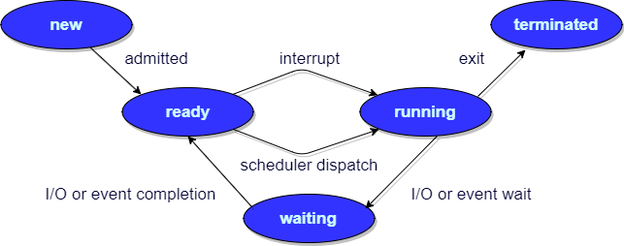
Process State
Exercise: describe the states of the process running hello world program
#include <stdio.h>
int main() {
printf(“Hello, world!”);
return 0;
}
Ho Chi Minh City
University of Technology

Slide 7
Create a new process
Linux allows a process to create a new one by calling fork system call.
When process A invokes fork, if the OS could create a new process then following events have happened:
The operating system created a new process (we call B).
A became B’s parent.
The content of process A was copied to process B. (B is a clone of A).
The fork system call returns two different values to A and B.
A receives a positive value which is the PID of its new child.
B receives a 0.
A and B concurrently continue executing the next instruction after the fork system call.
Ho Chi Minh City
University of Technology

Slide 8
Process in Linux
A process is identified by its unique Process ID (PID).
PIDs are assigned (generally) sequentially to processes, starting from 0.
Special process:
0 -> Scheduler: responsible for paging
1 -> Init startup and shutdown the system
2 -> Support memory management
…
Process’s state could be found in /proc directory.
Ho Chi Minh City
University of Technology

Slide 9
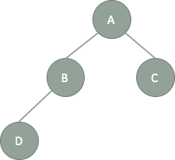
Process in Linux
When a process A creates process B:
A is B’s parent
B is A’s child
A process has only one parent but could have many children
The relationships between processes could be represented by a tree
A has two children: B and C.
B has only one child D and only one parent A.
Ho Chi Minh City
University of Technology

Slide 10
Process in Linux
If parent process terminates before its child then the child becomes an orphan process and process init will become its parent.
In Linux (and probably other Operating Systems), each process are isolated from others. Which means its does not knows the existence of other processes and what they are doing.
A process, however, could know a little information about its children and parent through system calls.
getppid() -> Get the PID of parent process
wait() -> Wait for one of children process terminating
Ho Chi Minh City
University of Technology

Slide 11
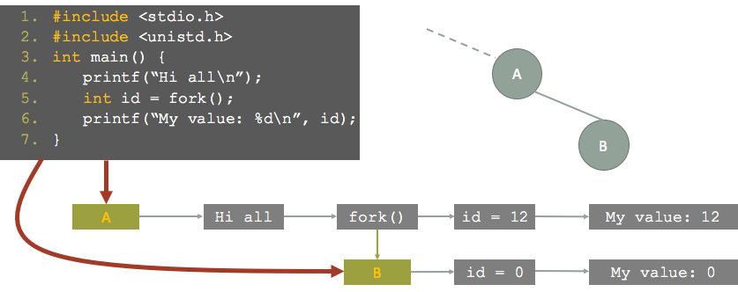
Example
Ho Chi Minh City
University of Technology

Slide 12
Exercises
What will we see on the screen?
#include <stdio.h>
#include <unistd.h>
int main() {
int a = 10;
if (fork() == 0) {
a++;
}else{
wait();
printf(“%d\n”, a);
}
}
Write a program that when executing, it create a new process and then both of them print their PID to stdout.
Ho Chi Minh City
University of Technology

Slide 13
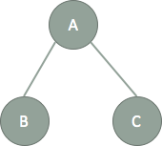
Exercises
Write a program that when executing, it has the OS to create two duplicate copies of itself.
Ho Chi Minh City
University of Technology

Slide 14
Exercises
Draw the tree of processes created by running the following program
#include <stdio.h>
#include <unistd.h>
int main() {
fork();
fork();
}
Ho Chi Minh City
University of Technology

Slide 15
Appendix: Useful commands
Use command ps -aux to show brief information about running processes.
Use command ptree to display a tree of processes
To terminate a foreground process, press Ctrl+C
In other to stop a running process, use kill –INT <Process’s PID>.
Ho Chi Minh City
University of Technology

Slide 16
Appendix: Suspend a process
If a foreground process taking so much time while we want to take the control of the shell back to do another task then we could suspend it by pressing Ctrl+Z.
To display suspended processes, type jobs.
To resume a suspended process, use
fg <n> : suspended process will be waken up and take the control of shell again.
bg <n> : suspended process will be waken up and run in foreground.
Note: n is the index of the suspended process which placed between a pair of square bracket before the name of process in the string that appears just after we press Ctrl+Z.
Ho Chi Minh City
University of Technology

Slide 17
End
Thanks!
Ho Chi Minh City
University of Technology

