Slide 1
BYTERIDE FINANCE ASSISTANT
Natural-language questions over a financial ledger — every answer computed by SQL against real records, never guessed by a model.
BVP TECH CATALYST HACKATHON · 5-PERSON TEAM
LIVE DEMO https://byteride-finance-assistant.onrender.com
ByteRide Finance Assistant
1

Slide 2
THE PROBLEM
Trustworthy answers over real transaction data
Finance teams and individuals ask plain-English questions of raw transaction data: “where did I spend the most”, “what's my tax total”.
A generic LLM answers by producing a plausible-looking number — no SQL, no evidence, no way to check it.
In finance, a confident wrong number is worse than no answer at all.
What's needed: an assistant that computes with real records and shows its work — or admits, honestly, when the data can't answer.
✖ A GENERIC LLM
“You spent about ₹15,90,000 last month.”
No SQL. No evidence. No way to verify it.
✓ BYTERIDE
“Total for 2026-05-01 to 2026-05-31: ₹1,62,50,89,107.”
+ the exact SQL, 25 masked evidence rows, a confidence badge, and anomaly flags — a real recorded answer.
ByteRide Finance Assistant
2

Slide 3
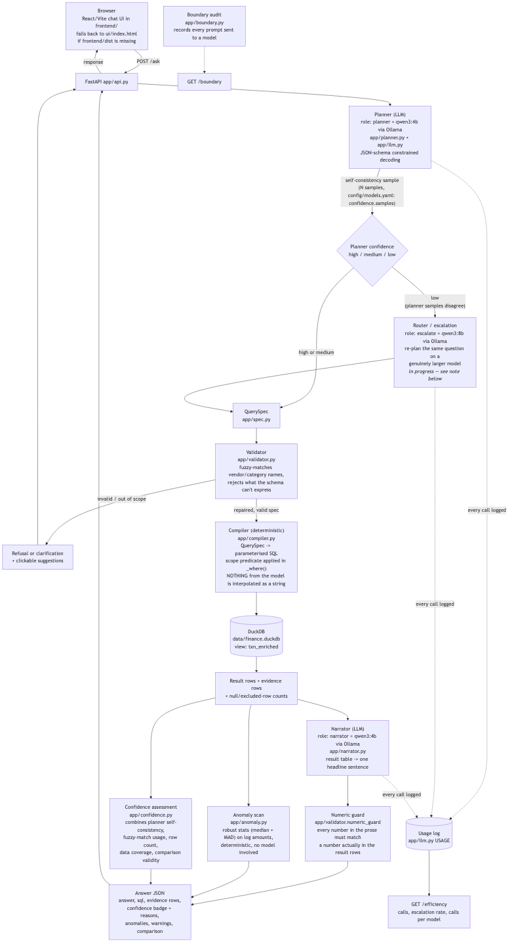
APPROACH
One picture: the request path
question → planner (small LLM) → QuerySpec
QuerySpec → validator → compiler → parameterised SQL
SQL → DuckDB → result + evidence rows
result → narrator (small LLM) → numeric guard
THE ONE RULE
The LLM never does arithmetic. SQL is compiled from a validated spec — the model never sees a data row.
ByteRide Finance Assistant
Full request-path diagram — docs/architecture-1.png
3

Slide 4
TRUST, BY DESIGN
What makes an answer verifiable
1
2
3
4
SQL shown with every answer
Evidence rows
Confidence badge
Anomaly flags
The exact parameterised SQL that produced the number ships alongside it.
Up to 25 real, PII-masked rows returned with every aggregate — the answer is checkable, not asserted.
High / medium / low, from planner self-consistency, fuzzy-match usage, row count and comparison validity.
Robust statistics (median + MAD on log amounts) flag outliers deterministically — no model involved.
5
6
7
Honest refusals
Boundary audit
PII masked in ETL
“This dataset has no reconciliation status … I will not infer one.” Declines instead of guessing.
GET /boundary logs every prompt sent to a model. Rule: the model receives the question and the schema, never a data row.
account_number → last 4 digits; utr_number → [redacted]. Masking happens in SQL — raw values never leave the database.
ByteRide Finance Assistant
4

Slide 5
JUDGEMENT CALLS
Data & scope decisions
Seven calls the real schema forced — each one a deliberate choice, not a lookup.
1
Reconciliation — dropped
Not in the data. The assistant must say so instead of inventing a status.
5
Encryption: ETL only
AES-256 decrypt happens once at load, never per query. account_number masked to last 4; utr_number never decrypted.
2
Scope: personal spend analytics
Vendor / category / channel / bank / period breakdowns, comparisons, lookups. Budgets, forecasts and chart-of-accounts are refused.
6
DuckDB over Snowflake
Decided: identical demo, but no venue-wifi dependency and no cold-warehouse pause at the worst moment.
3
Categories are derived
app/enrich.py classifies each narration at load time (TAX, SALARY, RENT, …, UNCATEGORISED) — never stored, never authoritative.
7
Negative balances — open
available_balance runs to −₹13,16,29,423 on several accounts. Sign convention or export issue — asked the organisers.
4
Vendors parsed from free text
No vendor table. Counterparty is parsed from the narration at load time. Open issue: branch/location noise still splits some vendors in two.
ByteRide Finance Assistant
5

Slide 6
MODEL CHOICE
Why small local models, and when to escalate
WHY SMALL & LOCAL
DEFAULT TIER
qwen3:4b — planner, narrator, router
Privacy — the model receives only the question and the schema, never a data row (app/boundary.py, audited).
Cost — no per-token bill for local inference against a self-hosted Ollama server.
Latency — no network hop; the whole pipeline answers in ~1.5–2s end to end.
Every question starts here. Deterministic sampling (temperature 0, seed 42) so the same question gets the same spec.
ESCALATION TIER
qwen3:8b — a genuinely larger model
Escalating to the same model proves nothing — 8b must differ from the 4b planner for the rate to mean anything.
HOSTED VARIANT (LIVE ON RENDER)
gemini-3.5-flash-lite for planner / narrator / router; gemini-3.6-flash as the cloud escalation tier — same config/models.yaml roles, same pipeline.
WHEN ESCALATION TRIGGERS
• Planner self-consistency agreement falls below the confidence threshold, or
• the validator's repair loop fails a second time.
ByteRide Finance Assistant
6

Slide 7
MODEL EFFICIENCY
Model comparison — golden set (57 cases)
Model | Params / size | Overall accuracy | Refusal correctness | Latency p50 | Latency max
qwen3:1.7b | 2.0B / 1.36 GB | 57/57 (100%) | 11/11 (100%) | 467 ms | 736 ms
qwen3:4b — default | 4.0B / 2.5 GB | 57/57 (100%) | 11/11 (100%) | 1,378 ms | 2,480 ms
qwen3:8b — escalation (pre-fix) | 8.2B / 5.23 GB | 54/55 (98%) | 11/11 (100%) | 2,014 ms | 29,013 ms
tiered 4b→8b (samples=1) | 4b + 8b co-resident | 57/57 (100%) | 11/11 (100%) | 1,591 ms | 16,330 ms
tiered 4b→8b (samples=3) | 4b + 8b co-resident | 57/57 (100%) | 11/11 (100%) | 4,399 ms | 32,996 ms
qwen3:1.7b and qwen3:4b are tied at 57/57 on the current golden set; qwen3:1.7b is now the committed default, at roughly 3x qwen3:4b’s p50. Self-consistency escalation fires for the first time once samples=3 (2/57, 4%), at 100% accuracy on the escalated cases. qwen3:8b’s 54/55 predates the golden-set fix and was not re-run, so it isn’t a like-for-like comparison here.
ByteRide Finance Assistant
7

Slide 8
MODEL EFFICIENCY
Which model answered what
57
46/57
11/57
0%
golden-set cases
answered by qwen3:4b (81%)
refused before any model call (19%)
escalated to qwen3:8b
Tiered (default config) latency: p50 1,591 ms · max 16,330 ms
GOLDEN SET COMPOSITION (TAGS, 57 CASES)
ESCALATION AT SAMPLES=1
At the committed samples=1 default, a single self-consistency sample can’t disagree with itself, so escalation is structurally 0% here — not evidence the tier doesn’t work. The same plan_with_confidence path escalates 2/57 cases (4%) once confidence.samples=3, at 100% accuracy on those cases — see the samples=3 comparison.
ByteRide Finance Assistant
8

Slide 9
ACCURACY
Golden-set results, per bucket
Bucket | Total | 1.7b | 4b | 8b | Tiered
aggregate | 8 | 8/8 | 8/8 | 8/8 | 8/8
ambiguous | 3 | 3/3 | 3/3 | 3/3 | 3/3
category | 11 | 11/11 | 11/11 | 11/11 | 11/11
channel | 1 | 1/1 | 1/1 | 1/1 | 1/1
dates | 18 | 18/18 | 18/18 | 15/16 | 18/18
filter | 14 | 14/14 | 14/14 | 12/12 | 14/14
grouped | 10 | 10/10 | 10/10 | 10/10 | 10/10
metric | 4 | 4/4 | 4/4 | 4/4 | 4/4
multiturn | 5 | 5/5 | 5/5 | 5/5 | 5/5
refusal | 11 | 11/11 | 11/11 | 11/11 | 11/11
vendor | 2 | 2/2 | 2/2 | 2/2 | 2/2
Refusal correctness: 11/11 (100%) across every configuration on the current 57-case set. The one miss shown in red (qwen3:8b on a date-range spec) is from its pre-fix, 55-case run — not re-run here, so its row is not directly comparable to the others’ totals.
ByteRide Finance Assistant
9

Slide 10
DEMO FLOW
Six steps to the money shot
1
“Which vendors did I pay the most last month?”
EMI BAJAJ FINANCE is highest at ₹13,73,25,576. Followed by LIC PREMIUM POLICY at ₹3,03,80,709.
2
Expand the SQL + evidence panel
The exact parameterised SQL, plus masked evidence rows (account_number → XXXXXX1922, utr_number → [redacted]).
3
“How does that compare with the month before?” (same session)
The biggest move is BIG BAZAAR RETAIL, up ₹1,13,26,049 — no context repeated in the follow-up question.
4
“How much tax did I pay this year?”
Total for 2026-01-01 to 2026-12-31: ₹1,95,63,10,950 — a derived category, shown as derived.
5
“Which transactions are unreconciled?” — the money shot
“This dataset has no reconciliation status … I will not infer one.” Refuses cleanly in 0.007s.
6
GET /efficiency
Which model answered, and the escalation rate — the model-efficiency claim, live.
ByteRide Finance Assistant
10

Slide 11
HONESTY
What's next — known limitations
Vendor name splitting
Negative balances — open question
Branch/location noise (“X” vs “X DAHISAR EAST”) still corrupts some “where did I spend most” answers — needs a real place-name list, not ten sample rows.
available_balance runs to −₹13,16,29,423 on several accounts. Sign convention or export issue, unresolved — asked the organisers.
TAX rules need the real corpus
Amount-unit parsing gaps
Keyword rules are tuned against a handful of examples; must be re-validated once the organisers' full export lands.
The planner doesn't resolve “lakh” as a unit, and combining an amount filter with a date filter can silently drop the date — found during real Q&A testing.
UNCATEGORISED coverage unreported
Escalation path untested by evals
The UNCATEGORISED percentage isn't yet surfaced in the pipeline — if it's high, spend-by-category answers understate the gap.
Self-consistency escalation is exercised by /ask but not by make eval — golden-set escalation rate should be read as “untested”, not “zero risk”.
ByteRide Finance Assistant
11

Slide 12
TRY IT
Repo, live demo, and how to run it
REPO
github.com/Aahan215/ByteRideFinanceAssistant
LIVE DEMO
byteride-finance-assistant.onrender.com
Render free tier — cold start up to ~1 min, hosted Gemini, synthetic 200k-row dataset.
RUN IT LOCALLY — THREE COMMANDS
$ make setup
$ make load
$ make ui-install && make ui-build && make run
→ open http://localhost:8765
ByteRide Finance Assistant
12

