Slide 1
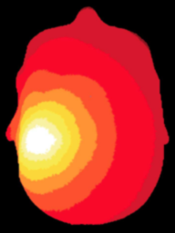
NeuroDOT
Data Samples, Flags, and Info Structures

Slide 2
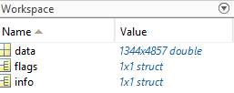

NeuroDOT Data Samples
10 NeuroDOT data samples are provided in the ‘Data’ folder that contain DOT data recorded from various experimental paradigms including rotating-wedge retinotopy (CCW1, CCW2, CW1), verb generation (GV1), hearing words (HW1, HW2, HW3_Noisy), contracting and expanding checkerboard $annuli^{1}$, and reading words (RW1)
The ‘CCW1’ data sample is used in each of the tutorials, and you are encouraged to try out each of the data sets in the same scripts.
When loaded in MATLAB, each ‘.mat’ file contains a ‘data’ field, a ‘flags,’ and an ‘info’ structure
1
BW Zeff et al., “Retinotopic mapping of adult human visual cortex with high-density diffuse optical tomography,” Proceedings of the National Academy of Sciences of the United States of America.

Slide 3
Data
Raw data for all of the measurements are contained in the ‘data’ variable loaded from the ‘.mat’ file for each data sample.
Each row in ‘data’ corresponds to a measurement, and each column corresponds to the time, in seconds of the recording.
Information for each measurement is in the info.pairs structure such that the j^{th} row of the data corresponds to the j^{th} row of each of the fields in info.pairs.

Slide 4
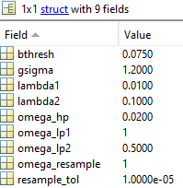
Flags
The ‘flags’ structure is provided with values to be used as defaults for processing

Slide 5
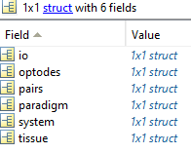
Info
The info structure contains all of the information required to process data with the NeuroDOT toolbox

Slide 6
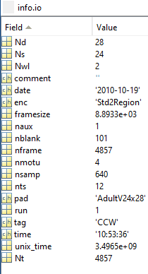
Info.io
Nd: # of detectors
Ns: # of sources
Nwl: # of wavelengths
Enc: name of encoding pattern used
Framesize: length of each frame (ms)
Naux: # of auxillary channels
Nframe: # of frames
Nmotu: # of analog-to-digital converters used
Nsamp: # of samples
Nts: # of time steps
Pad: pad measurements were taken on
Nt: # of time points

Slide 7
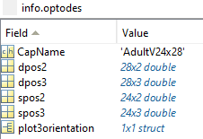
Info.optodes
Structure containing spatial coordinates for sources and detectors in array
info.optodes.spos2 – 2D coordinates of each sources
info.optodes.spos3 – 3D coordinates of each source
info.optodes.dpos2 – 2D coordinates of each detector
info.optodes.dpos3 – 3D coordinates of each detector

Slide 8
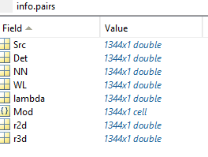
Info.pairs
Structure containing topological information for each source-detector measurement pair
The rows in each field of this structure corresponds to a measurement and must be in the same order as the optical data for valid processing
Generally, full list of sources and detectors is repeated for each wavelength/lambda.
info.pairs.Src – source in measurement
info.pairs.Det – detector in measurement
info.pairs.NN – Nearest Neighbor class in array (e.g., info.pairs.NN=1 means this measurement is one of the closest in the grid design)
info.pairs.WL – wavelength index of measurement
info.pairs.lambda – actual wavelength of measurement (e.g., info.pairs.lambda = 750 is a 750 nm measurement)
info.pairs.Mod – Modulation type of measurement (e.g., ‘CW’, or, ‘FD’)
info.pairs.r2d – 2D source-detector distances used for flattened cap visualizations and processing
info.pairs.r3d – 3D source-detector distances used for 3D visualizations and processing

Slide 9
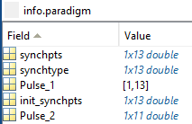
Info.paradigm
Contains information regarding the stimulus paradigm
Synchpts: sample points where a stimulus is presented
Synchtype: frequency of the stimulus synchronization pulse
Pulse_1 (Pulse_2, etc.): indices of synchpts corresponding to each stimulus
Init_synchpts: contains the initial synchpts values before resampling, a common pre-processing step that changes the current sample rate of the data.
E.g., the samples that start the ON stimulus epochs of most stimuli are given by: info.paradigm.synchpts(info.paradigm.Pulse_2)

Slide 10
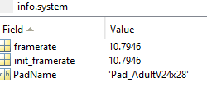
Info.system
Contains information about the system the data sample was recorded on
Framerate of the system
Name of the Pad used, corresponds to the file in Support_Files/Pad

Slide 11

Info.tissue
Most fields of info.tissue are created in the Basic Head Modeling script and are where A matrix and pad information are stored.

