Slide 1
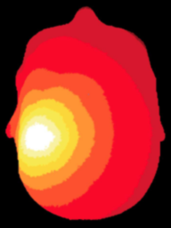
NeuroDOT
Tutorial:
Image Reconstruction

Slide 2
NeuroDOT Set-Up - Checklist
Before starting any tutorial, please make sure you’ve done the following
Set your path so that all required folders and subfolders are included
Folders w/subfolders to include
NeuroDOT
Any other toolbox used for whatever task
Your personal directory
Folders to include
Output directory
Set your output directory so that you can save files to the desired location
Change your current directory to your output directory
cd(outputdir)

Slide 3
NeuroDOT Set-Up – Output Directory
Once you’ve set your path, the next thing you should do is set your output directory.
The output directory must be located within your path
If it isn’t already in your path, you must add it to your path
You can set your own path to an output directory in the line shown above
An output directory specifies the location where files will be saved
MATLAB, by default, will save files to the current directory
The following line of code will change your current directory to the output directory that you just specified →
Now you can save outputs

Slide 4
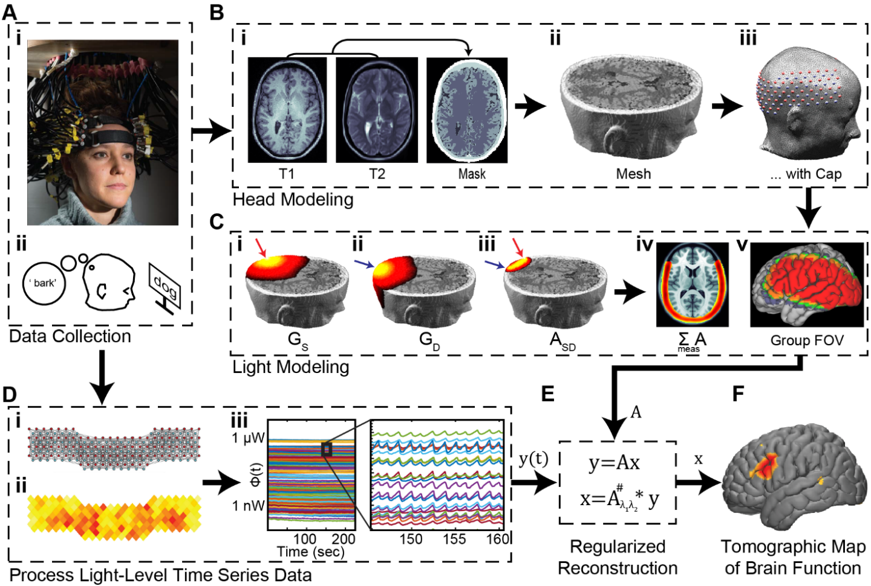
Diffuse Optical Tomography
In diffuse optical tomography (DOT), arrays of optical sources and detectors are used to perform functional neuroimaging experiments on task-based or resting state modes of human brain function.
Analyses are broken into several pipelines:
B: modeling of the tissue shape, optical property distribution, and source/detector locations
C: modeling of the light emission, diffusion, and detection through the head
D: preprocessing of the raw source-detector measurements
E: reconstruction and spectroscopy of the preprocessed data and light model into a functional neuroimaging volume
F: post-processing analysis of these results.

Slide 5
Image Reconstruction
This tutorial follows the NeuroDOT_ImageReconstruction_Script.m Matlab file which can be found in the Documentation/Scripts folder.
It expands on the full tutorial, NeuroDOT_Full_Processing_Script.m, and assumes the necessary sensitivity matrices are available
The tutorial will:
Process source-detector measurements
Perform image reconstruction using a light model sensitivity matrix A
Visualize the reconstructed data
We will use data from a rotating-wedge retinotopy experiment
Start by loading this data set:
load('NeuroDOT_Data_Sample_CCW1.mat'); % data, info, flags

Slide 6
Flow Chart for Pre-processing and Image Reconstruction
DOT Acquisition
Log-mean
Detect noisy channels
Band-pass filter
Superficial signal regression
Low-pass filter
Resample
Light
Model
Reconstruction
Spectroscopy
Spatial normalization

Slide 7
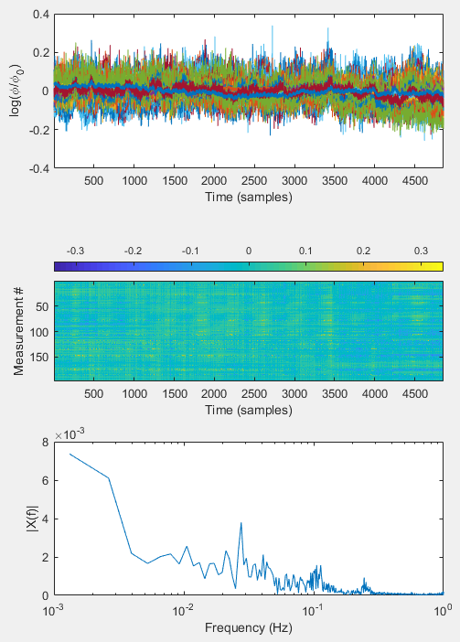
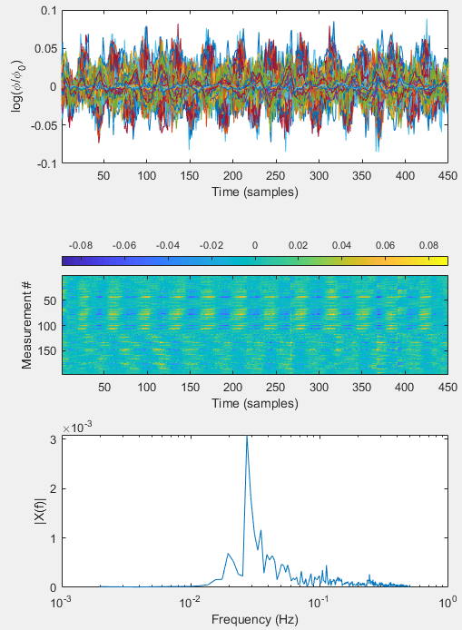
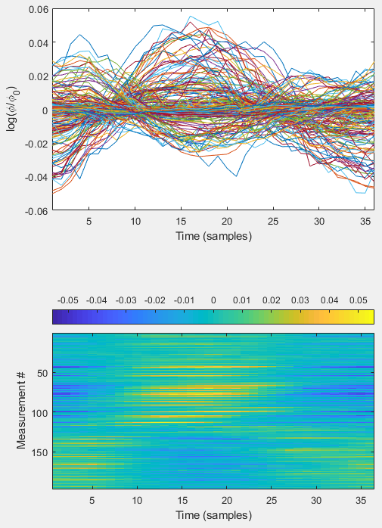
Pre-processing
After
Before
Pre-processing generally follows this pipeline:
lmdata = logmean(data); % Logmean Light Levels
info = FindGoodMeas(lmdata, info, 0.075); % Detect Noisy Channels
lmdata = detrend_tts(lmdata); % Detrend Data
lmdata = highpass(lmdata, .02, info.system.framerate); % HPF
lmdata = lowpass(lmdata, 1, info.system.framerate); % LPF 1
hem = gethem(lmdata, info); % Superficial Signal Regression
[lmdata, ~] = regcorr(lmdata, info, hem);
lmdata = lowpass(lmdata, 0.5, info.system.framerate); % LPF 2
[lmdata, info] = resample_tts(lmdata, info, 1, 1e-5);
% Block Average the measurement data
badata = BlockAverage(lmdata, … info.paradigm.synchpts(info.paradigm.Pulse_2), dt);
badata=bsxfun(@minus,badata,mean(badata,2));
Plots and images on right show differential measurements, computed as the logarithm of the ratio of each signal and its temporal average
Preprocessing comprises filters, processing, and averaging in order to reduce noise and physiologic components of the signals to highlight response to the stimulus
For a more in-depth exploration of pre-processing parameter settings, please see the Tutorial on Pre-processing.
Block-averaged

Slide 8
Reconstruction & Spectroscopy
DOT Acquisition
Absorption image volumes are reconstructed from the processed measurements based on a regularized inversion of the A matrix (for details, see, e.g., Eggebrecht et al., Neuroimage, 2012)
%% Reconstruct absorption, each wavelength
if ~exist('A', 'var')
load('A_AdultV24x28.mat') % Contains A-matrix, info.
end
for j = 1:2 % each wavelength
keep = (info.pairs.WL == j) & (info.pairs.r2d <= 40) & info.MEAS.GI;
% Invert A-Matrix
iA = Tikhonov_invert_Amat(A(keep, :), 0.01, 0.1);
% Smooth Inverted A-Matrix
iA_smoothed = smooth_Amat(iA, dim, 3);
% Reconstruct Image Volume
cortex_mu_a(:, :, j) = reconstruct_img(preprocessed(keep, :), iA_smoothed);
end
Image volumes store estimated absorption values as voxels by time by wavelength.
Hemoglobin images are computed from the wavelength-dependent absorption images
%% Spectroscopy, convert to Hb
load('E.mat')
cortex_Hb = spectroscopy_img(cortex_mu_a, E);
cortex_HbO = cortex_Hb(:, :, 1);
cortex_HbR = cortex_Hb(:, :, 2);
cortex_HbT = cortex_HbO + cortex_HbR;
Log-mean
Detect noisy channels
Band-pass filter
Superficial signal regression
Low-pass filter
Resample
Light
Model
Reconstruction
Spectroscopy

Slide 9
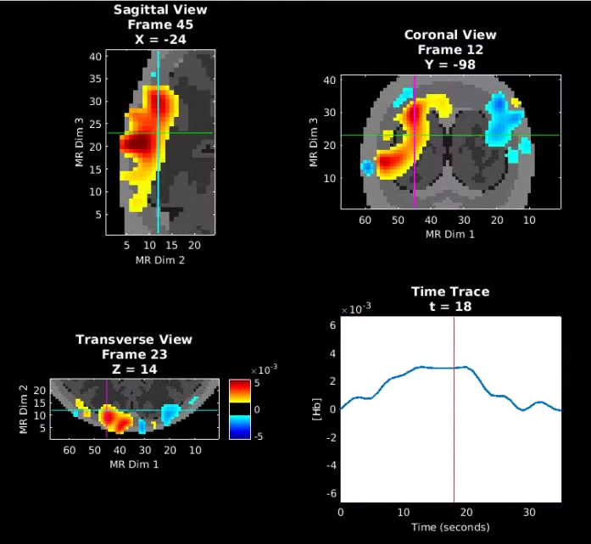
Spatial normalization and visualization
DOT Acquisition
As in the full tutorial, the reconstructed images are visualized on a spatially registered anatomical background
[MNI,infoB]=LoadVolumetricData('Segmented_MNI152nl_on_MNI111',[],'4dfp');
MNI_dim = affine3d_img(MNI,infoB,A.info.tissue.dim,eye(4),'nearest');
HbO_T1 = affine3d_img(cortex_HbO, A.info.tissue.dim, infoB, eye(4));
Block average and visualize
badata_HbO = BlockAverage(cortex_HbO,info.paradigm.synchpts(info.paradigm.Pulse_2), dt);
badata_HbO=bsxfun(@minus,badata_HbO,badata_HbO(:,1));
badata_HbOvol = Good_Vox2vol(badata_HbO,A.info.tissue.dim);
Params.Scale=0.8*max(abs(badata_HbOvol(:)));
Params.Th.P=0; %positive threshold
Params.Th.N=-Params.Th.P; %negative threshold
PlotSlicesTimeTrace(MNI_dim,A.info.tissue.dim,Params,badata_HbOvol,info)
The results below show the reconstructed oxyhemoglobin (HbO) volume.
Log-mean
Detect noisy channels
Band-pass filter
Superficial signal regression
Low-pass filter
Resample
Light
Model
Reconstruction
Spectroscopy
Spatial normalization

Slide 10
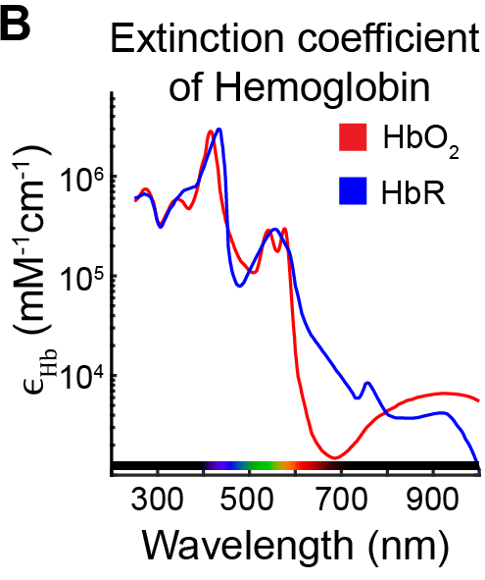
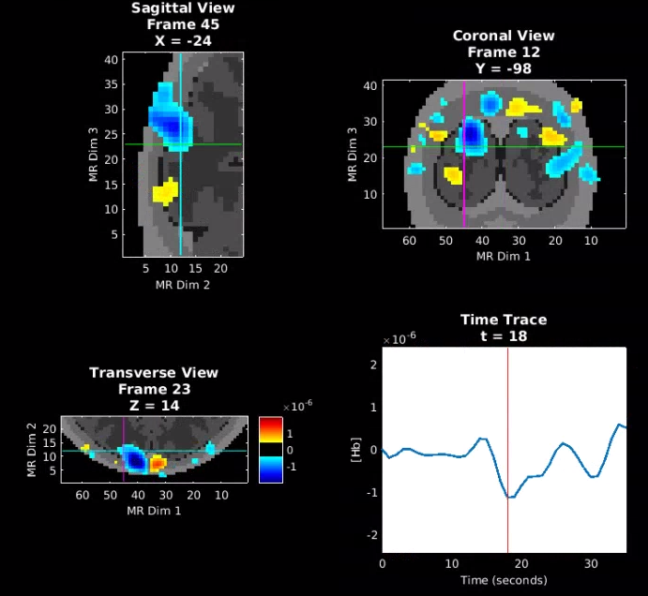
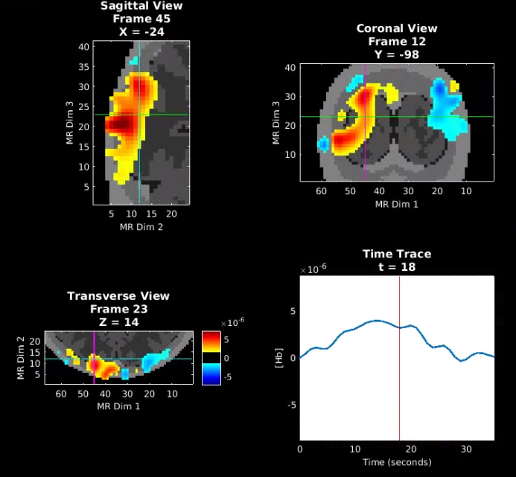


Visualization of Absorption Volumes
Reconstructed absorption volumes at 750 and 850 nm show sensitivity of the 850 nm wavelength to HbO and 750 nm wavelength to HbR.
Images are shown with a threshold of 20% of the maximum amplitude:
Params.Scale=0.8*max(abs(badata_HbOvol(:)));
Params.Th.P=0.2*Params.Scale;
Params.Th.N=-Params.Th.P;
Params.Cmap='jet';
PlotSlicesTimeTrace(MNI_dim,A.info.tissue.dim,Params,badata_HbOvol,info)
HbO
$μ_{a}$ - 750 nm
$μ_{a}$ - 850 nm

Slide 11
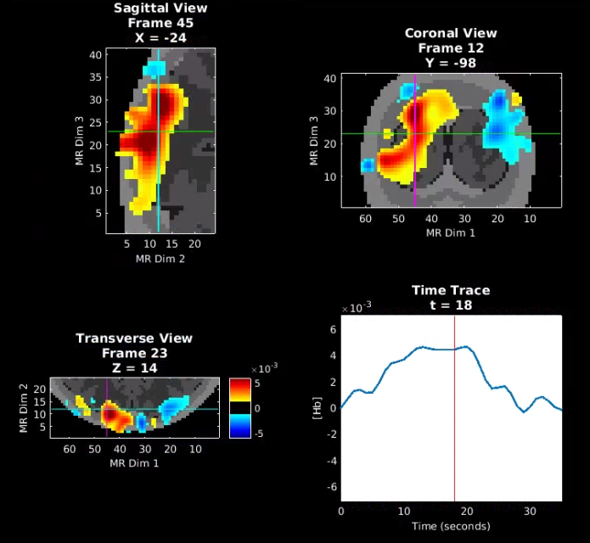
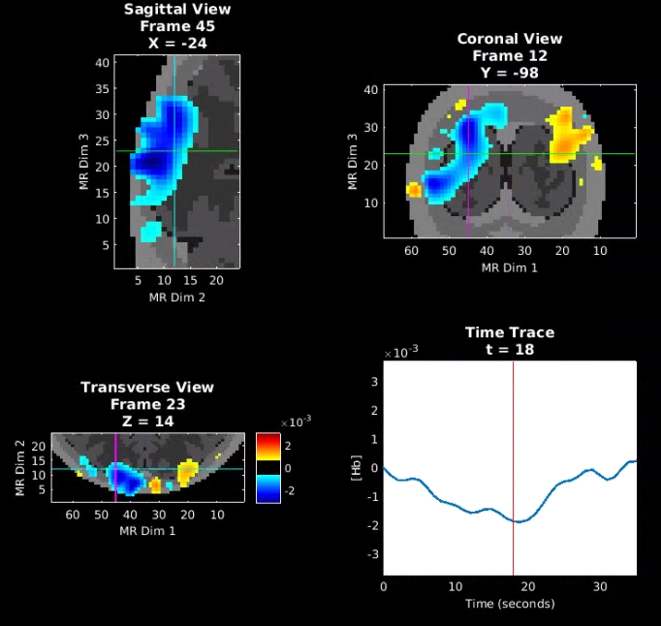
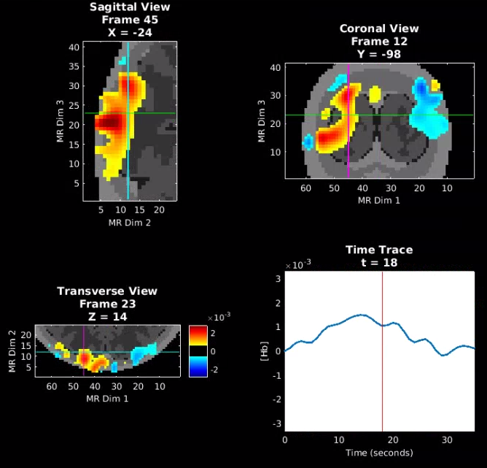
Hemoglobin volumes - HbO, HbR, HbT
Oxy-, deoxy-, and total hemoglobin estimates can also be visualized
HbO
HbR
HbT

Slide 12
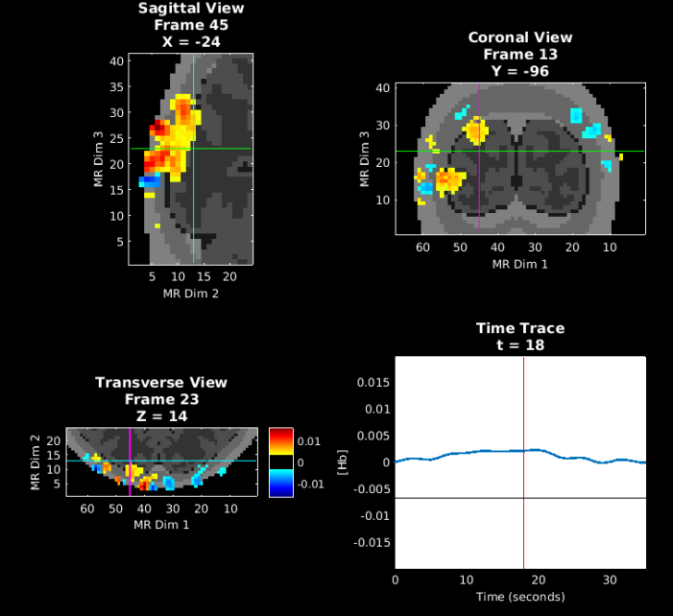
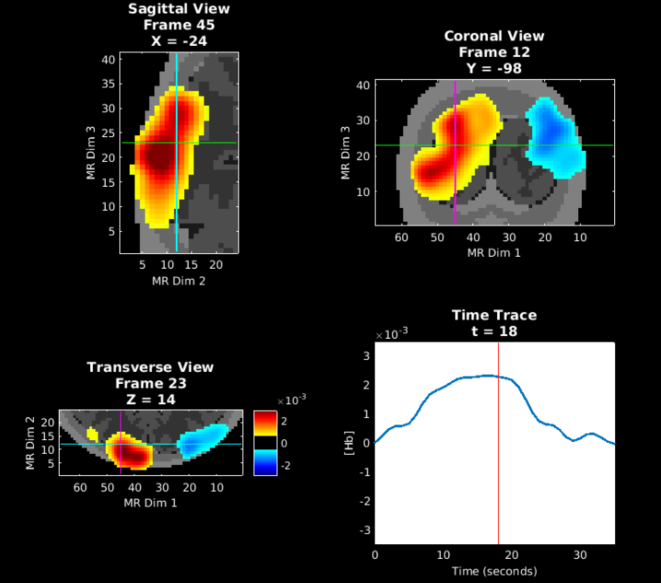
Spatial Smoothing
Spatial smoothing is implemented with a 3-dimensional Gaussian filter. The third parameter dictates the degree of smoothing via the filter width, in voxels
% Smooth Inverted A-Matrix
iA_smoothed = smooth_Amat(iA, dim, 3);
Increasing smoothing generally gives improved signal to noise ratio at the expense of resolution
HbO – Smoothed with 5 voxel filter
HbO – Smoothed with 3 voxel filter
HbO – Not smoothed

Slide 13
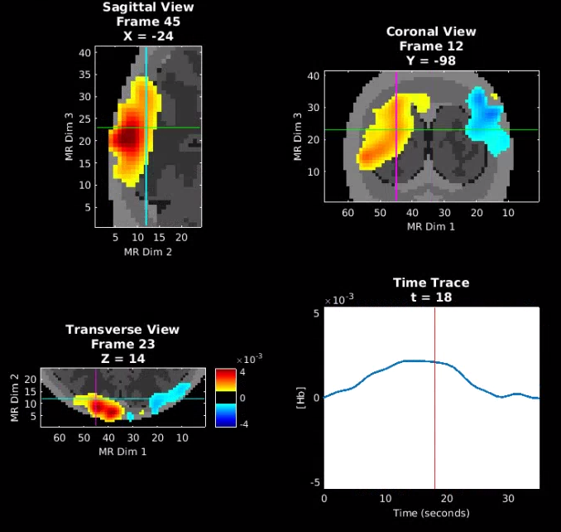
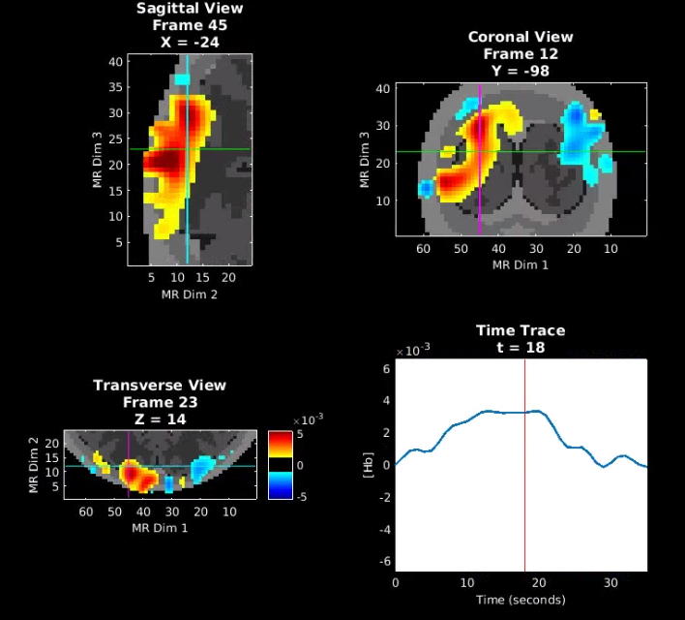

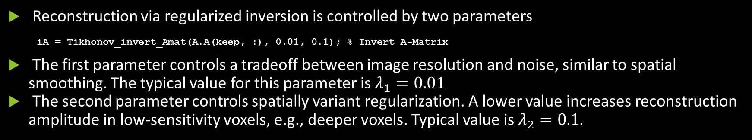


Reconstruction Parameters
Reconstruction via regularized inversion is controlled by two parameters
iA = Tikhonov_invert_Amat(A.A(keep, :), 0.01, 0.1); % Invert A-Matrix
The first parameter controls a tradeoff between image resolution and noise, similar to spatial smoothing. The typical value for this parameter is $λ_{1}=0.01$
The second parameter controls spatially variant regularization. A lower value increases reconstruction amplitude in low-sensitivity voxels, e.g., deeper voxels. Typical value is $λ_{2}=0.1.$
HbO – $λ_{1}=0.01$, $λ_{2}=0.1$
HbO – $λ_{1}=0.05$, $λ_{2}=0.1$
HbO – $λ_{1}=0.01$, $λ_{2}=0.$05

Slide 14
That’s It (For Now)
Congratulations! You have finished the NeuroDOT Image Reconstruction Tutorial
You are now ready to start the other NeuroDOT Tutorials
Recommended order for the tutorials is:
Generating a Light Model
Preprocessing
Image Reconstruction
Full Data Processing
Generating a Light Model PAD Adult 96x92
If you have any questions about the material presented in this tutorial, please consult the NeuroDOT User Manual on the WUSTL Optical Radiology Lab (ORL) GitHub page https://github.com/WUSTL-ORL/NeuroDOT_Beta in the documentation folder, or contact either: Adam Eggebrecht: aeggebre@wustl.edu, Emma Speh: espeh@wustl.edu, Ari Segel: ari@wustl.edu, or Jason Trobaugh: jasont@wustl.edu

