Slide 1
ARRAYS

Slide 2
Arrays
An array is a collection of similar type of elements which has contiguous memory location.
It is a data structure where we store similar elements. We can store only a fixed set of elements in a Java array.
Array in Java is index-based, the first element of the array is stored at the 0th index, 2nd element is stored on 1st index and so on.

Slide 3
Types of ARRAYS
Single Dimensional Array
Multidimensional Array

Slide 4
Declaring Single Dimensional Arrays
dataType[] arrayRefVar; // preferred way.
or
dataType arrayRefVar[]; // works but not preferred way.
double[] myList; // preferred way.
or
double myList[]; // works but not preferred way.

Slide 5
Creating Arrays
You can create an array by using the new operator with the following syntax −
arrayRefVar = new dataType[arraySize];
The above statement does two things −
It creates an array using new dataType[arraySize].
It assigns the reference of the newly created array to the variable arrayRefVar.
Declaring an array variable, creating an array, and assigning the reference of the array to the variable can be combined in one statement, as shown below
dataType[] arrayRefVar = new dataType[arraySize];

Slide 6
/Java Program to illustrate how to declare, instantiate, initialize
//and traverse the Java array.
class Testarray{
public static void main(String args[]){
int a[ ]=new int[5];//declaration and instantiation
//int a[]={33,3,4,5};//declaration, instantiation and initialization
a[0]=10;//initialization
a[1]=20;
a[2]=70;
a[3]=40;
a[4]=50;
//traversing array
for(int i=0;i<a.length;i++)//length is the property of array
System.out.println(a[i]);
}}

Slide 7
Review
What is the difference in meaning between x3 and x[3]?
Declare an array named Nos that stores five numbers from user input. Add logic to add only even numbers found in the array. Display the value of the sum

Slide 8
Review 2
Write a program in Java to store 7 user integers elements in an array and print the array elements

Slide 9
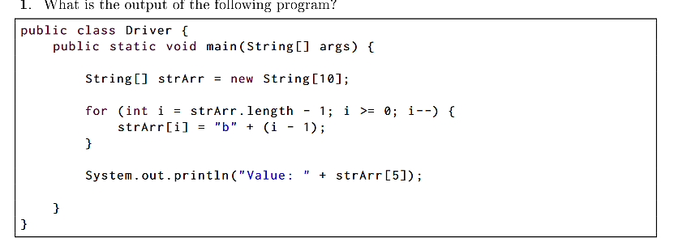

Slide 10
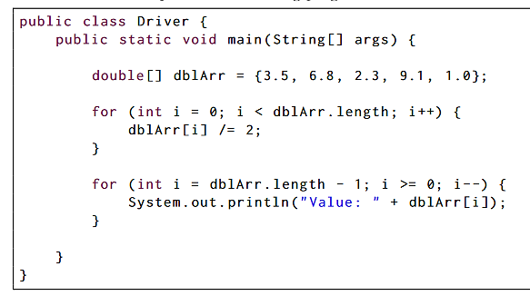

Slide 11
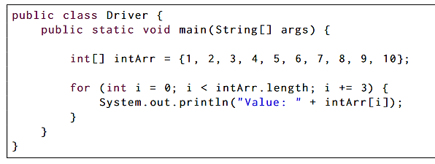

Slide 12
Multidimensional Arrays
Multidimensional array in Java represents 2D, 3D, . . . . arrays which is a combination of several types of arrays.
For example, a two-dimensional array is a combination of two or more one-dimensional (1D) arrays.
Similarly, a three-dimensional array is a combination of two or more two-dimensional (2D) arrays.

Slide 13
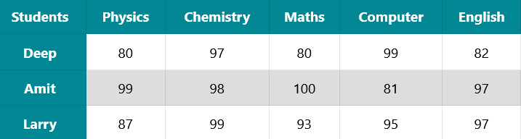
Two Dimensional Array (2D array) in Java
A two dimensional array in java represents many rows and columns of data. Data in matrix or table form can be represented by using two dimensional array.
For example, marks obtained by a group of three students in five different subjects can be represented in table form like this:

Slide 14
We can store marks of three students in the above table using two dimensional array as:
int marks[ ] [ ] = {
{80, 97, 80, 99, 82},
{99, 98, 100, 81, 97},
{87, 99, 93, 95, 97}
};

Slide 15
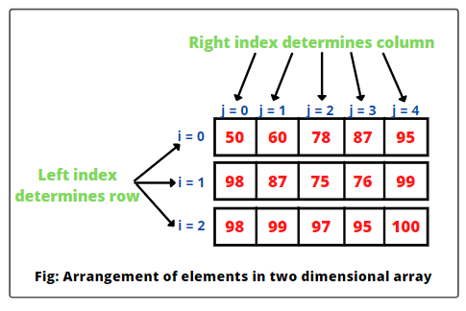
In a two-dimensional array, an element is accessed through a row and column index

Slide 16
Declaring an array and then allocating memory for it
int[ ][ ] marks; // declaring a marks array.
marks = new int[3][5]; // allocating memory for storing 15 elements.
The predecessor two statements can be written by combining them into a single statement, as:
int[ ][ ] marks = new int[3][5];

Slide 17
Jagged Array in Java
Since each row in a two dimensional array is itself an array, therefore, rows can have different lengths or sizes. A two-dimensional array with different rows is called jagged array in java.
Jagged array is also called ragged array in java. An example of creating a jagged array is as follows:
int[ ][ ] arr = {
{11, 12, 13, 14, 15},
{7, 8, 9, 10},
{4, 5, 6},
{2, 3},
{1}
};

Slide 18
int[ ][ ] arr = new int[5][ ];
arr[0] = new int[5];
arr[1] = new int[4];
arr[2] = new int[3];
arr[3] = new int[2];
arr[4] = new int[1];
Now we can initialize values in jagged array like this:
arr[0][3] = 90;
arr[4][0] = 75;

Slide 19
What is the output
class MultidimensionalArray {
public static void main(String[] args) {
// create a 2d array
int[][] a = {
{1, 2, 3},
{4, 5, 6, 9},
{7},
};
System.out.println("Length of row 1: " + a[0].length);
System.out.println("Length of row 2: " + a[1].length);
System.out.println("Length of row 3: " + a[2].length);
}
}

Slide 20
class MultidimensionalArray {
public static void main(String[] args) {
int[][] a = {
{1, -2, 3},
{-4, -5, 6, 9},
{7},
};
for (int i = 0; i < a.length; ++i) {
for(int j = 0; j < a[i].length; ++j) {
System.out.println(a[i][j]);
}
}
}
}

