Slide 1
EXCEPTIONS

Slide 2
Exceptions
An exception is an unwanted or unexpected event, which occurs during the execution of a program i.e. at run time, that disrupts the normal flow of the program’s instructions.
Exceptions can be caught and handled by the program. When an exception occurs within a method, it creates an object. This object is called the exception object. It contains information about the exception such as the name and description of the exception and the state of the program when the exception occurred

Slide 3
Causes of Exceptions
Invalid user input
Device failure
Loss of network connection
Physical limitations (out of disk memory)
Code errors
Opening an unavailable file

Slide 4
Exception Handling
Exception handling ensures that the flow of the program doesn’t break when an exception occurs. For example, if a program has bunch of statements and an exception occurs mid way after executing certain statements then the statements after the exception will not execute and the program will terminate abruptly. By handling we make sure that all the statements execute and the flow of program doesn’t break.

Slide 5
Difference between error and exception
Errors indicate that something severe enough has gone wrong, the application should crash rather than try to handle the error.
Exceptions are events that occurs in the code. A programmer can handle such conditions and take necessary corrective actions for example, ArrayIndexOutOfBoundsException – When you try to access the elements of an array out of its bounds, for example array size is 5 (which means it has five elements) and you are trying to access the 10th element.

Slide 6
Exception Hierarchy
All exception and errors types are subclasses of class Throwable, which is the base class of the hierarchy.
One branch is headed by Exception. This class is used for exceptional conditions that user programs should catch. NullPointerException is an example of such an exception.
Another branch, Error is used by the Java run-time system to indicate errors having to do with the run-time environment itself(JRE). StackOverflowError is an example of such an error.

Slide 7
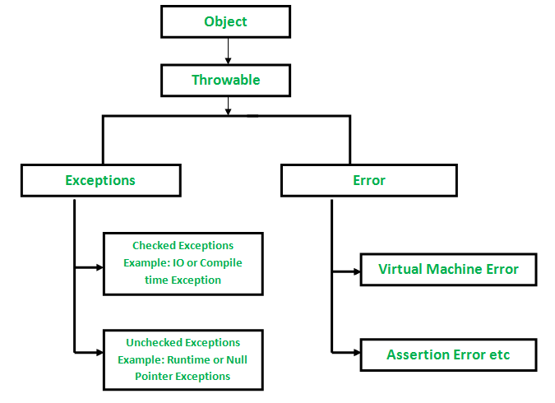
Hierarchy

Slide 8
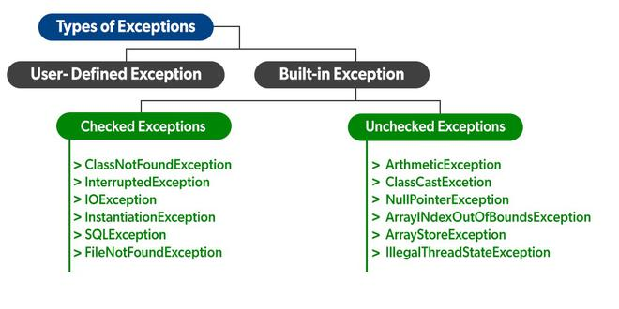
Types of Exceptions

Slide 9
Built-in Exceptions
Built-in Exceptions: Built-in exceptions are the exceptions that are available in Java libraries. These exceptions explain certain error situations.
Checked Exceptions: Checked exceptions are called compile-time exceptions because these exceptions are checked at compile-time by the compiler.
Unchecked Exceptions: The unchecked exceptions are just opposite to the checked exceptions. The compiler will not check these exceptions at compile time. In simple words, if a program throws an unchecked exception, and even if we didn’t handle or declare it, the program would not give a compilation error.

Slide 10
Java Exception Handling
Java exception handling is managed via five keywords: try, catch, throw, throws, and finally.
Here is how they work. Program statements that you think can raise exceptions are contained within a try block. If an exception occurs within the try block, it is thrown. Your code can catch this exception (using catch block) and handle it. System-generated exceptions are automatically thrown by the Java run-time system. To manually throw an exception, use the keyword throw. Any exception that is thrown out of a method must be specified as such by a throws clause. Any code that absolutely must be executed after a try block completes is put in a finally block.

Slide 11
try-catch:
public static void main (String[] args)
{
// array of size 4.
int[] arr = new int[4];
try
{
int i = arr[4];
// this statement will never execute
// as exception is raised by above statement
System.out.println("Inside try block");
}
catch(ArrayIndexOutOfBoundsException ex)
{
System.out.println("Exception caught in Catch block");
}
// rest program will be executed
System.out.println("Outside try-catch clause");
}

Slide 12
try-catch-finally clause :
int[] arr = new int[4];
try
{
int i = arr[4];
// this statement will never execute
// as exception is raised by above statement
System.out.println("Inside try block");
}
catch(ArrayIndexOutOfBoundsException ex)
{
System.out.println("Exception caught in catch block");
}
finally
{
System.out.println("finally block executed");
}
// rest program will be executed
System.out.println("Outside try-catch-finally clause");

Slide 13
Source of exceptions
int a=50/0;//ArithmeticException
String s=null;
System.out.println(s.length());//NullPointerException
String s="abc";
int i=Integer.parseInt(s);//NumberFormatException
int a[]=new int[5];
a[10]=50; //ArrayIndexOutOfBoundsException

Slide 14
throws
Used to throw an exception from a method or any block of code
The throw keyword is mainly used to throw custom exceptions.
Syntax:
throw Instance
Example:
throw new ArithmeticException("/ by zero");

Slide 15
Read about
Throw
Throws

