Slide 1
POLYMORPHISM

Slide 2
METHOD OVERLOADING
Method overloading is the process that can create multiple methods of the same name in the same class, and all the methods work in different ways.
Method overloading occurs when there is more than one method of the same name in the class.

Slide 3
Three ways to overload a method
1. Number of parameters. For example: This is a valid case of overloading
add(int, int)
add(int, int, int)
2. Data type of parameters. For example:
add(int, int)
add(int, float)
3. Sequence of Data type of parameters. For example:
add(int, float)
add(float, int)

Slide 4
Invalid case of method overloading
if two methods have same name, same parameters and have different return type, then this is not a valid method overloading example. This will throw compilation error.
int add(int, int)
float add(int, int)

Slide 5
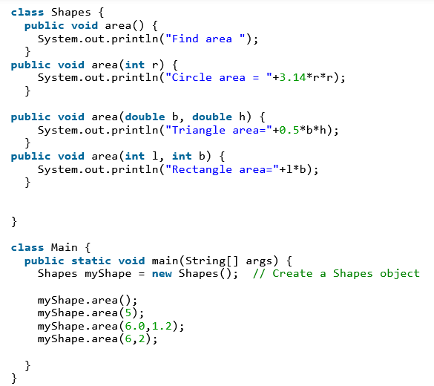
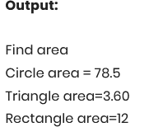

Slide 6
Method overriding
Method overriding is the process when the subclass or a child class has the same method as declared in the parent class.
if the subclass provides its definition to a method already present in the superclass; then that function in the base class is said to be overridden.

Slide 7
