Slide 1
Java Packages

Slide 2
Packages
A Package in Java is a mechanism to encapsulate (data hiding) a group of classes, sub packages and interfaces.
All we need to do is put related classes into packages. After that, we can simply write an import class from existing packages and use it in our program.
User defined or
In built packages

Slide 3
Accessing packages
Adding a class to a Package : We can add more classes to a created package by using package name at the top of the program and saving it in the package directory.
Subpackages: Packages that are inside another package are the subpackages. These are not imported by default, they have to imported explicitly.
Example :
import java.util.*;
util is a subpackage created inside java package.

Slide 4
Accessing classes inside a package
Consider following two statements :
// import the Vector class from util package.
_{import java.util.vector;}
// import all the classes from util package
_{import java.util.*;}

Slide 5
Built in packages
java.lang: Contains language support classes(e.g classed which defines primitive data types, math operations). This package is automatically imported.
java.io: Contains classes for supporting input / output operations. java.util: Contains utility classes which implement data structures like Linked List, Dictionary and support ; for Date / Time operations. java.applet: Contains classes for creating Applets. java.awt: Contain classes for implementing the components for graphical user interfaces (like button , ;menus etc). java.net: Contain classes for supporting networking operations.

Slide 6
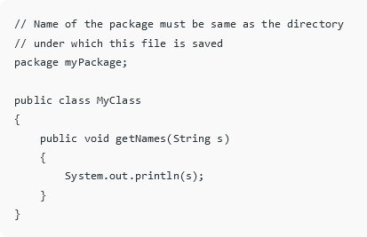
User defined packages
import myPackage.MyClass;
public class PrintName
{
public static void main(String args[])
{
String name = “this is a string";
// Creating an instance of class
MyClass obj = new MyClass();
obj.getNames(name);
}
}

Slide 7
ACCESS MODIFIERS
They specify the scope of the variable
Modifier | With in Class | Within Package | Outside Package
Private | Y | N | N
Public | Y | Y | N
Protected | Y | Y | N
Default | Y | Y | Y

