Slide 1
Inheritance

Slide 2
Inheritance
Inheritance in Java is a mechanism in which one object acquires all the properties and behaviors of a parent object.
The idea behind inheritance in Java is that you can create new classes that are built upon existing classes. When you inherit from an existing class, you can reuse methods and fields of the parent class. Moreover, you can add new methods and fields in your current class also.
Inheritance represents the IS-A relationship which is also known as a parent-child relationship.

Slide 3
Terms used in inheritance
Class: A class is a group of objects which have common properties. It is a template or blueprint from which objects are created.
Sub Class/Child Class: Subclass is a class which inherits the other class. It is also called a derived class, extended class, or child class.
Super Class/Parent Class: Superclass is the class from where a subclass inherits the features. It is also called a base class or a parent class.
Reusability: As the name specifies, reusability is a mechanism which facilitates you to reuse the fields and methods of the existing class when you create a new class. You can use the same fields and methods already defined in the previous class.

Slide 4
Syntax for inheritance
class Subclass-name extends Superclass-name
{
//methods and fields
}
The extends keyword indicates that you are making a new class that derives from an existing class. The meaning of "extends" is to increase the functionality.

Slide 5
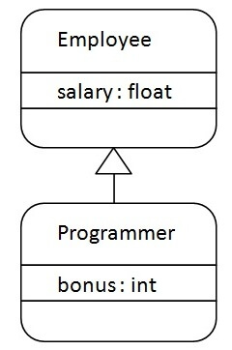
Inheritance
As displayed in the figure, Programmer is the subclass and Employee is the superclass. The relationship between the two classes is Programmer IS-A Employee. It means that Programmer is a type of Employee.

Slide 6
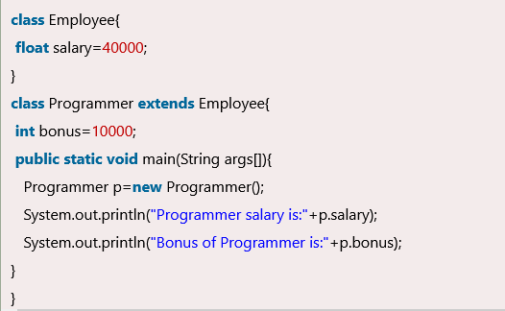
Code

Slide 7
Types of inheritance
On the basis of class, there can be three types of inheritance in java: single, multilevel and hierarchical.
In java programming, multiple and hybrid inheritance is supported through interface only. We will learn about interfaces later.

Slide 8
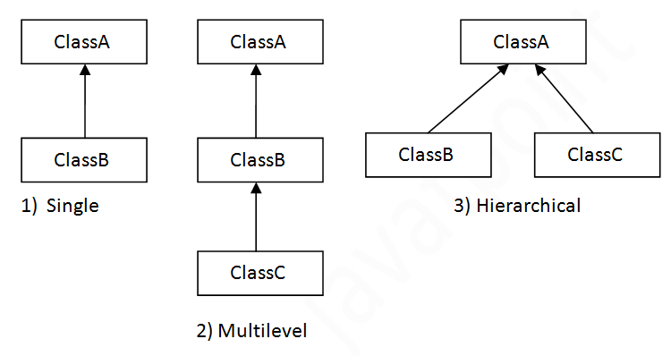
illustration

Slide 9
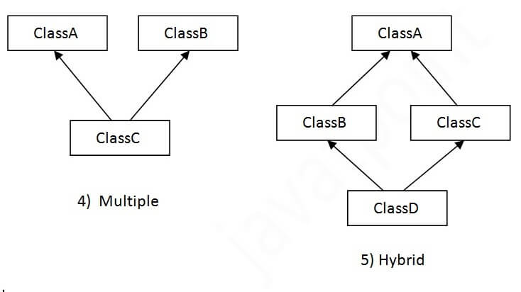
Inheritance
When one class inherits multiple classes, it is known as multiple inheritance. For Example

Slide 10
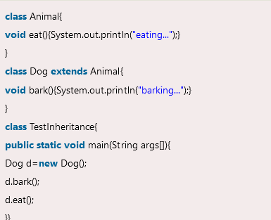
Single inheritance
When a class inherits another class, it is known as a single inheritance. In the example given below, Dog class inherits the Animal class, so there is the single inheritance.

Slide 11
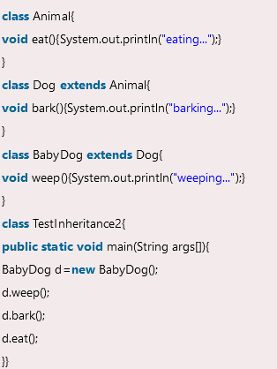
Multi level inheritance
When there is a chain of inheritance, it is known as multilevel inheritance. As you can see in the example given below, BabyDog class inherits the Dog class which again inherits the Animal class, so there is a multilevel inheritance.

