Slide 1
PhinD Me If You Can
(Find your perfect PhD advisor match)
Zakaria Mehrab, Farzana Yasmin Ahmad, Kazi Noshin

Slide 2


Pain Point
Finding the right match^{[a]}
Switching & Attrition^{[b]}
Mental Health Impact^{[c]}
Breen, Stephanie M., Jesse McCain, and Josipa Roksa. "Breaking points: exploring how negative doctoral advisor relationships develop over time." Higher Education 88.6 (2024): 2319-2338.
Verostek, Mike, Casey W. Miller, and Benjamin M. Zwickl. "Modeling when and how physics Ph. D. students search for a research group: The role of interests and prior research experiences in timely group integration." Physical Review Physics Education Research 20.2 (2024): 020119.
Mavrogalou-Foti, Alkistis P., Maria A. Kambouri, and Soljana Çili. "The supervisory relationship as a predictor of mental health outcomes in doctoral students in the United Kingdom." Frontiers in Psychology 15 (2024): 1437819.

Slide 3
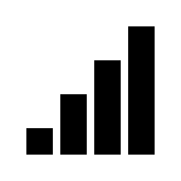

LLM for advisor search
Scaling Ability
Pattern Matching
Beyond Research Fit

Slide 4




System workflow
Qualitative
Justification of research fit
Justification of workstyle
Overall Justification
CV
SOP
LLM API
(e.g., Claude)
Publication History
Quantitative
Overall match score
Research fit score
Workstyle fit score
Prof. publication yearly rate
Student publication yearly rate
Website Link

Slide 5
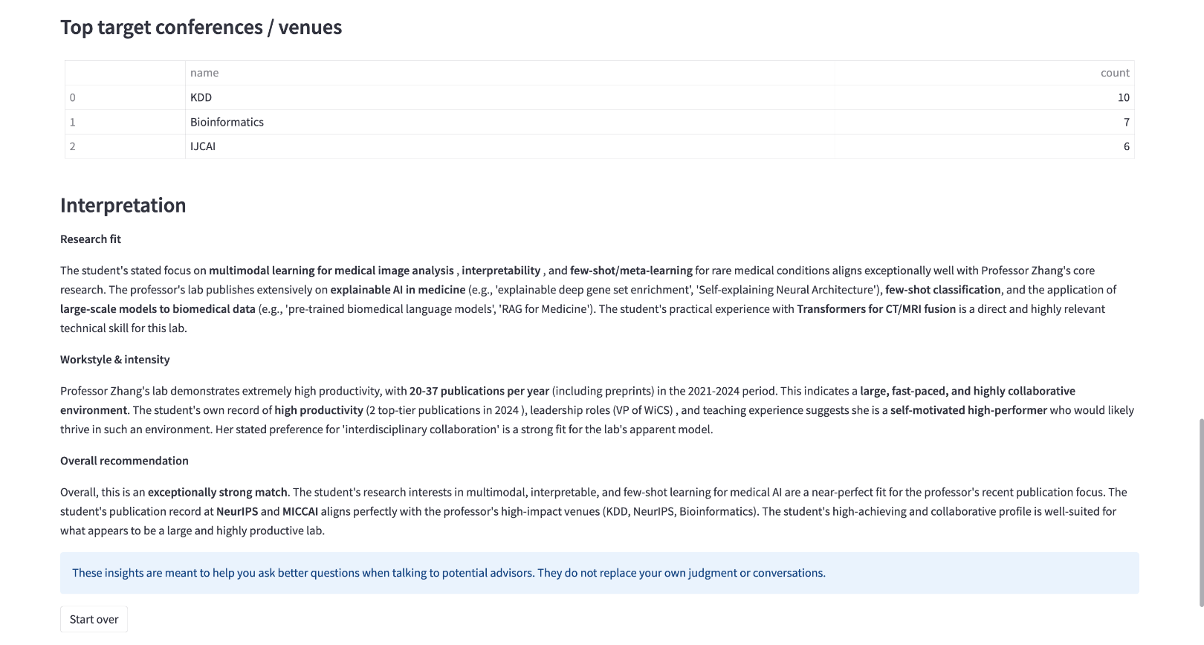
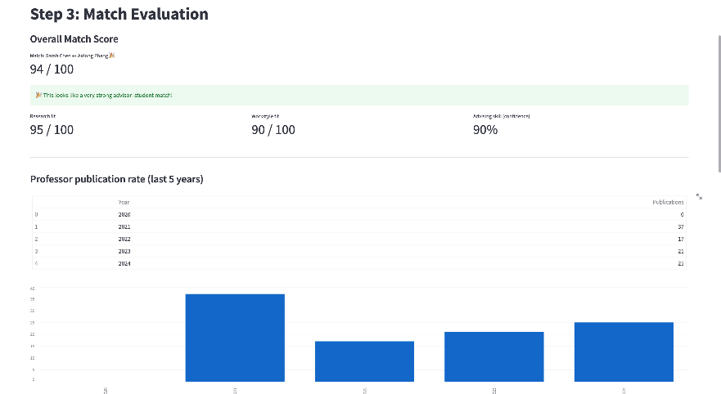
EXAMPLE

Slide 6
EXAMPLE

Slide 7


Future work
Bias & Fairness Testing
Uncertainty Quantification

Slide 8
Thank you!

