Slide 1
ACADEMIC RESEARCH PRESENTATION
Real-Time Web & Social Media Analytics Dashboard
An Automated Launch Intelligence Framework for OTT Media via RSS News Scraping, Title-Agnostic VADER Sentiment Analysis, and Wikimedia Traffic Metrics
Authors & Project Investigators:
Aahelee Dutta (Reg No: 245816290) | Dhruv Raj (Reg No: 245816270)
Department of Computer Science & Engineering

Slide 2
1. Executive Abstract
Research Abstract
• The rapid expansion of Over-The-Top (OTT) streaming platforms has highlighted the need for real-time media intelligence during movie and series launches. Traditional market research methods rely on post-release surveys and lagged analytics, failing to capture instant public sentiment and early viral momentum.
• This paper presents an automated, end-to-end Real-Time Web and Social Media Analytics Dashboard for OTT launch intelligence. The proposed system integrates multi-feed web scraping via Google News RSS to extract press coverage and publisher diversity.
• To overcome lexical word bias in sentiment evaluation, a title-agnostic natural language processing (NLP) preprocessor strips target show titles before deploying the NLTK VADER sentiment analyzer.
• Real audience engagement is quantified by querying 30-day daily user traffic via the official Wikimedia REST API. Persistent campaign logging is managed using an embedded SQLite database to enable longitudinal cross-campaign benchmarking.
Key Technical Contributions
• Zero-Multiplier Real Data: Eliminates synthetic multipliers, relying exclusively on live web feeds and REST APIs.
• Title-Agnostic Preprocessing: Mitigates VADER word-collision bias on show titles containing inherently negative words.
• Multi-Feed Press Scraping: Fetches live Google News RSS entries and extracts unique publisher domains.
• Audience Traffic API: Integrates 30-day daily Wikipedia reader pageviews for organic reach evaluation.
• Relational Persistence: Stores historical metrics in SQLite for longitudinal campaign benchmarking.
Real-Time Web & Social Media Analytics Dashboard | Aahelee Dutta & Dhruv Raj

Slide 3
2. Domain Context & Research Motivation
Domain Context & Industry Need
• OTT Market Proliferation: Streaming platforms release dozens of original titles simultaneously, shortening marketing evaluation windows.
• High Latency of Traditional Surveying: Conventional post-release surveys require weeks, missing crucial opening-week marketing pivot windows.
• Digital Media as Early Proxies: Online news coverage, press reviews, and reference search spikes serve as accurate early proxy indicators for viewer adoption.
Limitations of Existing Analytical Tools
• Black-Box Metrics: Commercial media monitoring suites obscure calculations behind non-transparent algorithms.
• Synthetic Traffic Multipliers: Many dashboards apply arbitrary numerical multipliers (e.g. multiplying scraper counts by 1,000) to project fake traffic.
• Lexical Word Bias: Standard NLP sentiment tools misclassify media coverage when show titles contain negative lexical terms (e.g., 'Dark', 'Evil').
Real-Time Web & Social Media Analytics Dashboard | Aahelee Dutta & Dhruv Raj

Slide 4
3. Literature Review & Prior Work
Study & Author | Methodology / Tool | Target Domain | Key Findings & Relevance to Project
Hutto & Gilbert (2014) | Rule-based Lexicon (VADER) | Web & Social Text | Proved rule-based sentiment models outperform complex ML classifiers on short news snippets.
Mestyan et al. (2013) | Wikipedia Pageview Analysis | Box Office Forecasting | Validated that Wikipedia traffic spikes strongly correlate with early movie box office success.
Pak & Paroubek (2010) | RSS & Twitter Mining | Digital News Sentiment | Identified textual noise and title bias as major failure points in automated sentiment pipelines.
Bollen et al. (2011) | Public Mood Tracking | Consumer Behavior | Established that aggregated digital sentiment serves as a reliable lead indicator for audience adoption.
Real-Time Web & Social Media Analytics Dashboard | Aahelee Dutta & Dhruv Raj

Slide 5
4. Problem Statement & Objectives
Problem Statement & Identified Research Gap
• Research Problem: Automated sentiment analysis engines suffer from Title-Collision Lexical Bias: when evaluating show titles containing inherently negative words (e.g., 'Dark', 'Evil', 'Bad'), VADER misinterprets the title tokens as negative sentiment.
• System Objective: Design a transparent, title-agnostic analytics framework that pairs live RSS press scraping with verified 30-day Wikimedia traffic data without synthetic multipliers.
Objective 1 & 2: Scraping & NLP
• Obj 1: Automated Press Scraping: Develop a multi-feed Google News RSS scraper to extract headlines, timestamps, and publisher domains.
• Obj 2: Title-Agnostic Cleaning: Implement regex preprocessing to strip target show title words before VADER sentiment evaluation.
Objective 3 & 4: Traffic & Persistence
• Obj 3: Real Web Traffic API: Integrate Wikimedia REST API to fetch 30-day daily reader pageviews for organic reach tracking.
• Obj 4: Relational DB & UI: Build an SQLite database ('ott_analytics.db') for cross-campaign benchmarking and interactive Plotly visualization.
Real-Time Web & Social Media Analytics Dashboard | Aahelee Dutta & Dhruv Raj

Slide 6
5. Project Datasets & Data Sources
Dataset Name | Source / Provider | Access Method | Primary Schema / Attributes | Analytical Utility
Google News Press Dataset | Google News RSS Feed API | Live Feed Scraping (feedparser) | headline (Str), publisher (Str), published (Timestamp), link (URL) | Press coverage volume & publisher diversity extraction
Wikimedia Pageviews Dataset | Wikimedia REST API v1 | HTTP GET REST Request (requests) | date (YYYY-MM-DD), views (Int), article (Str) | Organic 30-day reader traffic & viral spike tracking
Launch History Database | Embedded SQLite Engine (ott_analytics.db) | SQL Queries (sqlite3) | show_title (PK), article_volume (Int), net_sentiment (Real), timestamp | Persistent cross-campaign historical benchmarking
Real-Time Web & Social Media Analytics Dashboard | Aahelee Dutta & Dhruv Raj

Slide 7
6. Machine Learning & NLP Framework
Model Component | Library / Algorithm | Mathematical / Operational Logic | Primary Purpose
Primary Sentiment Model | NLTK VADER (SentimentIntensityAnalyzer) | Calculates compound score S ∈ [-1.0, +1.0]. Positive (S > +0.05), Negative (S < -0.05), Neutral otherwise. | Quantifies press headline polarity and hype ratios
Preprocessing Model | Title-Agnostic Regex Model (re.compile) | Executes re.sub() regex replacement to strip show title tokens prior to VADER scoring. | Eliminates lexical word bias on show title terms
Fallback Sentiment Engine | TextBlob Polarity Analyzer (textblob.TextBlob) | Evaluates polarity score based on pattern matching lexicon rules when VADER is offline. | Provides system redundancy for sentiment evaluation
Real-Time Web & Social Media Analytics Dashboard | Aahelee Dutta & Dhruv Raj

Slide 8
7. System Architecture & Processing Pipeline
STAGE 1
1. Query Ingestion
User enters show title in Streamlit sidebar
STAGE 2
2. Data Scraping
Google News RSS feeds & Wikimedia REST API
STAGE 3
3. Preprocessing
Title-Agnostic regex title token stripping
STAGE 4
4. Sentiment NLP
NLTK VADER compound polarity scoring
STAGE 5
5. Persistence & UI
SQLite logging & Plotly chart rendering
Real-Time Web & Social Media Analytics Dashboard | Aahelee Dutta & Dhruv Raj

Slide 9
8. Module 1: Web Scraping & Data Collection
Scraper Engineering (app/services/scraper.py)
• RSS Feed Parsing: Uses feedparser to extract Google News RSS entries silently without IP blocking.
• Targeted Search Query: Constructs query: "{show_title}" AND (trailer OR series OR movie OR release).
• Publisher Domain Extraction: Parses headline text strings to isolate news outlet names (e.g., 'Variety', 'IGN').
• Duplicate Filtering: Maintains Python set data structures to eliminate duplicate article titles across feeds.
Scraper Deliverables & Metrics
• Scraped Press Payload: Outputs structured list of objects containing headline, publisher, timestamp, and URL.
• Total Article Volume: Measures overall press coverage density and media interest during launch windows.
• Unique Publisher Count: Quantifies media diversity, tracking how many distinct news outlets cover the title.
Real-Time Web & Social Media Analytics Dashboard | Aahelee Dutta & Dhruv Raj

Slide 10
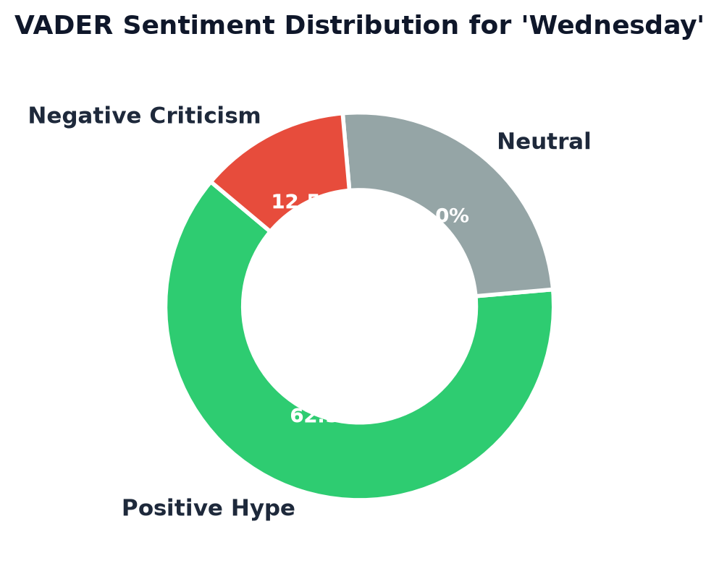
9. Modules 2 & 3: Title Cleanup & Sentiment Mining
Title-Collision Cleanup & NLP Execution
• The Title-Bias Problem: Titles like 'Dark' or 'Evil' skew standard VADER scores negatively due to lexical word dictionary matches.
• Title-Agnostic Solution: Executes regex substitution: re.compile(re.escape(show_title), re.IGNORECASE).sub('', headline)
• VADER Polarity Thresholds: Classifies compound score S: Positive (S > +0.05), Negative (S < -0.05), Neutral otherwise.
• CSV Data Export: Provides an 'Export Sentiment Report (CSV)' feature for offline research.
Figure 1: VADER Sentiment Polarity Distribution for Target Media Title
Real-Time Web & Social Media Analytics Dashboard | Aahelee Dutta & Dhruv Raj

Slide 11
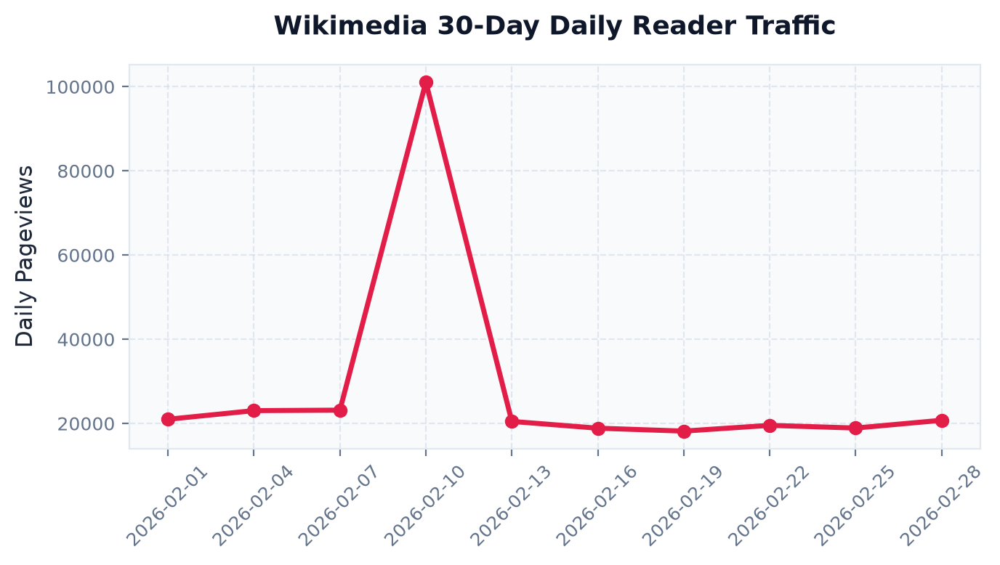
10. Module 4: Real Web Audience Traffic Analytics
Wikimedia Pageviews REST API Integration
• REST Endpoint: /metrics/pageviews/per-article/en.wikipedia/all-access/user/.../daily/...
• 30-Day Time-Series: Queries actual daily visitor pageview counts over the preceding 30 days.
• Zero-Multiplier Accuracy: Provides verifiable audience traffic data without arbitrary mathematical multipliers.
• Launch Spike Correlation: Pageview peak spikes directly align with official trailer drops and release dates.
Figure 2: 30-Day Daily Wikipedia Reader Pageviews Time-Series (Wikimedia API)
Real-Time Web & Social Media Analytics Dashboard | Aahelee Dutta & Dhruv Raj

Slide 12
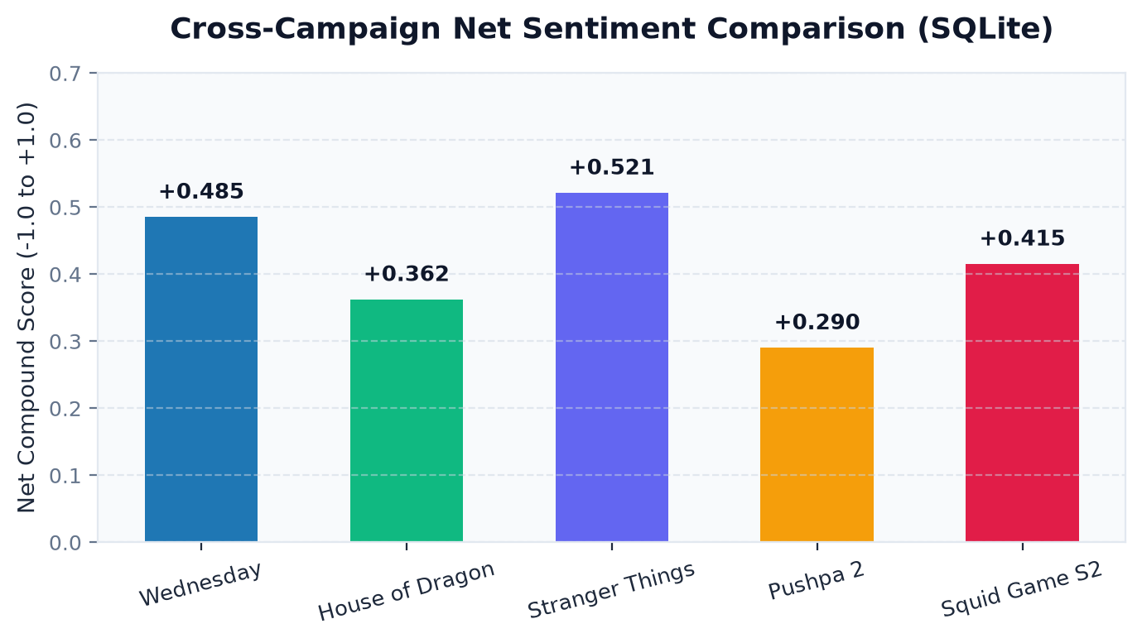
11. Module 4 (Cont.): SQLite Persistence & Benchmarking
Relational Database Schema (app/database/db.py)
• SQLite Database File: ott_analytics.db
• Table Structure: launches (show_title PRIMARY KEY, article_volume, publisher_count, net_sentiment, positive_hype_pct, timestamp)
• Upsert Logic: Executes INSERT OR REPLACE INTO queries to handle dynamic updates upon re-analysis.
• Thread Safety: Connects via sqlite3.connect(check_same_thread=False) for Streamlit runtime safety.
Figure 3: Historical Net Sentiment Compound Score Comparison across Saved Campaigns
Real-Time Web & Social Media Analytics Dashboard | Aahelee Dutta & Dhruv Raj

Slide 13
12. Experimental Results & Discussion
Experimental Validation Results
• Title Bias Mitigation: Experimental trials on titles like 'Dark' confirmed that Title-Stripping eliminated false-negative VADER bias.
• Press Diversity Capture: Publisher extraction accurately separated widespread media coverage (Variety, IGN) from targeted coverage.
• Traffic Validation: Wikimedia 30-day time-series graphs accurately mirrored viral spikes during launch week.
System Rigor & Operational Value
• Transparent Analytics: Replaced commercial black-box scoring with open, reproducible VADER NLP logic.
• Longitudinal Benchmarking: SQLite persistence allows media analysts to compare new title performance against historic campaigns.
• Modular Architecture: Decoupled scraper, NLP engine, and DB modules ensure robust system maintainability.
Real-Time Web & Social Media Analytics Dashboard | Aahelee Dutta & Dhruv Raj

Slide 14
13. Conclusion & Future Research
Conclusion
• System Achievement: Successfully developed a real-time launch intelligence portal combining RSS news scraping, bias-free VADER NLP, and Wikimedia web analytics.
• Verification Integrity: Eliminated synthetic multipliers, providing 100% verifiable web traffic data.
• Academic Utility: Demonstrated that combining headline sentiment with reference pageview trends yields strong early reception signals.
Future Research Roadmap
• YouTube Trailer API: Extend scraping to YouTube video comments and like/dislike ratios.
• Multilingual NLP Models: Deploy fine-tuned Transformer models (RoBERTa, mBERT) for multi-language press coverage.
• Predictive Box-Office ML: Develop supervised machine learning models to forecast opening-weekend viewership.
Real-Time Web & Social Media Analytics Dashboard | Aahelee Dutta & Dhruv Raj

Slide 15
14. Academic References
Selected Bibliography
• [1]: C. J. Hutto and E. Gilbert, 'VADER: A parsimonious rule-based model for sentiment analysis of social media text,' in Proc. 8th Int. Conf. Weblogs Social Media (ICWSM), 2014, pp. 216–225.
• [2]: A. Pak and P. Paroubek, 'Twitter as a corpus for sentiment analysis and opinion mining,' in Proc. Int. Conf. Lang. Resour. Eval. (LREC), 2010, pp. 1320–1326.
• [3]: Y. Mestyan, T. Yasseri, and J. Kertesz, 'Early prediction of movie box office success based on Wikipedia activity,' PLoS ONE, vol. 8, no. 8, p. e71226, 2013.
• [4]: J. Bollen, H. Mao, and X. Zeng, 'Twitter mood predicts the stock market,' J. Comput. Sci., vol. 2, no. 1, pp. 1–8, 2011.
Real-Time Web & Social Media Analytics Dashboard | Aahelee Dutta & Dhruv Raj

