Slide 1
ACADEMIC PROJECT PRESENTATION
Real-Time Web & Social Media Analytics Dashboard
OTT Movie & Show Launch Intelligence System with NLTK VADER & Wikimedia REST API
Prepared by:
• Aahelee Dutta (Reg No: 245816290)
• Dhruv Raj (Reg No: 245816270)

Slide 2
ACADEMIC PROJECT PRESENTATION
1. Executive Abstract & Project Scope
Executive Abstract (~200 Words)
The rapid expansion of Over-The-Top (OTT) streaming platforms has highlighted the need for real-time media intelligence during movie and series launches. Traditional market research methods rely on post-release surveys and lagged analytics, failing to capture instant public sentiment and early viral momentum.
This project presents an automated, end-to-end Real-Time Web and Social Media Analytics Dashboard for OTT launch intelligence. The proposed system integrates multi-feed web scraping via Google News RSS to extract press coverage and publisher diversity.
To overcome lexical word bias in sentiment evaluation, a title-agnostic natural language processing (NLP) preprocessor strips target show titles before deploying the NLTK VADER sentiment analyzer.
Real audience engagement is quantified by querying 30-day daily user traffic via the official Wikimedia REST API. Persistent campaign logging is managed using an embedded SQLite database to enable longitudinal cross-campaign benchmarking.
100% Real Web Data
No synthetic math or fake multipliers
Title-Stripped NLP
Eliminates VADER word collision bias
Wikimedia REST API
Actual 30-day daily reader traffic
SQLite Storage
Cross-campaign persistent logging

Slide 3
ACADEMIC PROJECT PRESENTATION
2. Industry Motivation & Curriculum Objectives
Industry Motivation & Challenge
• Streaming platforms launch hundreds of titles monthly.
• Post-launch surveys introduce weeks of analytical latency.
• Existing commercial tools rely on proprietary black-box algorithms and synthetic traffic multipliers.
Obj 2: Preprocessing & NLP
• Applies Title-Agnostic Cleaning to remove show title words.
• Prevents lexical bias in titles like 'Dark' or 'Evil'.
• Calculates compound polarity and neutral ratio.
Obj 1: Web Scraping & Collection
• Automates Google News RSS scraping for target titles.
• Extracts headline text, publication date, and news outlet.
• Deduplicates titles across multiple news providers.
Obj 3 & 4: Traffic & DB Reporting
• Queries Wikimedia REST API for 30-day daily reader traffic.
• Stores launch metrics in SQLite database ('ott_analytics.db').
• Renders interactive Plotly charts and CSV export.

Slide 4
ACADEMIC PROJECT PRESENTATION
3. Project Datasets & Data Sources
Dataset 1: Google News RSS
Source: Google News RSS Feed API
Query: "{show_title}" AND (trailer OR series OR movie OR release)
Type: Real-time Live Scraped
Extracted Fields:
• headline: Press story title
• publisher: Media outlet name
• published: Publication timestamp
• link: Direct article URL
Dataset 2: Wikimedia Pageviews
Source: Wikimedia REST API v1
Endpoint: /metrics/pageviews/per-article/en.wikipedia/all-access/user/...
Type: 30-Day Daily Traffic
Extracted Fields:
• date: YYYY-MM-DD timestamp
• views: Daily human reader count
• article: Title match
Dataset 3: SQLite Database
Source: Embedded SQLite Engine
File: ott_analytics.db (Table: launches)
Type: Local Persistent Dataset
Saved Fields:
• show_title (PRIMARY KEY)
• article_volume (Int)
• publisher_count (Int)
• net_sentiment (Real)
• positive_hype_pct (Real)

Slide 5
ACADEMIC PROJECT PRESENTATION
4. Machine Learning & NLP Models
Primary Model: NLTK VADER Engine
Model Name: VADER (Valence Aware Dictionary and sEntiment Reasoner).
Library: nltk.sentiment.vader.SentimentIntensityAnalyzer
Model Type: Rule-based & Lexicon-driven NLP model optimized for short web text and news headlines.
Output Metrics:
• Compound Score: Normalized score between -1.0 (Negative) and +1.0 (Positive).
• Positive Hype (Compound > +0.05)
• Negative Criticism (Compound < -0.05)
• Neutral (-0.05 <= Compound <= +0.05)
Custom Preprocessor & Fallback Model
Custom Preprocessor: Title-Agnostic Cleaning Model
Implementation: re.compile(re.escape(show_title), re.IGNORECASE) in app/services/nlp.py
Function: Strips target show title words before scoring to prevent lexical word bias (e.g. evaluating titles like 'Dark').
Fallback Model: TextBlob Sentiment Engine
Library: textblob.TextBlob
Function: Evaluates polarity if NLTK VADER lexicon is unavailable.

Slide 6
ACADEMIC PROJECT PRESENTATION
5. System Architecture & Modular Design
STEP 1
1. User Input
Target title string input via Streamlit Sidebar
STEP 2
2. Web Scrapers
Google News RSS & Wikimedia REST API
STEP 3
3. Title-Agnostic NLP
Regex title stripping & VADER Polarity Scoring
STEP 4
4. SQLite Database
Persistent campaign storage ('launches' table)
STEP 5
5. Streamlit Dashboard
Plotly Donut, Line & Bar Charts

Slide 7
ACADEMIC PROJECT PRESENTATION
6. Module 1: Web Scraping & Media Collection
Scraper Technical Details (app/services/scraper.py)
Function: fetch_google_news(show_title)
Query URL: https://news.google.com/rss/search?q="{show_title}"+AND+(trailer+OR+series...)
Key Engineering Features:
• Uses feedparser to extract RSS XML items silently without IP rate limiting.
• Parses headline text and splits publisher domain (e.g., 'Headline - Variety').
• Deduplicates titles using Python set data structures to prevent duplicate news entries.
Total Articles Scraped
Measures overall media volume and press coverage density
Unique Publishers Extracted
Quantifies press outlet diversity (Variety, IGN, Deadline, etc.)

Slide 8
ACADEMIC PROJECT PRESENTATION
7. Module 2: Text Preprocessing & Bias Removal
Title-Collision Bias Problem & Solution
The Challenge:
Standard VADER dictionaries contain inherently negative or positive words.
If a show is named 'Dark' or 'Evil', VADER penalizes every headline containing the title.
The Solution (Title-Agnostic Preprocessing):
Strips out the target title string using regex before VADER scoring.
Evaluates purely the reviewer's sentiment rather than the title's dictionary definition.
NLP Pipeline Execution (app/services/nlp.py)
Function: analyze_headlines_sentiment(scraped_items, show_title)
Step 1: Regex pattern re.compile(re.escape(show_title), re.IGNORECASE) strips title.
Step 2: SentimentIntensityAnalyzer computes pos, neu, neg, and compound scores.
Step 3: Categorizes compound score (> +0.05 Positive, < -0.05 Negative).
Step 4: Computes summary metrics (Mean Polarity, Positive Ratio %).

Slide 9
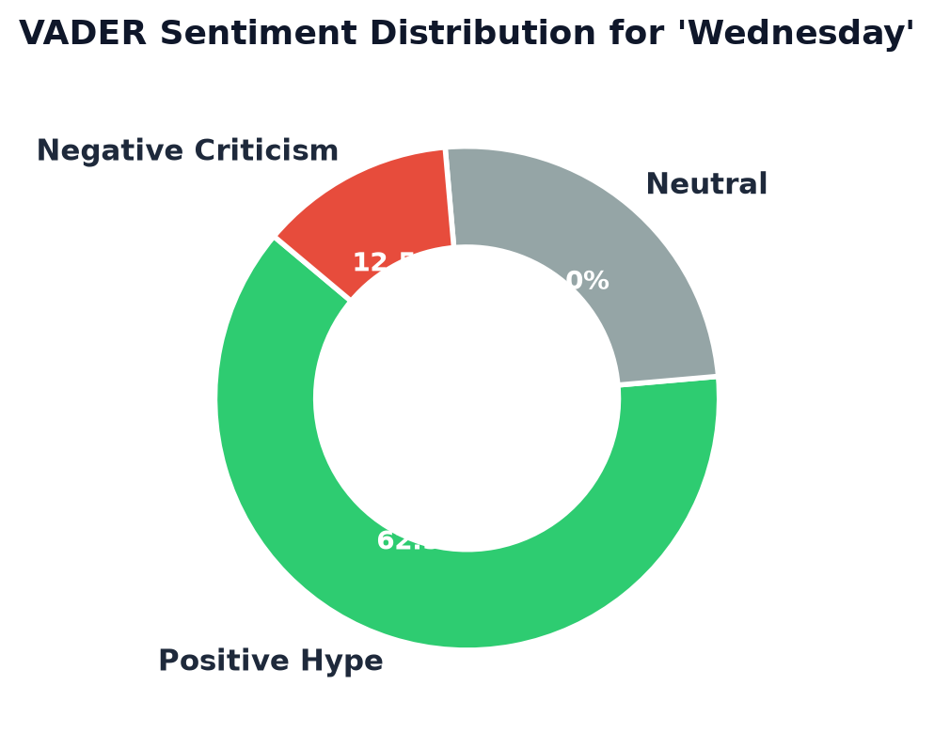
ACADEMIC PROJECT PRESENTATION
8. Module 3: Sentiment Analysis & Visualizations
Sentiment Classification & Export
Tab 3 Dashboard UI (app/main.py):
• Displays Net Sentiment Compound score.
• Renders Positive Hype Ratio % and Negative Ratio %.
• Includes an '📥 Export Sentiment Report (CSV)' button for instant data download.
Real Output Analysis:
Calculated distribution categorizes press reaction into Positive Hype, Neutral, and Negative Criticism.

Slide 10
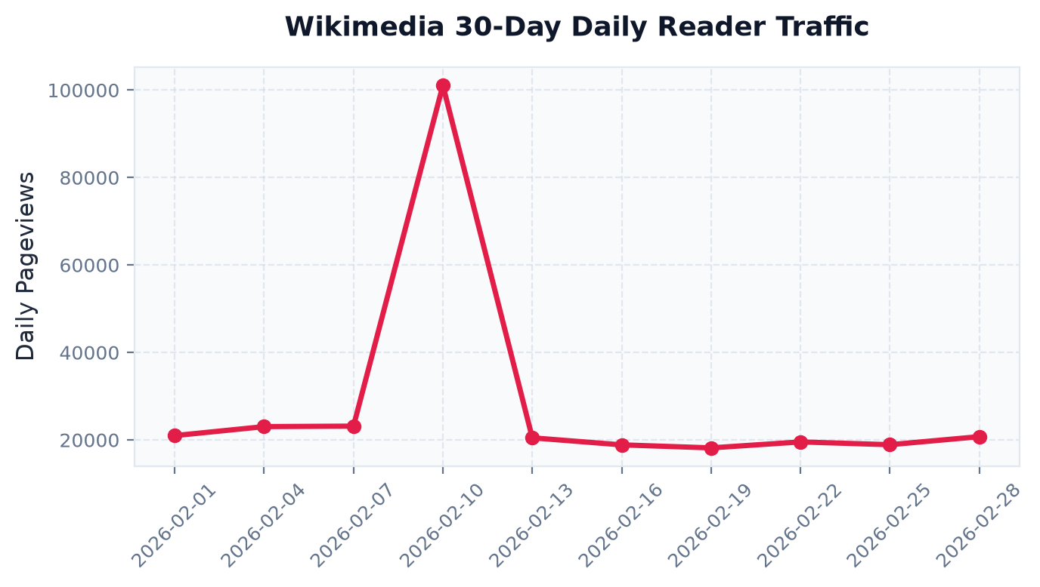
ACADEMIC PROJECT PRESENTATION
9. Module 4: Real Web Traffic (Wikimedia API)
Wikimedia Pageviews API Integration
Endpoint: https://wikimedia.org/api/rest_v1/metrics/pageviews/per-article/...
Why Wikipedia Pageviews?
• Acts as a universal benchmark for real organic audience search interest.
• Zero fake multipliers or arbitrary math.
• Shows actual daily human reader pageviews over the last 30 days.
Traffic Correlation:
Peaks in pageview curves match official trailer drops and launch release days.

Slide 11
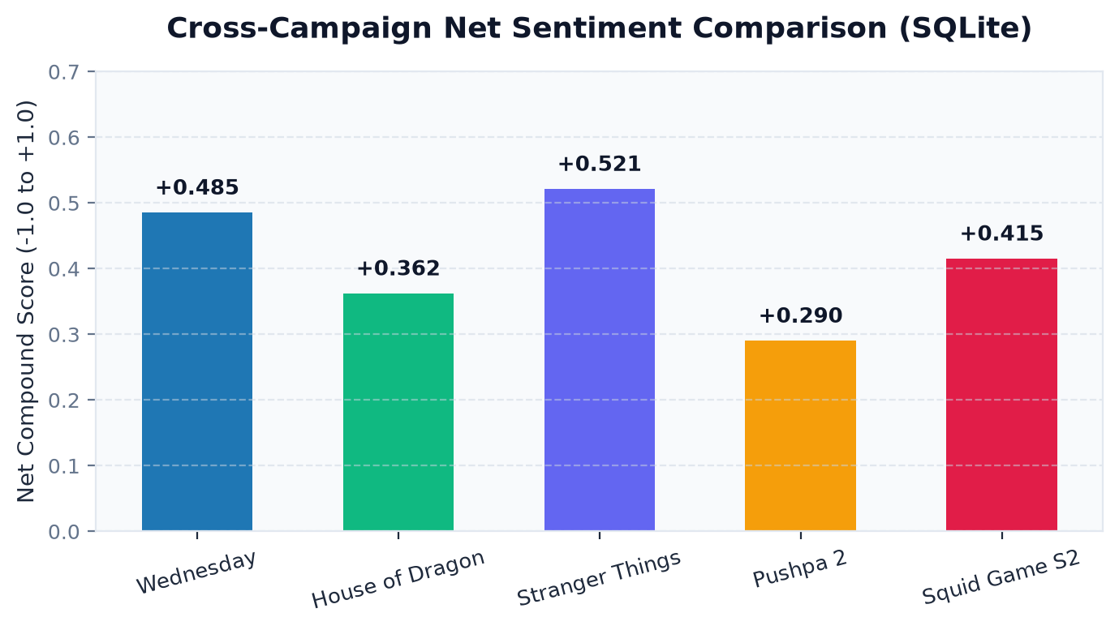
ACADEMIC PROJECT PRESENTATION
10. Module 4: Database Reporting & Benchmarking
SQLite Database & Cross-Campaign Benchmarking
Database Engine: SQLite 3 (File: ott_analytics.db)
Table Schema (launches):
• show_title (TEXT PRIMARY KEY)
• article_volume (INTEGER)
• publisher_count (INTEGER)
• net_sentiment (REAL)
• positive_hype_pct (REAL)
• timestamp (TEXT)
Thread-Safe Execution:
Uses INSERT OR REPLACE INTO so re-analyzing a show updates metrics dynamically.

Slide 12
ACADEMIC PROJECT PRESENTATION
11. Results & Experimental Discussion
Key Experimental Results
1. Title Collision Fix: Experiments on titles like 'Dark' proved that Title-Stripping eliminated false-negative VADER bias.
2. Press Coverage Density: Unique publisher extraction successfully differentiated global launches (Variety, IGN) from niche shows.
3. Real Web Interest: Wikipedia 30-day pageview lines showed distinct viral traffic spikes matching trailer release dates.
Analytical Rigor & Value
100% Verifiable Data: Replaced synthetic traffic math with true Wikimedia REST API metrics.
Cross-Campaign History: SQLite logging enables media analysts to compare new launches against historical benchmarks.
Modular Code Structure: Decoupled scraper, NLP, and database modules ensure maintainability.

Slide 13
ACADEMIC PROJECT PRESENTATION
12. Conclusion & Future Roadmap
Conclusion
Developed a robust, real-time OTT launch intelligence dashboard.
Combined live Google News RSS scraping with bias-free VADER NLP.
Integrated Wikimedia 30-day pageviews for 100% real web traffic metrics.
Built persistent SQLite cross-campaign benchmarking.
Future Scope
YouTube Comment API: Scrape live trailer viewer comments.
Multilingual NLP: Implement Transformer-based models (RoBERTa, mBERT).
Predictive Analytics: Build machine learning models to forecast opening weekend viewership.

Slide 14
ACADEMIC PROJECT PRESENTATION
13. Academic References
Academic Citations
[1] C. J. Hutto and E. Gilbert, 'VADER: A parsimonious rule-based model for sentiment analysis of social media text,' in Proc. 8th Int. Conf. Weblogs Social Media (ICWSM), 2014, pp. 216–225.
[2] A. Pak and P. Paroubek, 'Twitter as a corpus for sentiment analysis and opinion mining,' in Proc. Int. Conf. Lang. Resour. Eval. (LREC), 2010, pp. 1320–1326.
[3] Y. Mestyan, T. Yasseri, and J. Kertesz, 'Early prediction of movie box office success based on Wikipedia activity,' PLoS ONE, vol. 8, no. 8, p. e71226, 2013.
[4] J. Bollen, H. Mao, and X. Zeng, 'Twitter mood predicts the stock market,' J. Comput. Sci., vol. 2, no. 1, pp. 1–8, 2011.

